Slide 1
Bank Loan Data Analysis using Power BI
Insights into Loan Performance, Risk, and Customer Behavior
Analyst: Alok Yadav

Slide 2
Dataset Overview
Dataset Name: financial_loan
Source: Kaggle
Tools & Technologies
Power BI
Excel
Data cleaning & transformation

Slide 3
Key Business Requirements
Business Requirements Document – Loan Performance KPIs
The client requires a comprehensive analysis of loan performance data to support decision-making and monitor business health. The data analyst is expected to derive the following Key Performance Indicators (KPIs) and insights:
1. Loan Application Analysis
The client wants to understand the volume and trend of loan applications over time. Specifically:
Calculate the total number of loan applications received within a selected period.
Provide Month-to-Date (MTD) loan application counts.
Analyse and report Month-over-Month (MoM) changes to identify growth or decline trends.
2. Funded Amount Analysis
The client requires visibility into the total value of loans disbursed. The analysis should include:
Calculation of the total funded loan amount.
Tracking of MTD funded amounts.
Evaluation of MoM changes to monitor lending performance and growth.

Slide 4
3. Loan Repayment / Amount Received Analysis
To assess cash flow and repayment efficiency, the client wants:
Calculation of the total amount received from borrowers.
Monitoring of MTD collections.
Analysis of MoM variations to identify repayment trends and potential risks.
4. Interest Rate Analysis
The client aims to evaluate the overall cost and pricing of loans. The analyst should:
Compute the average interest rate across all loans.
Provide MTD average interest rate.
Analyse MoM changes to understand fluctuations in lending rates.
5. Borrower Financial Health (DTI Analysis)
To assess borrower risk and financial stability, the client requires:
Calculation of the average Debt-to-Income (DTI) ratio.
Tracking of MTD average DTI.
Monitoring of MoM changes to detect shifts in borrower financial health.

Slide 5
Good Loan v Bad Loan KPI’s
Good Loan:
Good Loan Application Percentage
Good Loan Applications
Good Loan Funded Amount
Good Loan Total Received Amount
Bad Loan
Bad Loan Application Percentage
Bad Loan Applications
Bad Loan Funded Amount
Bad Loan Total Received Amount
Good Loan (Definition)
A good loan is a loan that is being repaid on time without any significant delay or default.
Loan status = Fully Paid / Current
No missed EMI payments
Bad Loan (Definition)
A bad loan is a loan where the borrower is unable to repay or has defaulted on payments.
Loan status = Charged Off / Default
Missed payments (90+ days overdue)

Slide 6
Other Requirements
Monthly Trends by Issue Date: To identify seasonality and long-term trends in lending activities
Regional Analysis by State: To identify regions with significant lending activity and assess regional disparities
Loan Term Analysis To allow the client to understand the distribution of loans across various term lengths.
Employee Length Analysis How lending metrics are distributed among borrowers with different employment lengths, helping us assess the impact of employment history on loan applications.
Loan Purpose Breakdown: Will provide a visual breakdown of loan metrics based on the stated purposes of loans, aiding in the understanding of the primary reasons borrowers seek financing.
Home Ownership Analysis: For a hierarchical view of how home ownership impacts loan applications and disbursements.
Need for a comprehensive 'Details Dashboard' that provides a consolidated view of all the essential information within our loan data. This Details Dashboard aims to offer a holistic snapshot of key loan-related metrics and data points, enabling users to access critical information efficiently.

Slide 7
Dashboard Overview

Slide 8
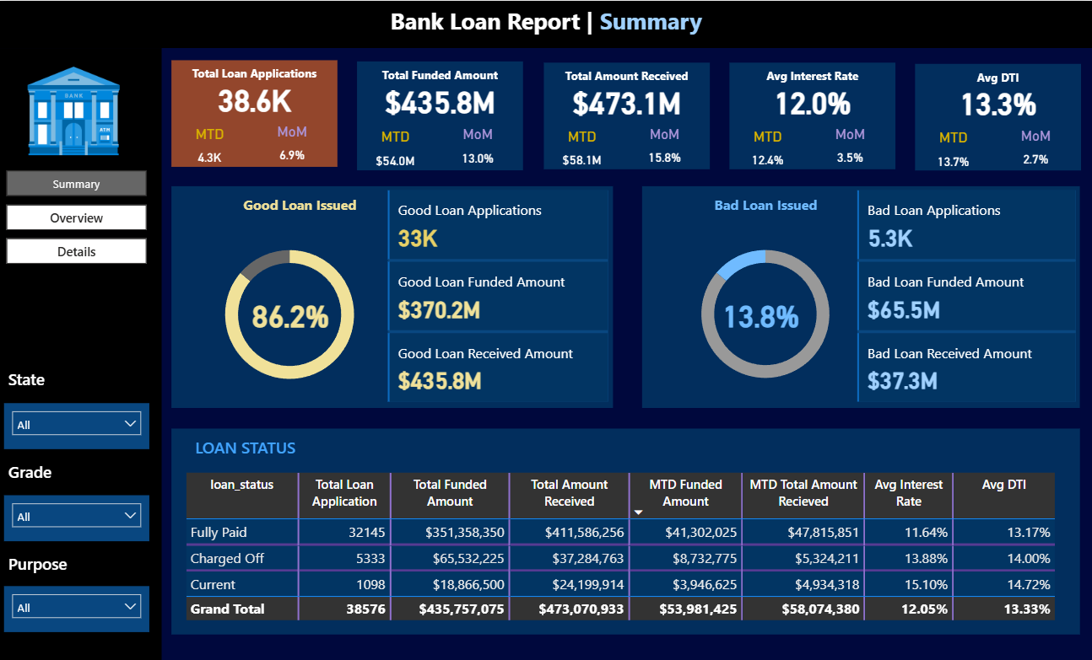

Slide 9
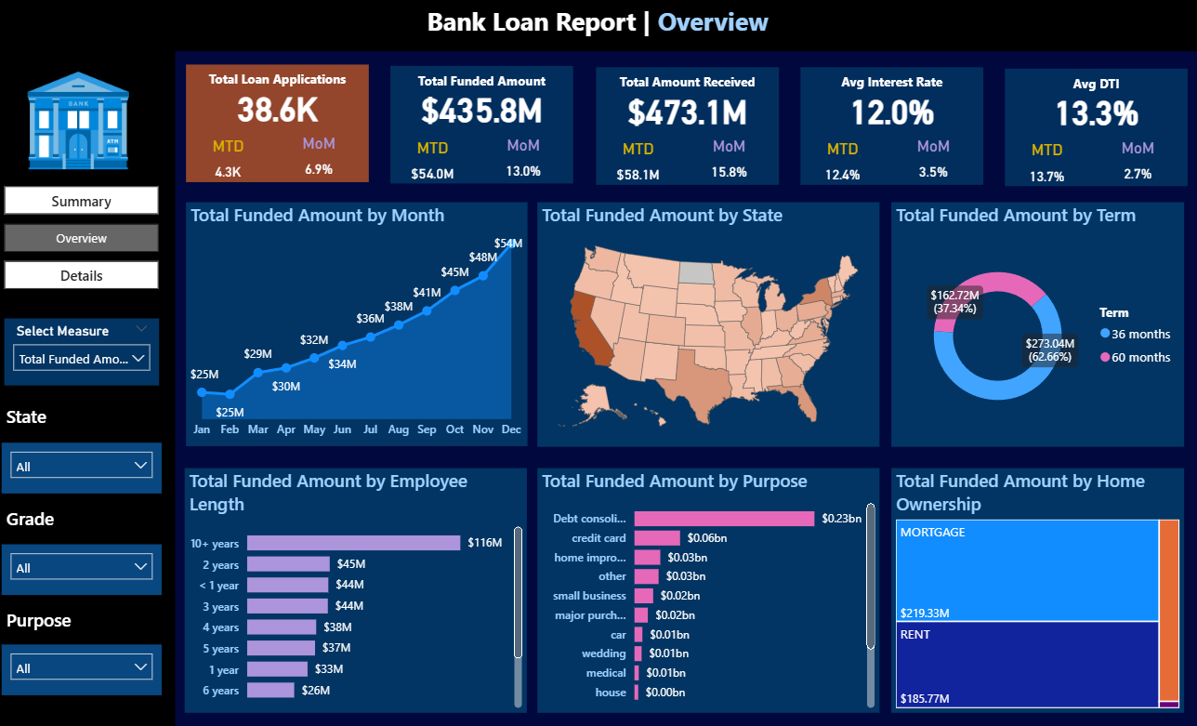

Slide 10
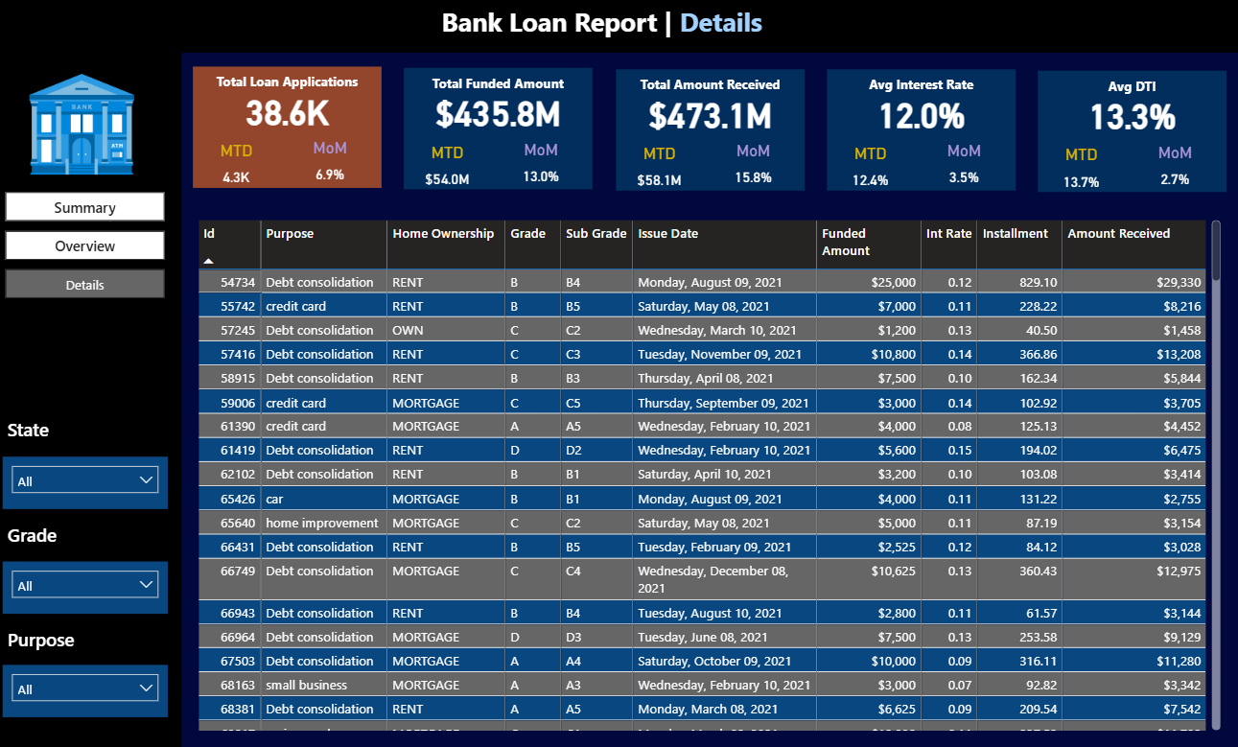

Slide 11
Key Insights on Bad Loans
1. Loan Purpose Risk
Small Business loans contribute the highest share of bad loans (~25%), followed by:
Renewable Energy loans (~18%)
Educational loans (~15%)
This indicates that business-related and long-term return investments carry higher default risk.
2. Geographic Risk
States with the highest bad loan percentages:
NE (60%)
NV (20%)
AK (19%)
This suggests regional economic or demographic factors significantly impact loan repayment behavior.
3. Home Ownership Risk
Around 15% of bad loans come from borrowers who:
Took home loans
But have home ownership status = RENT
This reflects financial instability or lack of asset backing.
4. Loan Term Risk
Loans with 60-month tenure have 22% bad loan rate
Loans with 36-month tenure have only 10% bad loan rate
Longer repayment periods are associated with higher default probability.

Slide 12
Business Recommendations
1. Strengthen Risk Assessment for High-Risk Loan Purposes
Apply stricter credit checks for:
Small business
Renewable energy
Education loans
Introduce:
Higher interest rates (risk-based pricing)
Lower loan limits
2. Region-Based Lending Strategy
For high-risk states (NE, NV, AK):
Tighten approval criteria
Require additional verification or collateral
3. Focus on Borrower Stability
For renters taking home loans:
Evaluate income stability & savings behavior
Consider:
Higher down payment requirement
Co-applicant or guarantor
4. Optimize Loan Tenure
Encourage shorter loan terms (36 months)
For long-term loans:
Increase monitoring (early warning systems)
Offer incentives for early repayment

Slide 13
Thank You

