Slide 1

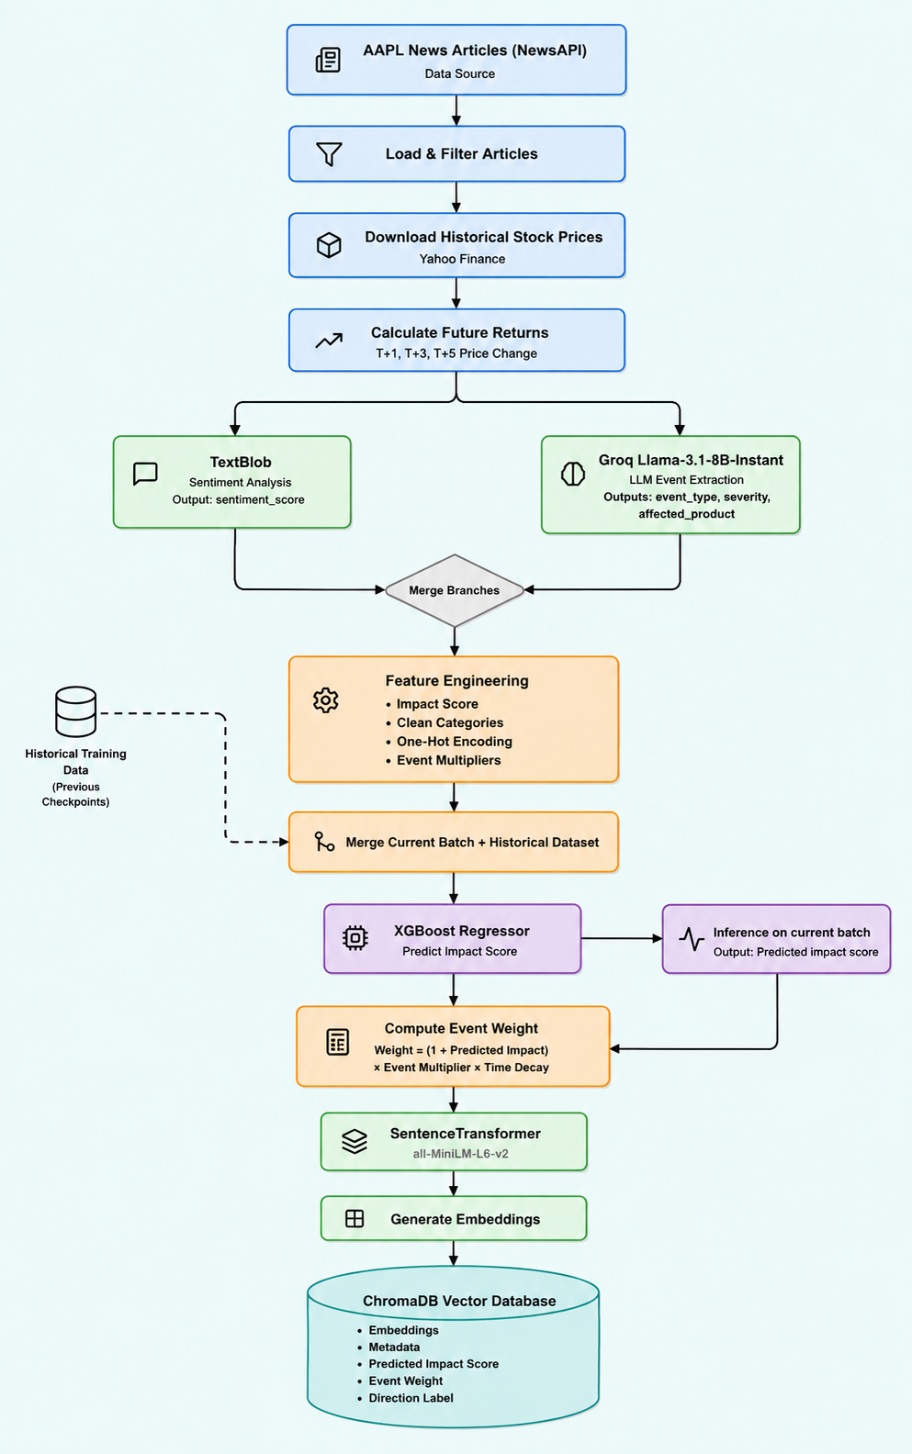
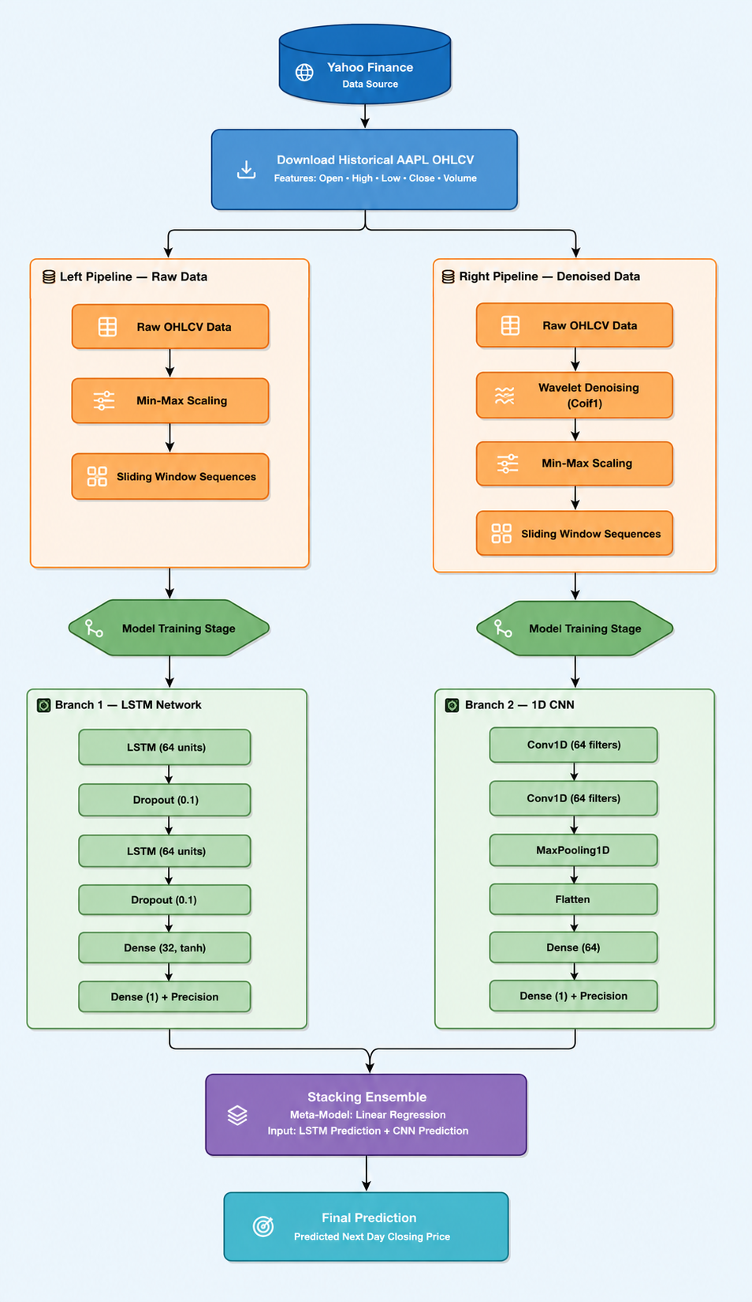
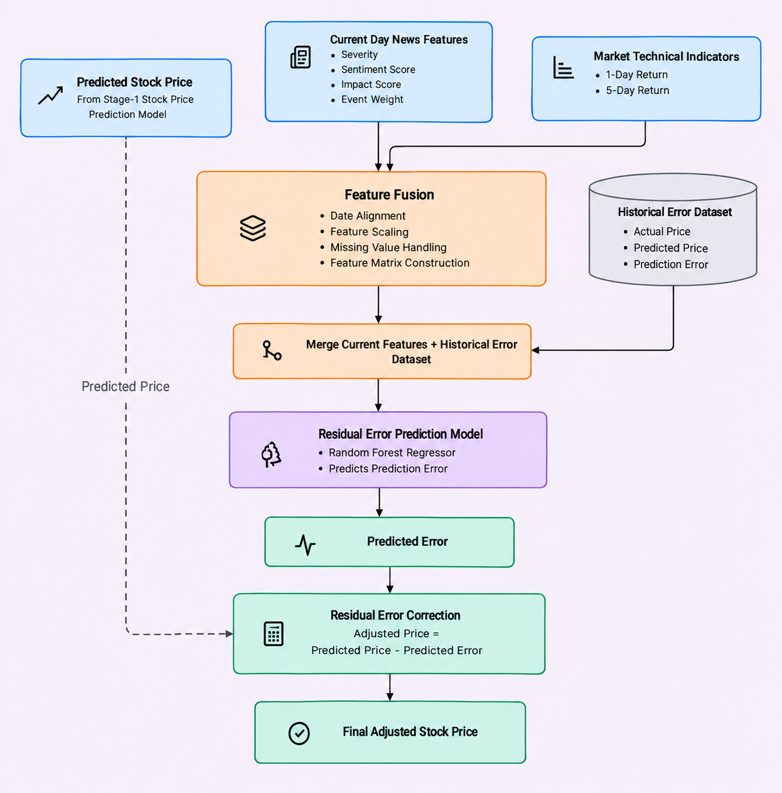
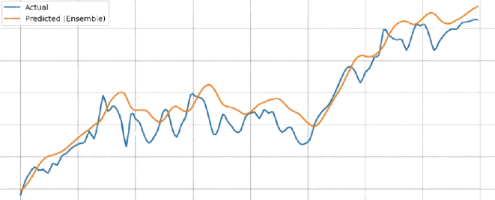
A Multi-Stage Deep Learning Framework for Stock Price Prediction Using LLM-Based News Intelligence and Error Correction
Alok Yadav, Dr. Bhupendra Kumar
1. Introduction
4. THREE-STAGE ARCHITECTURE OVERVIEW
6. RESULTS
THREE-STAGE ARCHITECTURE OVERVIEW
RESULTS
Stock price prediction is challenging due to the complex, noisy, and non-stationary nature of financial markets. While traditional models rely on historical prices and technical indicators, recent advances in Large Language Models (LLMs) enable the extraction of structured, actionable information from unstructured sources. We introduce a three-stage framework that separates news-driven prediction from price-driven prediction and later corrects residual errors using features of news signals, technical indicators, and historical prediction errors.
STAGE 1
STAGE 2
STAGE 3
News Intelligence Extraction (LLM + Vector Database)
Price Movement Prediction (Ensemble Deep Learning)
Error Correction (Random Forest Regressor)
Metric
Stage 2 (Raw Prediction)
Stage 2 + 3 (Corrected)
Improvement
R²
0.818
0.921
+12.5%
MAE
5.568
3.486
-37.4%
MAPE
2.63%
1.66%
-37.0%
Directional Accuracy
58.3%
77.5%
+19.2 pp
Hit Rate @1% / @2%
24.0% / 48.8%
43.8% / 71.1%
+19.8/+22.3 pp
➜
➜
2. DATASET & PERIOD
• Asset: Apple Inc. (AAPL)
• News Source: Financial news (AAPL-filtered CSV)
• Price Data: Daily OHLC, Yahoo Finance (2010–26, ~4,150 days)
• Preprocessing: Coif3 wavelet, 20-day window, 60/15/25 split (~4,130 samples)
• Test Window: 121 days, out-of-sample (Jan–Jun 2025)
7. CONCLUSION
Our three-stage framework significantly improves next-day stock price prediction by integrating LLM-based news intelligence, ensemble deep learning, and error correction. The approach achieves a 12.5% relative improvement in R² and a 19.2-point gain in directional accuracy on the out-of-sample period.
3. MODELS USED
5. METHODOLOGY HIGHLIGHTS
1. LLM-Based Financial News Intelligence • Collect and filter AAPL-related financial news. • Extract sentiment, event type, severity, affected product, and impact score using Llama-3.1-8B-Instant. • Generate sentence embeddings using all-MiniLM-L6-v2 and store news with metadata in ChromaDB for semantic retrieval. 2. Ensemble Time-Series Forecasting • Collect historical AAPL OHLC data and construct 20-day sliding windows. • Train LSTM and 1D-CNN models on raw/denoised price sequences. • Combine base-model predictions using stacking with Linear Regression to obtain the Stage-2 forecast.
3. Fused-Feature Residual Error Correction • Fuse news features (severity, sentiment, impact score, event weight) with 1-day/5-day returns and historical Stage-2 prediction errors. • Benchmark multiple regressors and select the best-performing model. • Random Forest Regressor predicts the residual error, which is subtracted from the Stage-2 forecast to obtain the final prediction. 4. Temporal Validation & Incremental Learning • Use chronological train/validation/test splits to prevent data leakage and look-ahead bias. • Continuously accumulate new news data and periodically retrain the models for incremental improvement.
3. MODELS USED
8. REFERENCES
• LLM: Llama-3.1-8B-Instant (Groq API) — event type, severity, product extraction
• Embeddings: all-MiniLM-L6-v2 → ChromaDB (cosine similarity)
• Deep Learning: LSTM & CNN (raw/denoised); ensemble = LSTM-Raw + CNN-Denoised
• Regression Benchmark: 7 candidates — Linear, Random Forest, Gradient Boosting, Extra Trees, Hist-GB, k-NN, XGBoost
• Final Model: Random Forest — best of 7 (test R² = 0.70 on residual task)
[1] Devlin et al., BERT: Pre-training of Deep Bidirectional Transformers, NAACL 2019.
[2] Hyndman & Athanasopoulos, Forecasting: Principles and Practice, 3rd ed., 2021.
[3] Hochreiter & Schmidhuber, Long Short-Term Memory, Neural Computation, 1997.
[4] Breiman, Random Forests, Machine Learning, 2001.
[5] Mallat, A Wavelet Tour of Signal Processing, 3rd ed., 2008.

