Slide 1
UNIVERSITY OF OULU · BOTANICAL GARDEN · MAY 2026
PhytoSense
Continuous Environmental Monitoring
Romeo & Julia hold 1,200 irreplaceable exotic species.
A Finnish winter night can silently stress them all.
Nobody is currently listening.
1

Slide 2



The Problem
Manual floor rounds happen twice a day, at best.
The system catches the 3am humidity accumulation in the tropical corner that nobody would find until morning.
Fungal risk
Watering gaps
Winter stress
Botrytis & pathogens establish overnight in high humidity
Overwatered succulents, parched tropicals — between rounds
Glass-wall cold spots damage specimens silently in Finnish winter
2

Slide 3



What PhytoSense Does
A wireless mesh of sensor nodes installed across one greenhouse zone.
EUR 220
1,200
Each node carries three sensors that report continuously to a central hub. Staff receive real-time alerts. No cloud services. No ongoing costs. Self-contained on the garden's local network.
Total MVP hardware
Exotic species monitored
Temperature
24 / 7
EUR 0
Humidity
Continuous
Software cost (open source)
Soil Moisture
3

Slide 4


Problem 1 — Fungal Risk Conditions
What the system detects
Sustained humidity + temperature combinations that favour pathogen development
When it matters most
Overnight when no one is on the floor — humidity accumulates for hours undetected until morning rounds
Botrytis
& Mould
What staff receive
An alert the moment conditions enter the risk window — not after damage appears
4

Slide 5

Problem 2 — Watering Problems
The challenge
A desert succulent and a tropical orchid have entirely different moisture needs. One threshold fits neither.
Overwatered
Underwatered
Root rot, fungal growth, soil compaction — the most common cause of exotic specimen loss in mixed greenhouses
Heat stress, leaf drop, irreversible damage to decades-old specimens before any visual sign appears
Soil
Moisture
PhytoSense sets per-zone thresholds agreed directly with horticulture staff — not a single global setting.
5

Slide 6

Problem 3 — Environmental Suitability
Conditions the system watches continuously
Cold spots near the glass walls
Romeo's tropical corner can fall below safe limits on Finnish winter nights — long before a staff member walks the floor.
Humidity collapse
Heating systems dry the air. The tropical zone can lose safe humidity levels within hours during cold snaps.
Finnish
Winter
Summer heat accumulation
Glass greenhouses trap heat. Sensitive specimens — orchids, carnivorous plants, decades-old rarities — need early warning.
6

Slide 7




How It Works
01
02
03
04
→
→
→
Sensor Nodes
WiFi Mesh
Staff Alerts
Two Dashboards
Four ESP32 nodes, each with soil moisture, humidity and temperature sensors. Battery powered, wireless, no cabling required.
Nodes communicate continuously over the greenhouse WiFi network to a central Raspberry Pi hub on the garden's local network.
Home Assistant on the Pi logs all data and fires real-time alerts to horticulture staff when any threshold is crossed.
A staff-only view with zone status and alert history, plus a visitor-facing exhibit showing live plant environment conditions.
7

Slide 8
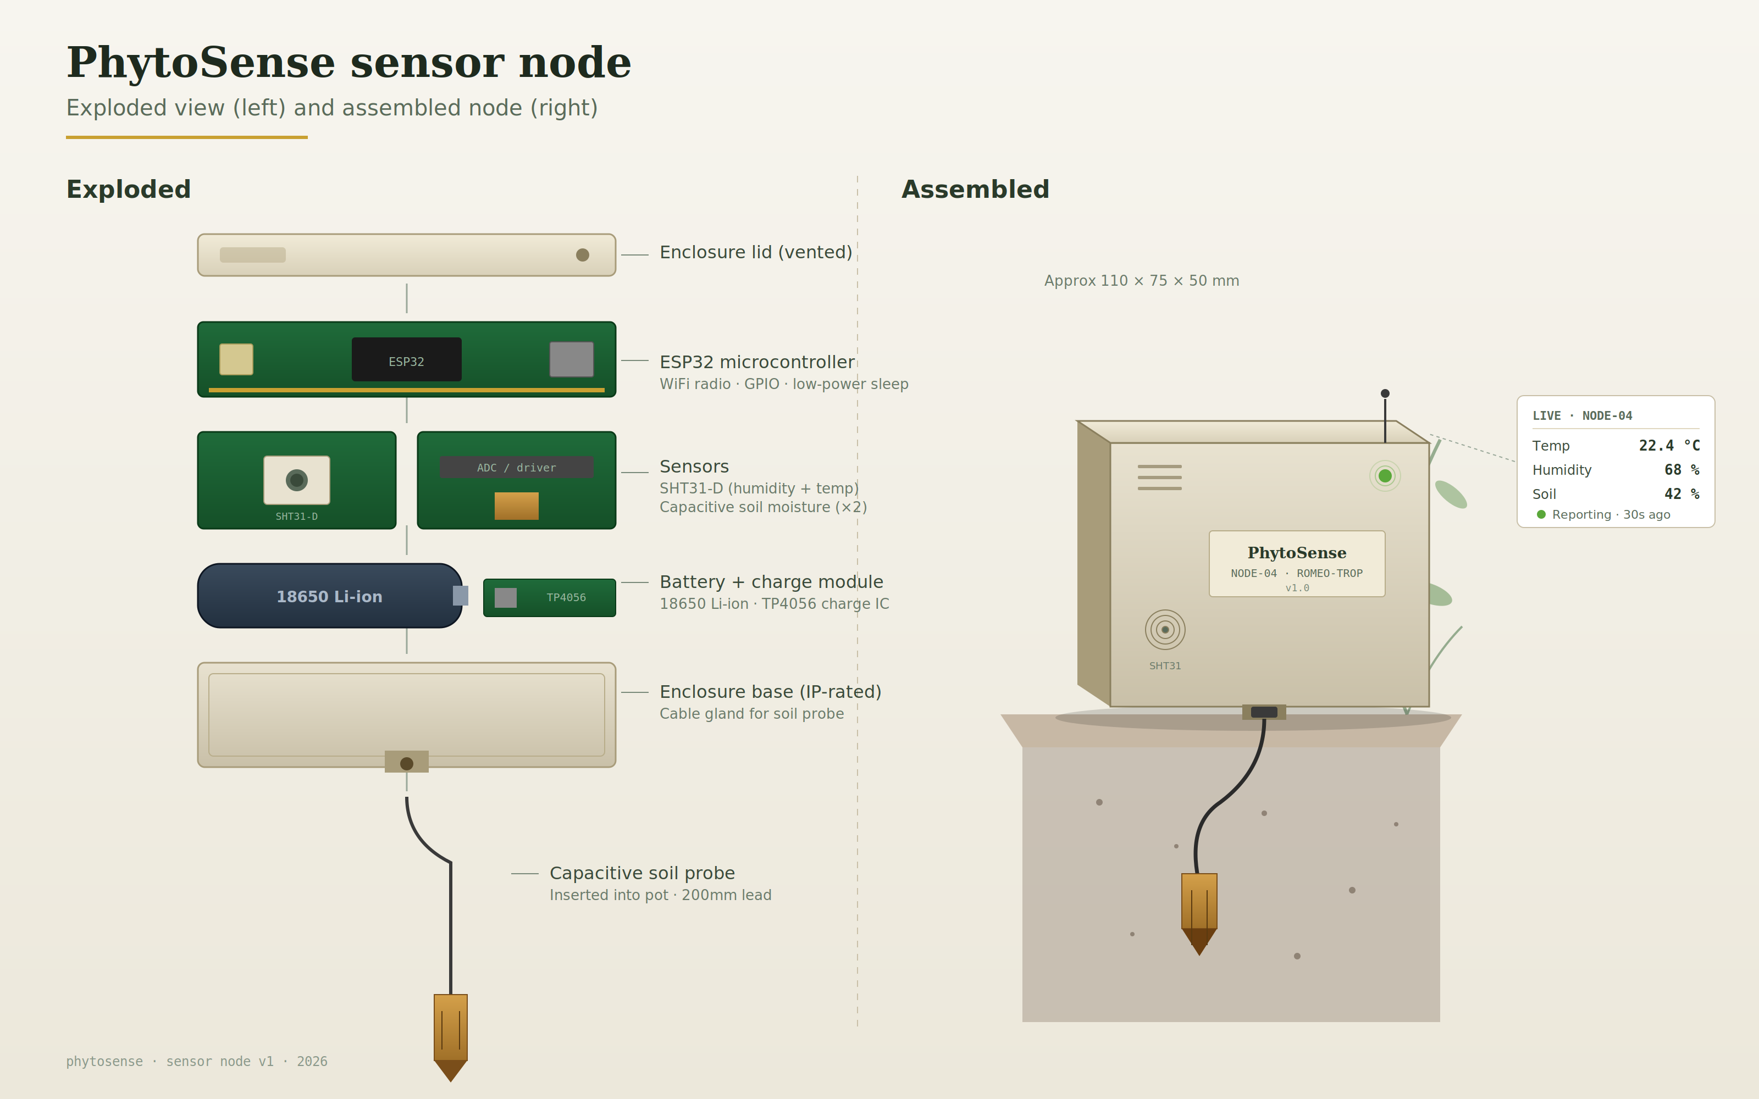
Sensor Node
8

Slide 9
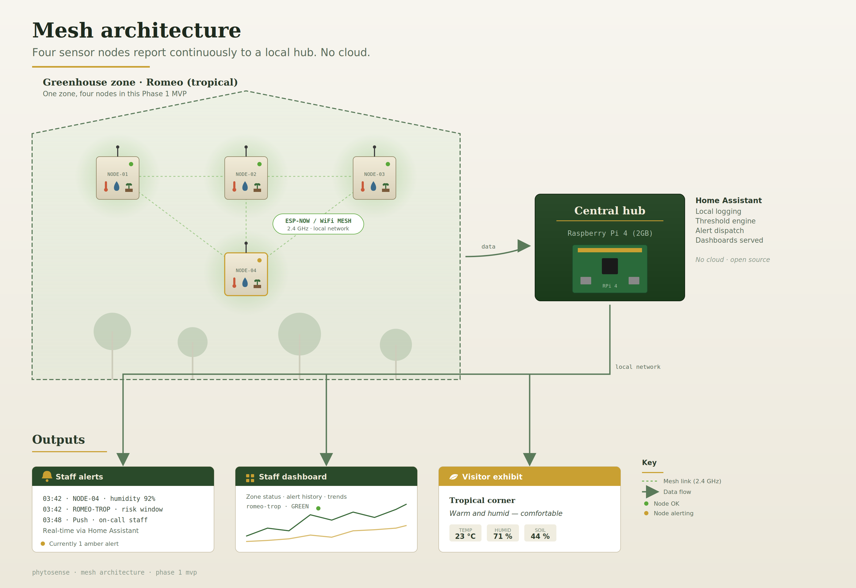
Mesh Network
9

Slide 10


Two Dashboards, One Data Source
Staff Dashboard
Visitor Exhibit
Colour-coded zone status — green, amber, red
— Live environmental conditions framed as the plant experience
— Real-time threshold alerts to staff devices
— "Tropical corner: warm and humid — comfortable"
— Full data history and overnight logs
— No operational alerts — no data that reflects on maintenance
— Thresholds configured with horticulture staff at installation
— Invites visitors into the science happening in real time
— Internal only — no public access to operational data
— Interactive exhibit at zero additional hardware cost
10

Slide 11
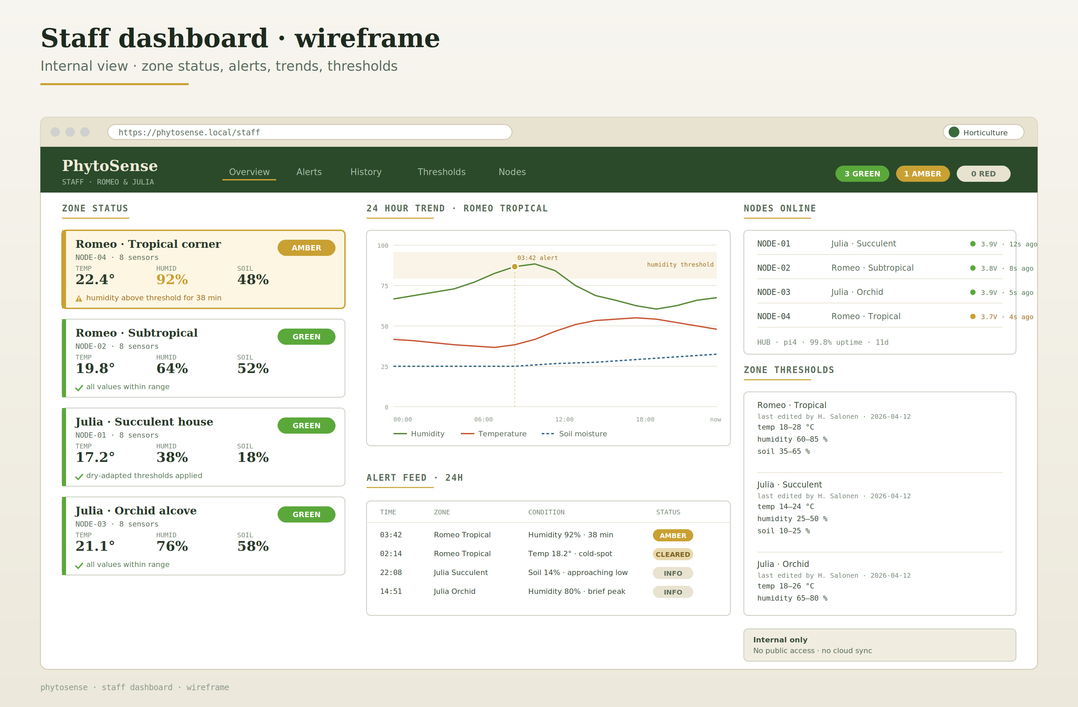
Staff Dashboard
11

Slide 12
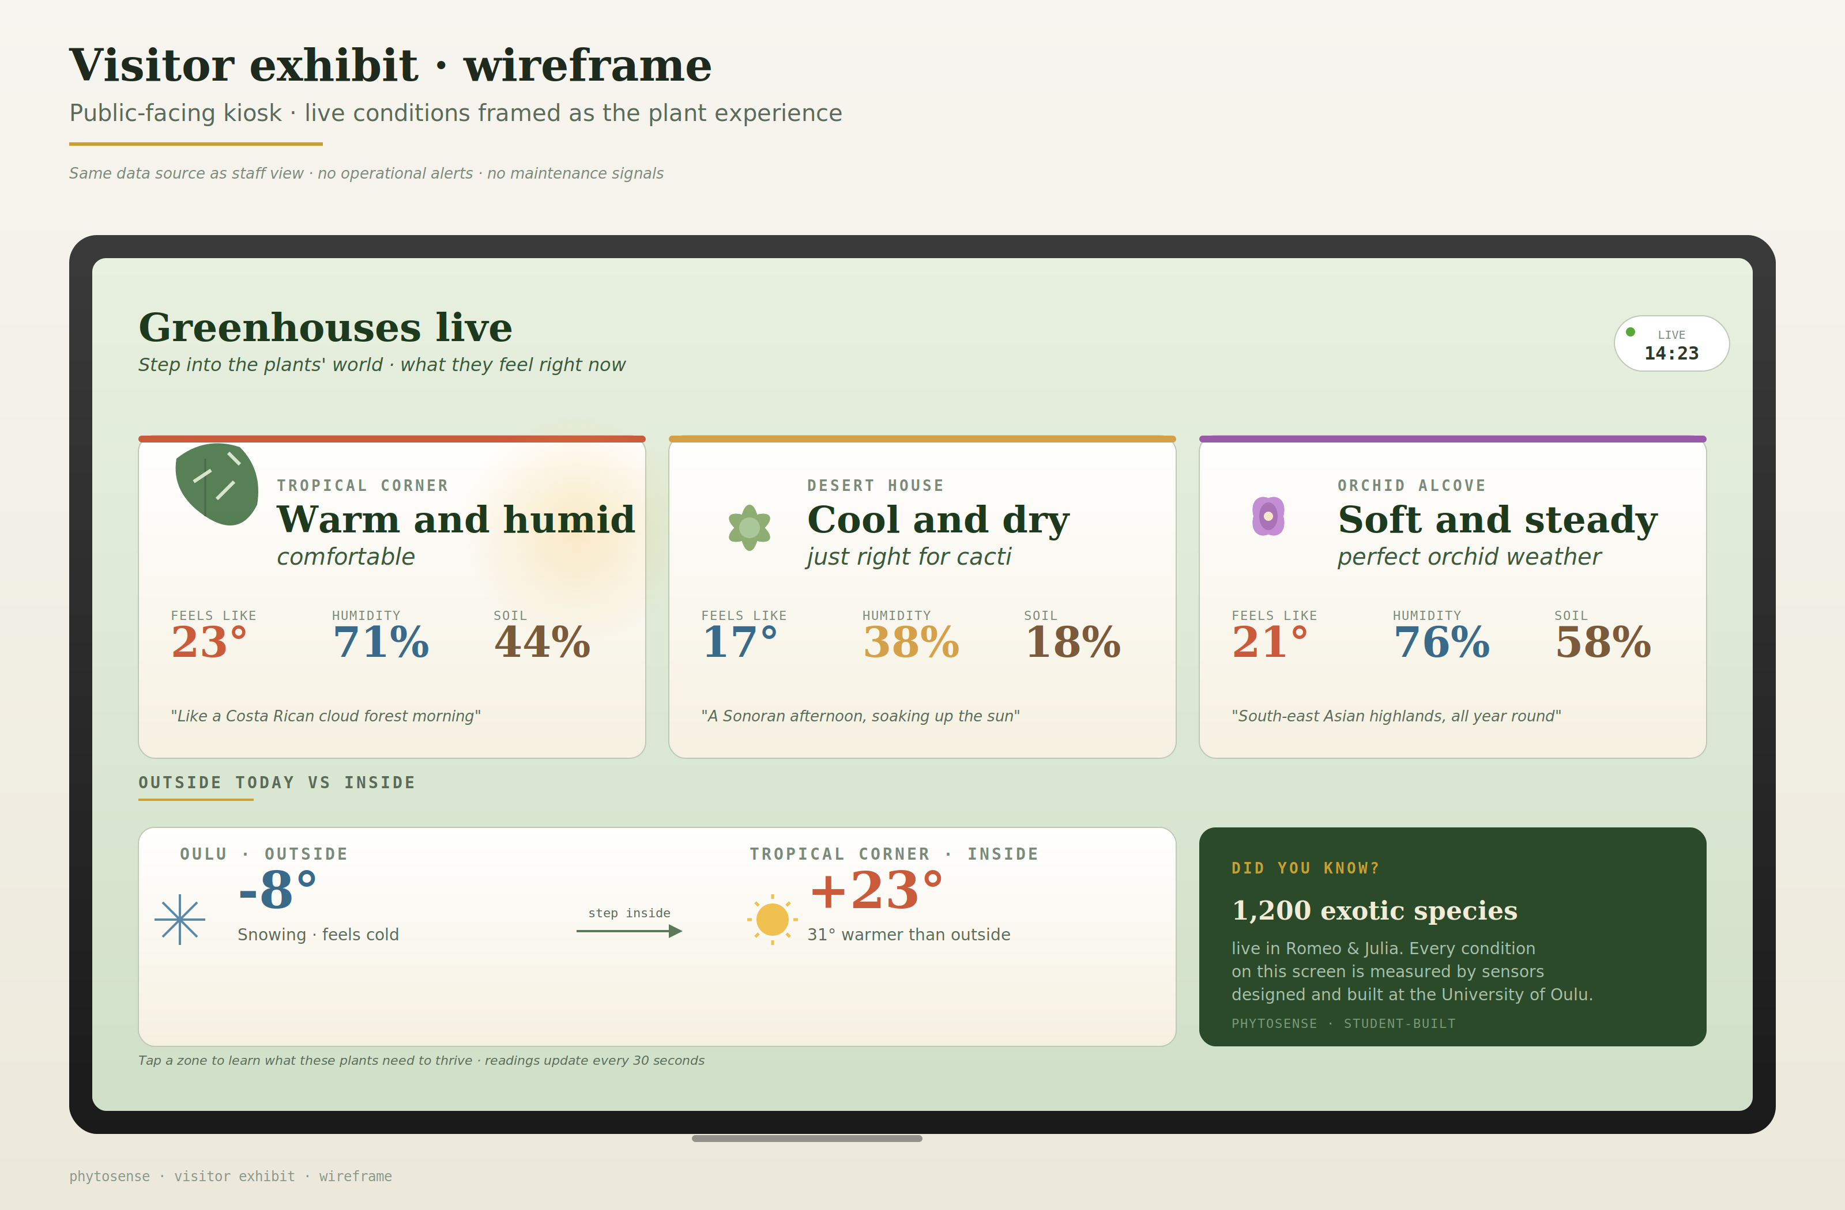
Visitor Dashboard
12

Slide 13
Cost & Scale
EUR 220
Phased rollout — committee asked to fund Phase 1 only
Phase 1
Total Phase 1 MVP hardware cost
4 nodes · one zone
Commercial systems with equivalent capability: several thousand euros
This proposal. Staff alerts live from installation.
Phase 2
Phase 1 Components
10–12 nodes · Romeo
Full tropical and subtropical coverage.
First seasonal dataset.
ESP32 microcontrollers (x5)
~EUR 40
Raspberry Pi 4 hub (2GB)
~EUR 55
SHT31-D humidity + temp sensors (x4)
~EUR 18
Phase 3
Soil moisture sensors (x8)
~EUR 12
16–20 nodes · Both
18650 batteries & charge modules (x4)
~EUR 22
Romeo and Julia covered.
Full public exhibit.
Solar-powered nodes.
Enclosures, PCB, cables
~EUR 47
13

Slide 14
Thank you!
Questions?
Team PhytoSense · University of Oulu · May 2026
14

