Slide 1
2IV60 Computer Graphics
2D transformations
Jack van Wijk
TU/e

Slide 2
Overview
Why transformations?
Basic transformations:
  translation, rotation, scaling
Combining transformations
  homogenous coordinates, transform. Matrices
First 2D, next 3D

Slide 3
Transformations
instantiation…
world
train
animation…
viewing…
wheel
modelling…
image

Slide 4
Why transformation?
Model of objects
  world coordinates: km, mm, etc.
  Hierarchical models::
  human = torso + arm + arm + head + leg + leg
  arm = upperarm + lowerarm + hand …
Viewing
  zoom in, move drawing, etc.
Animation

Slide 5
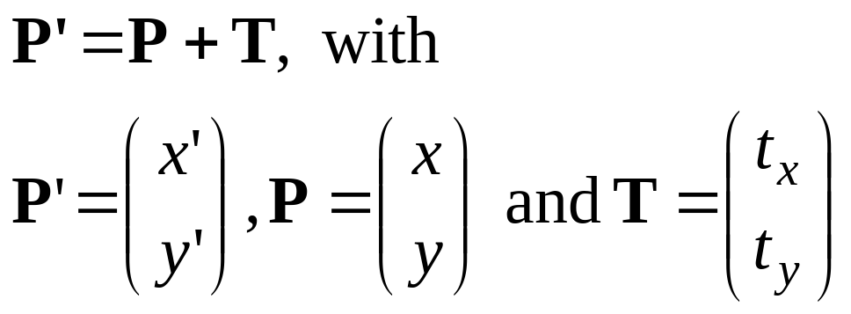
Translation
Translate over vector (t_{x}, t_{y})
x’=x+ t_{x}, y’=y+ t_{y}
or
y
P+T
T
P
x
H&B 7-1:220-222

Slide 6
Translation polygon
Translate polygon:
Apply the same operation on all points.
Works always, for all transformations of objects defined as a set of points.
y
T
x
H&B 7-1:220-222

Slide 7
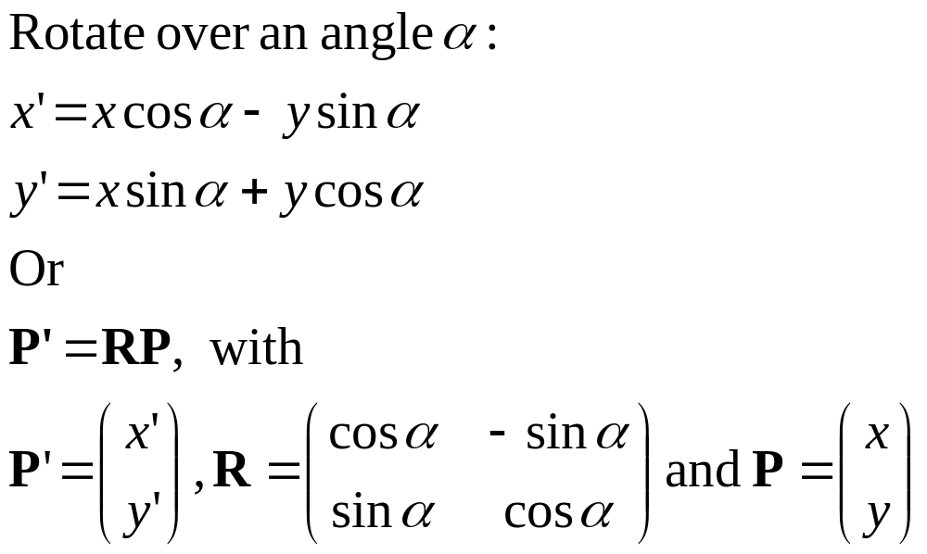
Rotation
y
y
P’
α
P
x
x
H&B 7-1:222-223

Slide 8
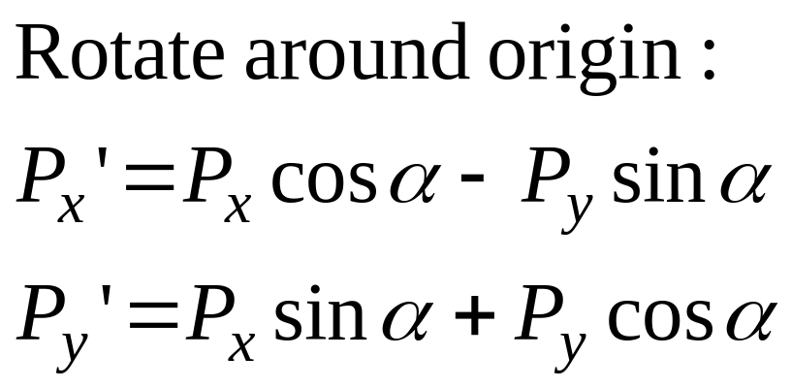
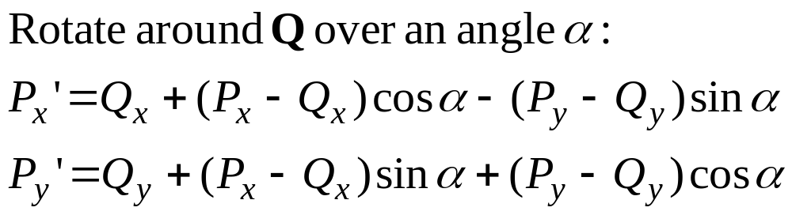
Rotation around a point Q
y
y
P’
α
P
P−Q
Q
x
x
H&B 7-1:222-223

Slide 9
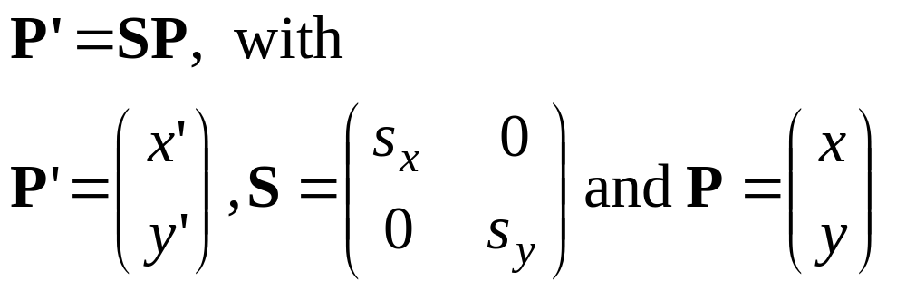
Scaling
Schale with factor s_{x} and s_{y}:
x’= s_{x} x, y’= s_{y} y
or
y
P’
P
Q’
Q
x
x
H&B 7-1:224-225

Slide 10
Scaling with respect to a point F
y
Scale with factors s_{x} and s_{y}:
P_{x}’= s_{x} P_{x}, P_{y}’= s_{y}P_{y}
With respect to F:
P_{x}’ − F_{x} = s_{x} (P_{x} − F_{x}),
P_{y}’ − F_{y} = s_{y} (P_{y} − F_{y})
or
P_{x}’= F_{x} + s_{x} (P_{x} − F_{x}),
P_{y}’= F_{y} + s_{y} (P_{y} − F_{y})
P’
P
P−F
Q’
F
Q
x
x
H&B 7-1:224-225

Slide 11
Transformations
Translate with V:
  T = P + V
Schale with factor s_{x} = s_{y} =s:
  S = sP
Rotate over angle α:
  R’_{x} = cos α P_{x} − sin α P_{y}
  R’_{y} = sin α P_{x} + cos α P_{y}
y
S
R
T
P
x
H&B 7-2:225-228

Slide 12
Transformations…
Messy!
Transformations with respect to points: even more messy!
How to combine transformations?
H&B 7-2:225-228

Slide 13
Homogeneous coordinates 1
Uniform representation of translation, rotation, scaling
Uniforme representation of points and vectors
Compact representation of sequence of transformations
H&B 7-2:225-228

Slide 14
Homogeneous coordinaten 2
Add extra coordinate:
P = (p_{x} , p_{y} , p_{h}) or
x = (x, y, h)
Cartesian coordinates: divide by h
x = (x/h, y/h)
Points: h = 1 (for the time being…),
vectors: h = 0
H&B 7-2:225-228

Slide 15
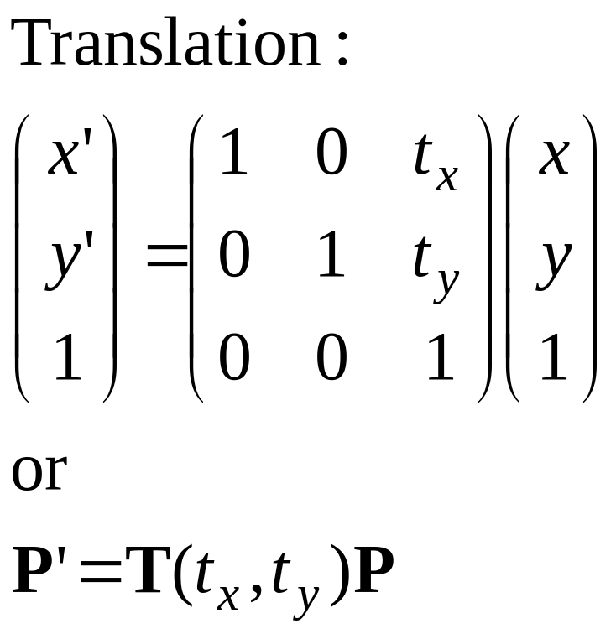
Translation matrix
H&B 7-2:225-228

Slide 16
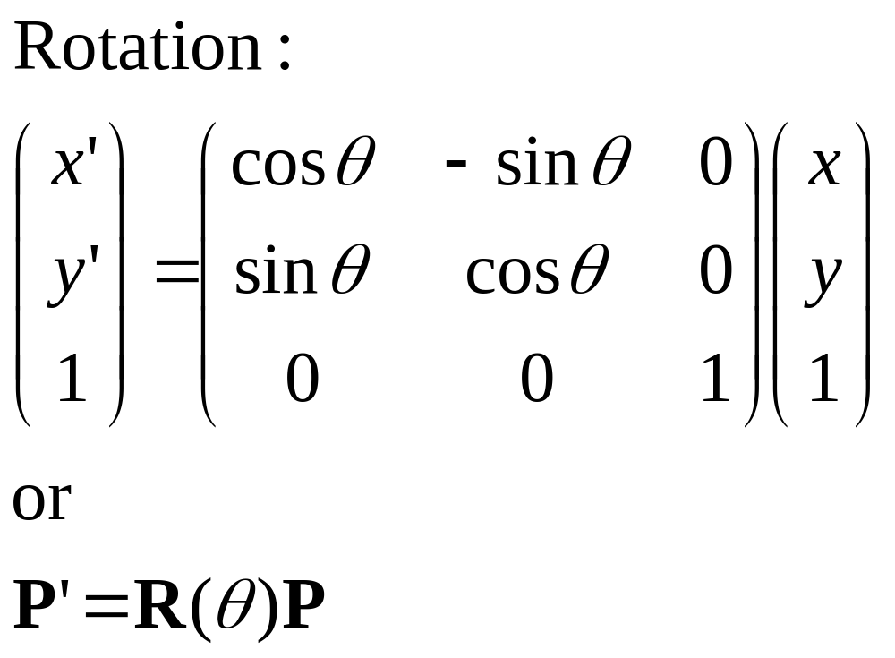
Rotation matrix
H&B 7-2:225-228

Slide 17
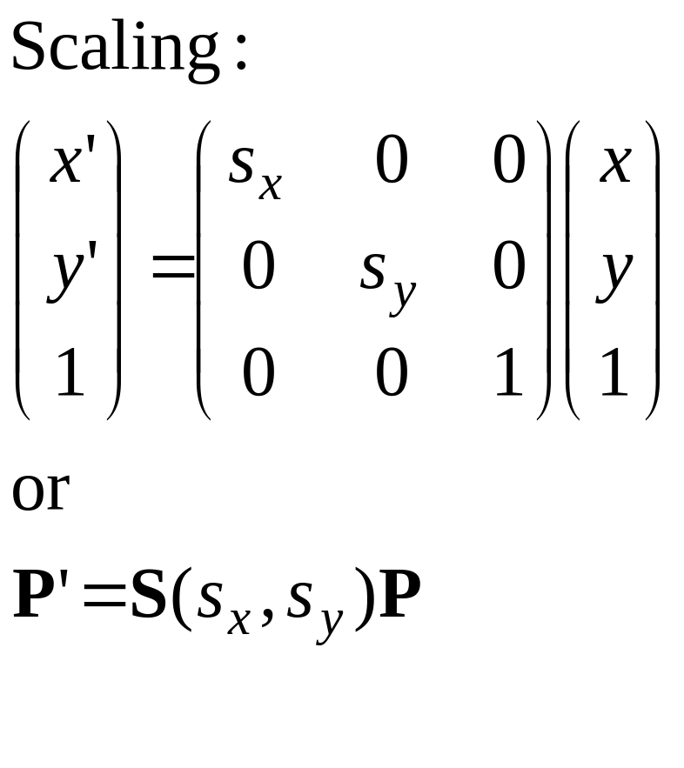
Scaling matrix
H&B 7-2:225-228

Slide 18
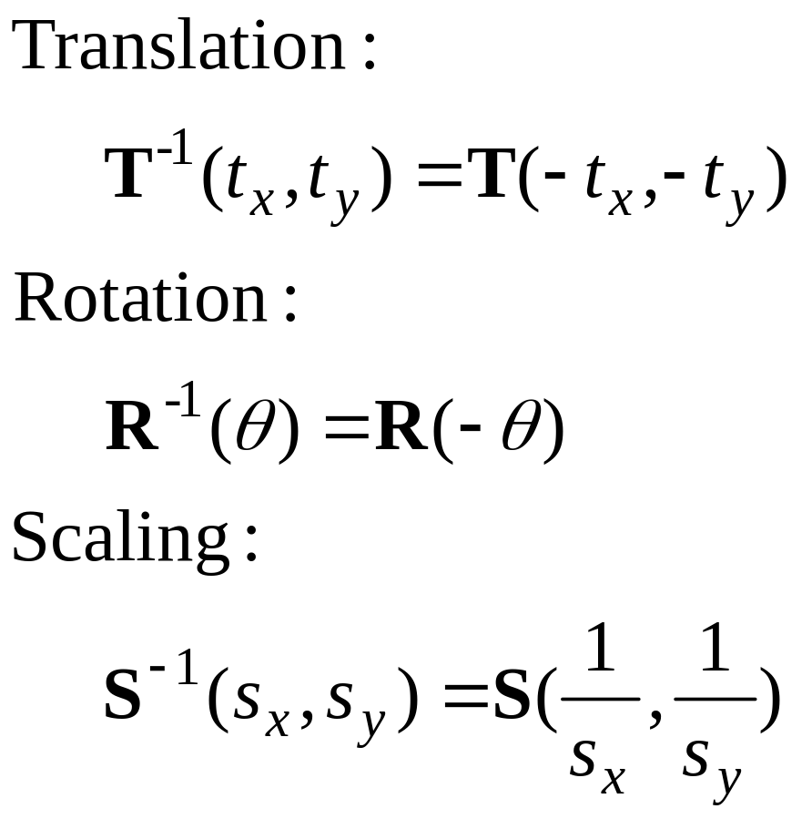
Inverse transformations
H&B 7-3:228

Slide 19
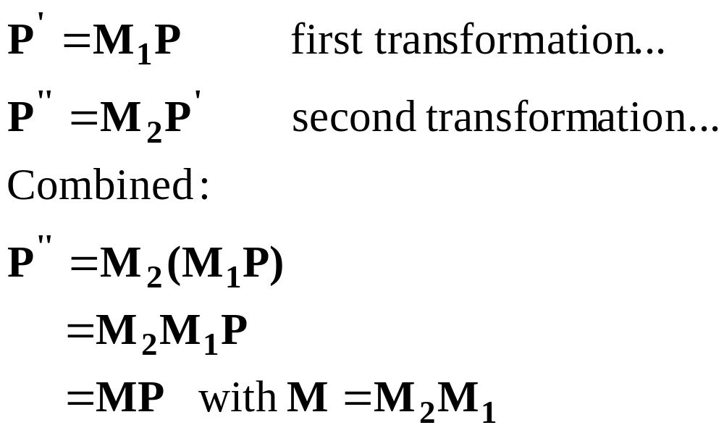
Combining transformations 1
H&B 7-4:228-229

Slide 20
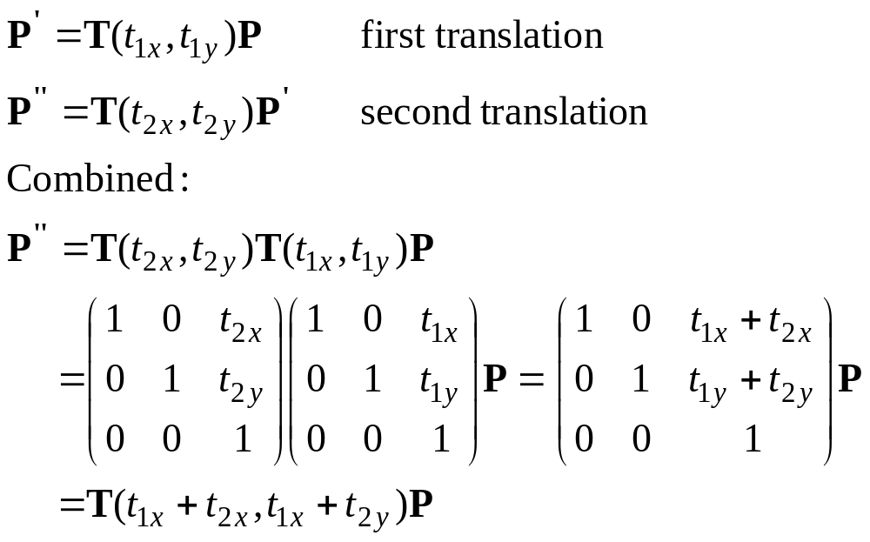
Combining transformations 2
H&B 7-4:229

Slide 21
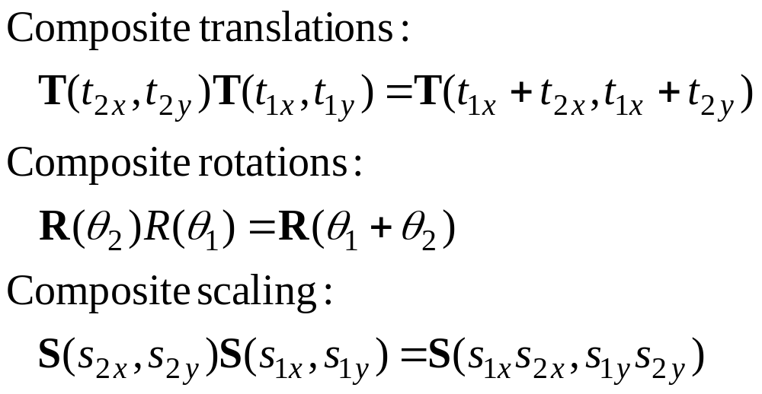
Combining transformations 3
H&B 7-4:229

Slide 22
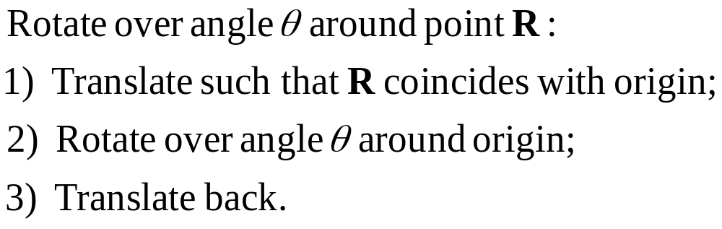
Rotation around a point 1
R
1) 2) 3)
H&B 7-4:229-230

Slide 23
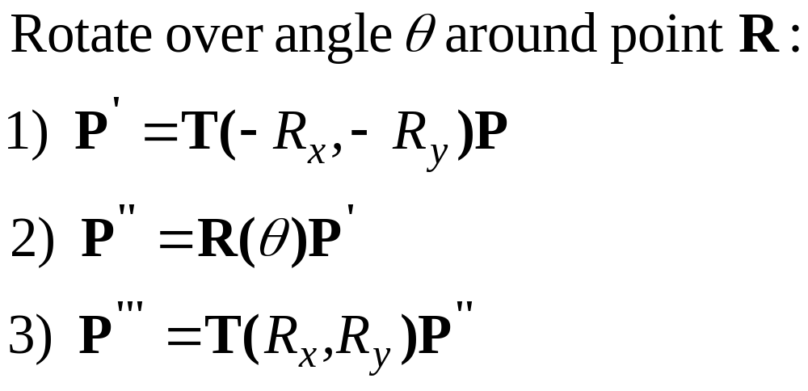
Rotation around a point 2
R
1) 2) 3)
H&B 7-4:229-230

Slide 24
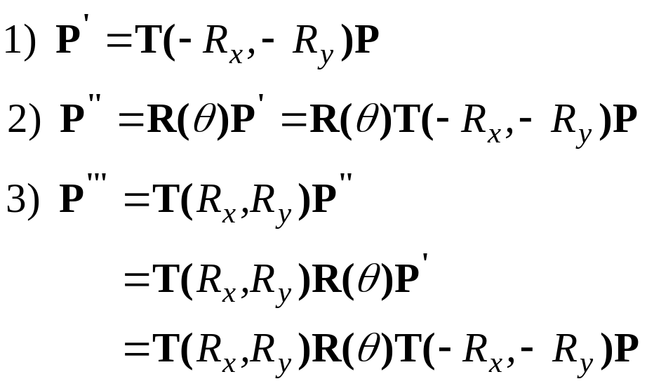
Rotation around point 3
R
1) 2) 3)
H&B 7-4:229-230

Slide 25
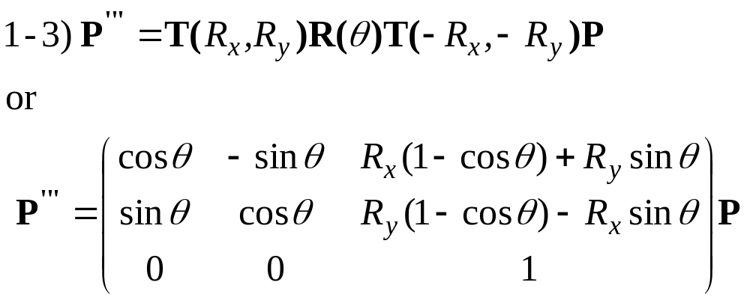
Rotation around point 4
R
1) 2) 3)
H&B 7-4:229-230

Slide 26
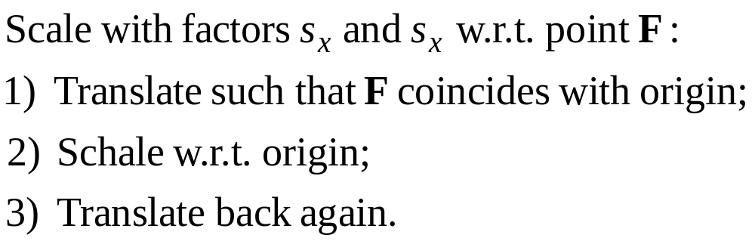
Scaling w.r.t. point 1
F
1) 2) 3)
H&B 7-4:230-231

Slide 27
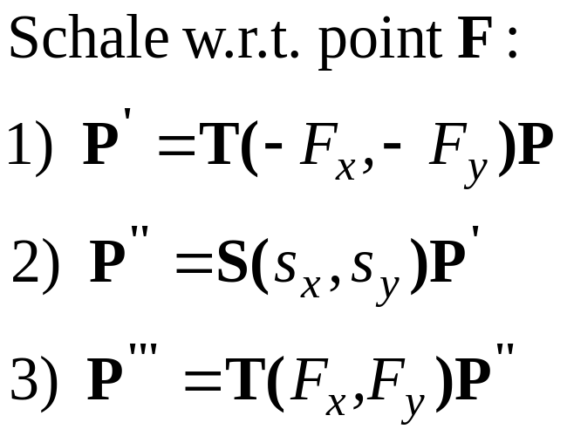
Scaling w.r.t.point 2
F
1) 2) 3)
H&B 7-4:230-231

Slide 28
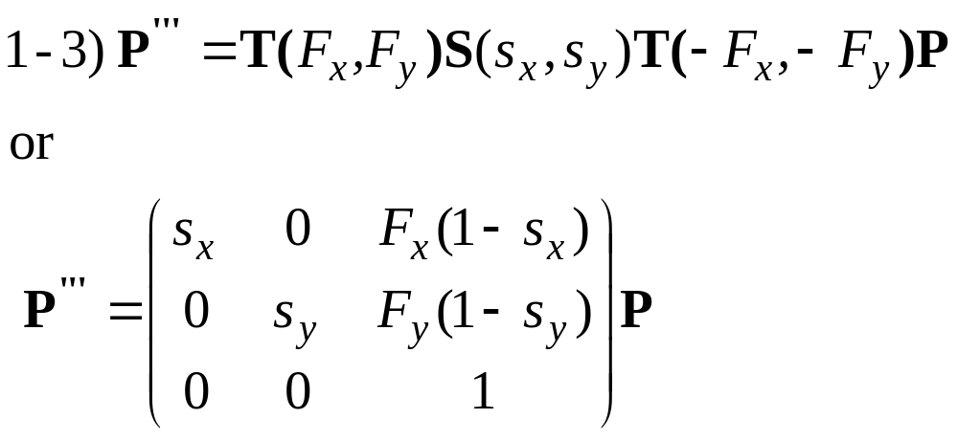
Scaling w.r.t.point 3
F
1) 2) 3)
H&B 7-4:230-231

Slide 29
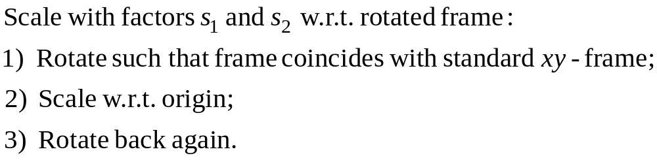
Scale in other directions 1
1) 2) 3)
H&B 7-4:230-231

Slide 30
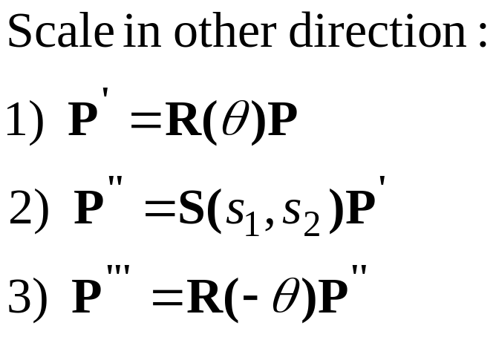
Scale in other directions 2
1) 2) 3)
H&B 7-4:230-231

Slide 31
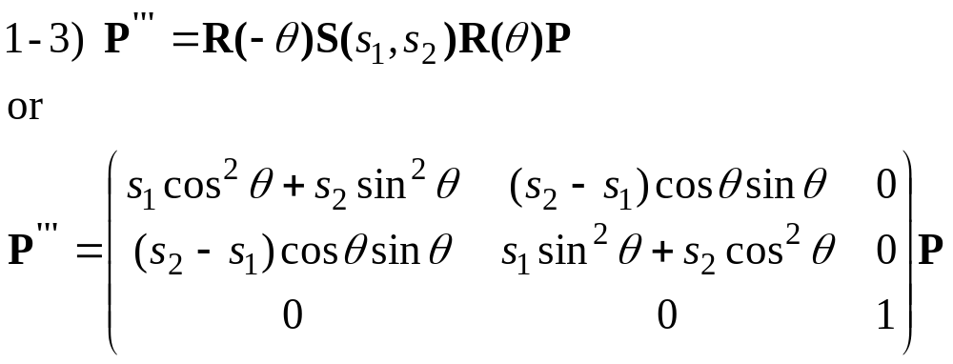
Scale in other directions 3
1) 2) 3)
H&B 7-4:230-231

Slide 32
Order of transformations 1
Rotation, translation… Translation, rotation…
y’
y’’
y’’
x’’
x’’
y
y
y’
x’
x’
x
x
Matrix multiplication does not commute.
The order of transformations makes a difference!
H&B 7-4:232

Slide 33
Order of transformations 2
Pre-multiplication:
  P’ = M _{n} M _{n-1}…M ₂ M ₁ P
  Transformation M _{n} in global coordinates
Post-multiplication:
  P’ = M ₁ M ₂…M _{n-1} M _{n} P
  Transformation M _{n} in local coordinates: the
  coordinate system after application of
  M ₁ M ₂…M _{n-1}
H&B 7-4:232

Slide 34
Order of transformations 3
OpenGL: glRotate, glScale, etc.:
Post-multiplication of current transformation matrix
Always transformation in local coordinates
Global coordinate version: read in reverse order
H&B 7-4:232

Slide 35
Order of transformations 4
Local transformations:
Global transformations:
y’
y’’
y’’
x’’
x’’
y
y
y’
x’
x’
x
x
Local trafo
interpretation
Global trafo
interpretation
glTranslate(…);
glRotate(…);
H&B 7-4:232

Slide 36

Matrices in general
rotation and scaling
translation
H&B 7-4:233-235

Slide 37
Direct construction of matrix
If you know the target frame:
Construct matrix directly.
Define shape in nice local
u,v coordinates, use matrix
transformation to put it
in x,y space.
y
v
u
B
A
T
x
H&B 7-4:233-235

Slide 38
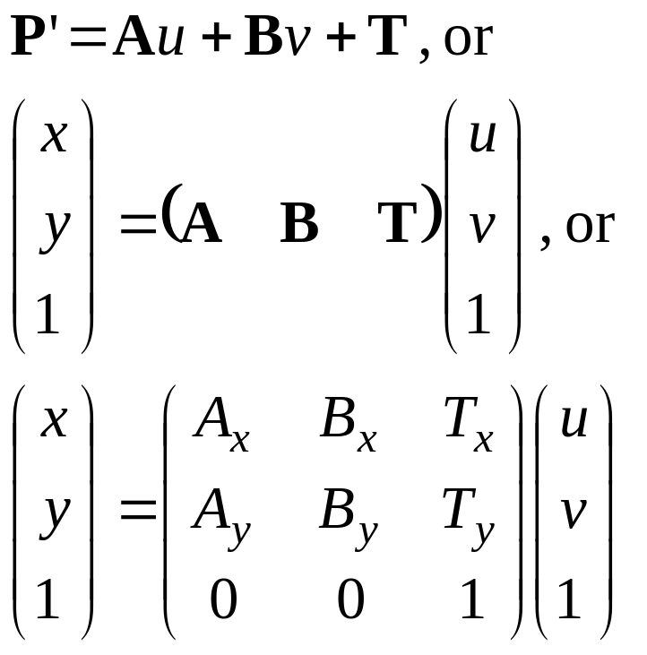
Direct construction of matrix
If you know the target frame:
Construct matrix directly.
y
v
u
B
A
T
x
H&B 7-4:233-235

Slide 39
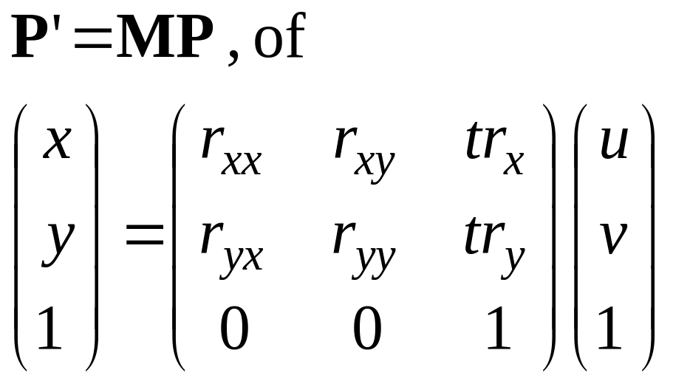
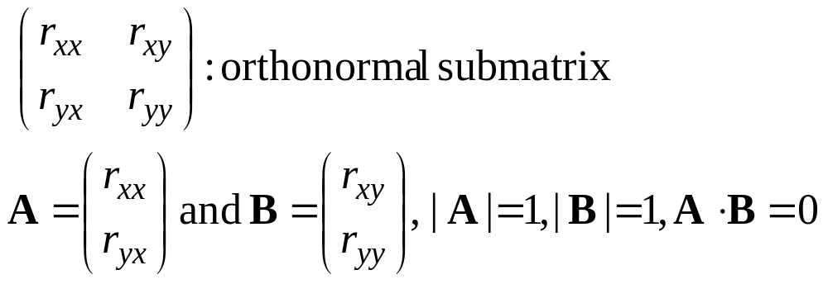
Rigid body transformation
only rotation
translation
y
u
v
B
A
T
x
H&B 7-4:233-235

Slide 40
Other 2D transformations
Reflection
Shear
Can also be combined
H&B 7-4:240

Slide 41
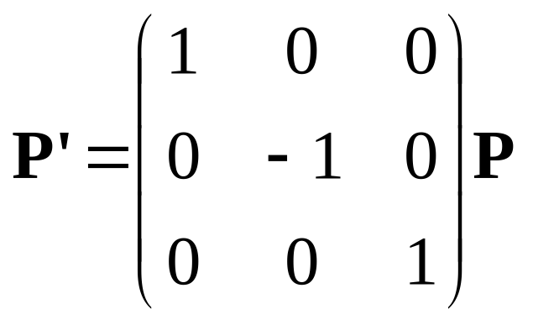
Reflection over axis
Reflext over x-axis:
x’= x, y’= −y
or
y
x
H&B 7-4:240-242

Slide 42
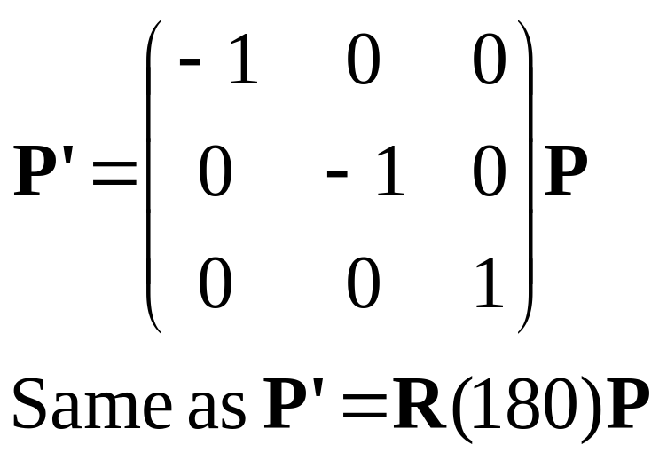
Reflect over origin
Reflect over origin:
x’= −x, y’= − y
or
y
x
H&B 7-4:240-242

Slide 43
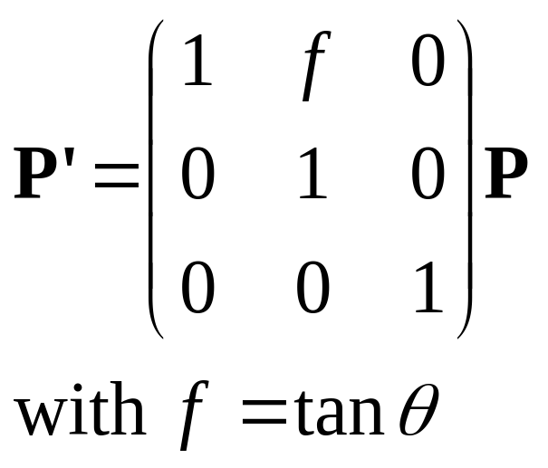
Shear
Shear the y-as:
x’=x+fy, y’=y
or
y
θ
x
H&B 7-4:242-243

Slide 44
Transformations coordinates
Given (x,y)-coordinates,
Find (x’,y’)-coordinates.
Reverse route as
object transformaties.
y
y’
θ
x’
(x₀, y₀)
x
H&B 7-8:246-248

Slide 45
Transformations coordinates
Given (x,y)-coordinates,
Find (x’,y’)-coordinates.
Example: user points at
(x,y), what’s the position
in local coordinates?
y
y’
θ
x’
(x₀, y₀)
x
H&B 7-8:246-248

Slide 46
Transformations coordinates
Given X: (x,y)-coordinates,
Find X’: (x’,y’)-coordinates.
Standard:
X=MX’ (object trafo:
from local to global)
Here:
X’=M⁻¹X (from global to local)
y
y’
θ
x’
(x₀, y₀)
x
H&B 7-8:246-248

Slide 47
Transformations coordinates
Given X: (x,y)-coordinates,
Find X’: (x’,y’)-coordinates.
Here:
X’=M⁻¹X (from global to local)
Approach 1:
- Determine “standard matrix” M (from local to global coordinates) and invert
y
y’
θ
x’
(x₀, y₀)
x
H&B 7-8:246-248

Slide 48
Transformations coordinates
Given X: (x,y)-coordinates,
Find X’: (x’,y’)-coordinates.
Here:
X’=M⁻¹X (from global to local)
Approach 2:
construct transformation that maps local frame to global (reverse of usual).
y
y’
θ
x’
(x₀, y₀)
x
H&B 7-8:246-248

Slide 49
Transformations coordinates
Given X: (x,y)-coordinates,
Find X’: (x’,y’)-coordinates.
Here:
X’=M⁻¹X (from global to local)
Approach 2:
Translate (x₀, y₀) to origin;
Rotate x’-axis to x-axis.
y
y’
θ
x’
(x₀, y₀)
x
H&B 7-8:246-248

Slide 50
Transformations coordinates
Given X: (x,y)-coordinates,
Find X’: (x’,y’)-coordinates.
Here:
X’=M⁻¹X (from global to local)
Approach 2:
M⁻¹ = T(−x₀, −y₀) R(−θ)
y
y’
θ
x’
(x₀, y₀)
x
H&B 7-8:246-248

Slide 51
OpenGL 2D transformations 1
Internally:
Coordinates are four-element row vectors
Transformations are 4×4 matrices
2D trafo’s: Ignore z-coordinates, set z = 0.
H&B 7-9:248-253

Slide 52
OpenGL 2D transformations 2
OpenGL maintains two matrices:
GL_PROJECTION
GL_MODELVIEW
Transformations are applied to the current matrix, to be selected with:
glMatrixMode(GL_PROJECTION) or
glMatrixMode(GL_MODELVIEW)
H&B 7-9:248-253

Slide 53
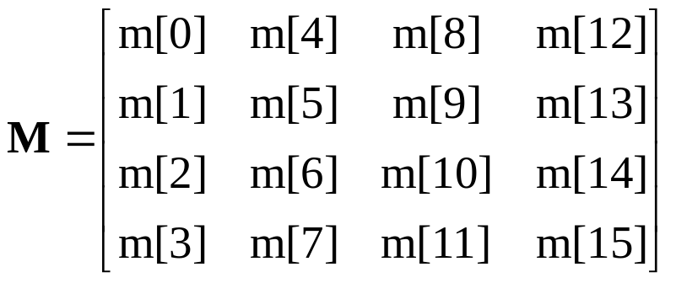
OpenGL 2D transformations 3
Initializing the matrix to I:
glLoadIdentity();
Replace the matrix with M:
GLfloat M[16]; fill(M);
glLoadMatrix*(M);
Matrices are specified in column-major order:
Multiply current matrix with M:
glMultMatrix*(M);
H&B 7-9:248-253

Slide 54
OpenGL 2D transformations 4
Basic transformation functions: generate matrix and post-multiply this with current matrix.
Translate over [tx, ty, tz]:
glTranslate*(tx, ty, tz);
Rotate over theta degrees (!) around axis [vx, vy, vz]:
glRotate*(theta, vx, vy, vz);
Scale axes with factors sx, sy, sz:
glScale*(sx, sy, sz);
H&B 7-9:248-253

Slide 55
OpenGL 2D Transformations 5
OpenGL maintains stacks of transformation matrices.
Two operations:
glPushMatrix():
  Make copy of current matrix and put that on top of the stack;
glPopMatrix():
  Remove top element of the stack.
Handy for dealing with hierarchical models
Handy for “undoing” transformations
H&B 9-8:324-327

Slide 56
OpenGL 2D Transformations 6
Standard:
glRotate(10, 1, 2, 0);
glScale(2, 1, 0.5);
glTranslate(1, 2, 3);
glutWireCube(1);
glTranslate(−1, −2, −3);
glScale(0.5, 1, 2);
glRotate(−10, 1, 2, 0);
Using the stack:
glPushMatrix();
glRotate(10, 1, 2, 0);
glScale(2, 1, 0.5);
glTranslate(1, 2, 3);
glutWireCube(1);
glPopMatrix();
Shorter, more robust
Undo transformation
H&B 9-8:324-327

Slide 57
2D transformations summarized
Transformations: modeling, viewing, animation;
Several kinds of transformations;
Homogeneous coordinates;
Combine transformations using matrix multiplication.
Up to 3D!

