Slide 1

Bank Churn Prediction
Unlocking Customer Retention Insights. Utilizing machine learning to predict customer churn based on behavioral, demographic, and financial data. Empowering banks to take proactive steps to improve customer loyalty and reduce attrition.

Slide 2


Data Overview
1
Dataset Size
10,000 rows and 13 columns of bank churn data.
Key Features
2
CreditScore,Geography,Gender,Age,Tenure,Balance,Numofproducts,HasCrCard,IsActiveMember,EstimatedSalary.
3
Target Variable
EXITED target variable(1=churned,0=stayed).

Slide 3
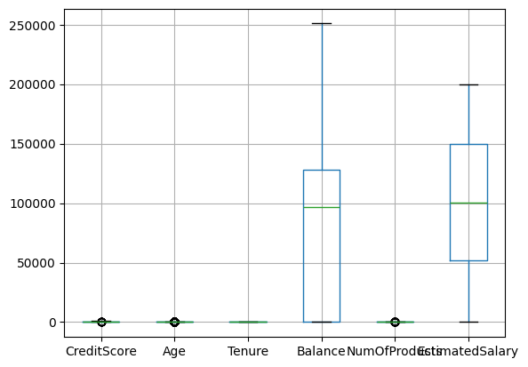
Data Preprocessing
1
Handling Missing Values
Used is null().sum() to find any Missing value / any null value
2
Outlier Treatment
Applied boxplot to find any Outlier in bank churn Xtrain.boxplot data set
3
Statistical Summary
To find statistical summary of data for training set
Xtrain.describe()

Slide 4
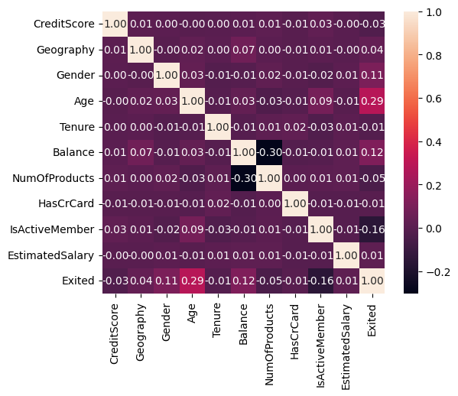
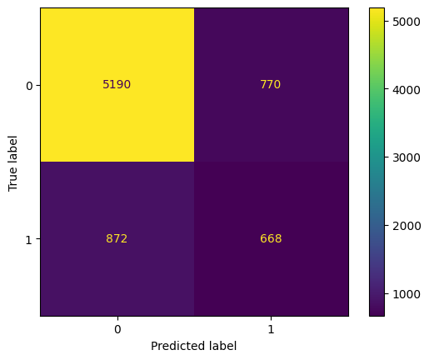
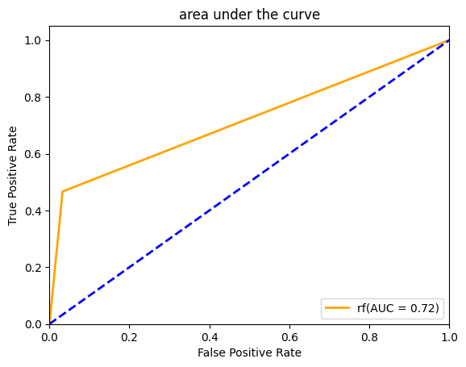
Exploratory Data Analysis
Correlation Analysis
Confusion Matrix Display
Roc-curve(Area under the curve)
Heatmap revealed relationships between variables, guiding feature selection.
confusion matrix shows the number of correct and incorrect predictions made by the model compared to the actual classifications in the data.
Area Under the curve(AUC) IS measure of overall performance of binary classification model and represents the area under the ROC curve.

Slide 5
Model Selection
Logistic Regression Model
Tree-based Models
Advanced Models
Logistic regression is a supervised
Machine learning algorithm –for binary classification problem where the outcome is a probability bounded between 0 and 1
We used this in this data set to find where the target variable (1=churned,0=stayed)
Decision Tree (criterion=‘gini’ and’entropy’) in this algorithm entropy is given best result then gini but both Accuracy score is low compared to Random Forest algorithm.
Random forest algorithm is best algorithm with Accuracy score 86%
Support Vector Machine(SVC)
Tested with hyperparameters like class-weight etc but low Accuracy score and f1_score=0,
XGBoost Classifier() is the best compared to SVM .xgboost accuracy score is 86.32%, ROC-AUC =0.73.

Slide 6
Model Training and Evaluation
Data Splitting
Performance Metrics
80% training, 20% testing split for model evaluation.
Evaluated models using f1-score,accuracy-score,precision ,recall, auc,roc and
confusion-matrix-display.
1
2
3
Hyperparameter Tuning
Class-weight ,max_iter ,random_state, max_depth, criterion, c, degree

Slide 7
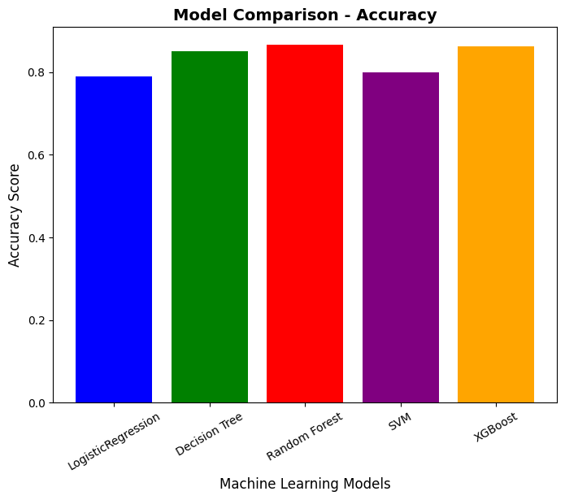
Model Performance Comparison
Best Performer
Runner-up
Baseline
Random Forest Regressor achieved highest Accuracy score of 0.866.
XGBoost Regressor came second with Accuracy score of 0.86.
Logistic Regression, Decision Tree and SVM performed similarly less Accuracy score around 0.79-0.85.

Slide 8

Key Findings
1
Best Model
Random Forest Regressor outperformed other models in predicting Bank Churn.
2
Important Factors
Age, Estimated Salary, Credit Score and Balance plays every important role in customer attrition. probability of stay is more based on their demographic, financial, and account activity data.
3
Model Accuracy
Achieved 86% accuracy in predicting Bank Churn.

Slide 9
THANK YOU

