Slide 1
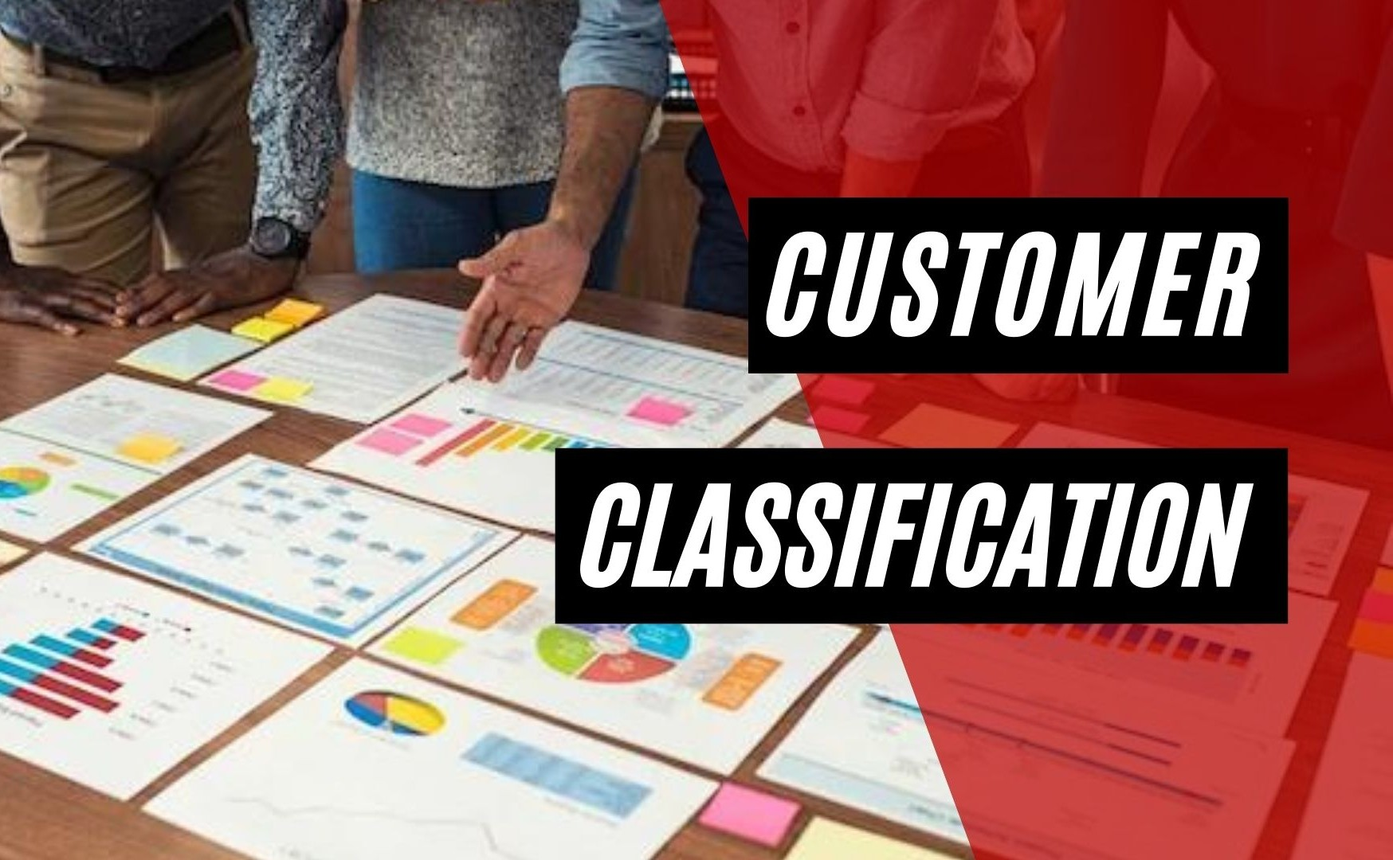

Customer Classification – Capstone Project
Identifying High and Low Revenue Customers for a Stock Broking Firm

Slide 2
Project Objective
• Classify customers into:
- Class 1: High Revenue
- Class 2: Low Revenue
• Help stock broking firm focus on potential high-value customers
• Supervised classification using labeled data

Slide 3
Machine Learning Pipeline
1. Load Data into Python
2. Train-Validation Split
3. EDA and Preprocessing
4. Model Building
5. Model Evaluation
6. Iterative Performance Tuning

Slide 4
Class Imbalance Challenge
• Imbalance in class distribution:
- 90%: Class 2 (Low Revenue)
- 10%: Class 1 (High Revenue)
• Used F1-score for fair evaluation
• Addressed imbalance during model training

Slide 5
Algorithms Used
• Logistic Regression
• Random Forest
• K-Nearest Neighbors (KNN)
• Decision Tree
• Support Vector Machine (SVM)
• Gradient Boosting Classifier

Slide 6
Hyperparameter Tuning
• GridSearchCV – Exhaustive parameter tuning
• RandomizedSearchCV – Faster alternative for hyperparameter search

Slide 7
Ensemble Modeling
• Combined best performing models:
- Logistic Regression
- Random Forest
- K-Nearest Neighbors
• Custom ensemble improved overall performance

Slide 8
Model Performance
• Train F1 Score: 0.880
• Validation F1 Score: 0.821
• Best Model: SVM (SVC)
- Mean Train Score: 0.881
- Mean Validation Score: 0.851

Slide 9
Conclusion
• Successful classification of high vs low revenue customers
• SVM and Ensemble methods gave best results
• Business value: Enables targeted customer strategies

Slide 10
Thank You
Questions and Discussions Welcome!

