Slide 1
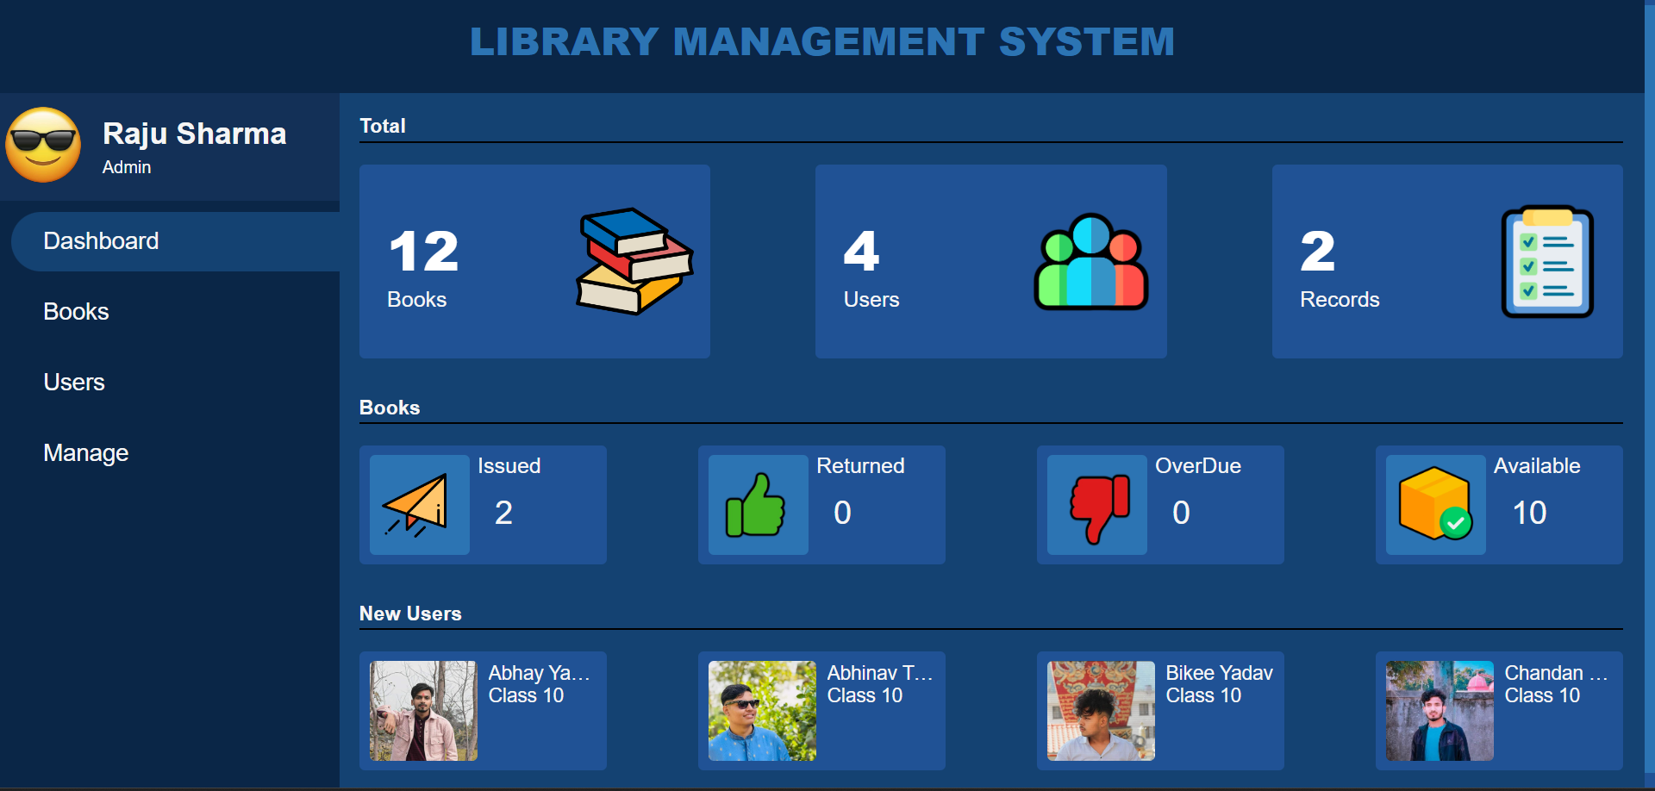

Slide 2
This is Admin User Details

Slide 3
This is Main Menu

