Slide 1

Embed, Encode, Attend, Predict – applying the 4 step NLP recipe for text classification and similarity
Sujit Pal, Elsevier Labs
July 6, 2017

Slide 2
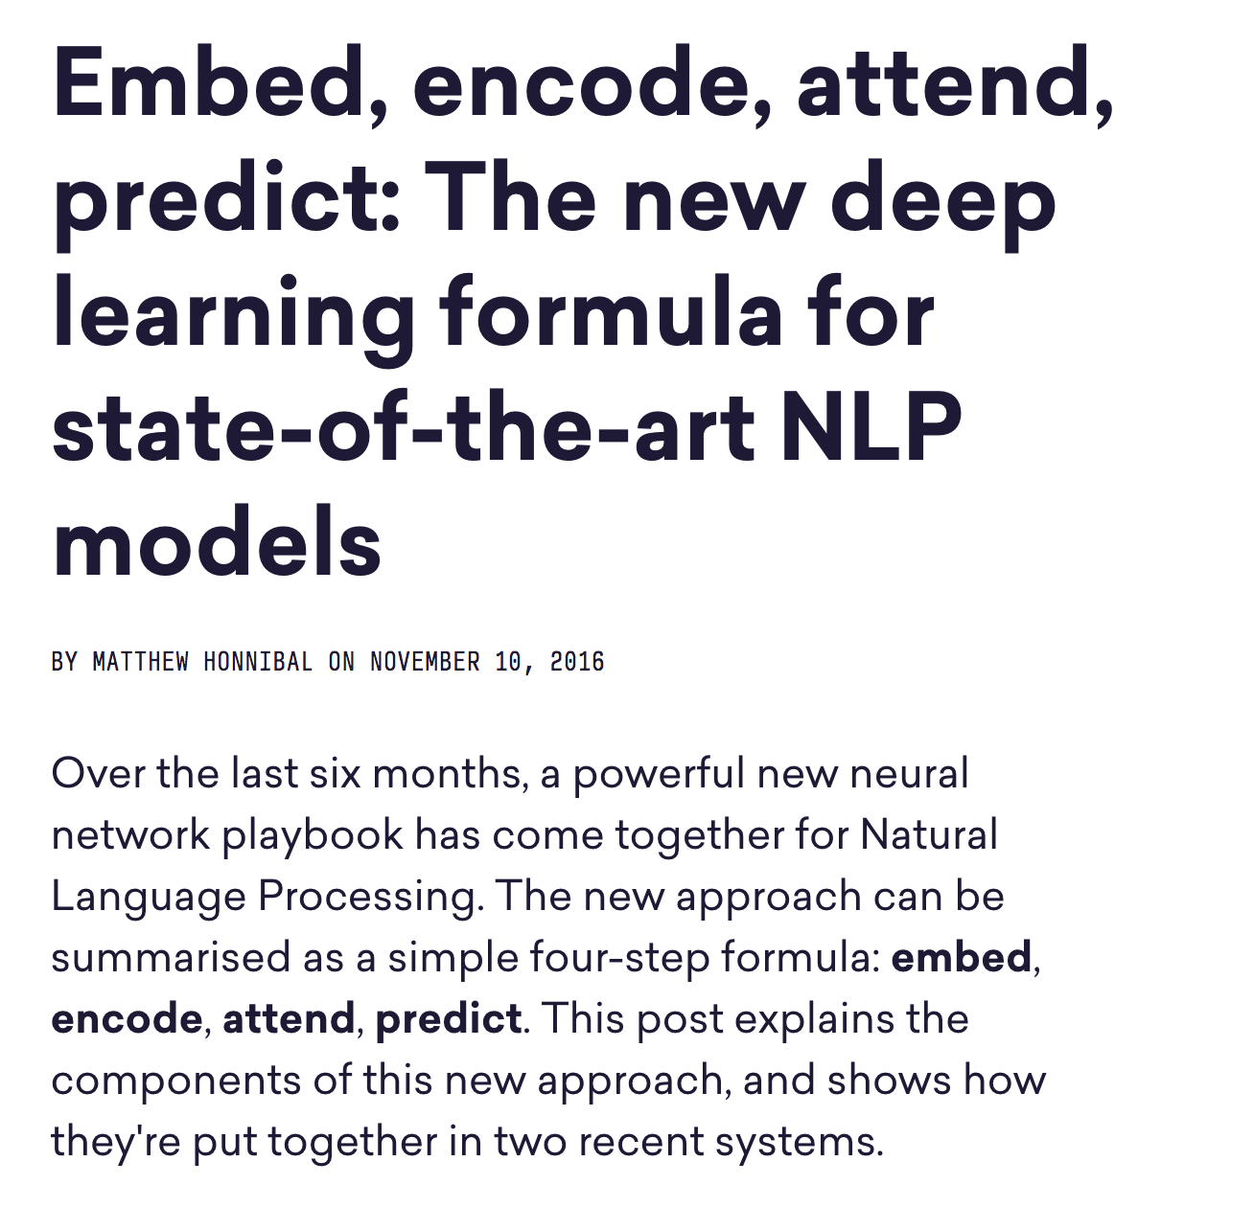
INSPIRATION

Slide 3
AGENDA
NLP Pipelines before Deep Learning
Deconstructing the “Encode, Embed, Attend, Predict” pipeline.
Example #1: Document Classification
Example #2: Document Similarity
Example #3: Sentence Similarity

Slide 4
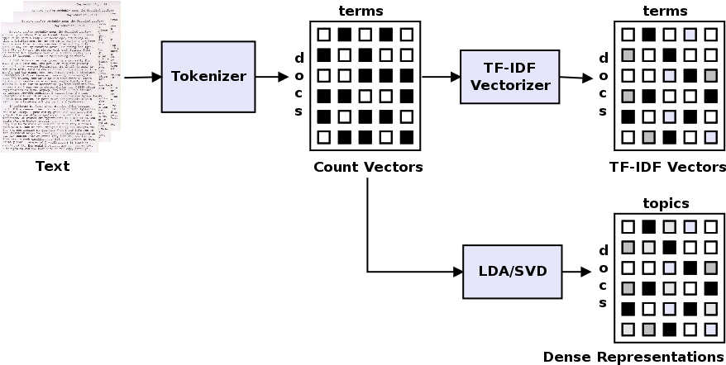
NLP PIPELINES BEFORE DEEP LEARNING
Document Collection centric
Based on Information Retrieval
Document collection to matrix
Densify using feature reduction
Feed into SVM for classification, etc.

Slide 5
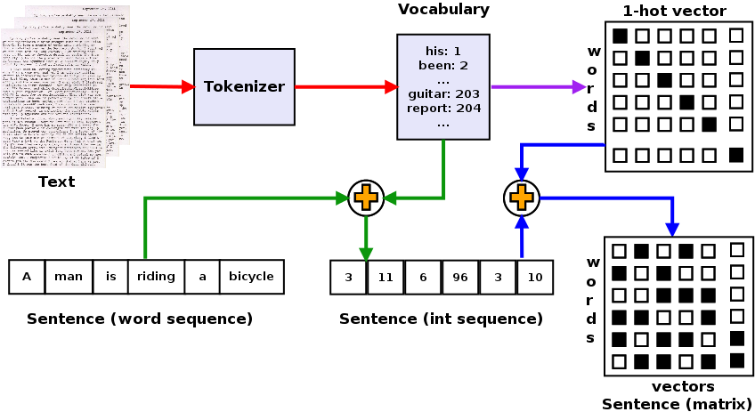
NLP PIPELINES BEFORE DEEP LEARNING
Idea borrowed from Machine Learning (ML)
Represent categorical variables (words) as 1-hot vectors
Represent sentences as matrix of 1-hot word vectors
No distributional semantics.

Slide 6
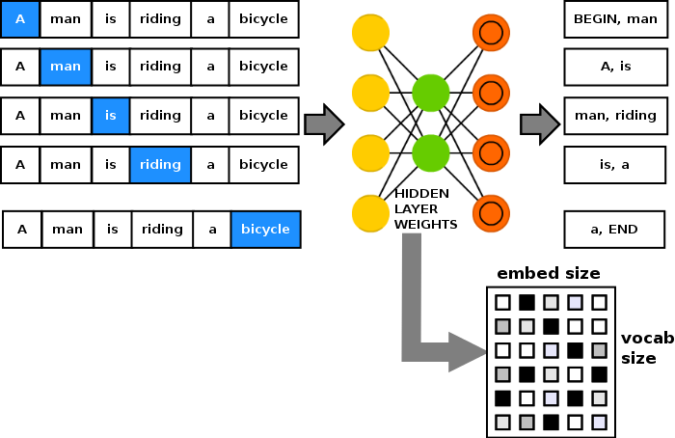
WORD EMBEDDINGS
Word2Vec – predict word from context (CBOW) or context from word (skip-gram) shown here.
Trained on large corpora and publicly available.
Other embeddings – GloVe, FastText.

Slide 7
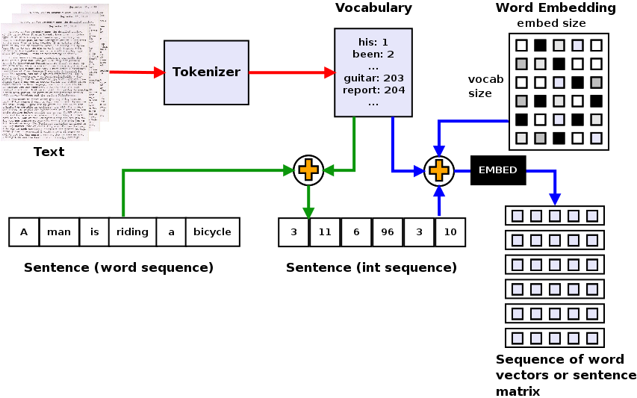
STEP #1: EMBED
Replace 1-hot vectors with 3rd party embeddings.
Embeddings encode distributional semantics
Sentence represented as sequence of dense word vectors
Converts from word ID to word vector

Slide 8
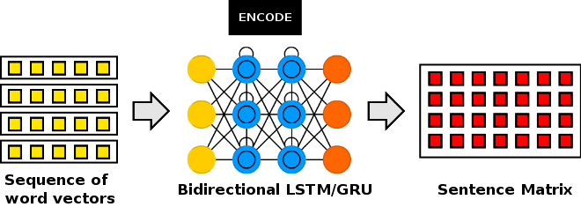
STEP #2: ENCODE
Bag of words – concatenate word vectors together.
Encode step computes a representation of the sentence as a matrix.
Each row of sentence matrix encodes the meaning of each word in the context of the sentence.
Use either LSTM (Long Short Term Memory) or GRU (Gated Recurrent Unit)
Bidirectional processes words left to right and right to left and concatenates.

Slide 9
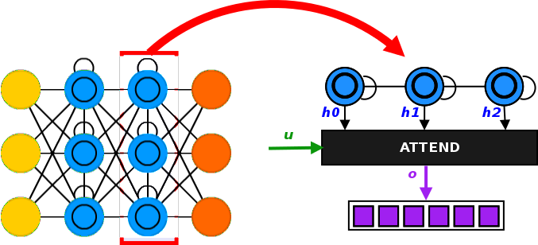
STEP #3: ATTEND
Reduction operation – could be Sum or Global Average/Max Pooling instead
Attention tells what to keep during reduction to minimize information loss.
Different kinds – matrix, matrix + context (learned), matrix + vector (provided), matrix + matrix.

Slide 10

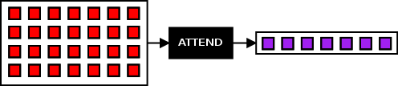

ATTENTION: MATRIX
Proposed by Raffel, et al
Intuition: select most important element from each timestep
Learnable weights W and b depending on target.
Code on Github

Slide 11

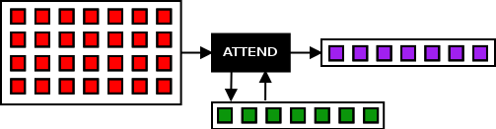
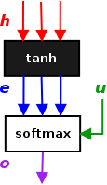
ATTENTION: MATRIX + VECTOR (LEARNED)
Proposed by Lin, et al
Intuition: select most important element from each timestep and weight with another learned vector u.
Code on Github

Slide 12

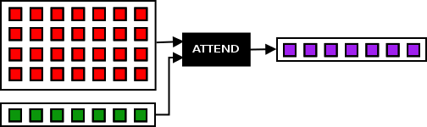
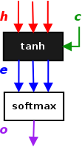
ATTENTION: MATRIX + VECTOR (PROVIDED)
Proposed by Cho, et al
Intuition: select most important element from each timestep and weight it with a learned multiple of a provided context vector
Code on Github

Slide 13
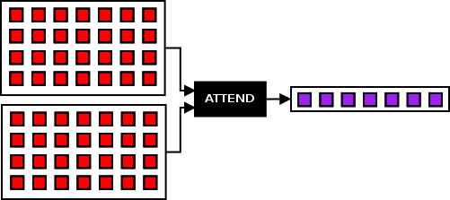
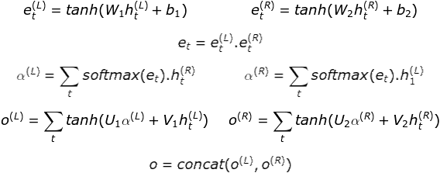
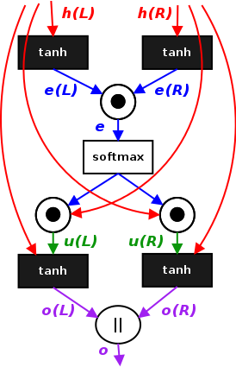
ATTENTION: MATRIX + MATRIX
Proposed by Parikh, et al
Intuition: build alignment (similarity) matrix by multiplying learned vectors from each matrix, compute context vectors from the alignment matrix, and mix with original signal.
Code on Github

Slide 14
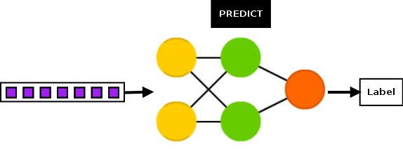
STEP #4: PREDICT
Convert reduced vector to a label.
Generally uses shallow fully connected networks such as the one shown.
Can also be modified to have a regression head (return the probabilities from the softmax activation.

Slide 15
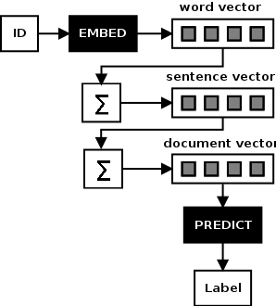
DOCUMENT CLASSIFICATION EXAMPLE – ITERATION #1
20 newsgroups dataset
40k training records
10k test records
20 classes
Embed, Predict
Bag of Words idea
Sentence = bag of words
Document = bag of sentences
Code on Github

Slide 16
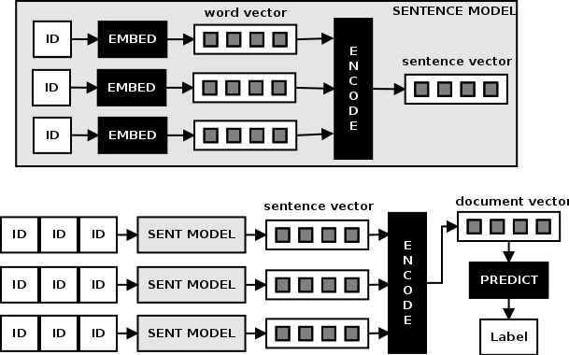
DOCUMENT CLASSIFICATION EXAMPLE – ITERATION #2
Embed, Encode, Predict
Hierarchical Encoding
Sentence Encoder: converts sequence of word vectors to sentence vector.
Document Encoder: converts sequence of sentence vectors to document vector.
Sentence encoder Network embedded inside Document network.
Code on Github

Slide 17
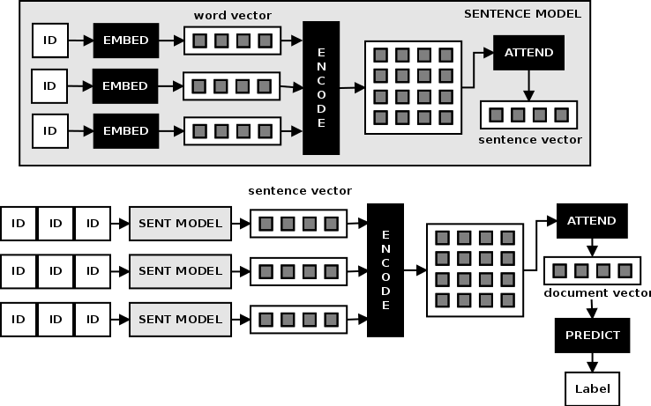
DOCUMENT CLASSIFICATION EXAMPLE – ITERATION #3 (a, b, c)
Embed, Encode, Attend, Predict
Encode step returns matrix, vector for each time step.
Attend reduces matrix to vector.
3 types of attention (all except Matrix Matrix) applied to different versions of model.
Code on Github – (a), (b), (c)

Slide 18
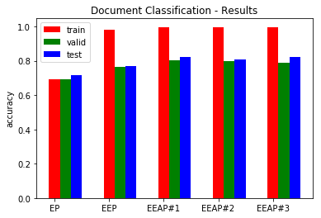
DOCUMENT CLASSIFICATION EXAMPLE – RESULTS

Slide 19
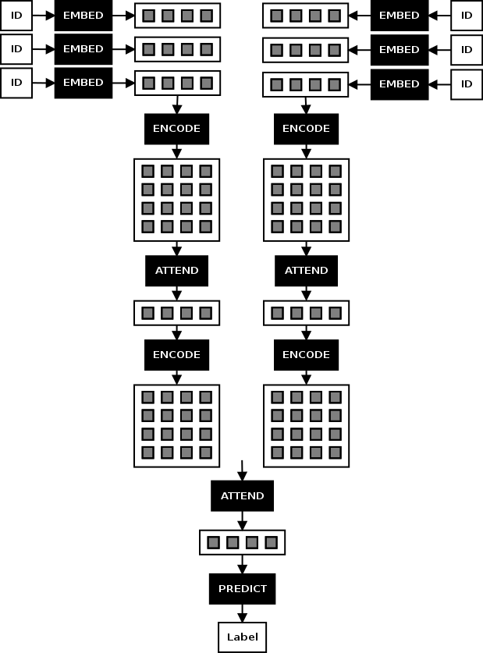
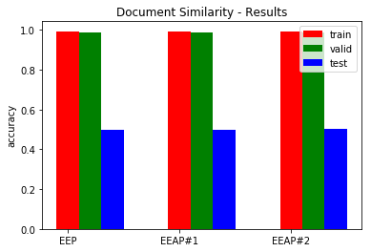
DOCUMENT SIMILARITY EXAMPLE
Data derived from 20 newsgroups
Hierarchical Model (Word to Sentence and sentence to document)
Tried w/o Attention, Attention for sentence encoding, and attention for both sentence encoding and document compare
Code in Github – (a), (b), (c)

Slide 20
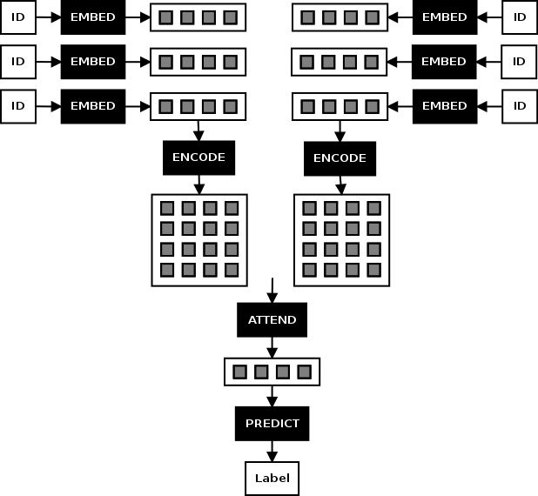
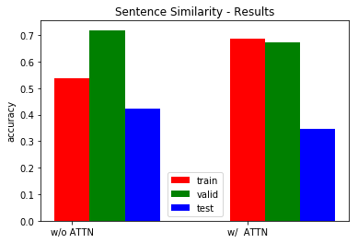
SENTENCE SIMILARITY EXAMPLE
2012 Semantic Similarity Task dataset.
Hierarchical Model (Word to Sentence and sentence to document).
Used Matrix Matrix Attention for comparison
Code in Github – without attention, with attention

Slide 21
SUMMARY
4-step recipe is a principled approach to NLP with Deep Learning
Embed step leverages availability of many pre-trained embeddings.
Encode step generally uses Bidirectional LSTM to create position sensitive features, possible to use CNN here also.
Attention of 3 main types – matrix to vector, with or without implicit context, matrix and vector to vector, and matrix and matrix to vector. Computes summary with respect to input or context if provided.
Predict step converts vector to probability distribution via softmax, usually with a Fully Connected (Dense) network.
Interesting pipelines can be composed using complete or partial subsequences of the 4 step recipe.

Slide 22
REFERENCES
Honnibal, M. (2016, November 10). Embed, encode, attend, predict: The new deep learning formula for state-of-the-art NLP models.
Liao, R. (2016, December 26). Text Classification, Part 3 – Hierarchical attention network.
Leonardblier, P. (2016, January 20). Attention Mechanism
Raffel, C., & Ellis, D. P. (2015). Feed-forward networks with attention can solve some long-term memory problems. arXiv preprint arXiv:1512.08756.
Yang, Z., et al. (2016). Hierarchical attention networks for document classification. In Proceedings of NAACL-HLT (pp. 1480-1489).
Cho, K., et al. (2015). Describing multimedia content using attention-based encoder-decoder networks. IEEE Transactions on Multimedia, 17(11), 1875-1886.
Parikh, A. P., et al. (2016). A decomposable attention model for natural language inference. arXiv preprint arXiv:1606.01933.

Slide 23
THANK YOU
Code: https://github.com/sujitpal/eeap-examples
Slides: https://www.slideshare.net/sujitpal/presentation-slides-77511261
Email: sujit.pal@elsevier.com

