Slide 1

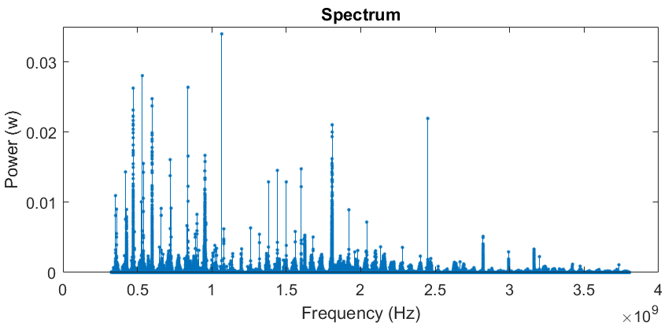
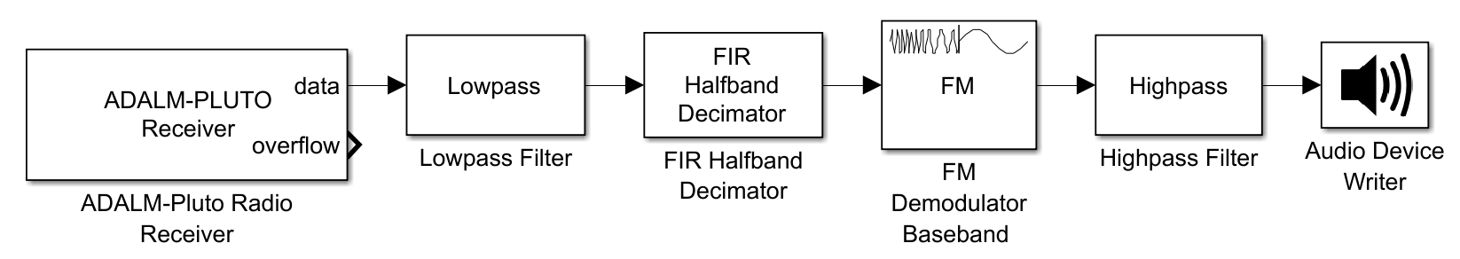
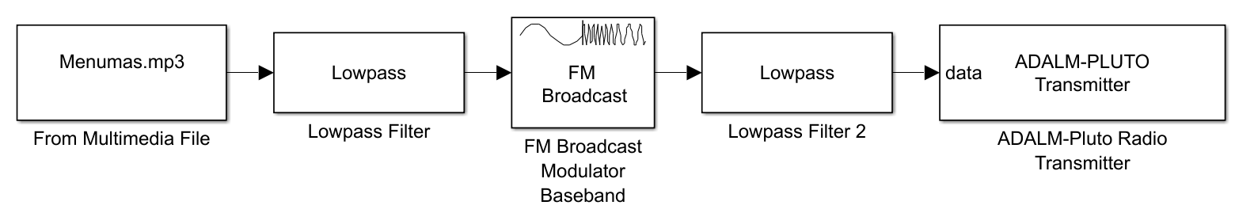
EEE-B-5
Electrical and Electronics Engineering
Students: Alon Talgouker
Itay Matzri
Advisor: Mr. Amit Twik
Mobile Electronic Warfare System
Introduction:
Full Range Scan:
Communication systems are essential for operational success.
The enemy uses tactical radio networks to gain battlefield advantage.
The transmissions are difficult to detect, monitor, or disrupt.
An SDR-based system has been developed to counter this threat.
The system targets common tactical radios in operational environments.
Goals:
Exp for Rx/Tx:
Understanding communication in walkie-talkie systems.
Deepening knowledge of SDR devices and how to use them.
Receiving signals through the SDR.
Transmitting data/noise on the identified frequencies.
Thorough investigation of scenarios and drawing conclusions from the experiments conducted.
The overarching goal of the project is to build a system for combating mobile communication systems.

Slide 2


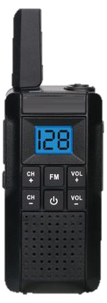
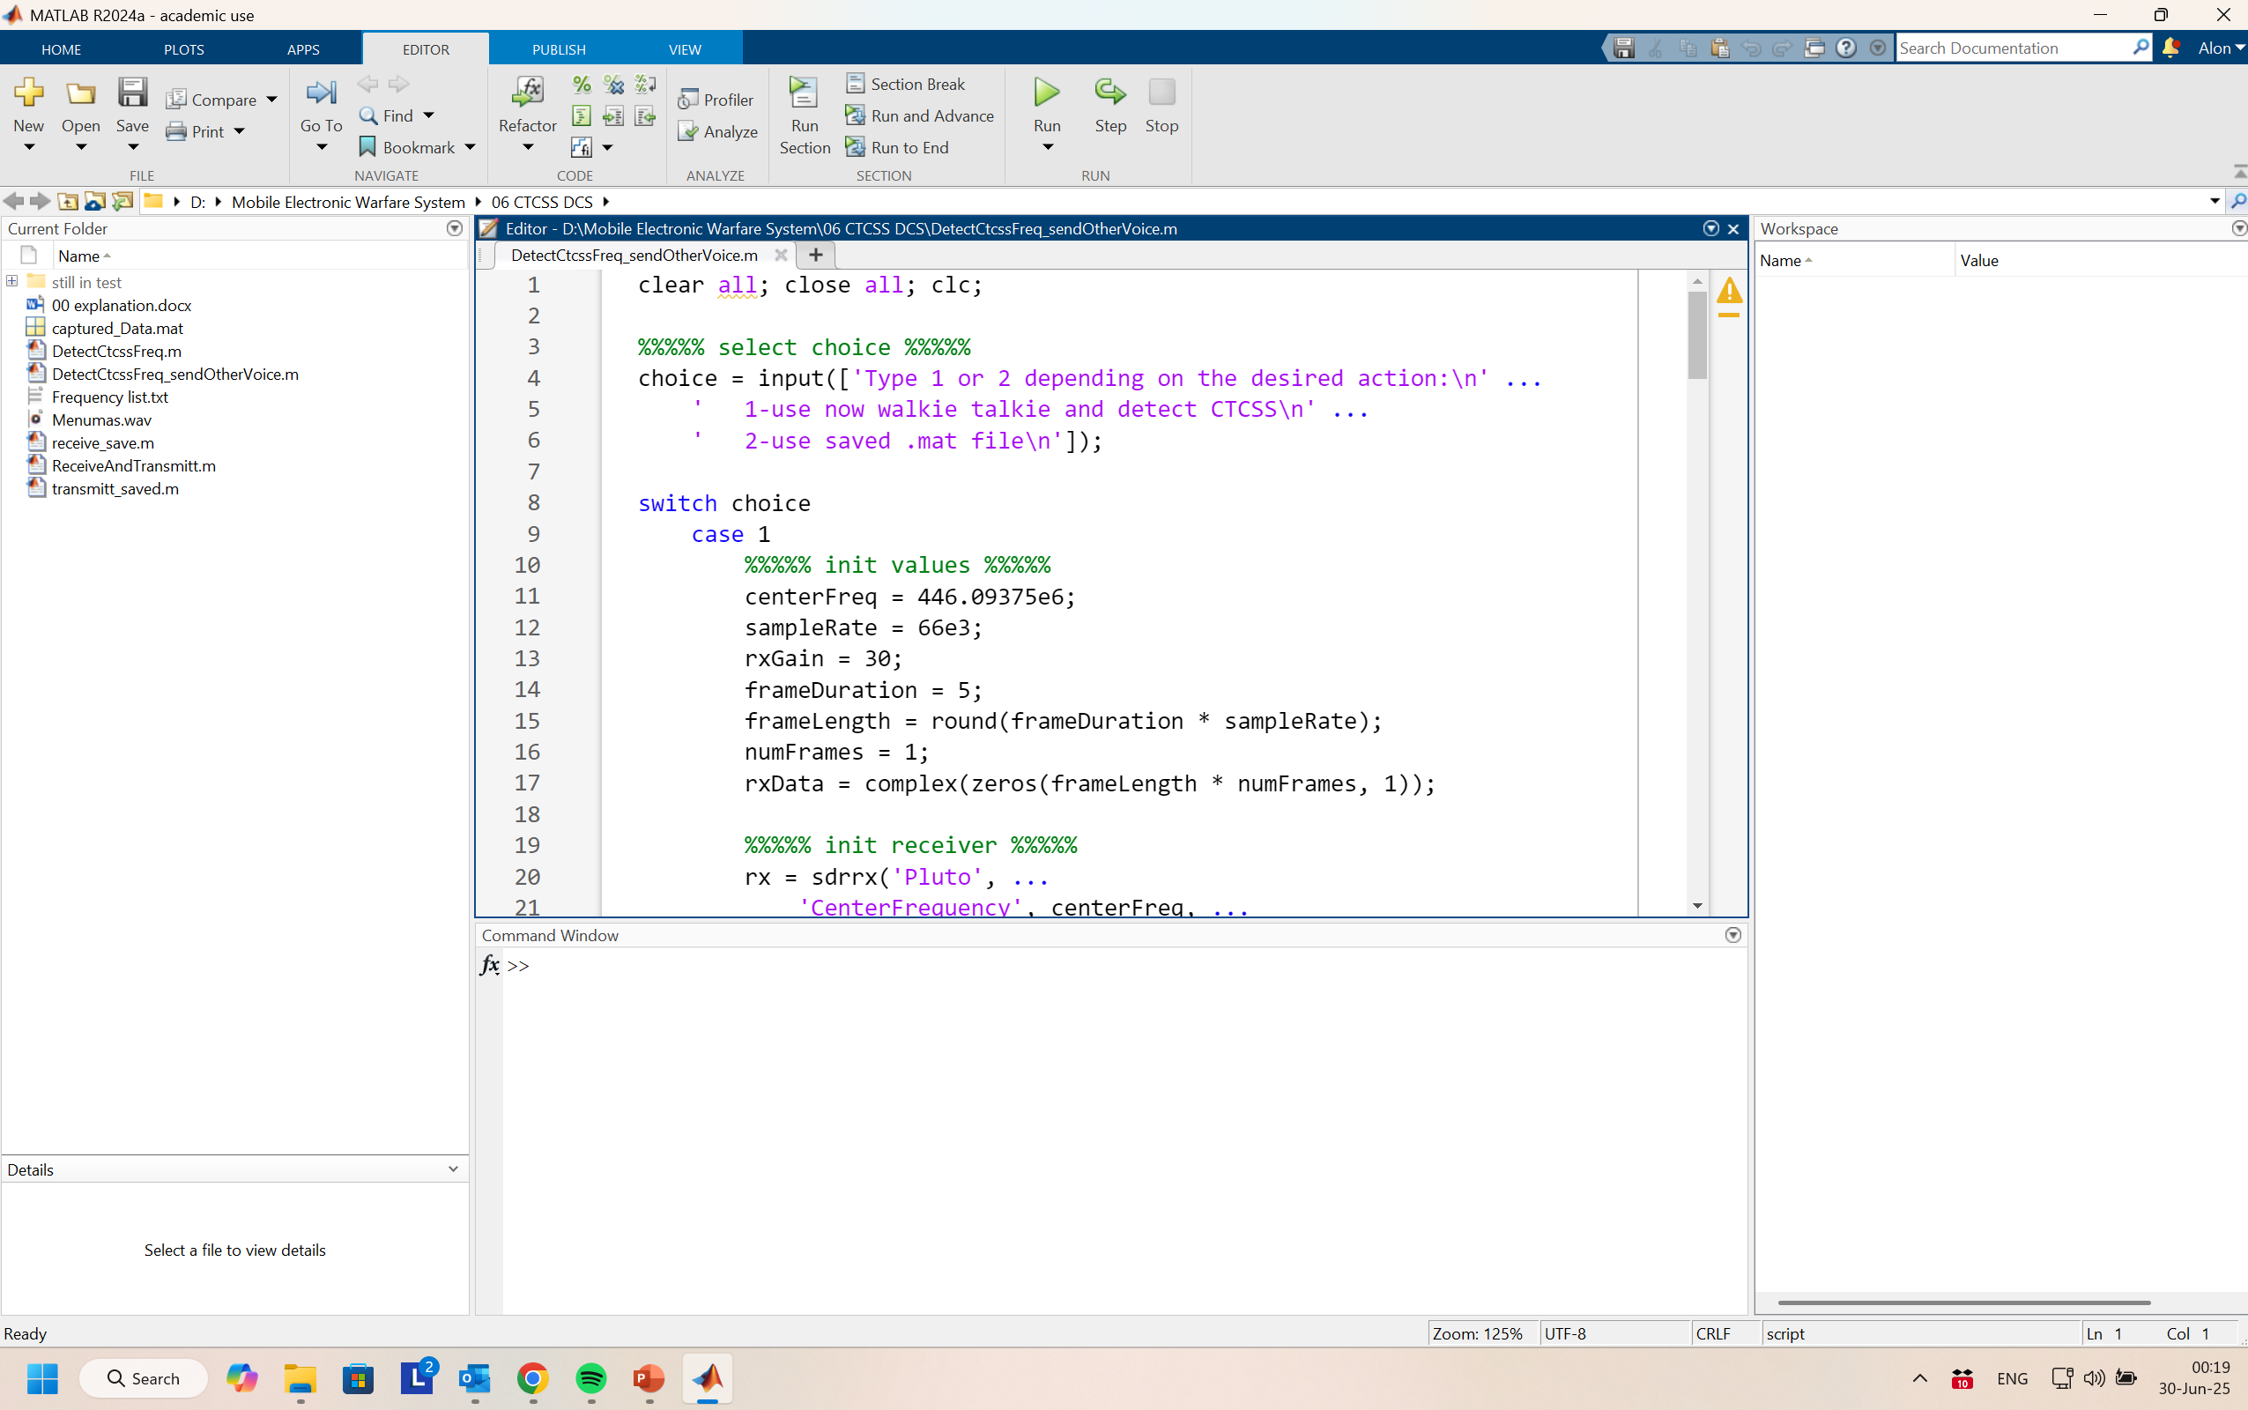
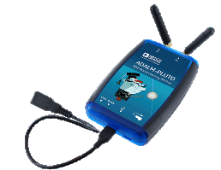
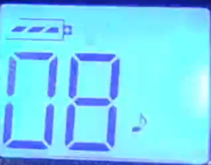




EEE-B-5
Electrical and Electronics Engineering
Students: Alon Talgouker
Itay Matzri
Advisor: Mr. Amit Twik
Mobile Electronic Warfare System
Continuous noise/audio transmission
Walkie talkie received
Continuous noise/audio
The two-way radio is encrypted or assigned to a channel with a room
Record-
[ REC]
Transmission of noise/signal in short time pulses
Walkie talkie received
noise/audio in short time pulses
Transmit the Recorded signal-
Play both sounds together
Or the “stronger” Voice
Transmission Voice from 2 SDR

Slide 3

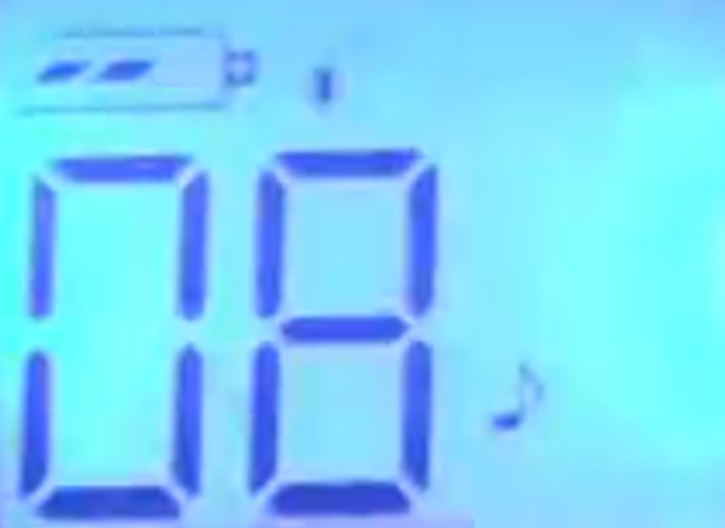
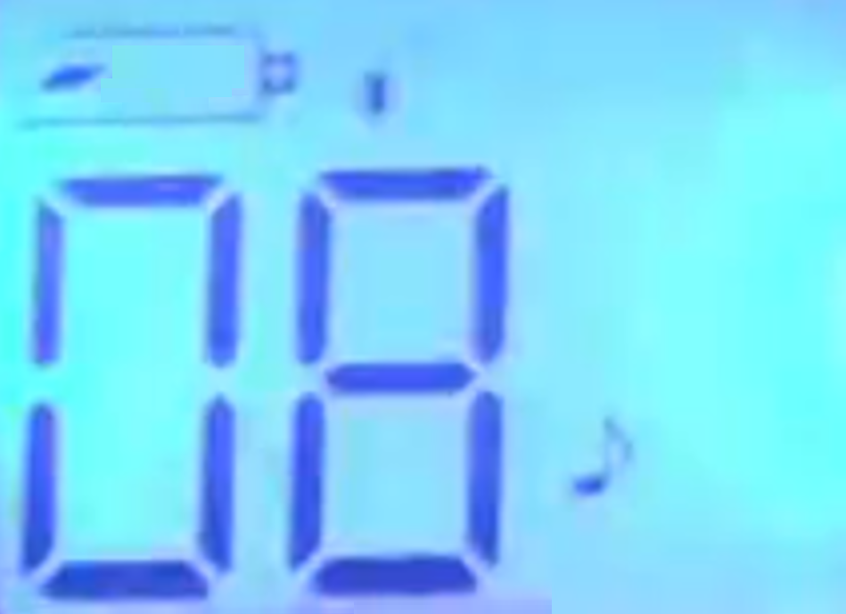
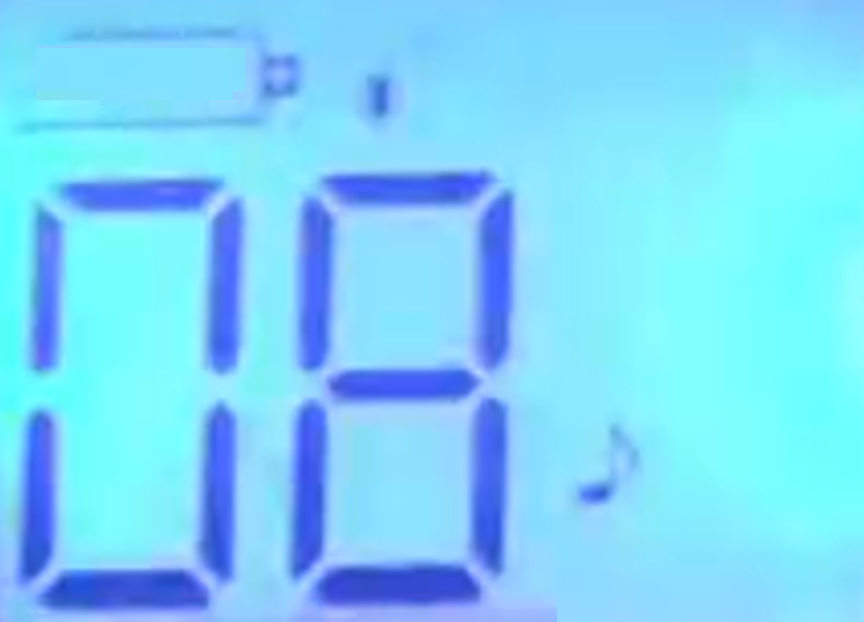

EEE-B-5
Electrical and Electronics Engineering
Students: Alon Talgouker
Itay Matzri
Advisor: Mr. Amit Twik
Mobile Electronic Warfare System
Results:
Conclusion:
Integrating the ADALM-Pluto with MATLAB provides an efficient and user-friendly platform.
The walkie-talkie showed accelerated battery drain, failing sooner than its expected 18-hour runtime.
Despite its low 5mW power, the SDR caused loud and clicks noises in the Walkie-Talkie.
The experiment proves SDR tools can impact communication devices, though effectiveness depends on factors like power, multiple channel use, and target device quality.
Constant noise
00:00
04:40
09:20
11:00
12:40
Noise in pulse time
00:00
04:35
09:00
10:40
12:20
Noise diff F(Hz) same CH
00:00
04:35
09:00
10:40
12:20
Voice pulse time (W-T coded)
00:00
07:40
---
---
---
Voice in pulse time
00:00
03:20
07:10
08:45
10:20
Send Voice in Parallel =
Listen both together / The stronger voice
The next generation of tactical electronic warfare - combining technological power with engineering precision.
Walkie talkie played the recorded voice with CTCSS DCS codes

