Slide 1
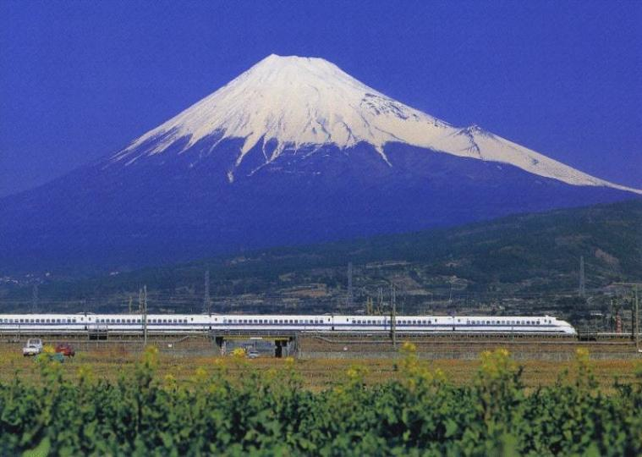

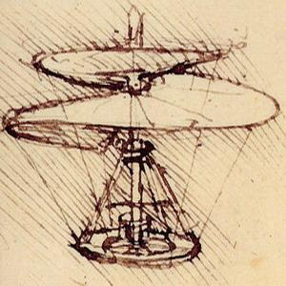
Sweeping a Terrain by Collaborative Aerial Vehicles
Alon Efrat U Arizona, USA
Mikko Nikkilä Helsinki Institute for IT
Valentin Polishchuk U Helsinki, Finland
Micha Sharir Tel-Aviv University.

Slide 2
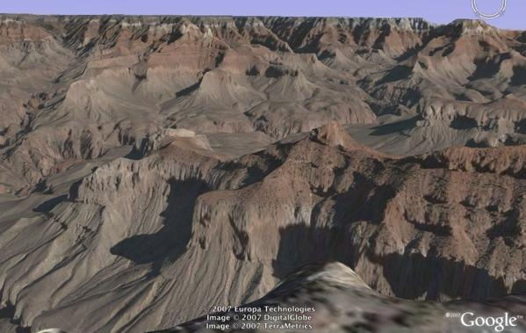
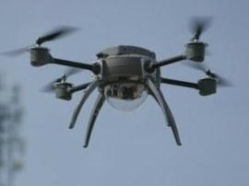
Typical Scenario
Child is lost in a hilly terrain
Group of searchers is formed
walkers?
terrain is hard to access by foot...
slow
manpower
helicopters?
expensive
noisy
manpower
UAVs (Unmanned Aerial Vehicles)!
modern flight technologies
navigation, communication
2

Slide 3
Challenges
Visibility is limited by terrain features
cannot see through a mountain
Child may move to avoid being found
Need strategy to determine and synchronize UAVs motion to utilize resources efficiency:
Elevations
Number of UAV
Time before re-fueling
Quality of visibility
Robustness visibility

Slide 4
Related Scenarios
Search after an Alzheimer patient, escaping inmate, hostile forces, etc.
Common themes to all problems
the person might (intentionally or accidentally) use his mobility to avoid being found
trajectories of the UAVs should take this into account
terrain need to be swept (to be defined formally later)
In this talk:
Addressing the synchronized path planning problem of the UAVs,
Understanding the underlying combinatorial structure

Slide 5

Previous results
Our work is tangential to many previous results. A very non-conclusive list:
Polygon Sweeping
[Guibas et al][Efrat et al] (computational geometry, robotics)
Opt Guards Location in terrains
[Franklin et al] (mostly in GIS community)
Path planning for swarms of robots
Multiple Surveillance Cameras coordination
Experimental platform for field tests in Alps
[Doherty et al ]
Yamaha rmax with laser and high-res camera

Slide 6
Model: (Triangulated) Terrain
Specified by:
A triangulation of the “floor” (xy-plane) of the terrain.
h vertex
Piecewise-linear interpolation
Triangles Sizes not uniform

Slide 7
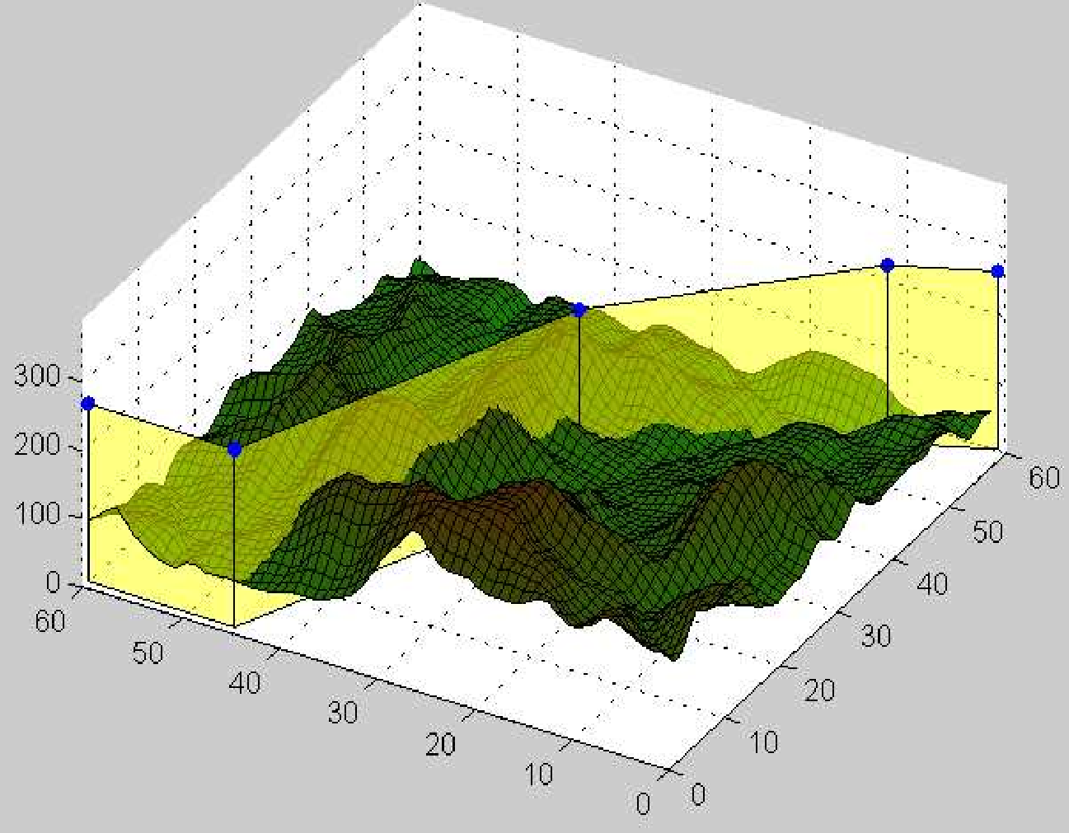
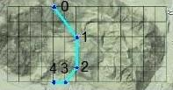
Efrat et al ACM GIS’12
This work prelim presented at ACM GIS 2013
Minmize total fuel consumption
given # of guards
|g₁g₂| ≤ 2 grid units
uniformly over terrain
Heuristic
High memory cost
16 x 16 grid
Top view
Min # of guards
Feasibility
Interesting combinatorial structure (we are not objective)
|g₁g₂| unrestricted
conforms to terrain
Exact solutions

Slide 8
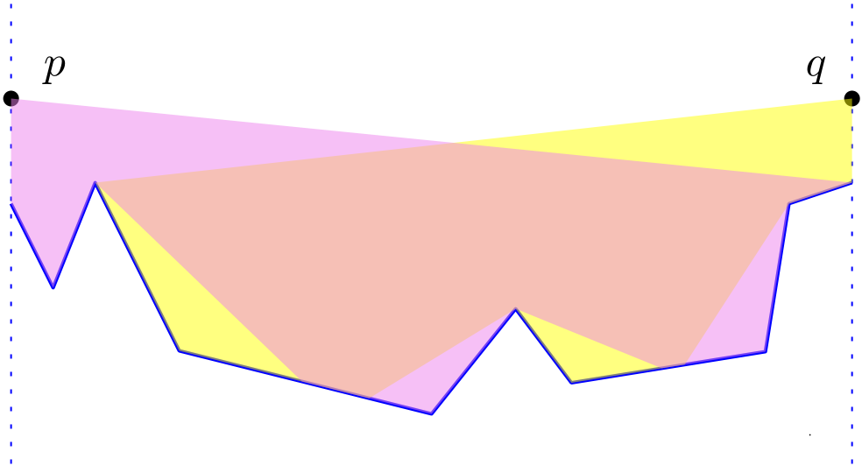
Model: Curtains and Two-Sides Visibility
Given: A terrain T=T(x,y), and two positions of UAV (guards) p,q
Def: h_{pq,} the cross section plane – plane containing p and q, and vertical to the xy-plane.
Def: The infinite slab of which is the region of h_{pq} between the lines passing through p,q and parallel to the z-axis is the curtain C_{pq}
Def: C_{pq} is a proper curtain if every point of is seen by p or q (or both).
p
q

Slide 9
When is edge seen (collectively by 2 guards)?
p
q

Slide 10
Non-proper curtain

Slide 11
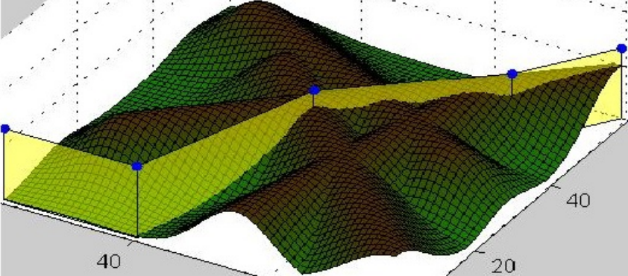
Model: Feasibility of curtains
Def: Chain of guards is feasible
IFF
consecutive guards along
the chain define proper curtains.
The chain partitions the terrain into ≥ 2 portions.
The target could not move from one portion to another w/o being observed

Slide 12
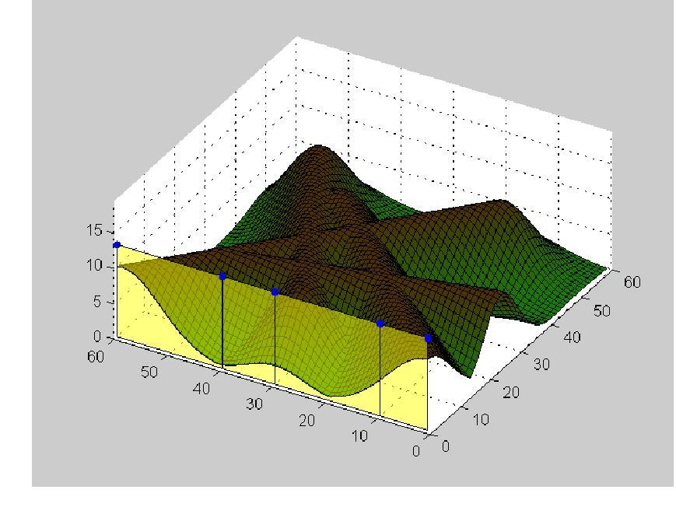
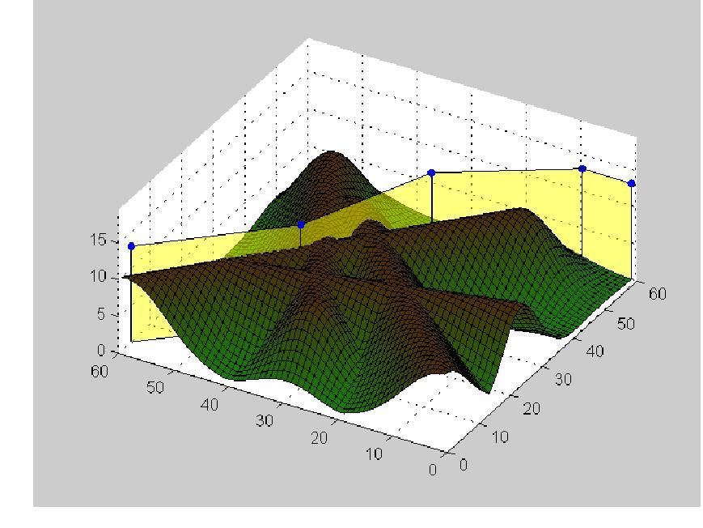
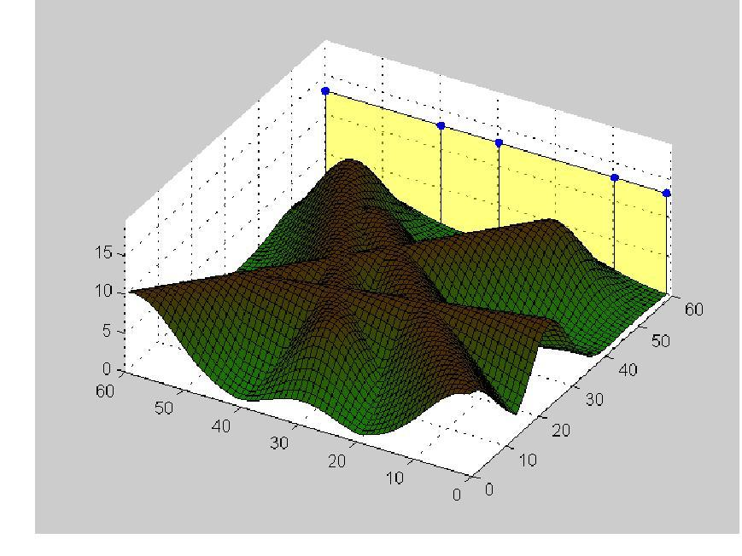
Model: Sweeping
Invariant: Area left of the chain is clean
Area right of the chain is contaminated

Slide 13
Problem versions
UAVs capabilities:
coordination
path control
altitude control
speed control
Are guards’ tracks given?
straight lines
polygonal
arbitrary
Is the number of guards given?
Or are we minimizing it?

Slide 14
Problem statement
Given a terrain, and a height (elevation) h above the see level
Coordinate motion of guards
So as to sweep the terrain with min number of guards.

Slide 15
Brief explanation
Full coordination
Guards on given tracks
each track: a segment from left to right
Arbitrary tracks:
straightforward extension
math more complex

Slide 16
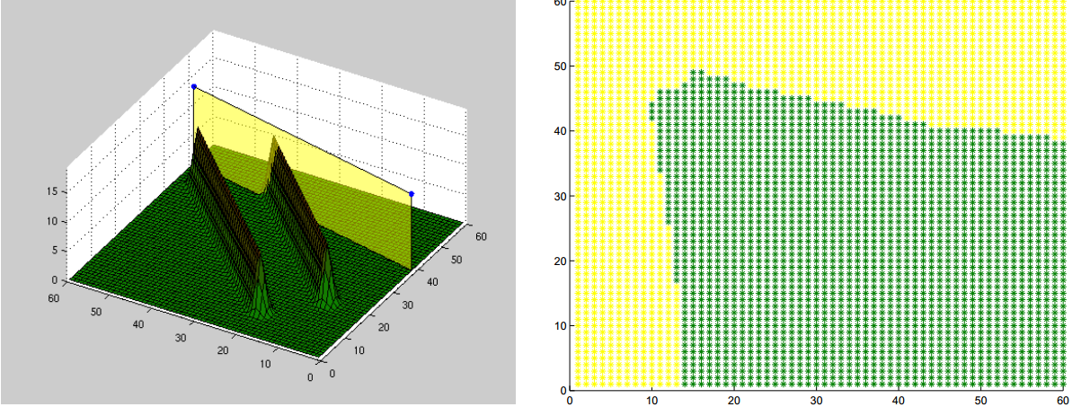
2 guards: Main idea: Free Space Diagram (FSD)
guards positions -> a point in the (x,y)-plane
Point is yellow if the corresponding guards locations define a proper curtain.
Else point is green
Find path from LL corner to UR corner.

Slide 17
Concatenation
Generate the FSD of guards p₁p₂
Generate the FSD of guards p₂p₃
“Glue” them – provides the coordination between 3 guards
Etc for more guards

Slide 18
The FSP has O(n^{4+ε}) cells (and A La Euler, same number of edges, vertices) Could be built in this time (divide and concur)
Key Theorem

Slide 19
Implementation
60x60 grid
3 options for input terrain:
Given terrain
Terrain generator:
segments -> walls -> Gaussian smoothing
Grayscale image -> terrain
inspired by Minecraft players :)
http://www.minecraftforum.net/topic/992750-mapping-using-real-world-terrain-data/

Slide 20
Software
Java code to coordinate motion
MATLAB to visualize
Code is free
http://www.cs.helsinki.fi/group/compgeom/rescue.zip

Slide 21
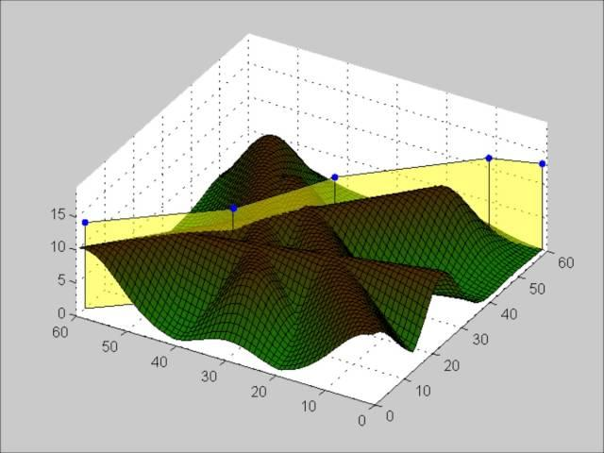
Output
Default terrain in our code

Slide 22
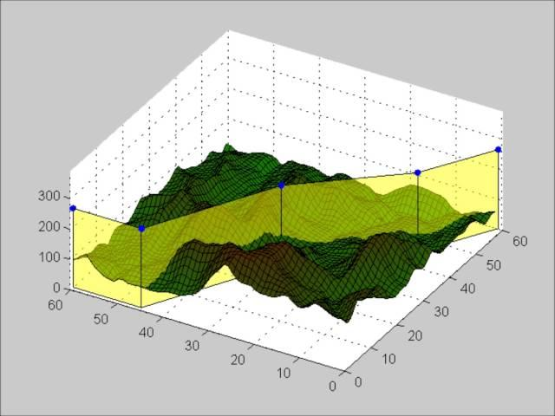
Output
Somewhere in Arizona (~ 36.1°N 112.1°W)

Slide 23
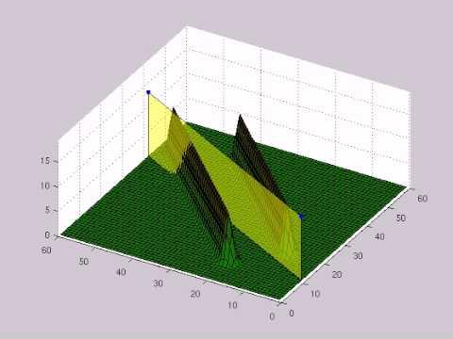
Output
Coordination

Slide 24
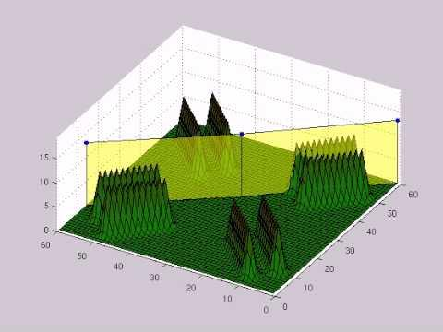
Output
Coordination!

Slide 25
Variant: Polygonal tracks
Free Space Diagram
guards positions -> (x,y)-plane

Slide 26
Variant: Minimize # of guards
Arbitrary tracks -- open Are “greedy” tracks polygonal?

Slide 27
Ingredients for the proof
Thm: The lower envelop of n functions f₁(x,y),… f_{n}(x,y) has complexity O(n^{2+ε})
The overlay of upper and lower envelops of n functions has complexity O(n^{2+ε})
In our setting, fix a terrain face f. Each terrain edge e_{i} casts a shadow, which is a function of two variables (guards locations)
The face is properly seen if the hidden portion is not “too large” – the lower envelop is below the upper envelope.
Iteate over all pairs of edges e_{i,} e_{j}

