Slide 1
Graph-Based Dependency Parsing

Slide 2
Dependency Structures
A dependency structure is a rooted tree over the words of a sentence
Nodes correspond to words
Edges represent head-dependent relations between the words
Verbs are heads of clauses, nouns are heads of noun phrases
Details vary across dependency schemes

Slide 3
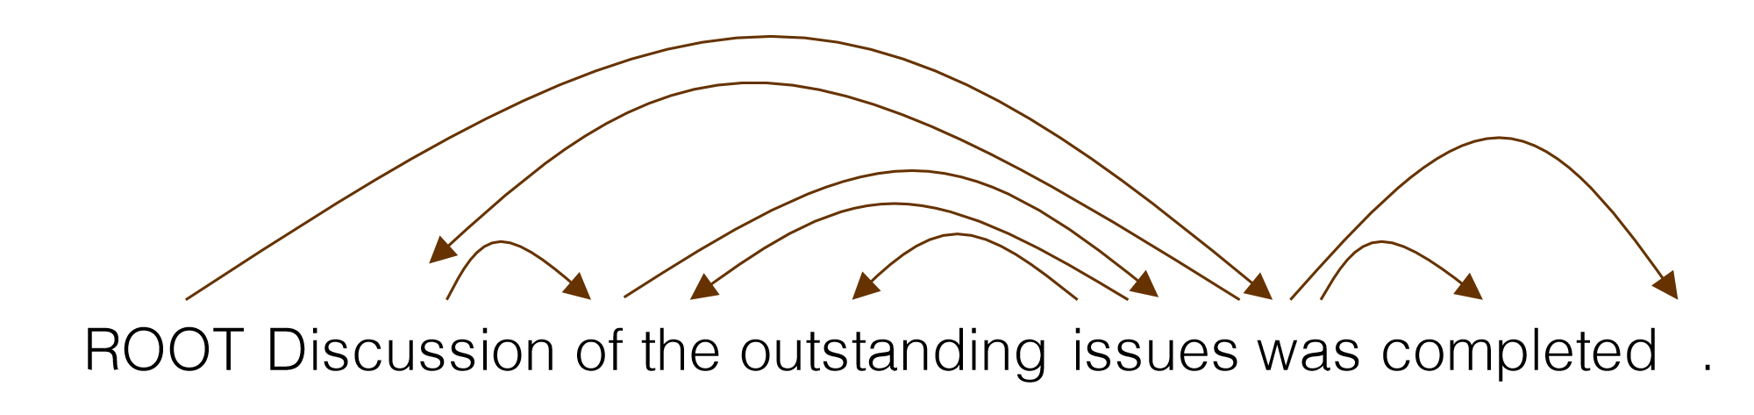
Dependency Parsing
What are the sources of information for dependency parsing?
Bi-lexical affinities
[issues → the] is plausible, [outstanding → the] is not
Dependency distance
mostly with nearby words
Intervening material: dependencies rarely span intervening verbs or punctuation
Valency – how many dependents on which side are usual for a head?

Slide 4
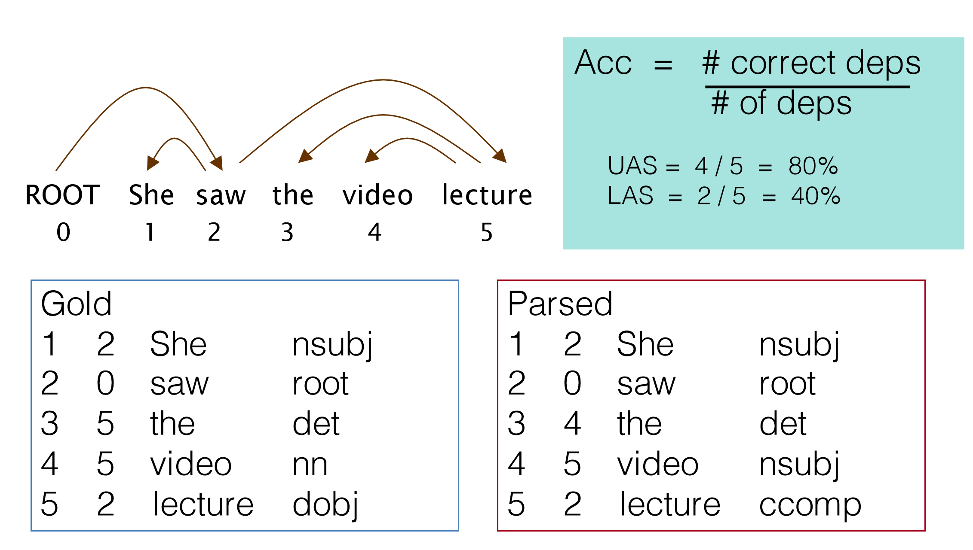
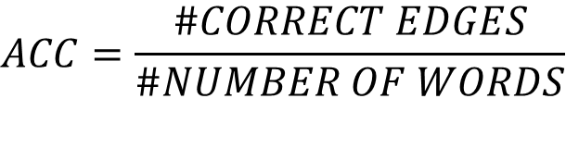
Dependency Parsing Evaluation
$$ACC=\frac{\#CORRECT EDGES}{\#NUMBER OF WORDS}$$
index head word edge label
index

Slide 5
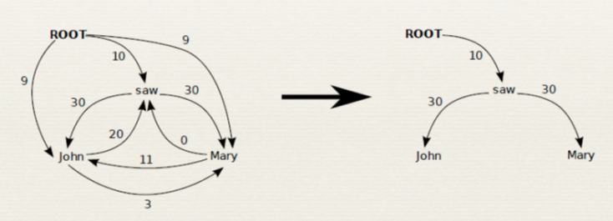
Graph-based Parsing
Graph-based parsing addresses it as a structured prediction problem
MST Parser:
Score the arcs independently, based on how likely they are to appear in a parse
Find the maximum directed spanning tree over the resulting weighted graph
Online Large-Margin Training of Dependency Parsers R. McDonald, K. Crammer, and F. Pereira, ACL 2005

Slide 6
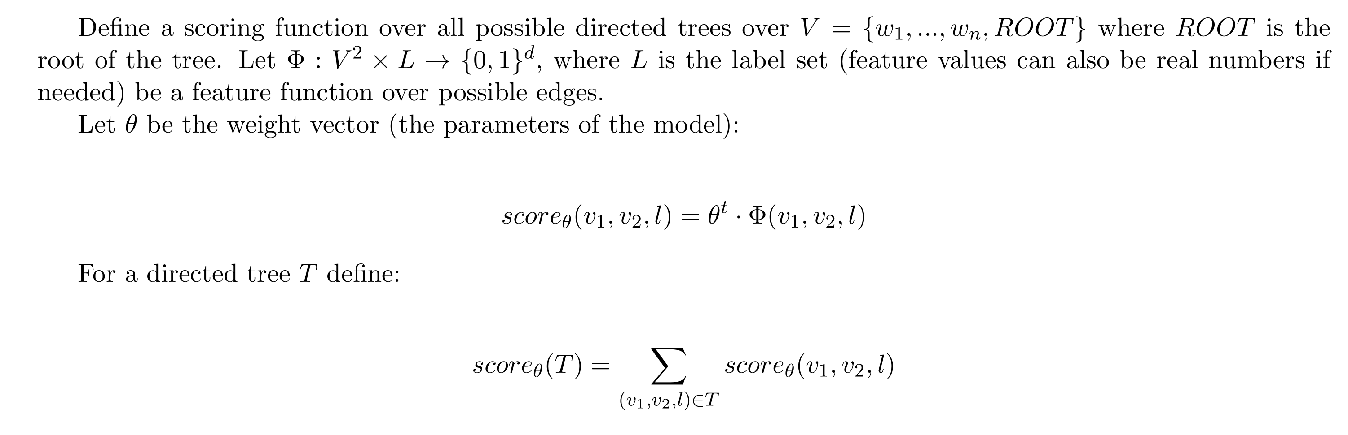
MST Parser

Slide 7
MST Parser
Binary Features

Slide 8
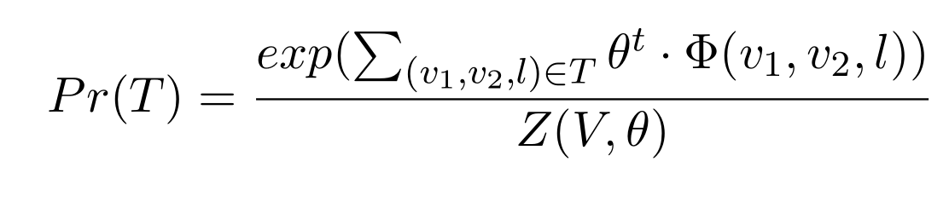
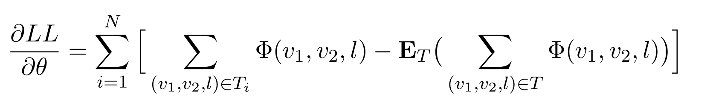
MST Parser: Inference and Learning
Note that inference is finding the maximum directed spanning tree
We can score each edge based on its features
This is done by the Chu-Liu Edmonds algorithm
It is possible to define this model as log-linear:
The gradient of the log-likelihood is given by:

Slide 9
MST Parser: Inference and Learning
It is possible to compute the second term exactly, but the algorithm is not simple
The Averaged Perceptron algorithm provides a simple and useful alternative, by replacing the expectation with a maximum →
Structured Prediction Models via the Matrix-Tree Theorem
Koo et al., 2007

Slide 10
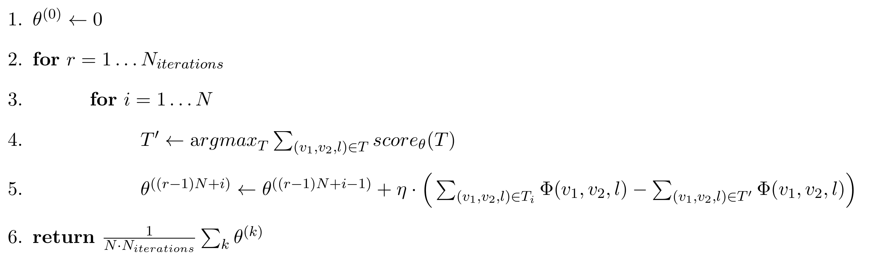
MST Parser: Inference and Learning
Learning Rate
Discriminative Training Methods for Hidden Markov Models: Theory and Experiments with Perceptron Algorithms
Collins, 2002

Slide 11
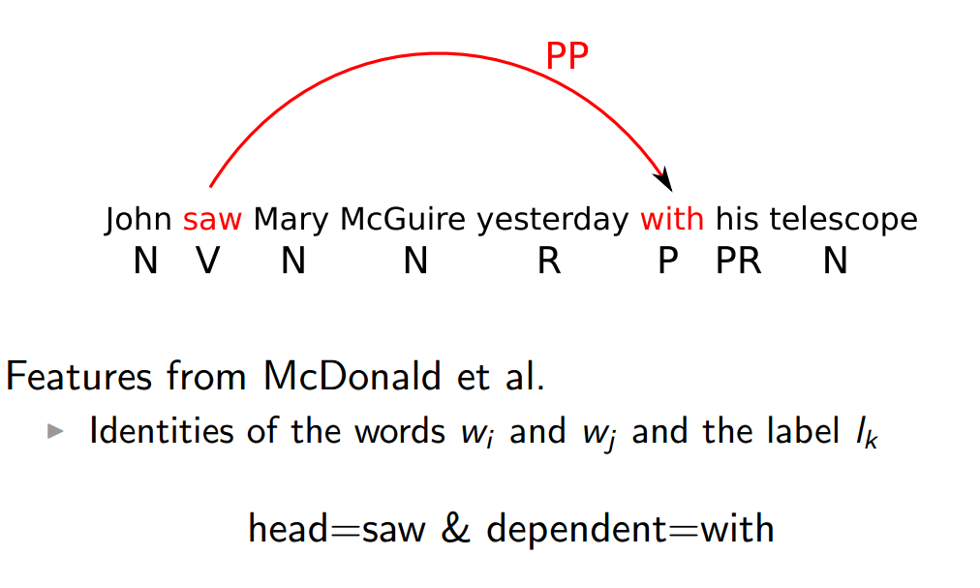
Features Used in Graph-based Dep Parsing

Slide 12
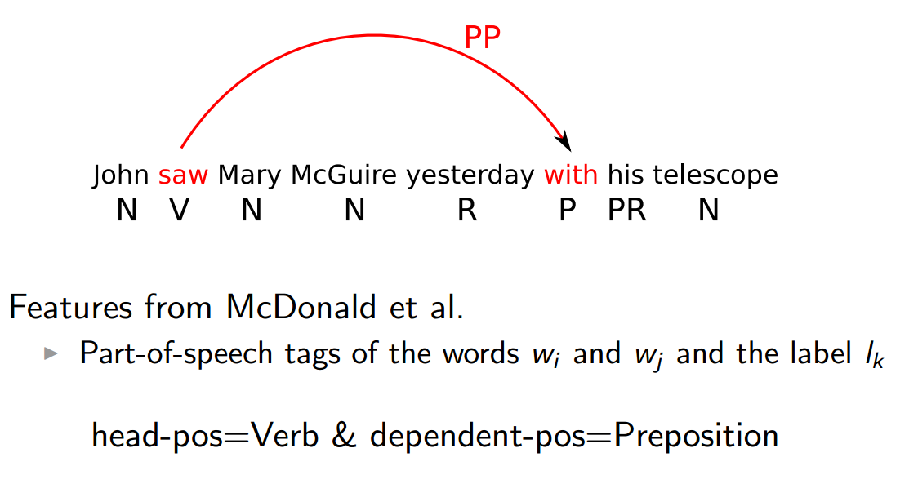
Features Used in Graph-based Dep Parsing

Slide 13
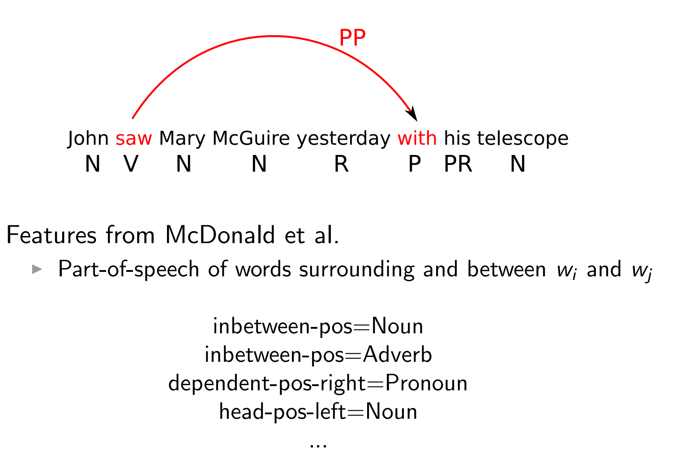
Features Used in Graph-based Dep Parsing
Again conjoined with the label
(omitted from now on for brevity)

Slide 14
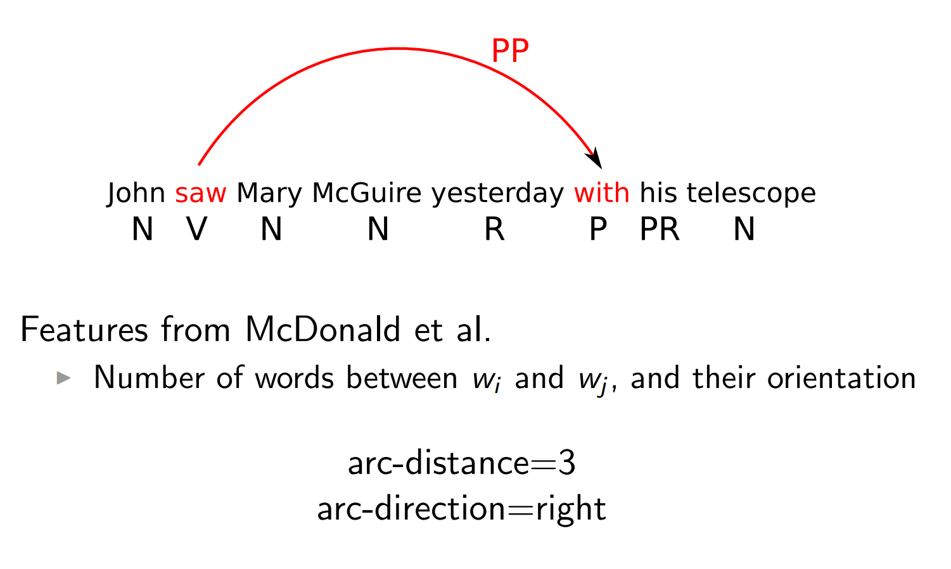
Features Used in Graph-based Dep Parsing

Slide 15
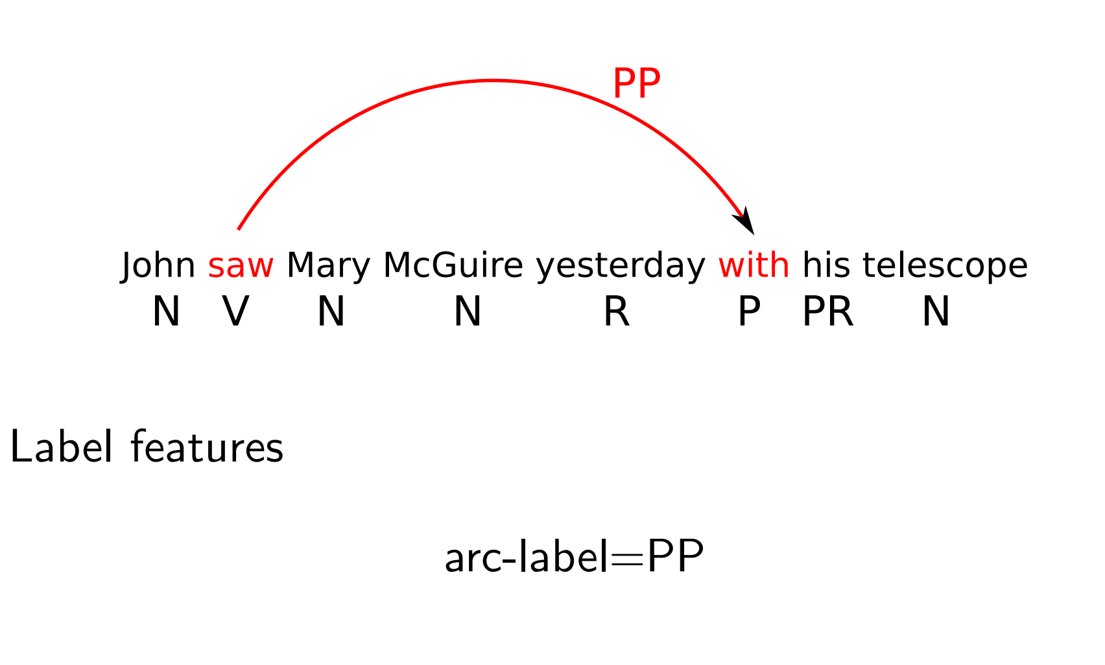
Features Used in Graph-based Dep Parsing
And Combinations of all these features…

