Slide 1
Planning in the Continuous Domain: a Generalized
Belief Space Approach for Autonomous Navigation in
Unknown Environments
Vadim Indelman, Luca Carlone , and Frank Dellaert
International Journal of Robotics Research - 2015
Dan and Alon

Slide 2
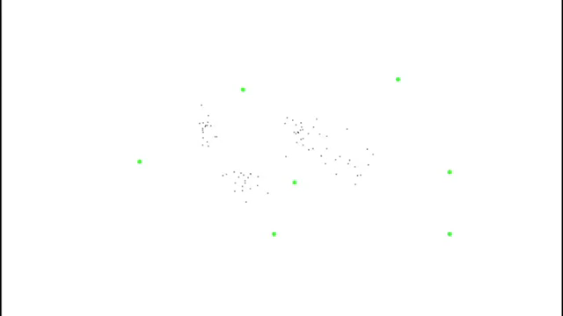
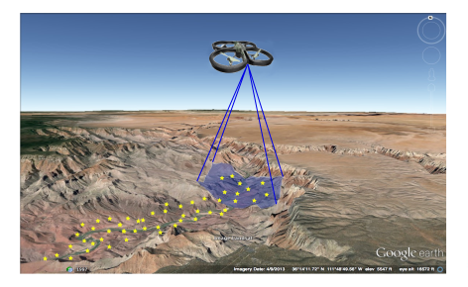

Slide 3
Mission
Reach goals without exceeding uncertainty level
Assumptions
Unknown Environments
Maximum Likelihood observations

Slide 4
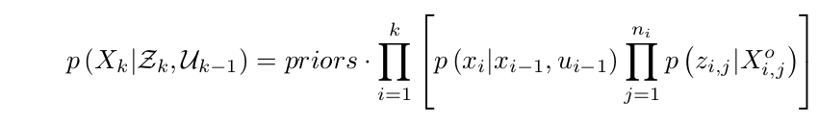
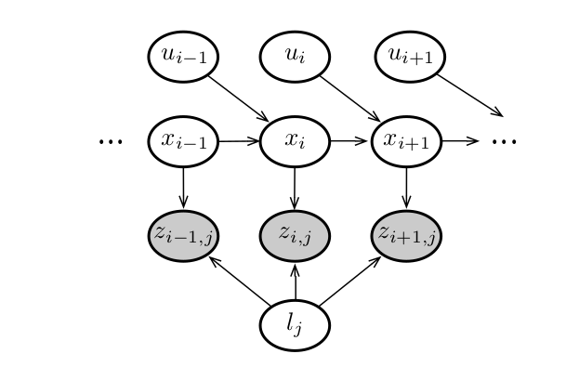


Slide 5
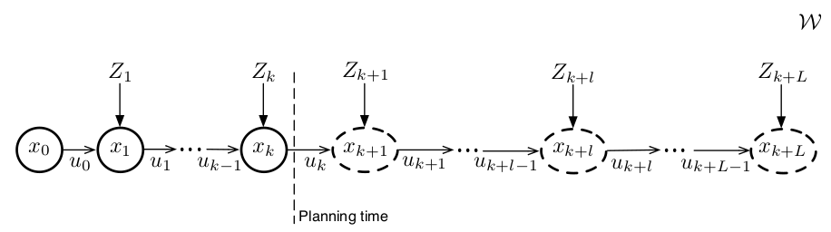
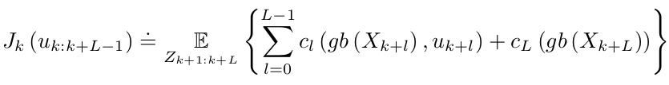


Slide 6
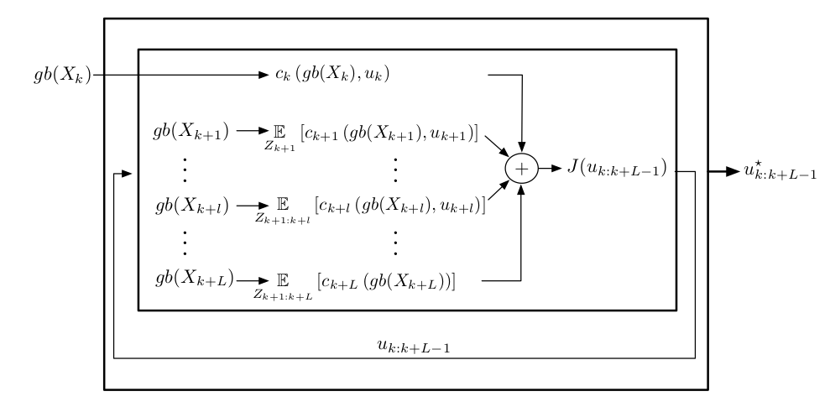



Slide 7
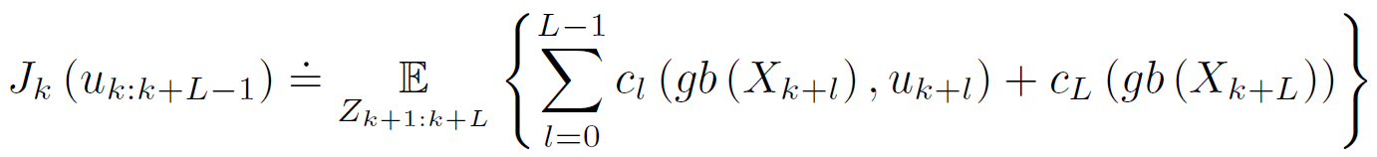


Planning in the GBS
At planning time $t_{k}$, the optimal control minimizes an objective
$J_{k}(u_{k:k+L−1}$) for $L$ look ahead steps:
reminder:
The objective involves $L$immediate cost functions $c_{l}$, one for each look-ahead step.
The subscript $k$ in $J_{k}$ to remark that the objective function depends on the generalized belief $gb(x_{k})$ at planning time $t_{k}.$

Slide 8


Planning in the GBS
We can see in the objective that the expectation is taken to account for all the possible observations during the planning lag. Since these are not given at planning time and are stochastic, each immediate cost function $c_{l}$ may involve ant subset of states $X_{k+l}^{c}⊆X_{k+l }.$
Therefore, the immediate cost $c_{l}$ can be written as:

