Slide 1
Planning in the Continuous Domain: a Generalized
Belief Space Approach for Autonomous Navigation in
Unknown Environments
Vadim Indelman, Luca Carlone , and Frank Dellaert
International Journal of Robotics Research - 2015
Dan and Alon

Slide 2
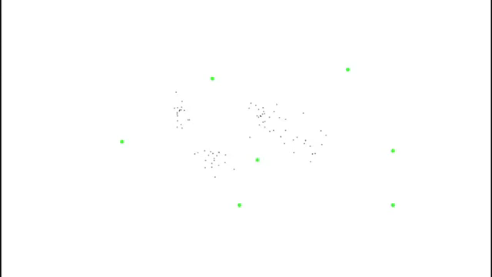
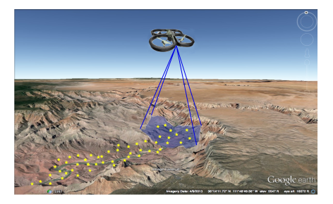

Slide 3
Mission
Reach goals without exceeding uncertainty level
Assumptions
Unknown Environments
Maximum Likelihood observations

Slide 4
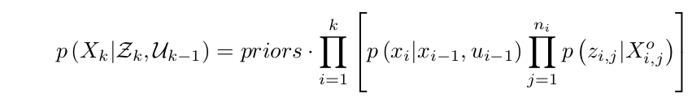
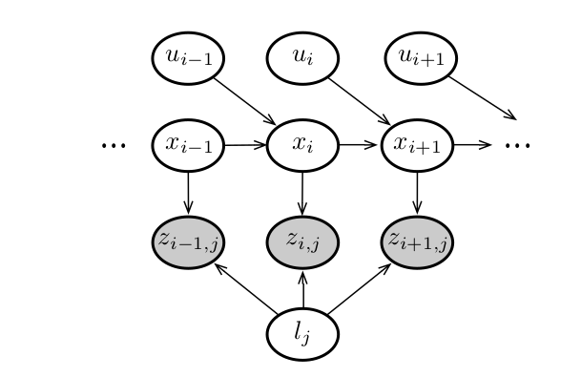


Slide 5
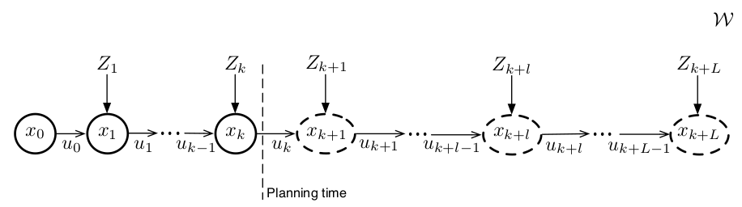
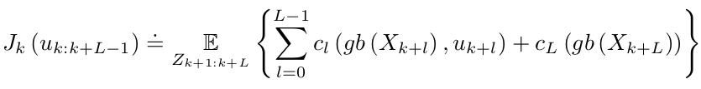


Slide 6
