Slide 1
Planning in the Continuous Domain: a Generalized
Belief Space Approach for Autonomous Navigation in
Unknown Environments
Vadim Indelman, Luca Carlone , and Frank Dellaert
International Journal of Robotics Research - 2015
Dan and Alon

Slide 2
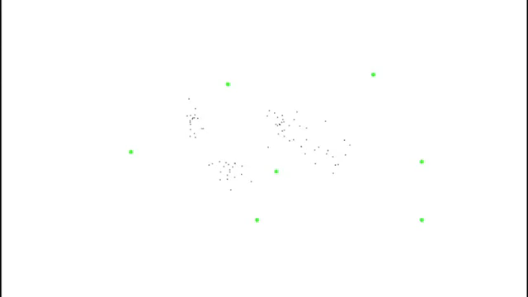
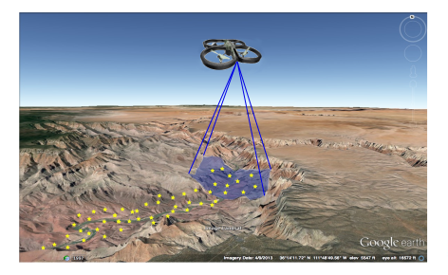

Slide 3
Mission
Reach goals without exceeding uncertainty level
Assumptions
Unknown Environments
Maximum Likelihood observations

Slide 4
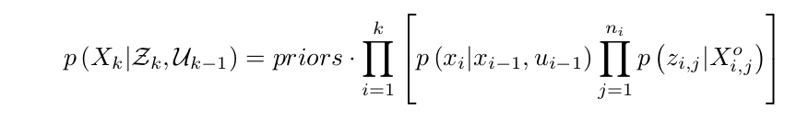
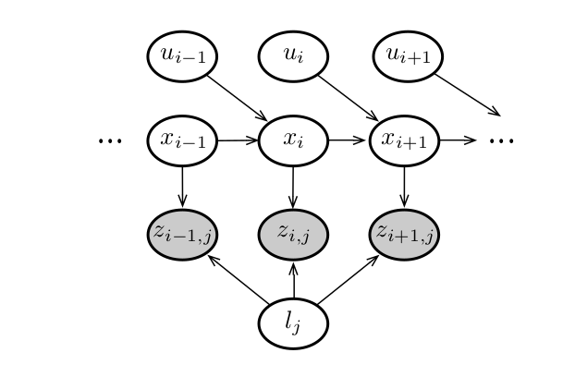


Slide 5
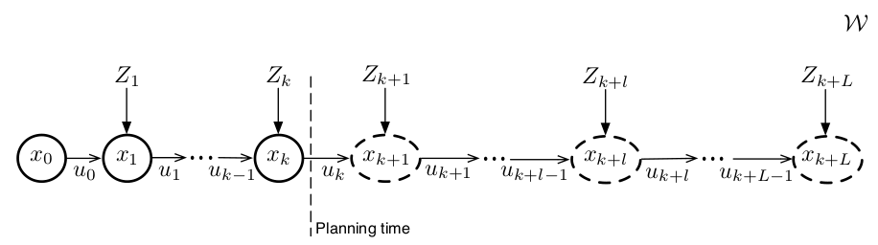
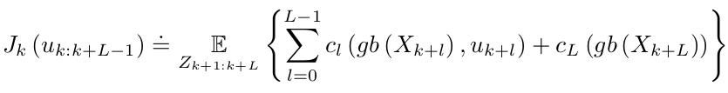


Slide 6
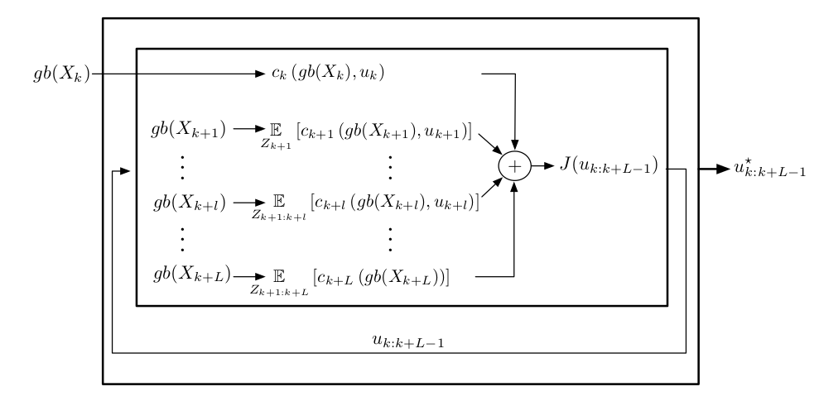



Slide 7
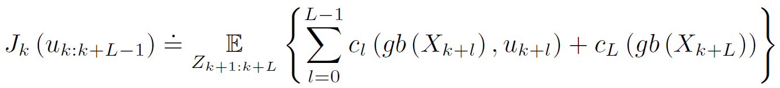


Planning in the GBS
At planning time $t_{k}$, the optimal control minimizes an objective
$J_{k}(u_{k:k+L−1}$) for $L$ look ahead steps:
reminder:
The objective involves $L$immediate cost functions $c_{l}$, one for each look-ahead step.
The subscript $k$ in $J_{k}$ to remark that the objective function depends on the generalized belief $gb(x_{k})$ at planning time $t_{k}.$

Slide 8


Planning in the GBS
We can see in the objective that the expectation is taken to account for all the possible observations during the planning lag. Since these are not given at planning time and are stochastic, each immediate cost function $c_{l}$ may involve ant subset of states $X_{k+l}^{c}⊆X_{k+l }.$
Therefore, the immediate cost $c_{l}$ can be written as:

Slide 9
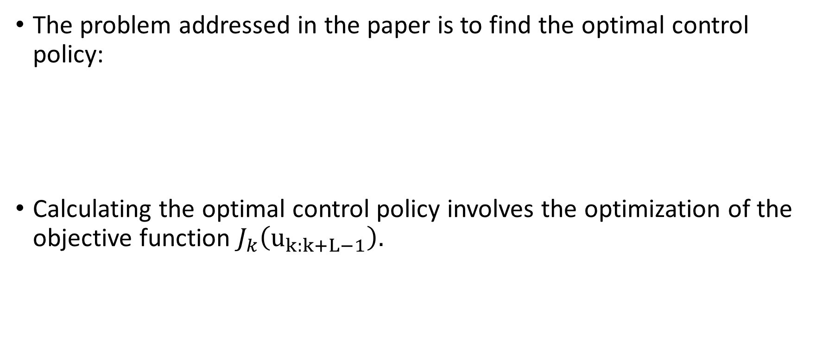
Planning in the GBS
The problem addressed in the paper is to find the optimal control policy:
Calculating the optimal control policy involves the optimization of the objective function $J_{k}\left(u_{k:k+L−1}\right).$

Slide 10
Planning in the GBS
The expectation is a linear operator so we can rewrite the objective function as:
In order to optimize the objective function ,as written in the paper, we resort to an iterative optimization approach, starting from known initial guess on the controls.

Slide 11
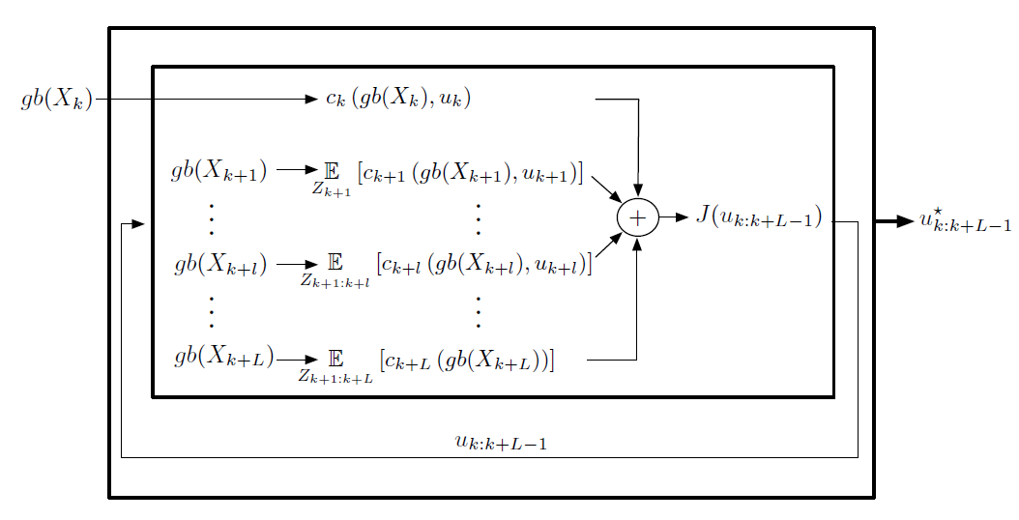

Planning in the GBS
The optimization approach can be described as a dual-layer inference:
The inner layer preforms inference to calculate the generalized belief $gb\left(X_{k+l}\right),$at each of the look ahead steps for given $u_{k:k+L−1}$
The outer layer preforms inference over the control $u_{k:k+L−1},$ minimizing the objective function
In the picture we can see illustration
of the dual-layer inference planning
approach

