Slide 1
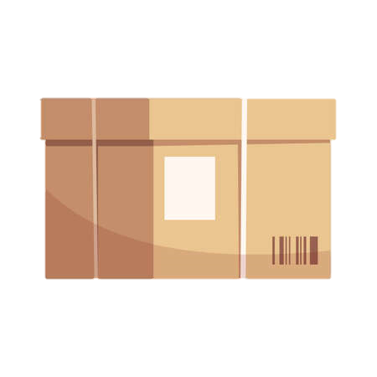






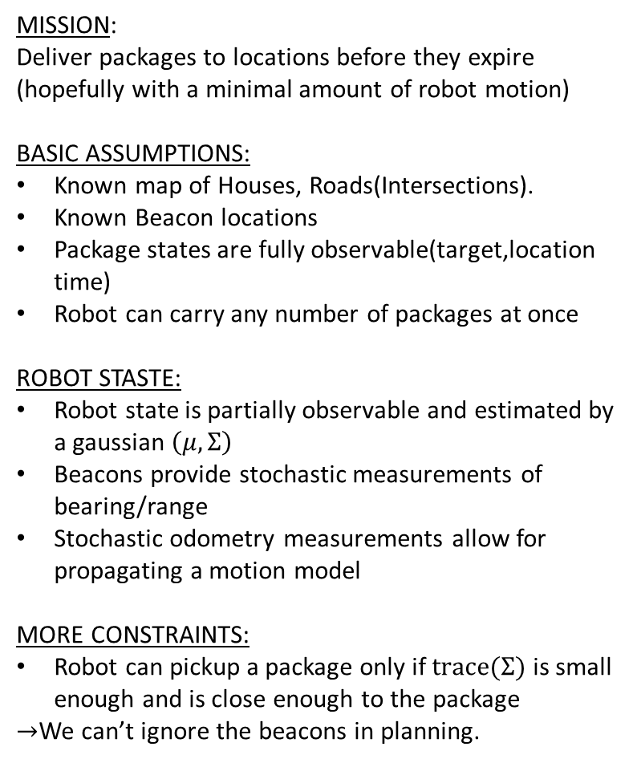








MISSION:
Deliver packages to locations before they expire
(hopefully with a minimal amount of robot motion)
BASIC ASSUMPTIONS:
Known map of Houses, Roads(Intersections).
Known Beacon locations
Package states are fully observable(target,location time)
Robot can carry any number of packages at once
ROBOT STASTE:
Robot state is partially observable and estimated by a gaussian $\left(μ,Σ\right)$
Beacons provide stochastic measurements of bearing/range
Stochastic odometry measurements allow for propagating a motion model
MORE CONSTRAINTS:
Robot can pickup a package only if $trace(Σ)$ is small enough and is close enough to the package
$→$We can’t ignore the beacons in planning.
$$H_{4}$$
$$H_{5}$$
$$B_{1}$$
$$(H_{2},20s)$$
$$B_{4}$$
$$(H_{1},32s)$$
$$B_{2}$$
$$H_{1}$$
$$B_{3}$$
$$H_{2}$$
$$H_{3}$$
$$N\left(x,y,θ;\left[μ,Σ\right]\right)$$
$$(H_{2},20s)$$

Slide 2

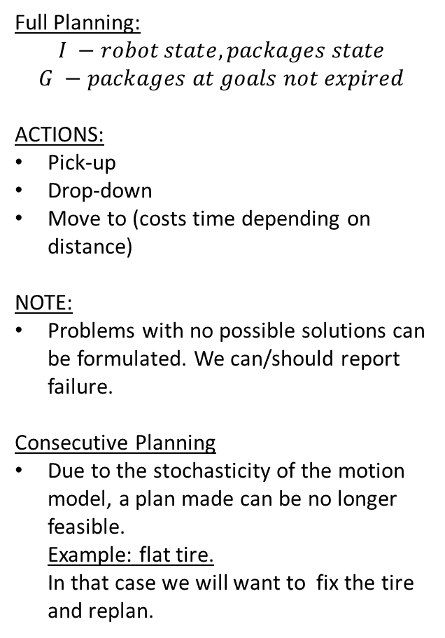
Full Planning:
$$I −robot state, packages state$$
$$G −packages at goals not expired$$
ACTIONS:
Pick-up
Drop-down
Move to (costs time depending on distance)
NOTE:
Problems with no possible solutions can be formulated. We can/should report failure.
Consecutive Planning
Due to the stochasticity of the motion model, a plan made can be no longer feasible. Example: flat tire. In that case we will want to fix the tire and replan.
$$H_{4}$$
$$H_{5}$$
$$B_{1}$$
$$(H_{2},20s)$$
$$B_{4}$$
$$(H_{1},32s)$$
$$B_{2}$$
$$H_{1}$$
$$B_{3}$$
$$H_{2}$$
$$H_{3}$$
$$N\left(x,y,θ;\left[μ,Σ\right]\right)$$
$$(H_{2},20s)$$

Slide 3
Consecutive Planning
PDDL
Plan
Act
Motion
Drop/pickup
Replan?
Estimate
Measure
EKF or similar
Beacons

Slide 4
PROBLEM
Our classic PDDL solver is not capable of POMDP!
Solution:
We make further assumptions when planning

Slide 5

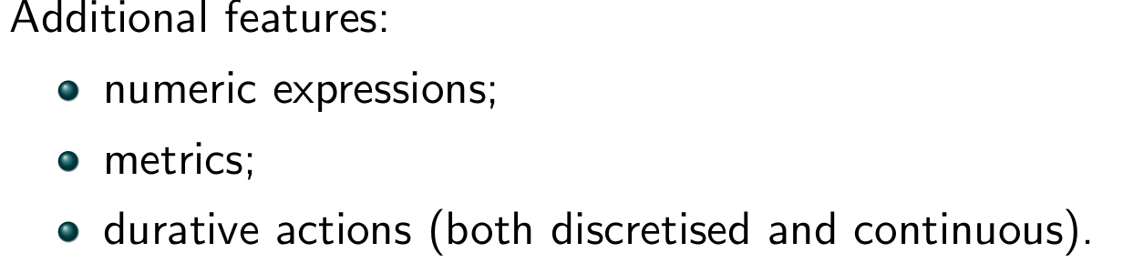
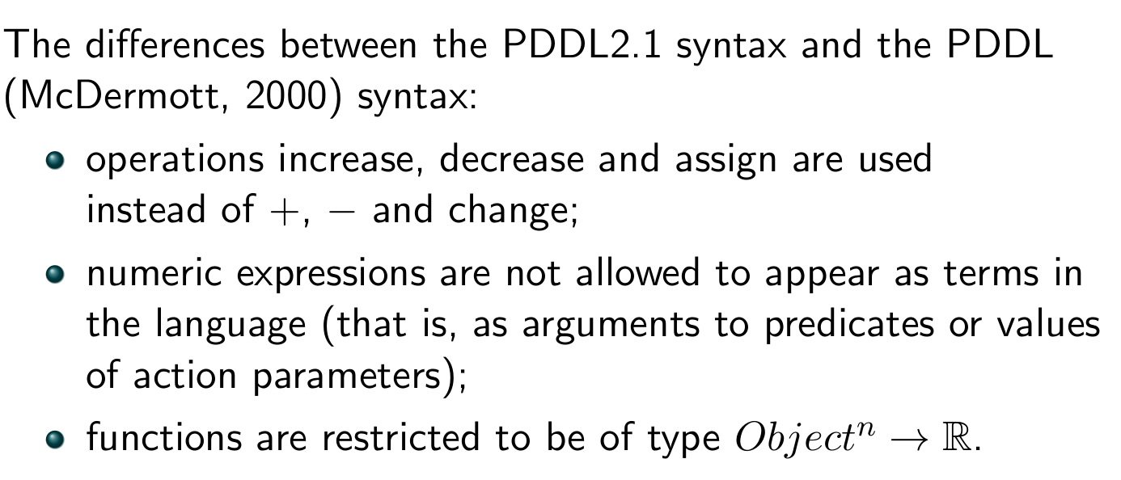
What are our options? What are we dealing with?

Slide 6
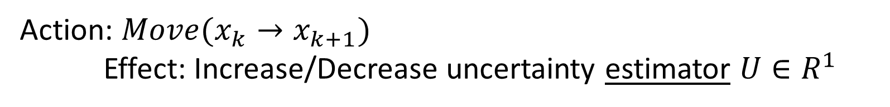
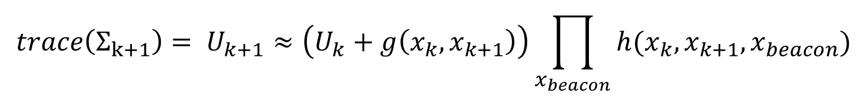
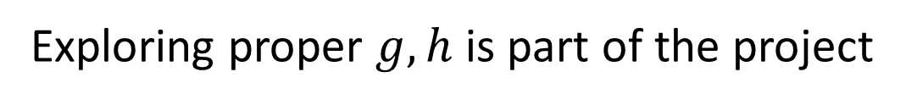
Suggestion:
Action: $Move(x_{k}→x_{k+1})$
Effect: Increase/Decrease uncertainty estimator $U∈R^{1}$
$$trace\left(Σ_{k+1}\right)= U_{k+1}≈\left(U_{k}+g\left(x_{k},x_{k+1}\right)\right)\prod_{x_{beacon}}{h(x_{k},x_{k+1},x_{beacon})}$$
Exploring proper $g,h$ is part of the project

Slide 7
Tools of the trade

Slide 8
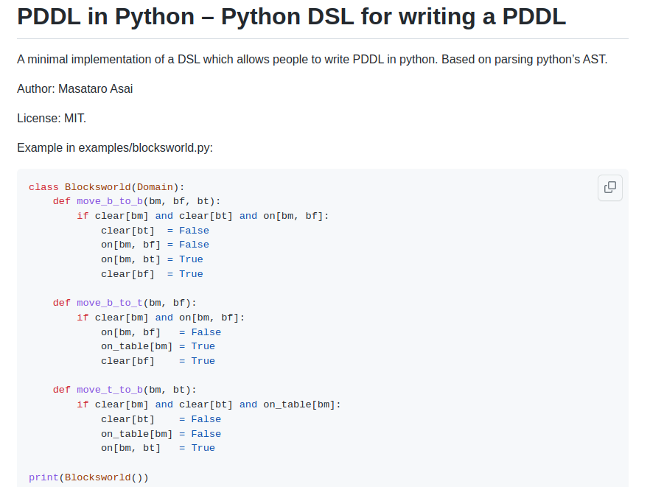
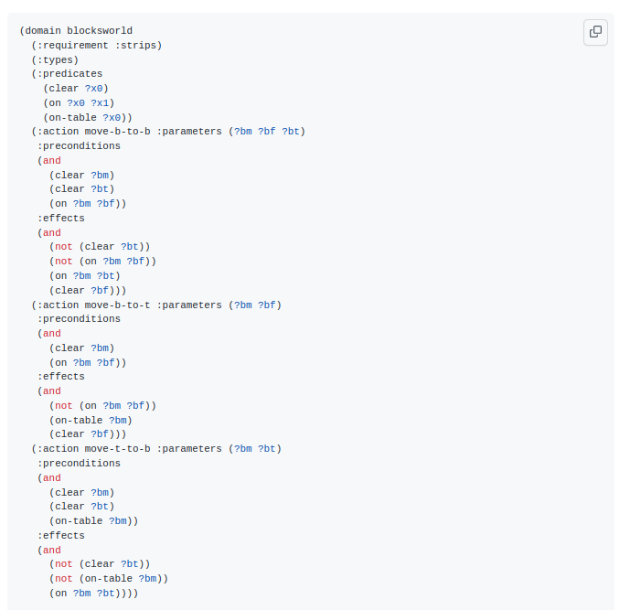
https://github.com/IBM/pddl-in-python

Slide 9
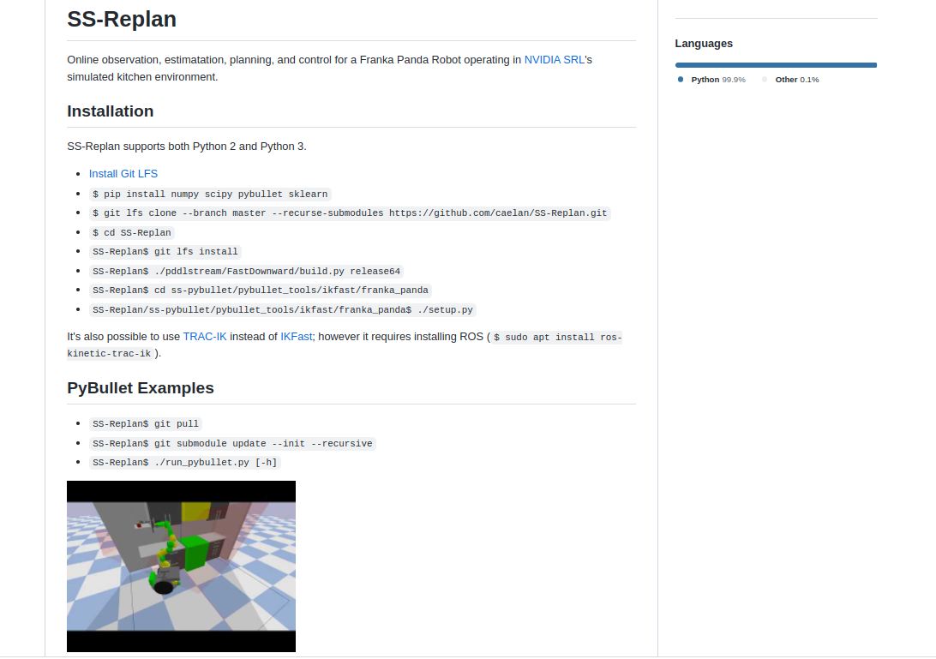
https://github.com/caelan/SS-Replan

Slide 10
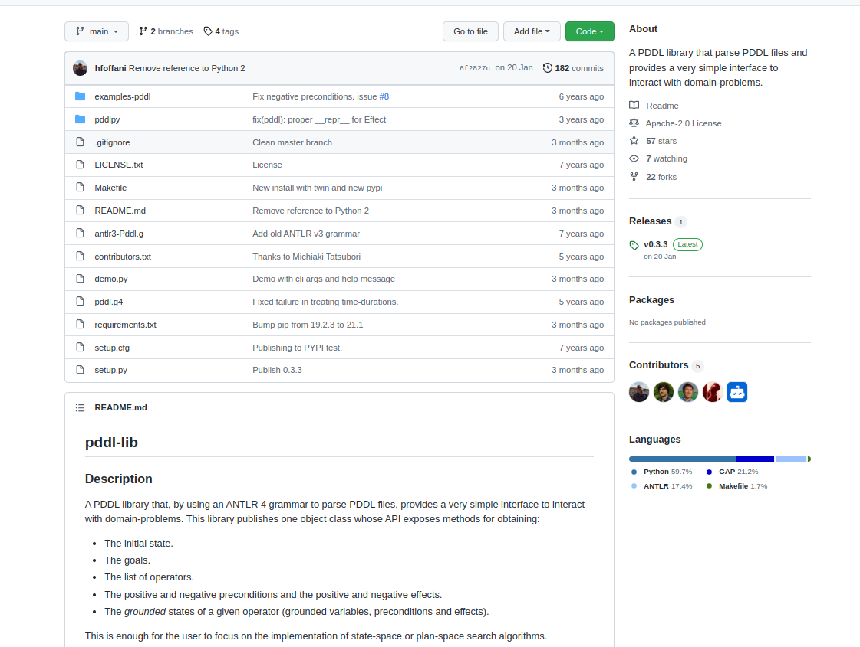
https://github.com/hfoffani/pddl-lib

Slide 11
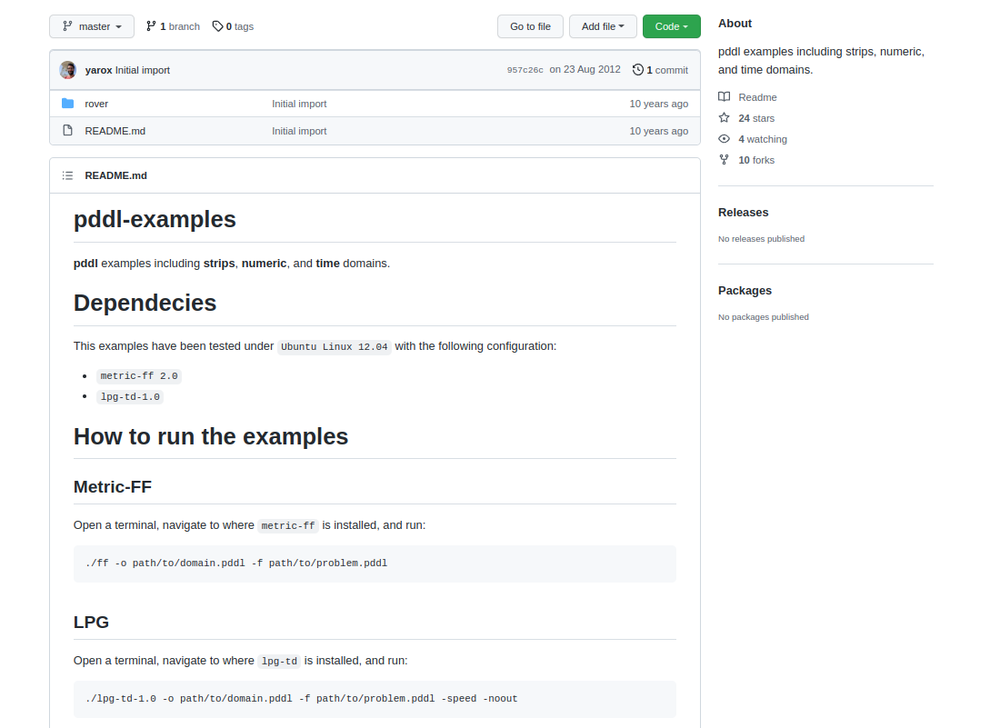
https://github.com/yarox/pddl-examples

Slide 12
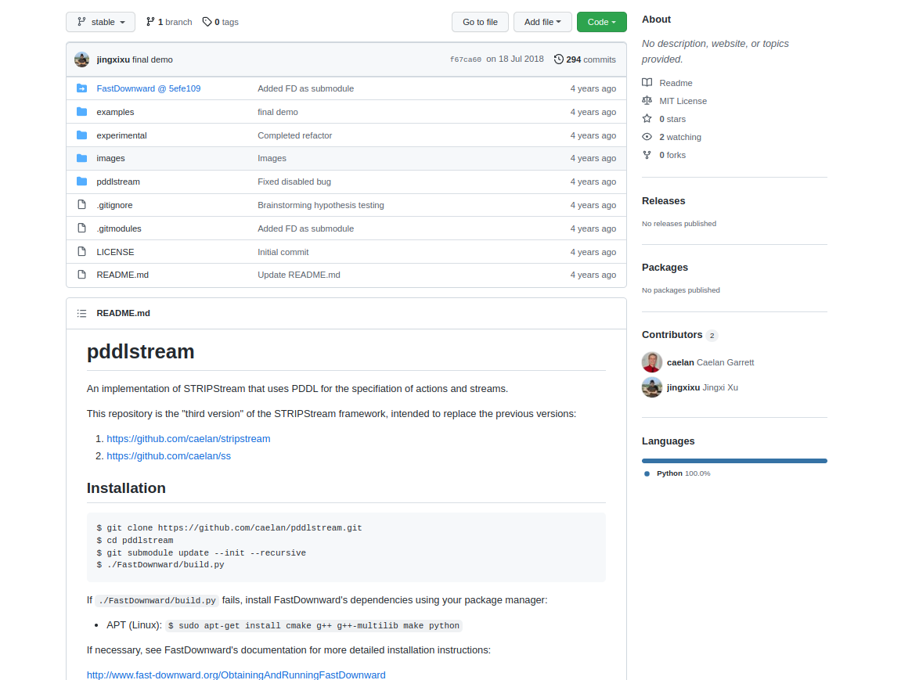
https://github.com/jingxixu/pddlstream

