Slide 1
Table of Contents
Matlab Simulation Structure
Simulator – Unreal Environment
Plant + Controllers
Event Camera Model
DataSet Creator
Training Process
Results
nLMS predictor for Improvement
Python Simulation Structure

Slide 2
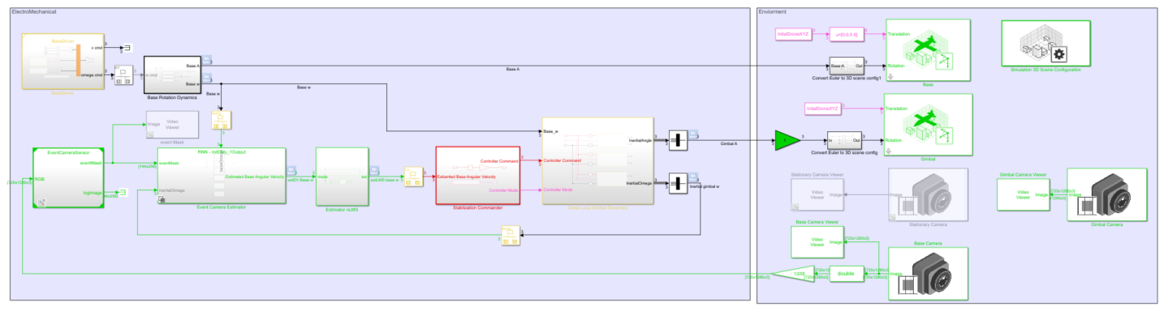
Matlab Simulation Structure
Unreal Enviorment
Base Command and Dynamics
Gimbal Close Loop
Camera on Gimbal
EventCamera Model
Command to Controller
Deep learning estimator
nLMS predictor
Camera on Base

Slide 3
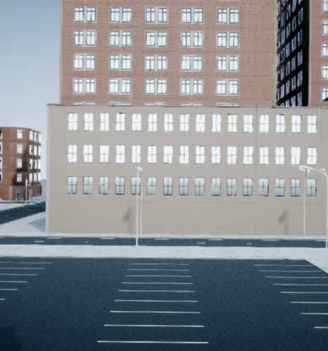
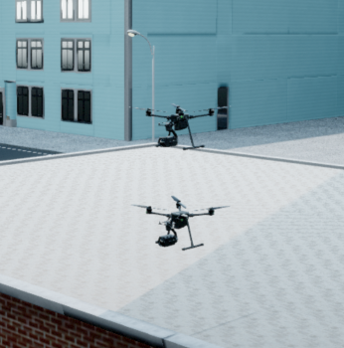
2) Simulator – Unreal Environment
We use two drones to simulate the Base+Gimbal configuration only for the purpose of connecting easily to the simulation environment. Simulink allows the installation of cameras on drones or stationary. The gimbal is attached de-facto to the base in the simulation’s math.
The Event camera is installed on the Base to allow acquiring events during stabilization. A stabilized gimbal has angular rates approaching zero.
The site chosen inside the simulation was a parking-lot with a lot of white lines, to allow for easy testing and calibration of our methods.
Base
Gimbal
Typical view from base’s camera before applying EventCamera Model

Slide 4
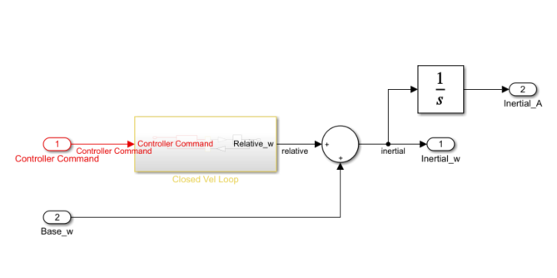
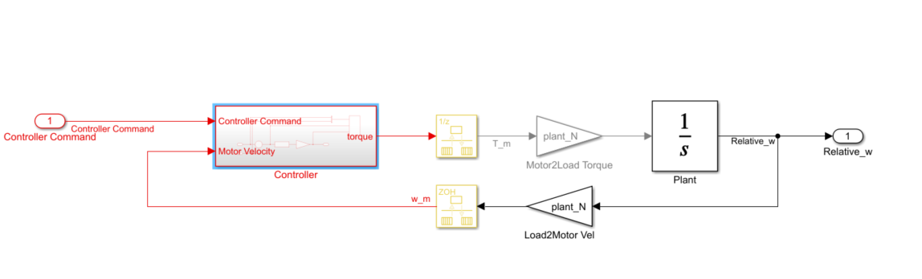
3) Plant + Controllers –simple model
Sample times:
Control sample time is 0.0008[sec] camera sample time is 0.016[sec](our simulation lower bound)
Continuous solver (ode 45)
our model cant change states instantly as it follows dynamic behavior of the drone.
velocity Closed loop
Velocity command [rad/sec]
Velocity controller
Plant modeled as integrator
Base angular rate [rad/sec]

Slide 5
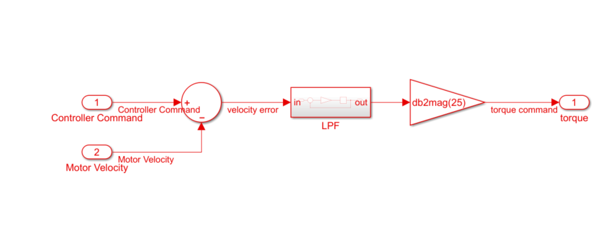
3) Plant + Controllers –simple model
Velocity controller scheme

Slide 6
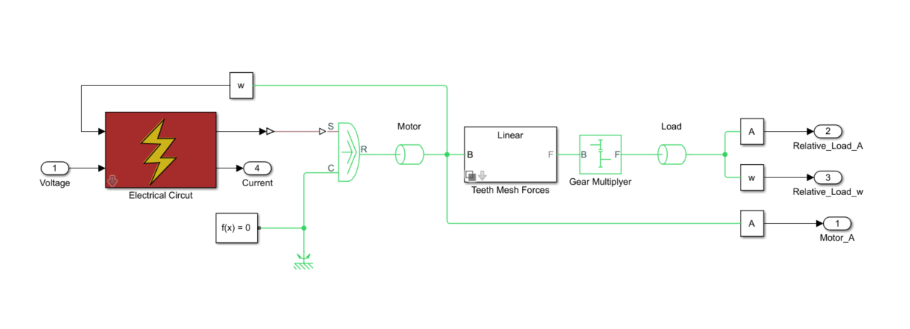
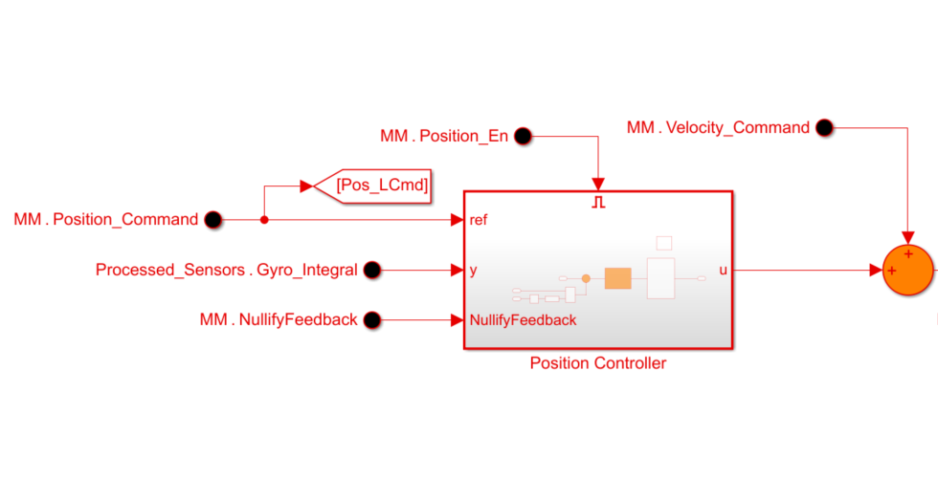
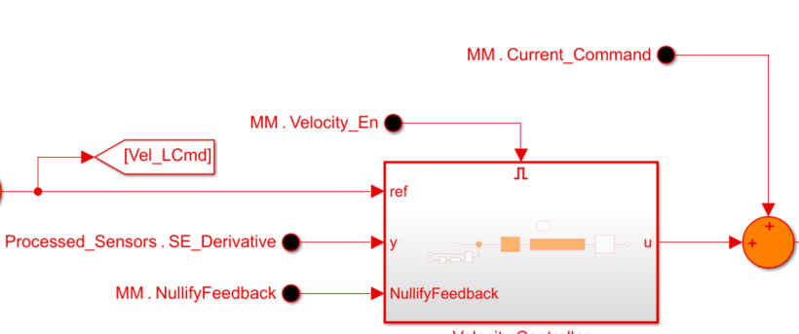
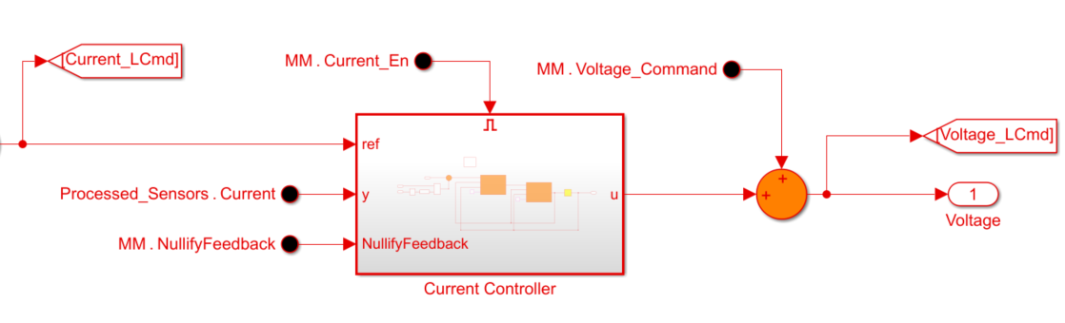
3) Plant + Controllers –complex model
Plant: our plant model include 2 mass (motor and load) connected by gear with stiffness and viscosity.
Controllers:
The controllers include advanced control techniques – PID, Notch,Lead-Lag anti wind up.
Physical plant

Slide 7
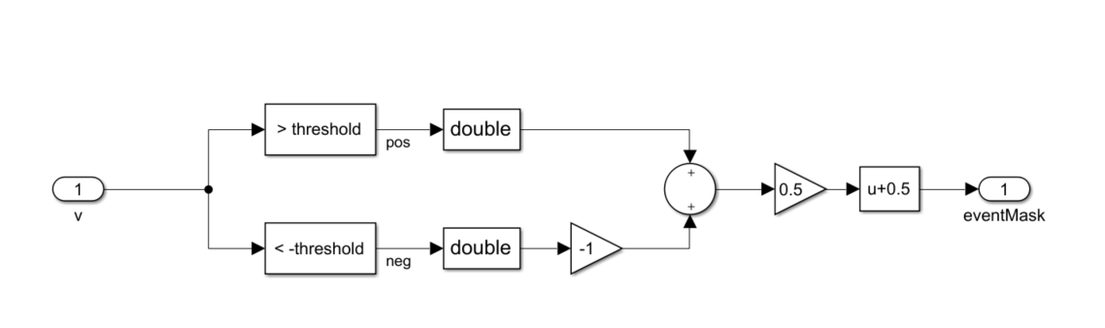
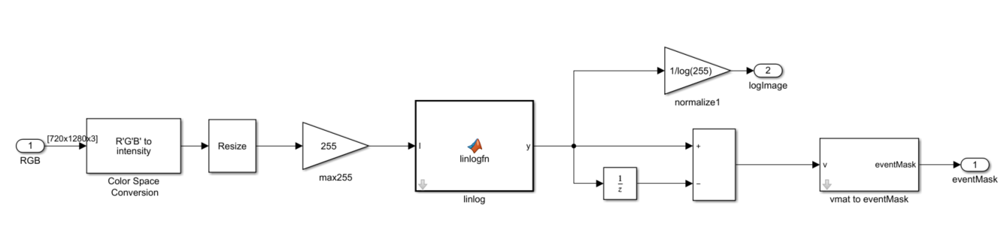
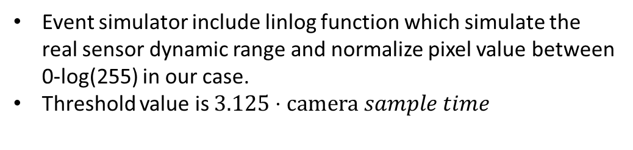
4) Event Camera Model
Event simulator include linlog function which simulate the real sensor dynamic range and normalize pixel value between 0-log(255) in our case.
Threshold value is $3.125⋅camera sample time$

Slide 8
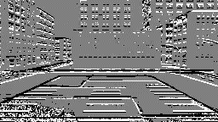
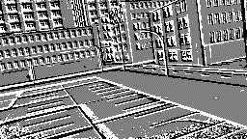
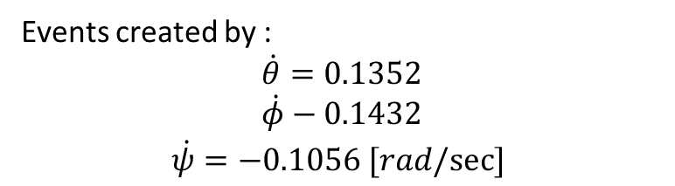
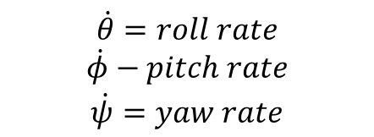
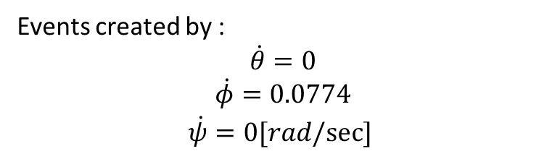
4) Event Camera Model- events example
Events created by :
$$\begin{matrix}\dot{θ}=0 \\ \dot{φ}=0.0774 \\ \dot{ψ}=0[rad/sec] \end{matrix}$$
Events created by :
$$\begin{matrix}\dot{θ}=0.1352 \\ \dot{φ}−0.1432 \\ \dot{ψ}=−0.1056 [rad/sec] \end{matrix}$$
$$\begin{matrix}\dot{θ}=roll rate \\ \dot{φ}−pitch rate \\ \dot{ψ}=yaw rate\end{matrix}$$

Slide 9
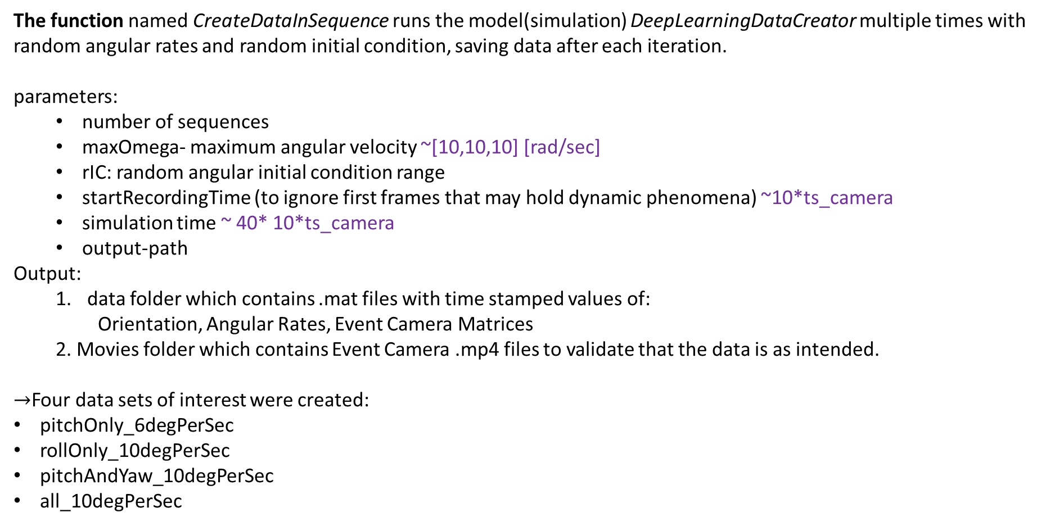
5) DataSet Creator
The function named CreateDataInSequence runs the model(simulation) DeepLearningDataCreator multiple times with random angular rates and random initial condition, saving data after each iteration. parameters:
number of sequences
maxOmega- maximum angular velocity ~[10,10,10] [rad/sec]
rIC: random angular initial condition range
startRecordingTime (to ignore first frames that may hold dynamic phenomena) ~10*ts_camera
simulation time ~ 40* 10*ts_camera
output-path
Output:
data folder which contains .mat files with time stamped values of:
Orientation, Angular Rates, Event Camera Matrices
2. Movies folder which contains Event Camera .mp4 files to validate that the data is as intended.
$→$Four data sets of interest were created:
pitchOnly_6degPerSec
rollOnly_10degPerSec
pitchAndYaw_10degPerSec
all_10degPerSec

Slide 10
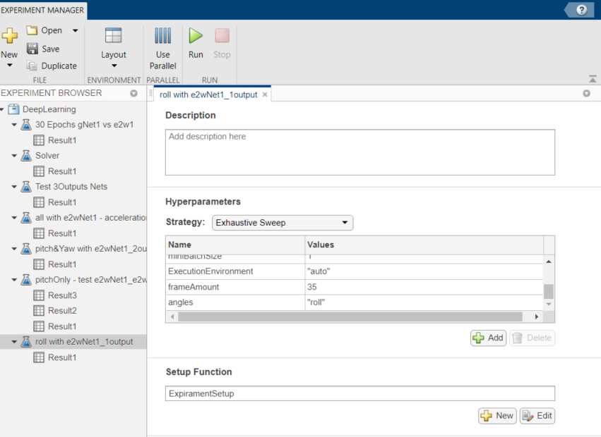
6) Training Process
We used MATALB’s Experiment Manager test different network architectures, and training hyper parameters on different data sets to obtain confidence in our network design:
1) Pitch only with a simple network
2) Pitch only with googleNet based network
3) Pitch + Yaw with a simple network and more mini batches
4) And so on…

Slide 11
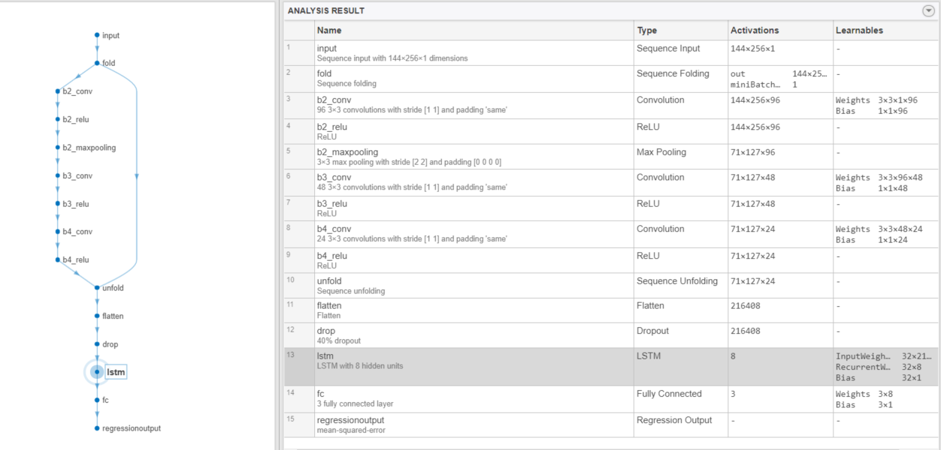
6) Training Process
e2wNet1 – Chosen Architecture

Slide 12
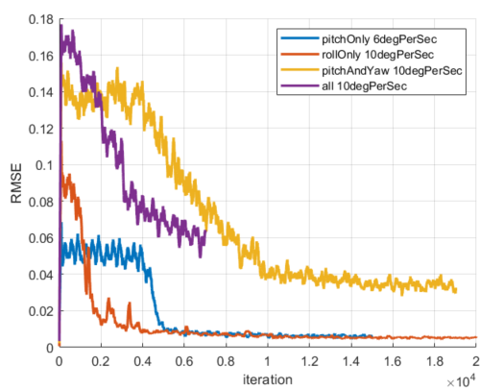
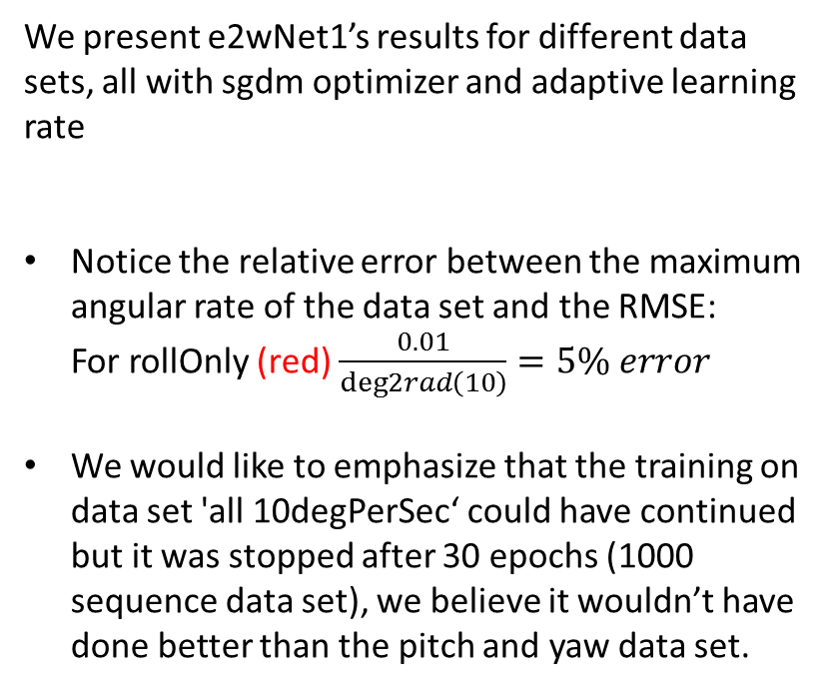
6) Training Process
We present e2wNet1’s results for different data sets, all with sgdm optimizer and adaptive learning rate
Notice the relative error between the maximum angular rate of the data set and the RMSE: For rollOnly (red) $\frac{0.01}{deg2rad\left(10\right)}=5\% error$
We would like to emphasize that the training on data set 'all 10degPerSec‘ could have continued but it was stopped after 30 epochs (1000 sequence data set), we believe it wouldn’t have done better than the pitch and yaw data set.

Slide 13
Results

