Slide 1
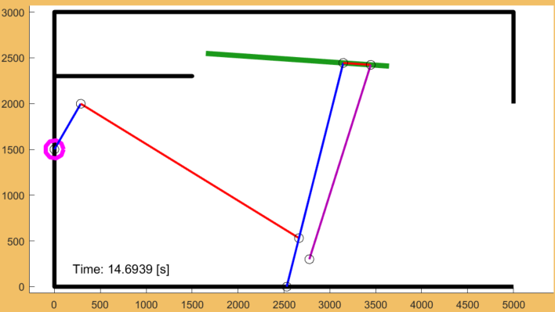
5
6
2
1
3
7
4

Slide 2
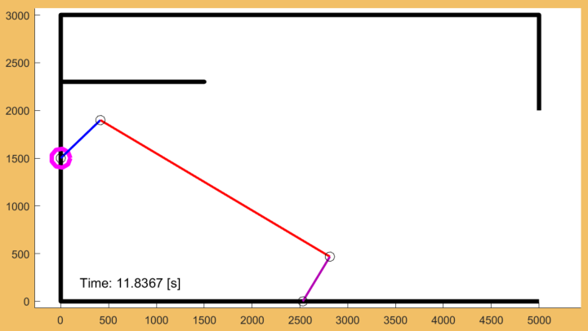





$$a_{L}$$
Mtr
$$f_{L}$$
$$P_{L0}$$
$$b_{L}$$
Act
$$P_{L1}$$

Slide 3
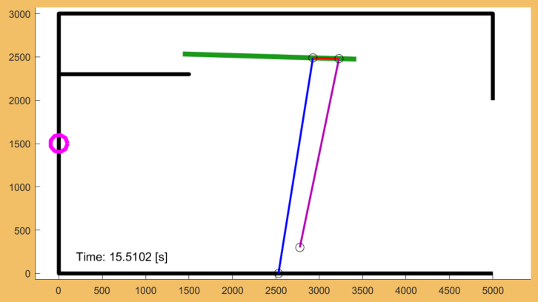





$$f_{R}$$
Actuator
$$b_{R}$$
$$a_{R}$$
Out
$$P_{R1}$$
$$P_{R0}$$
Act

Slide 4
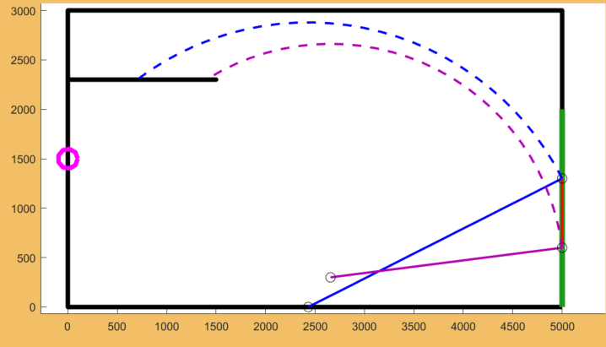

Slide 6
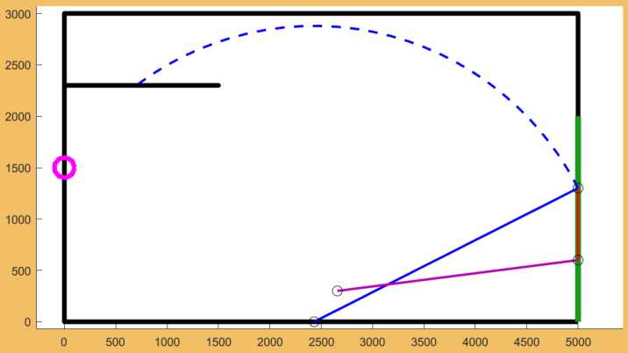

Slide 7
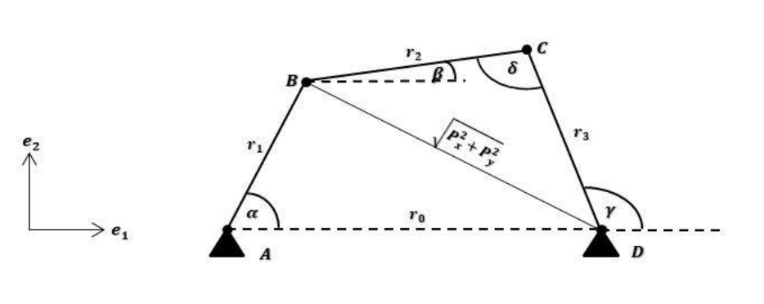
f
a
b
g

Slide 8
f
a
b
e
g

Slide 9
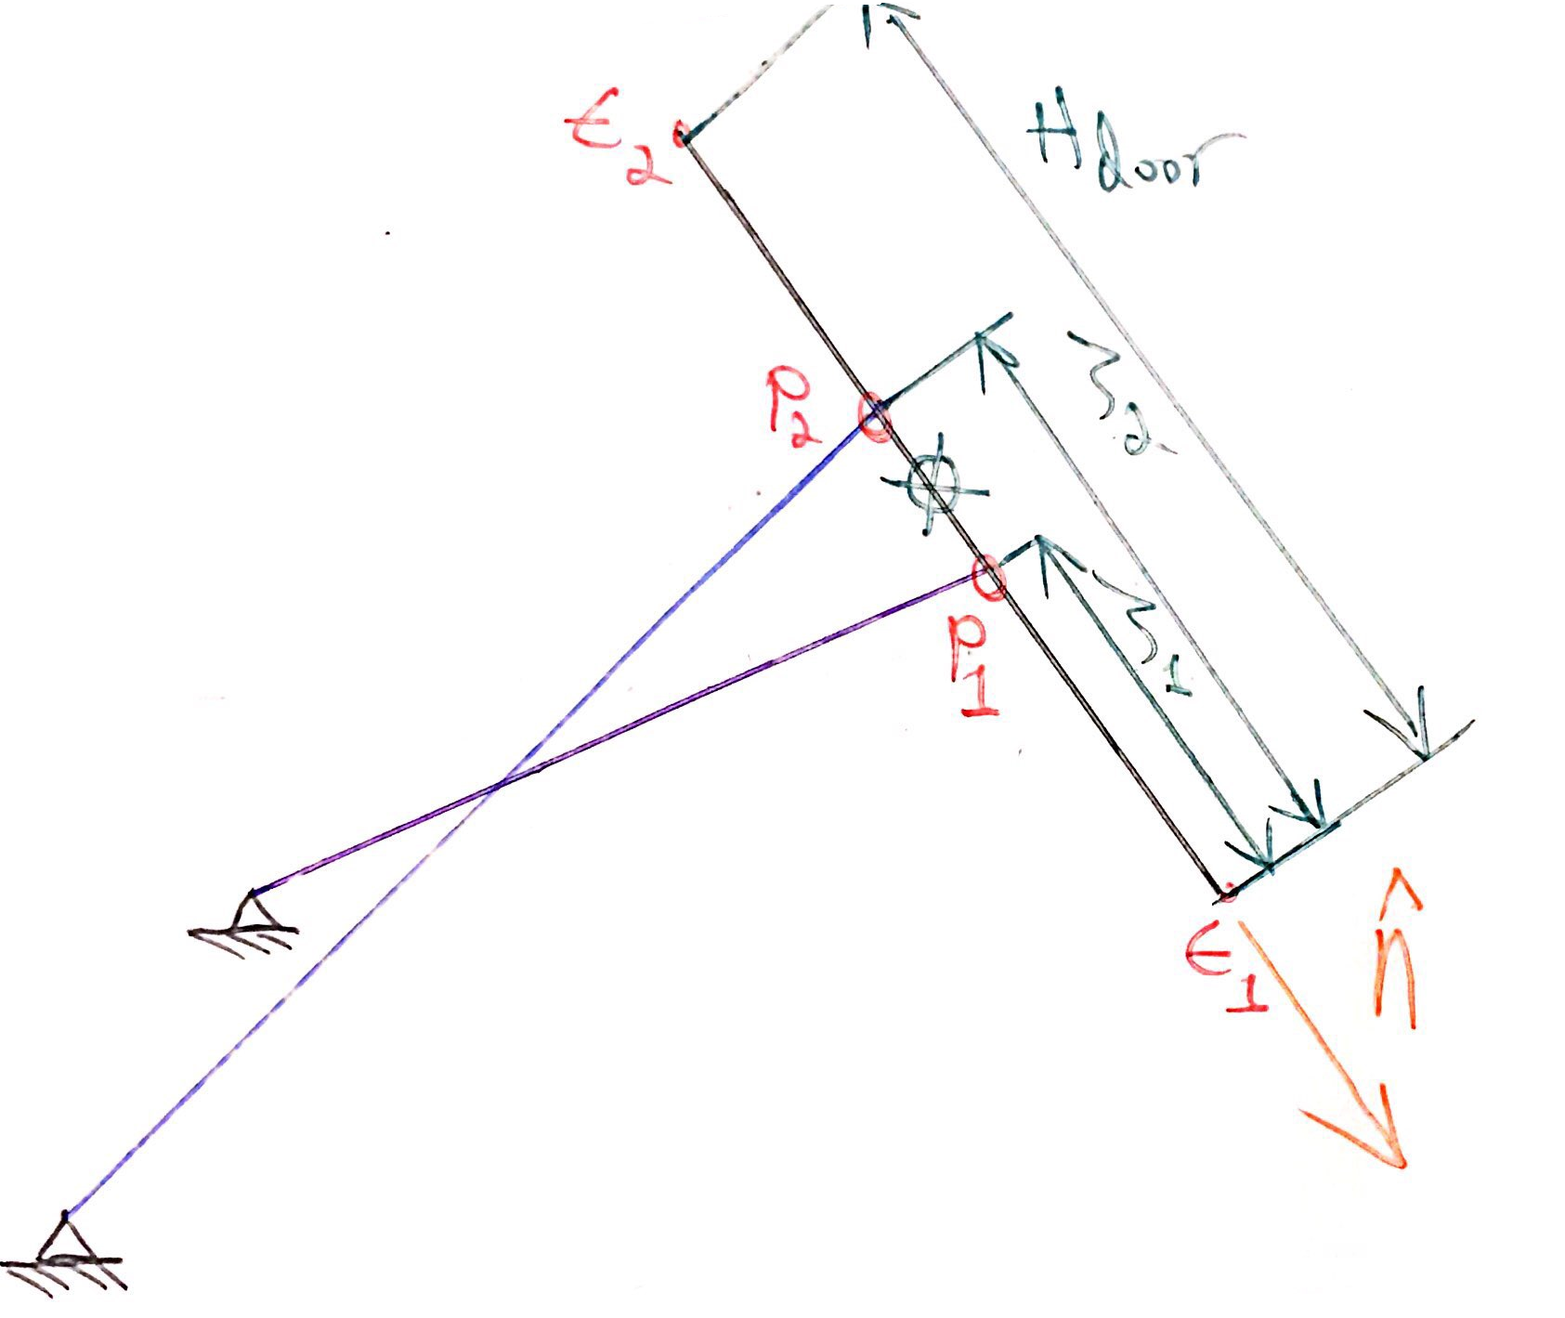








$$E_{2}$$
$$H_{door}$$
$$P_{2}$$
$$ξ_{2}$$
$$ξ_{1}$$
$$P_{1}$$
$$E_{1}$$
$$\vec{n}$$

Slide 10
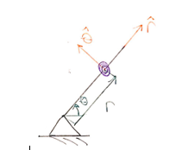



$$\vec{r}$$
$$\vec{θ}$$
$$r$$
θ

Slide 11








$$\vec{a}$$
$$H_{door}$$
$$\vec{α}$$
$$R$$
$$P$$
$$C$$
$$\vec{β}$$
$$a$$
$$\vec{f}$$
β
α

Slide 12
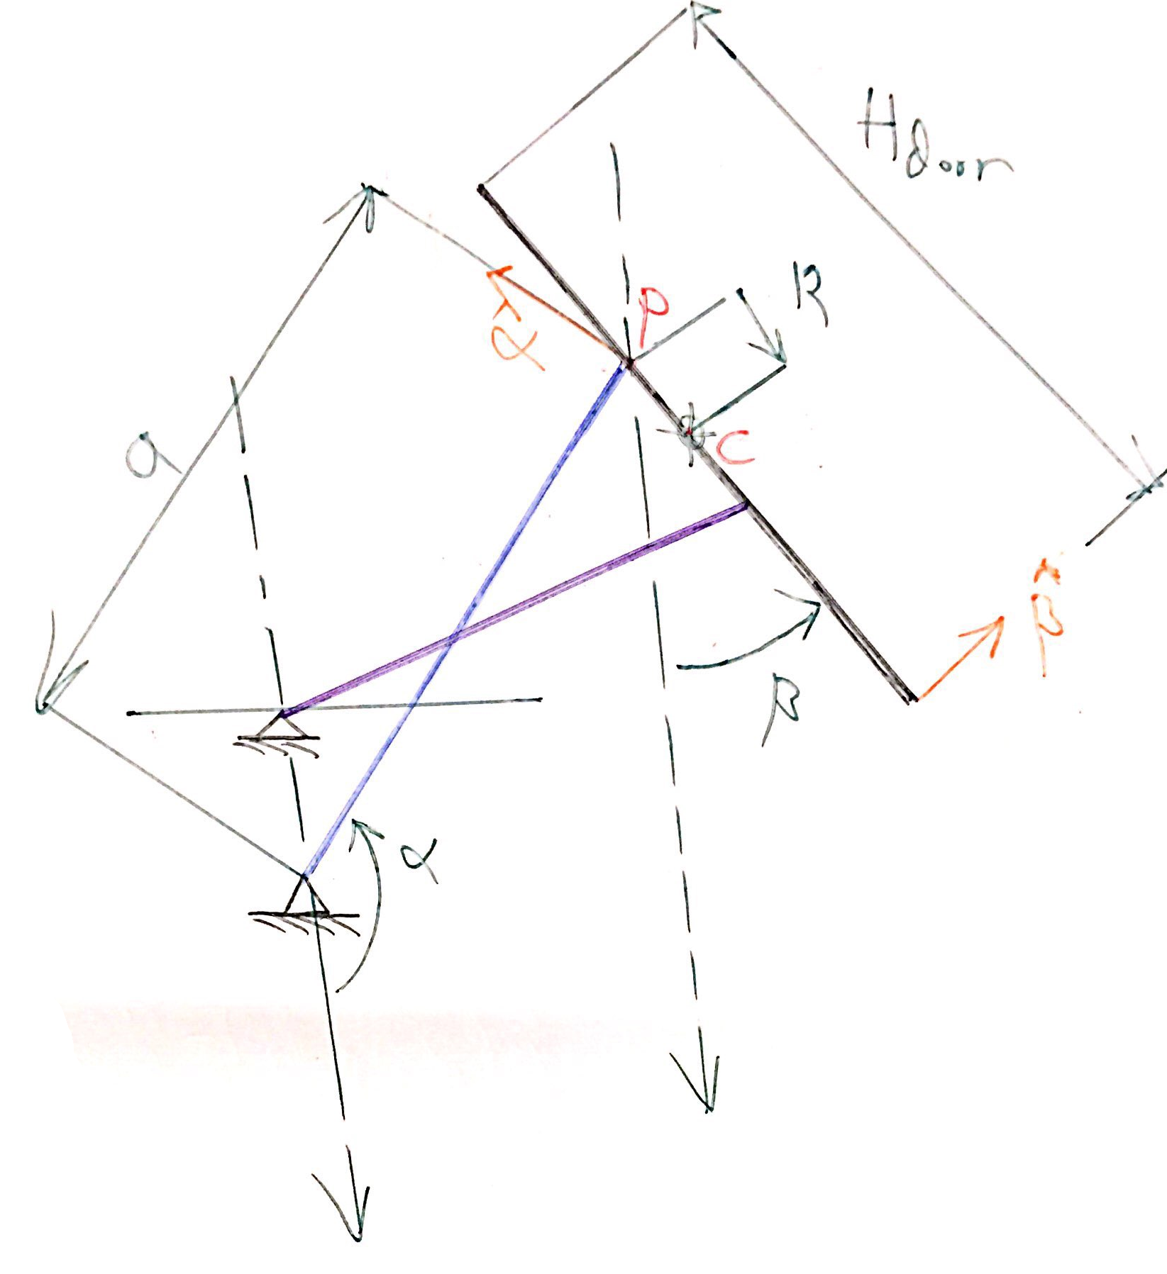
$$H_{door}$$
$$\vec{α}$$
$$R$$
$$P$$
$$C$$
$$\vec{β}$$
$$a$$
β
α

Slide 13
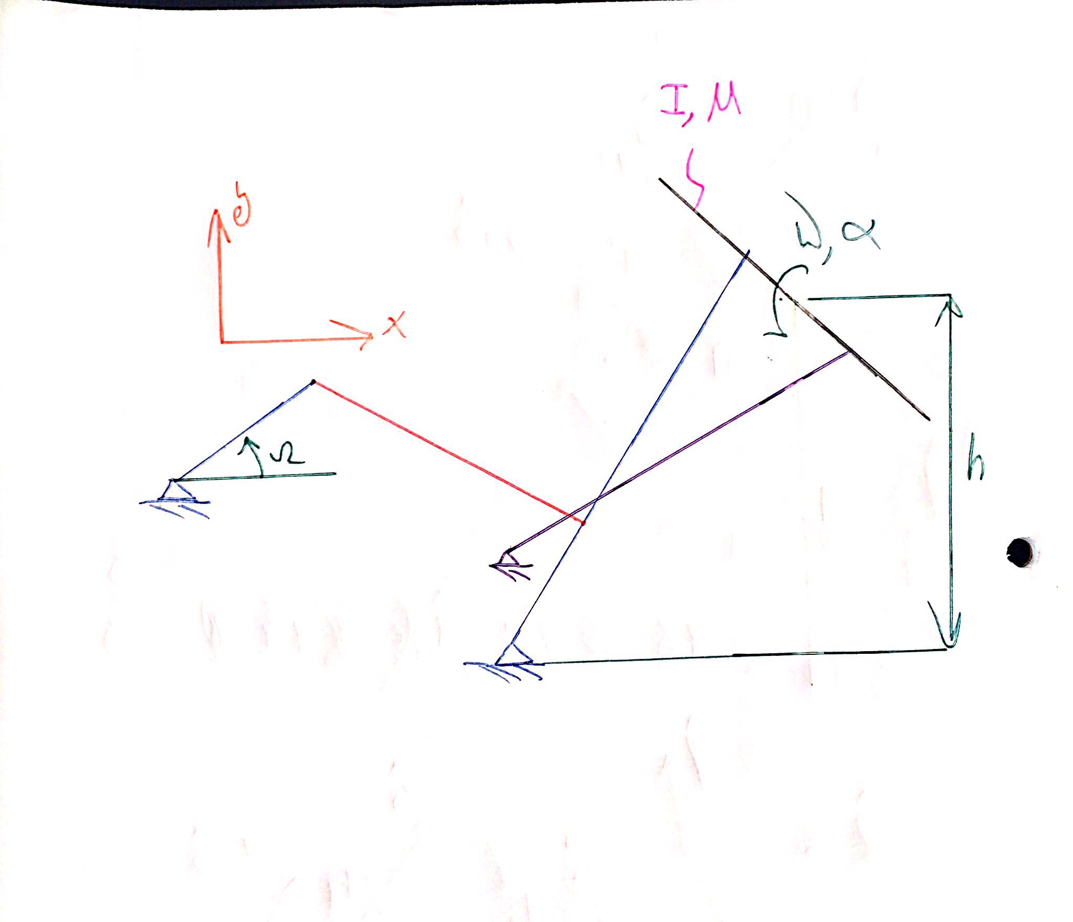




$$\vec{y}$$
$$\vec{x}$$
α, ω
$$I,M$$
Ω
$$h$$
β

Slide 14
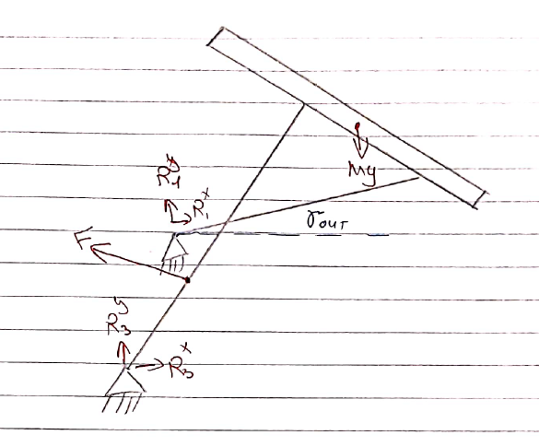












$$f_{R}$$
Door
$$\vec{y}$$
$$\vec{x}$$
$$Mg$$
$$b_{R}$$
$$R_{1}^{x}$$
Out
$$F$$
$$R_{1}^{y}$$
$$a_{R}$$
$$b_{L}$$
$$R_{3}^{x}$$
Act
$$R_{3}^{y}$$

Slide 15
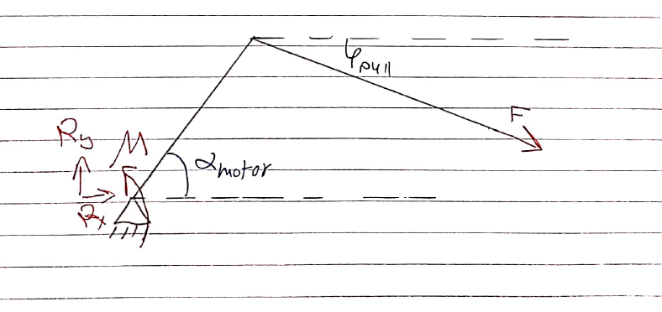






$$\vec{y}$$
$$\vec{x}$$
$$F$$
$$T$$
Mtr
$$f_{L}$$
$$a_{L}$$
Push

Slide 16










$$f_{R}$$
$$\vec{y}$$
$$R_{1}^{x}$$
Door
$$C$$
$$\vec{x}$$
$$R_{2}^{x}$$
$$R_{1}^{y}$$
$$Mg$$
$$b_{R}$$
$$R_{2}^{y}$$

Slide 17









$$\vec{y}$$
$$R_{2}^{x}$$
$$\vec{x}$$
$$R_{2}^{y}$$
$$F$$
Push
$$a_{R}$$
$$b_{L}$$
$$R_{3}^{x}$$
Act
$$R_{3}^{y}$$

Slide 18
