Slide 1

A robust method for fitting a model to noisy measurements
Alon Spinner
Oren Elmakis

Slide 2
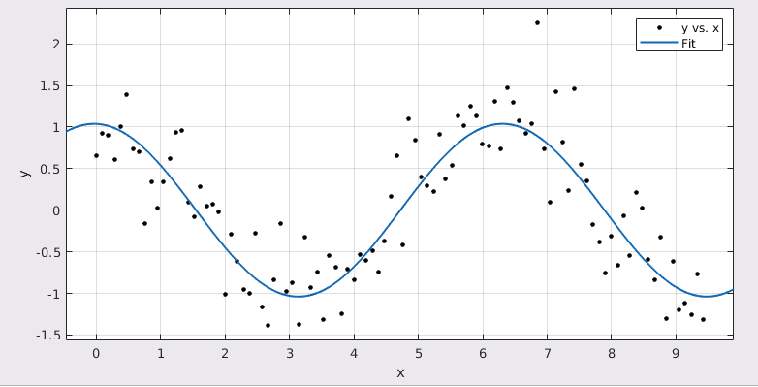
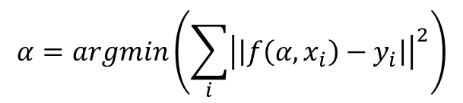
Fitting a model to noisy data via Least Mean Squares
$$α=argmin\left(\sum_{i}{{\left|\left|f\left(α,x_{i}\right)−y_{i}\right|\right|}^{2}}\right)$$
$$f(α,x)=α_{1}sin⁡(α_{2}x+α_{3})$$

Slide 3
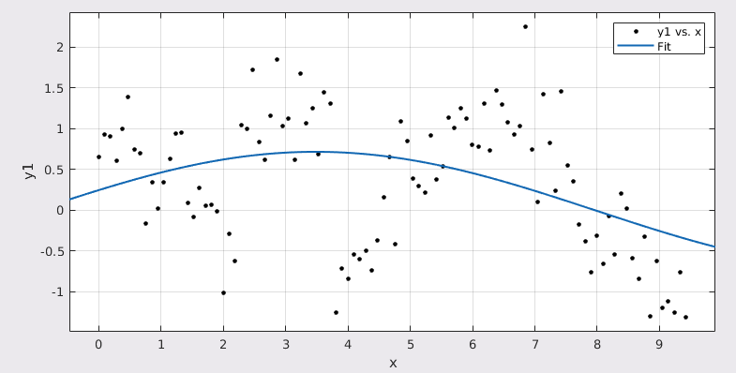
LMS is not robust to outliers
LMS fit of sine + gaussian noise
LMS fit of sine + gaussian noise + shift

Slide 4
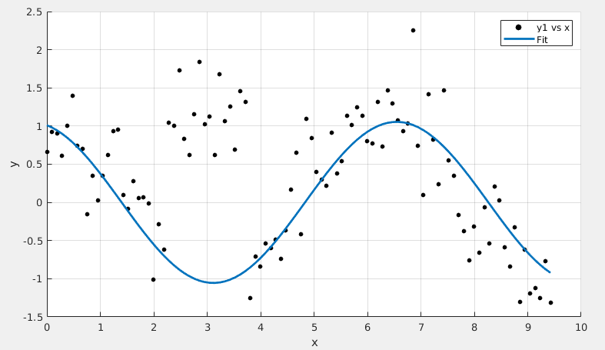
RANSAC is an algorithm that is robust to such outliers
RANSAC fit of sine + gaussian noise + shift

Slide 5
The RANSAC Method

Slide 6
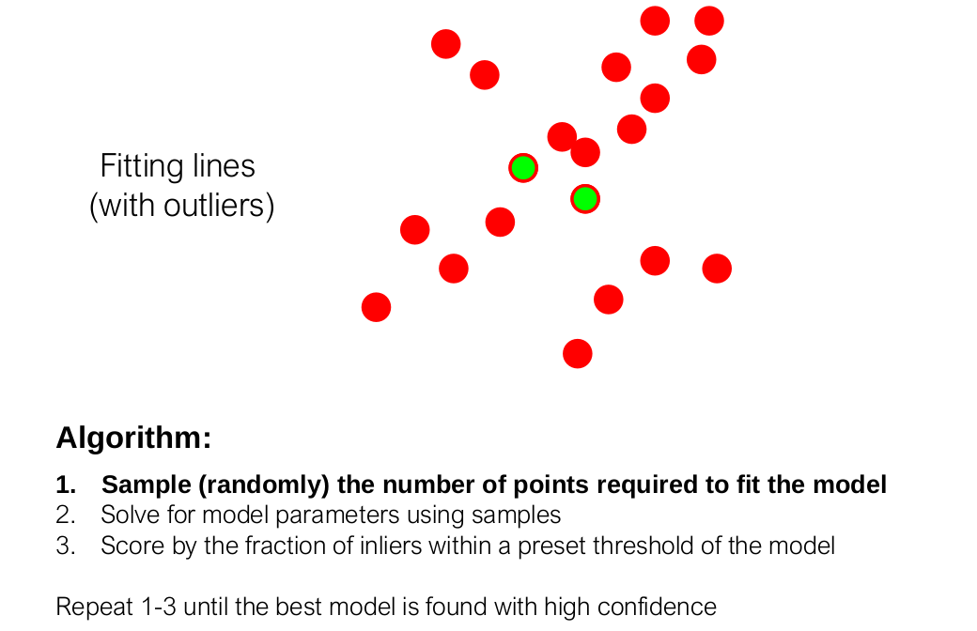

Slide 7
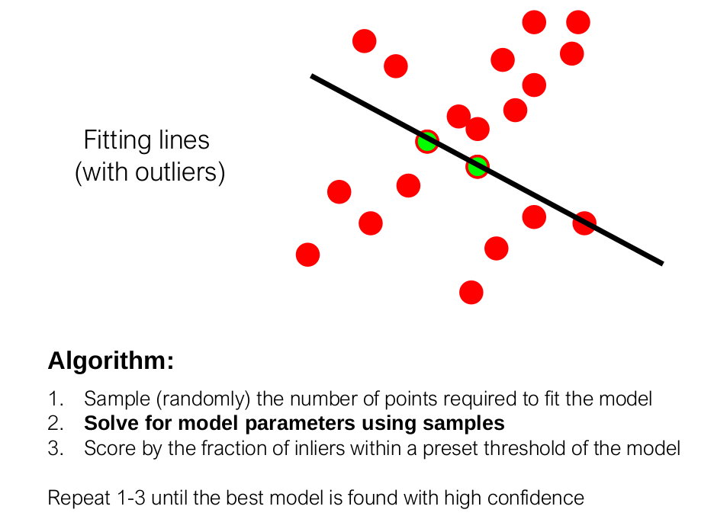

Slide 8
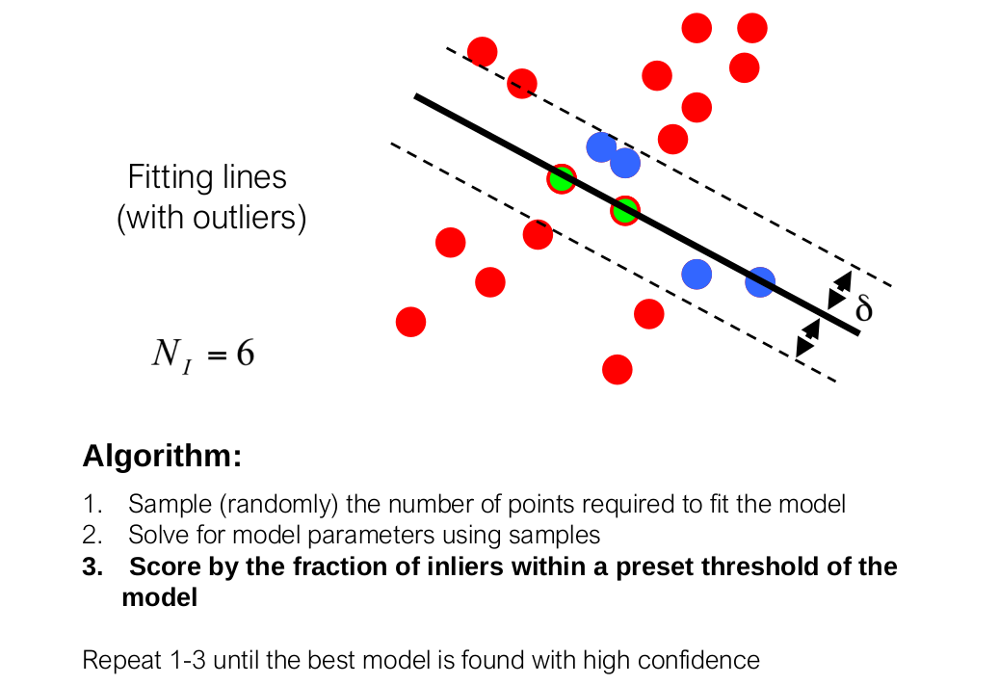

Slide 9
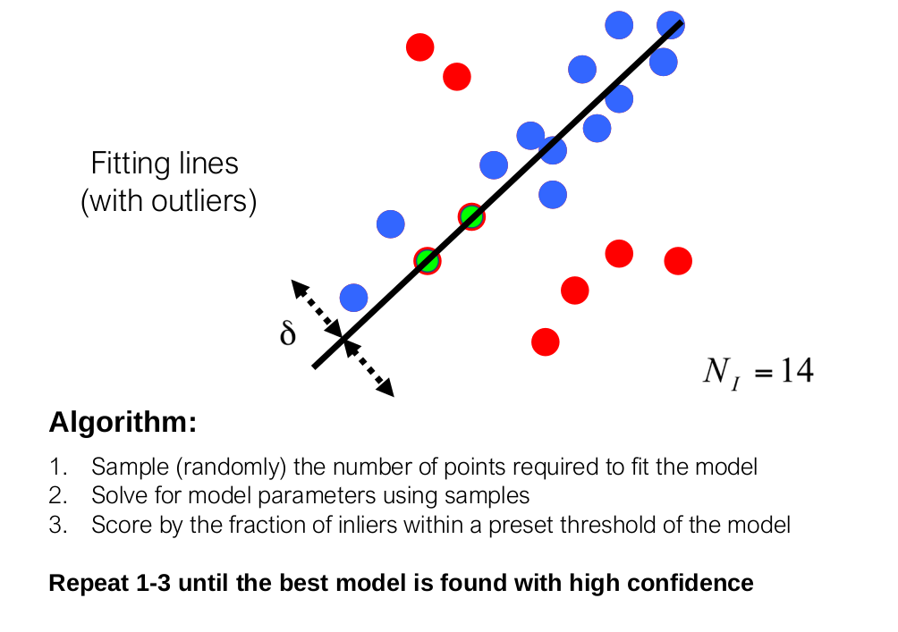

Slide 10
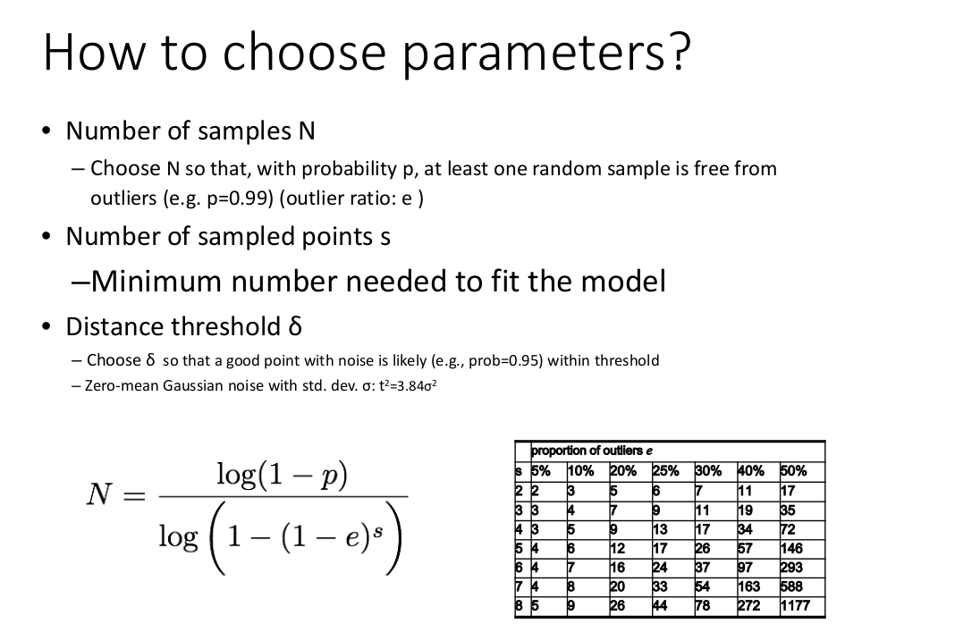

Slide 11
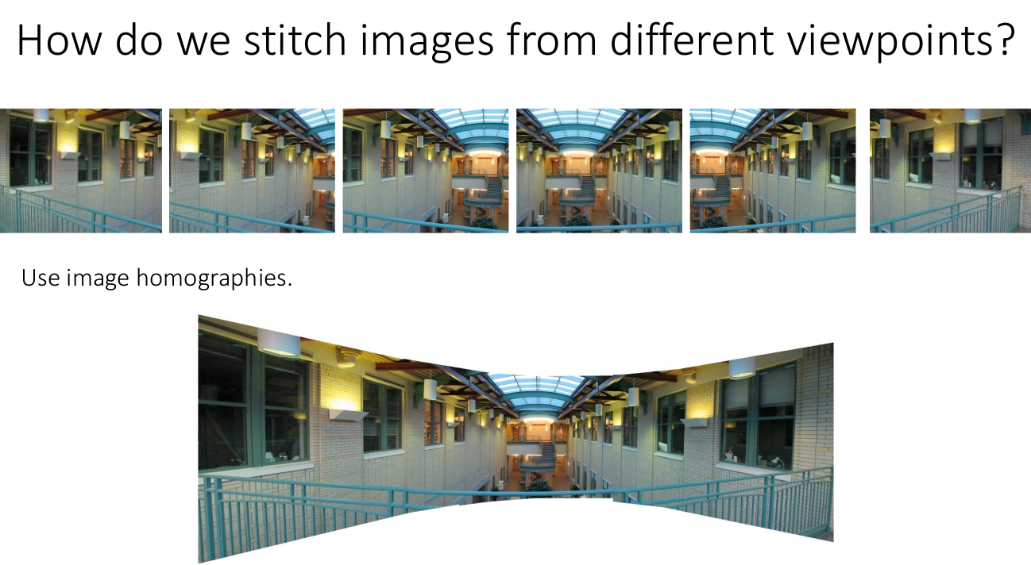
Example:

Slide 12
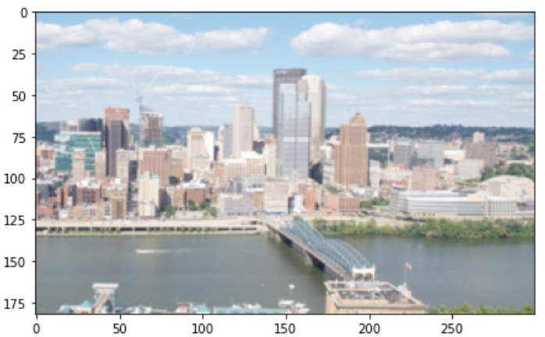
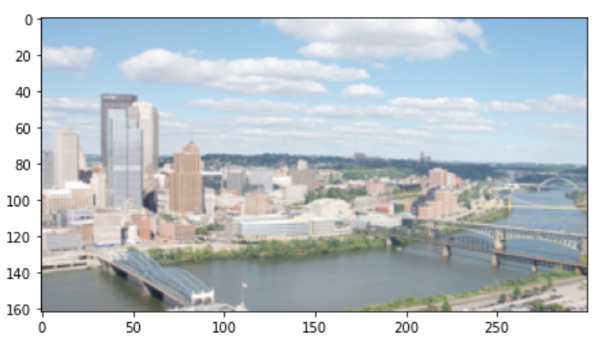




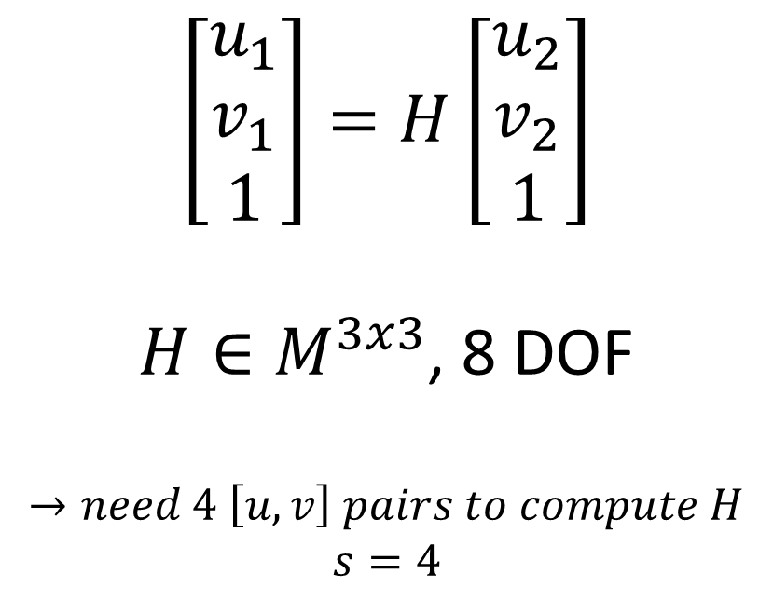
Picture 1
Model:
$$v_{1}$$
Point correspondents have the following connection:
$$\left[\begin{matrix}u_{1} \\ v_{1} \\ 1\end{matrix}\right]=H\left[\begin{matrix}u_{2} \\ v_{2} \\ 1\end{matrix}\right]$$
$H∈M^{3x3}$, 8 DOF
$$→need 4 \left[u,v\right] pairs to compute H$$
$$s=4$$
$$u_{1}$$
Picture 2
$$v_{2}$$
$$u_{2}$$

Slide 13
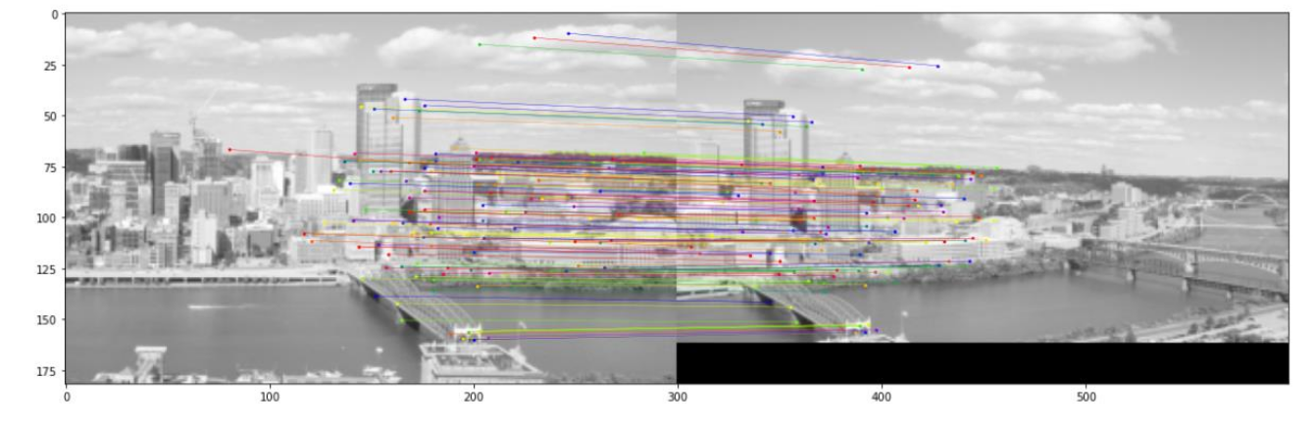
Correspondence given by surf features

Slide 14
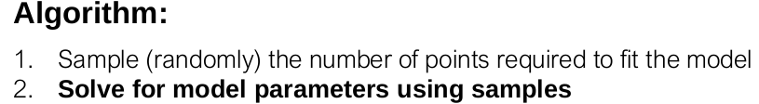

Random 4 matches to compute $H$
Points from right picture after applying H

Slide 15
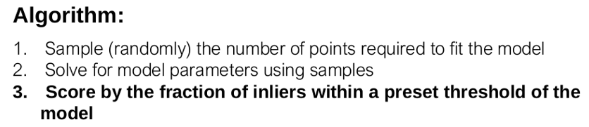
Match considered outlier
Match considered inlier
Fixed tolerance radius

Slide 16
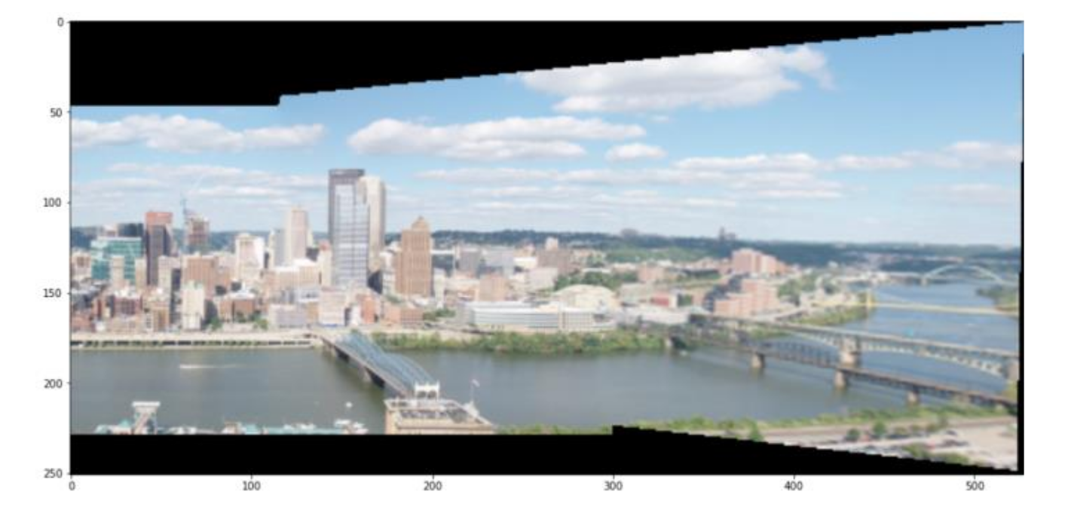

Panorama with our $H_{RANSAC}$

Slide 17
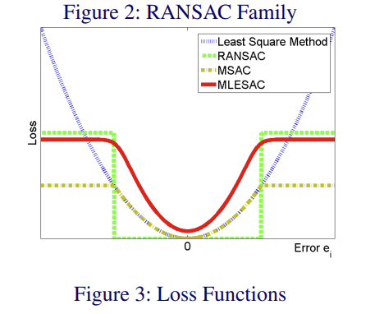
Further insight:
RANSAC is a robust loss function, and there is a whole field of research dedicated to those.

