Slide 1
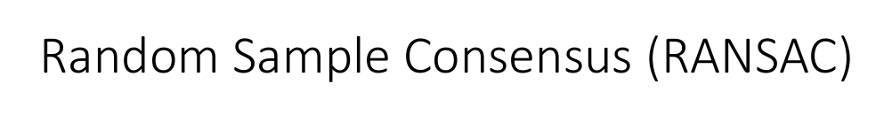

Slide 2
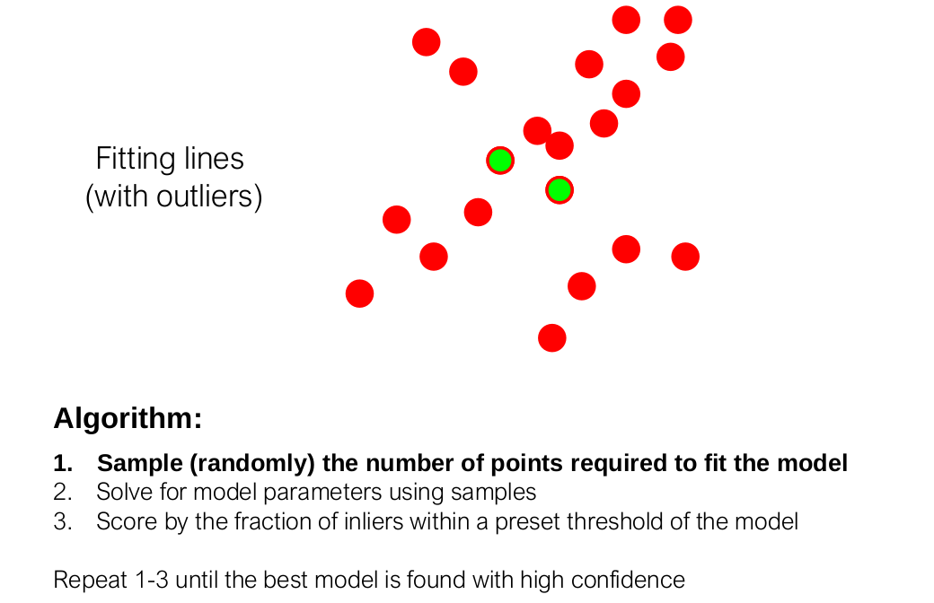

Slide 3
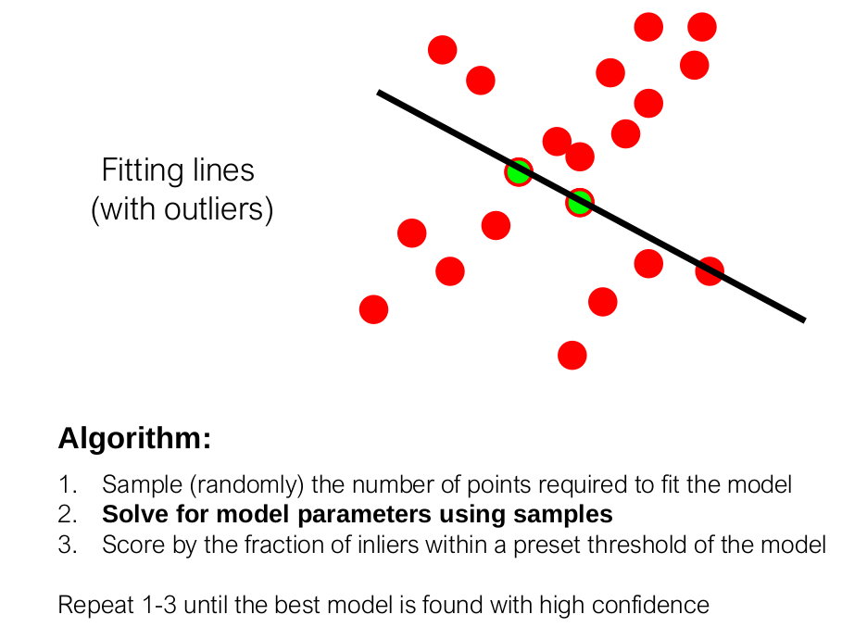

Slide 4
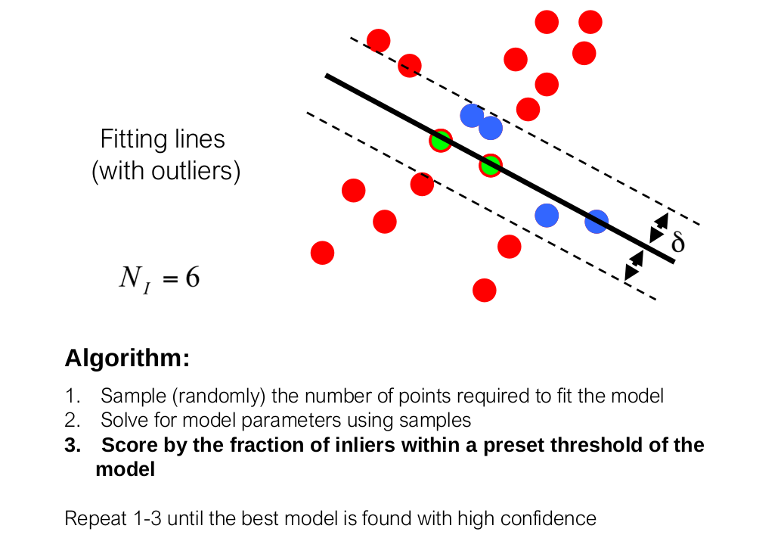

Slide 5
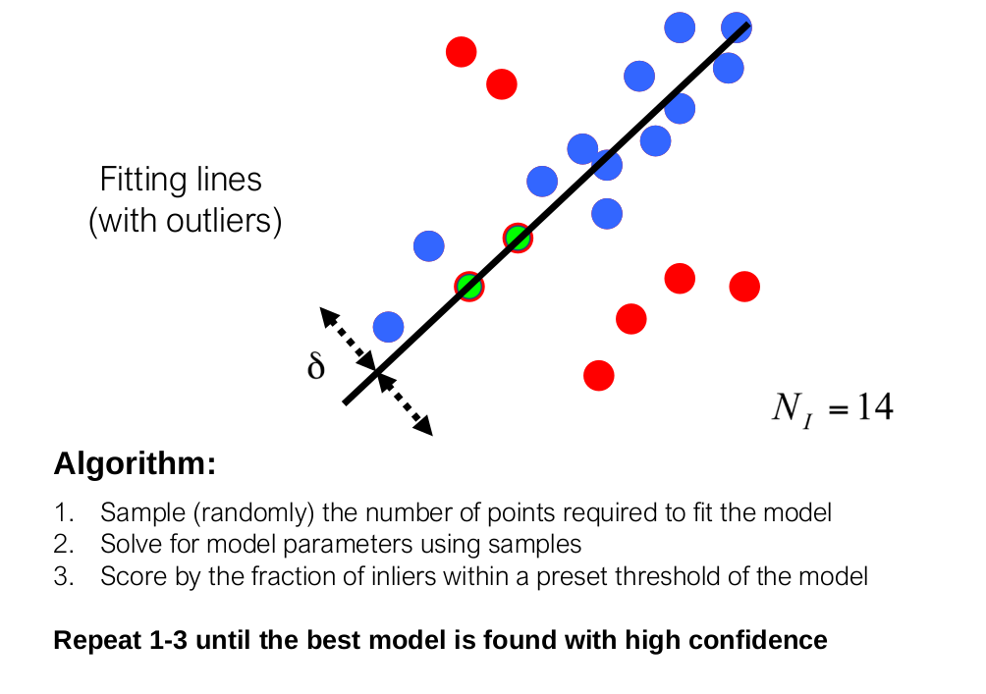

Slide 6
Implementation

Slide 7
Advantages of RANSAC:
Robust to outliers
Least mean squares

Slide 8
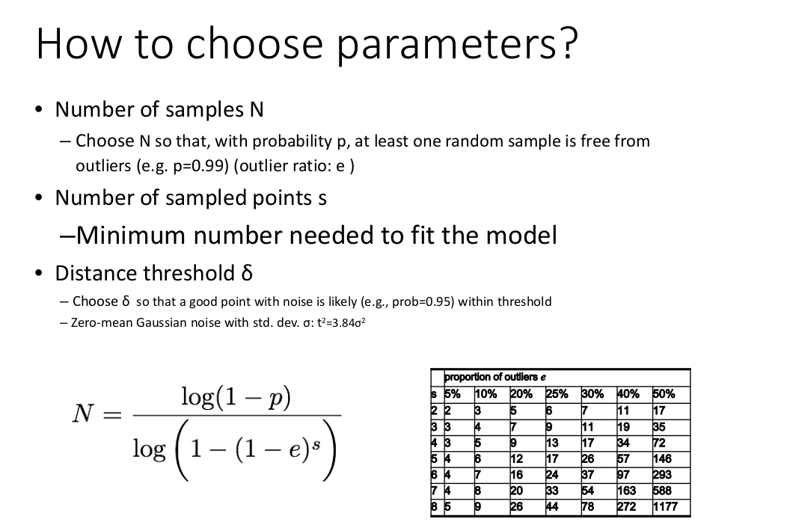

Slide 9
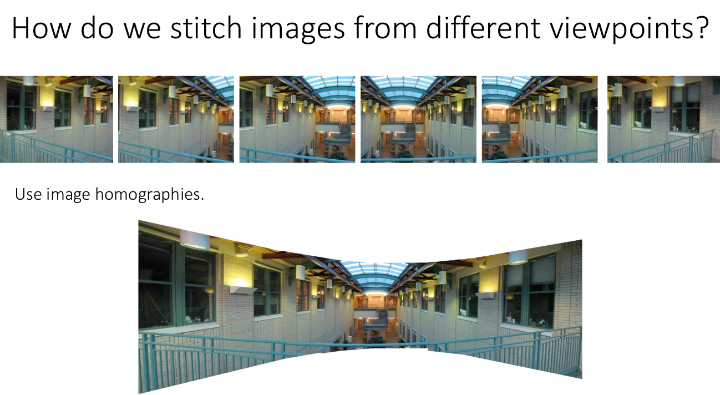
Example:

Slide 10
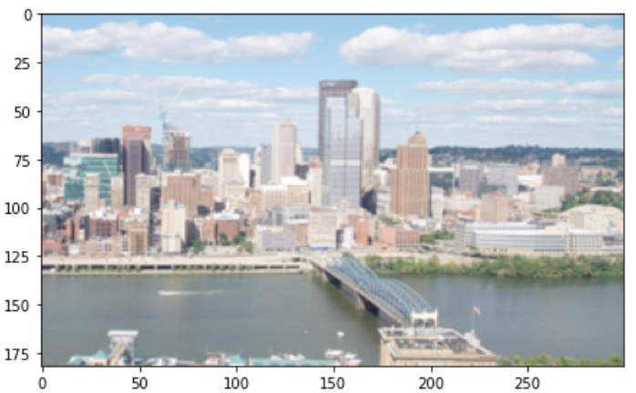
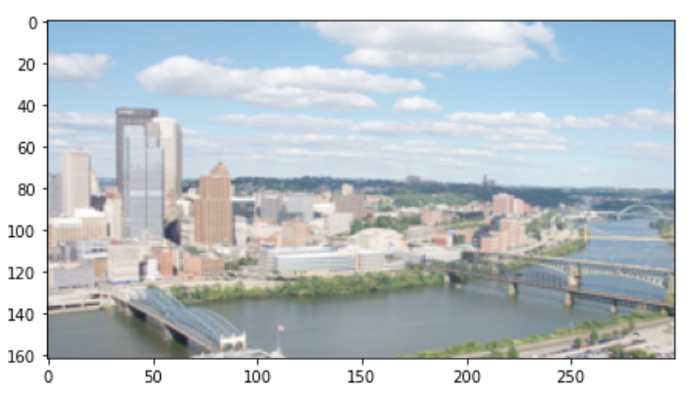
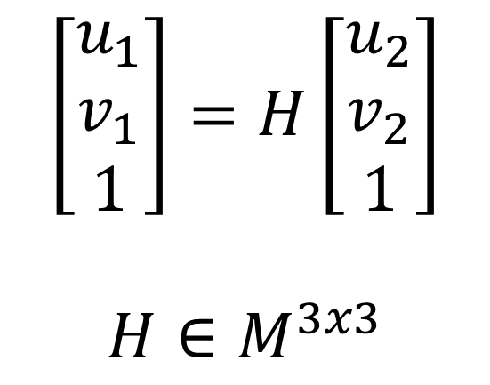
Picture 1
Model:
$$\left[\begin{matrix}u_{1} \\ v_{1} \\ 1\end{matrix}\right]=H\left[\begin{matrix}u_{2} \\ v_{2} \\ 1\end{matrix}\right]$$
$$H∈M^{3x3}$$
Picture 2

Slide 11
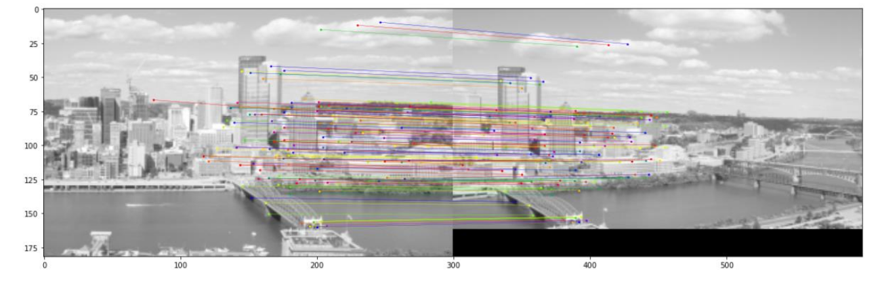
Correspondence given by surf features

Slide 12

Random 4 matches to compute $H$
Points from right picture after homography

Slide 13
Match considered outlier
Match considered inlier
Fixed tolerance radius

Slide 14
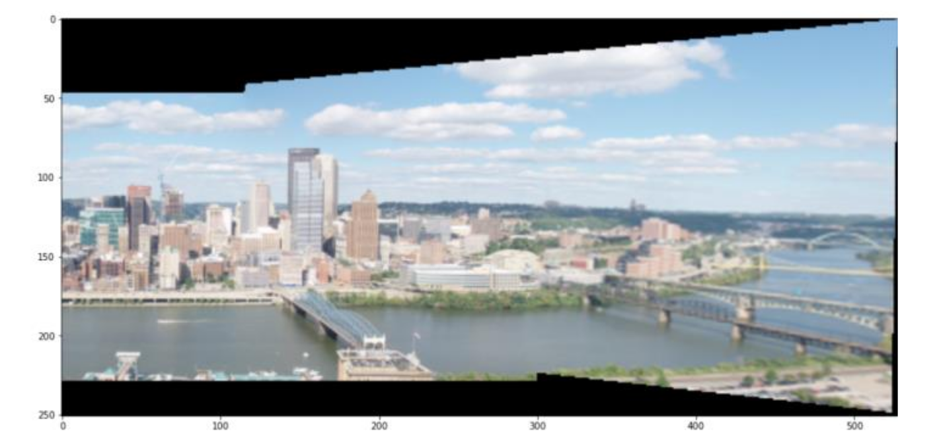

Slide 15
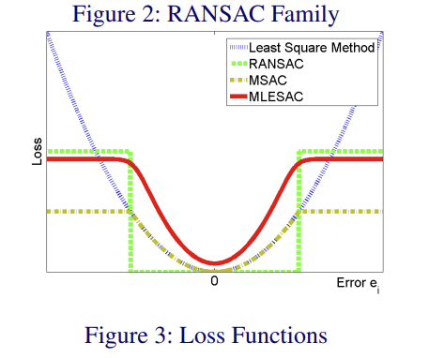
Further insight:
RANSAC vs LMS

