Slide 1

A robust method for fitting a model to noisy measurements
Alon Spinner
Oren Elmakis

Slide 2
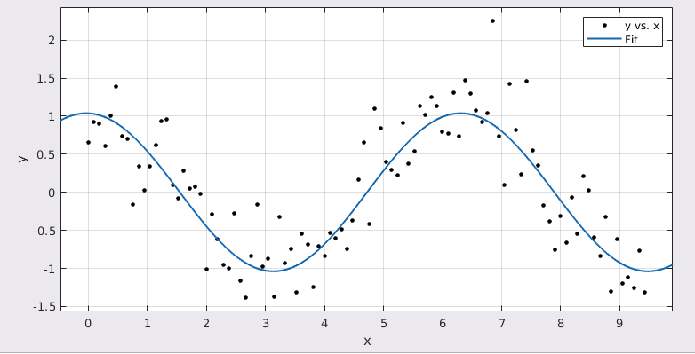
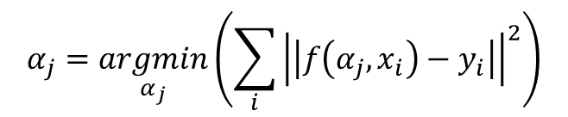
Fitting a model to noisy data via Least Mean Squares
$$α_{j}=\underset{α_{j}}{argmin}\left(\sum_{i}{{\left|\left|f\left(α_{j},x_{i}\right)−y_{i}\right|\right|}^{2}}\right)$$
$$f(α,x)=α_{1}sin⁡(α_{2}x+α_{3})$$

Slide 3
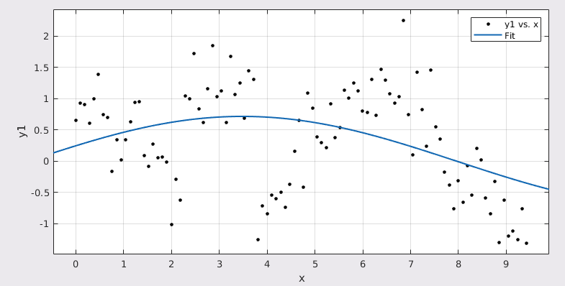
LMS is not robust to outliers
LMS fit: sine + gaussian noise
LMS fit: sine + gaussian noise + shift

Slide 4
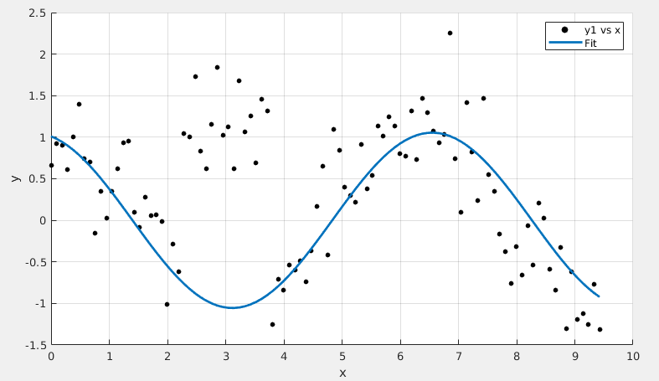
RANSAC is an algorithm that is robust to such outliers
RANSAC + LMS fit: sine + gaussian noise + shift

Slide 5
The RANSAC Method

Slide 6
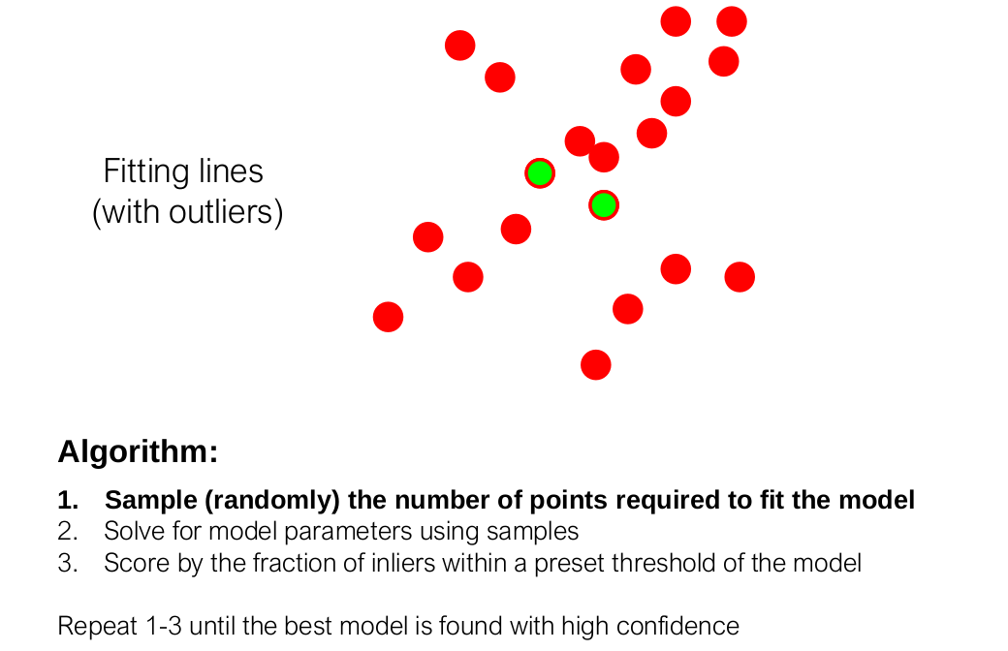

Slide 7
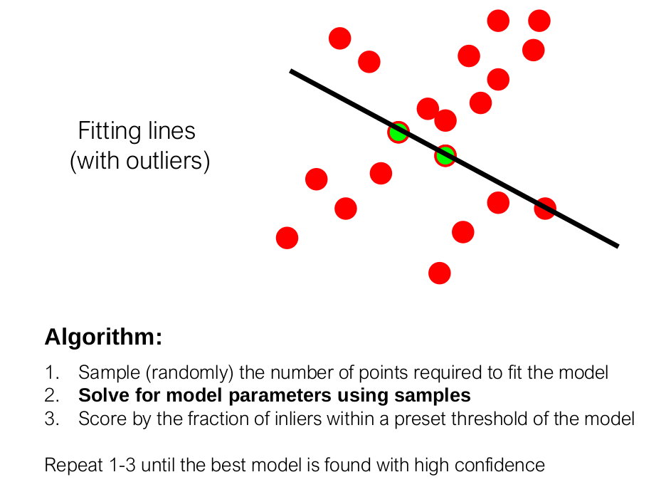

Slide 8
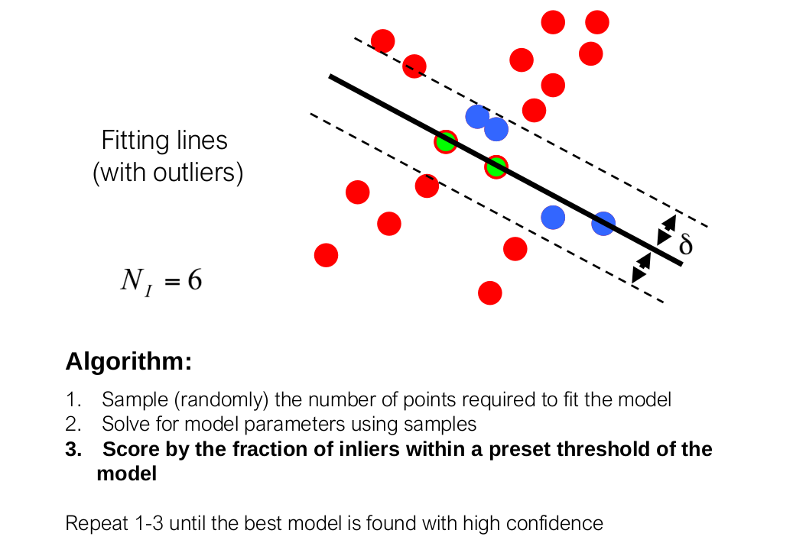

Slide 9
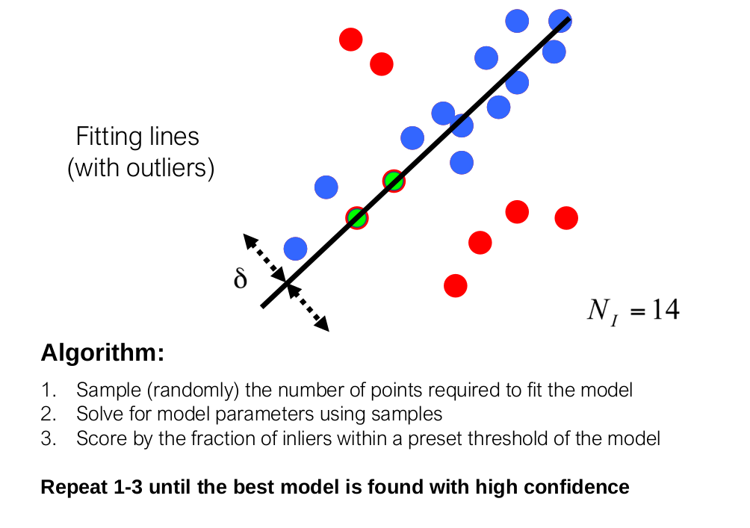

Slide 10
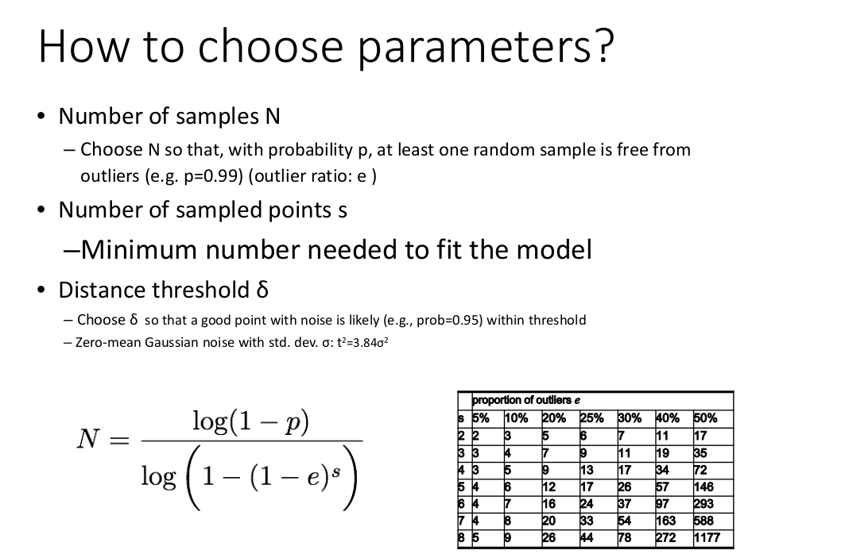
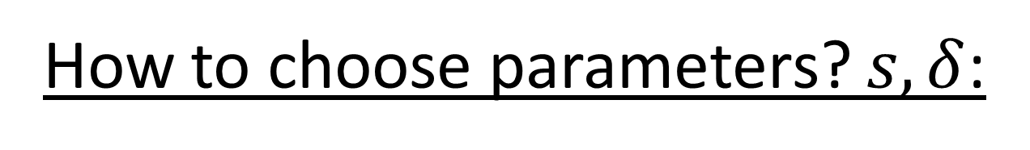
How to choose parameters? $s,δ$:

Slide 11
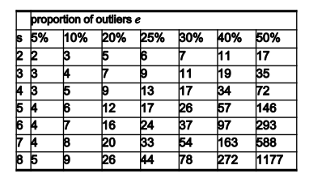
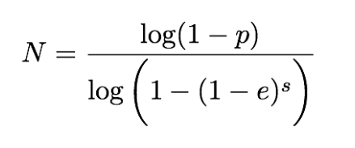
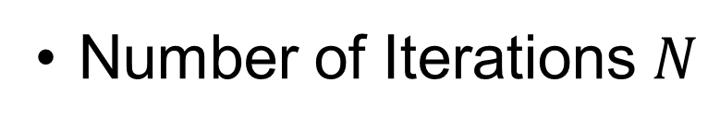
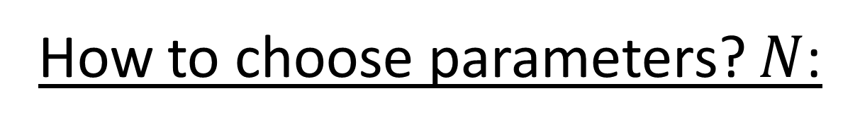
How to choose parameters? $N$:
Number of Iterations $N$

Slide 12
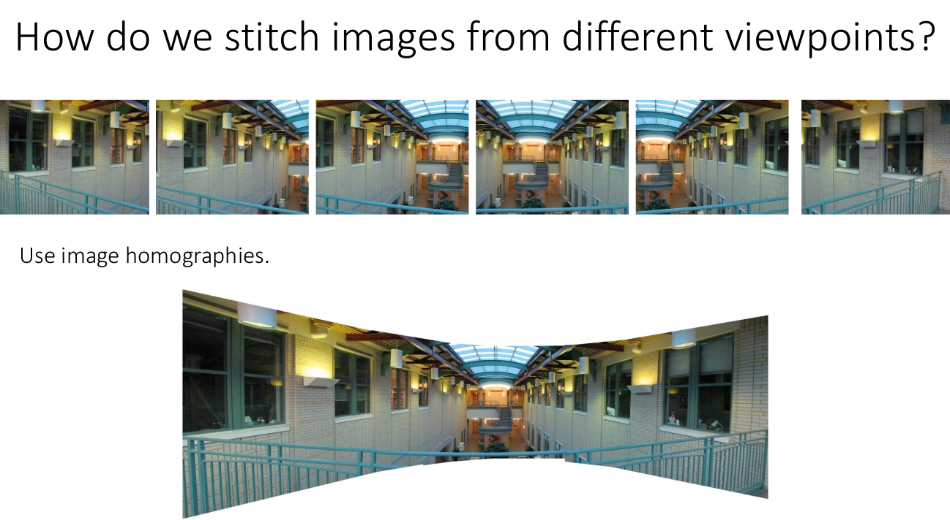
Example:

Slide 13
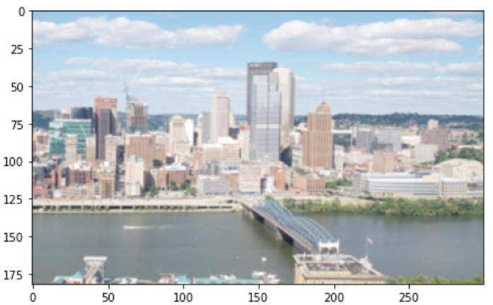
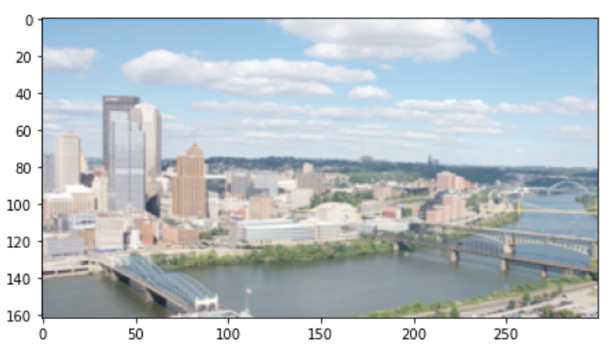




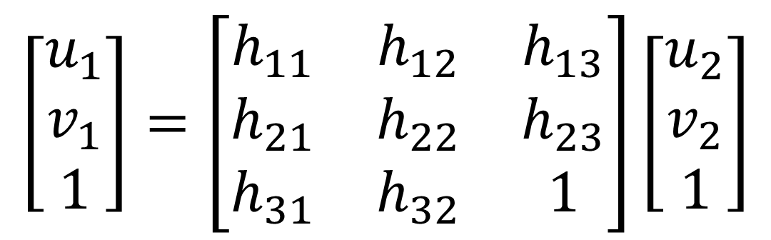
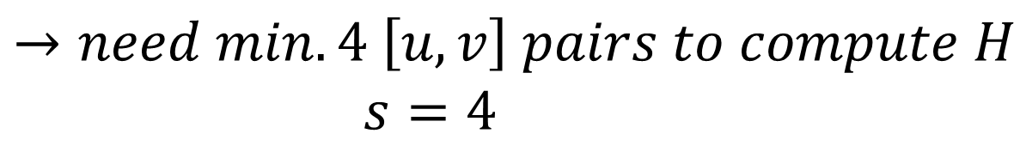
Picture 1
Model:
Point correspondents have the following connection:
$$v_{1}$$
$$\left[\begin{matrix}u_{1} \\ v_{1} \\ 1\end{matrix}\right]=\left[\begin{matrix}h_{11} & h_{12} & h_{13} \\ h_{21} & h_{22} & h_{23} \\ h_{31} & h_{32} & 1\end{matrix}\right]\left[\begin{matrix}u_{2} \\ v_{2} \\ 1\end{matrix}\right]$$
$$u_{1}$$
Picture 2
$$v_{2}$$
$$→need min. 4 \left[u,v\right] pairs to compute H$$
$$s=4$$
$$u_{2}$$

Slide 14
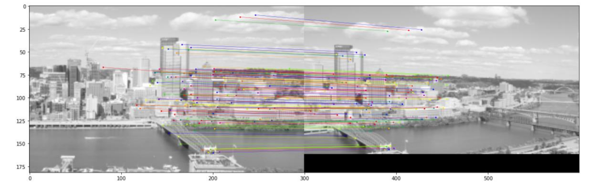
Correspondence given by surf features

Slide 15
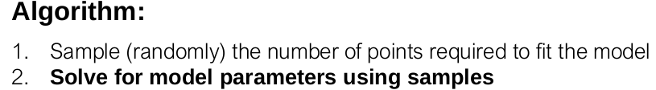

Random 4 matches to compute $H$

Slide 16
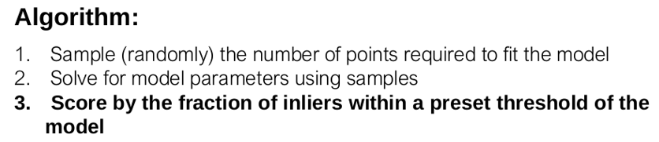

Match considered outlier
Match considered inlier
Fixed tolerance radius $δ$

Slide 17
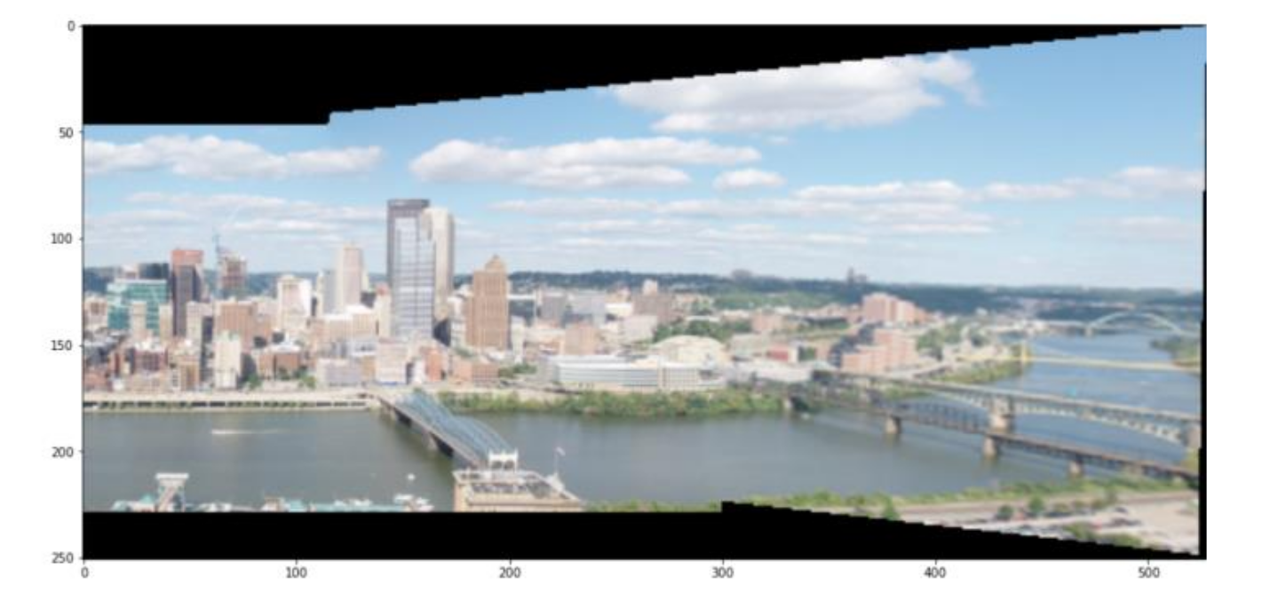

Panorama with our $H_{RANSAC}$

Slide 18
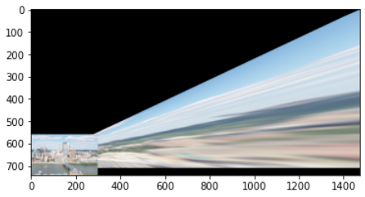
Panorama with $H_{Someone that we have no relations to whatsoever}$

Slide 19
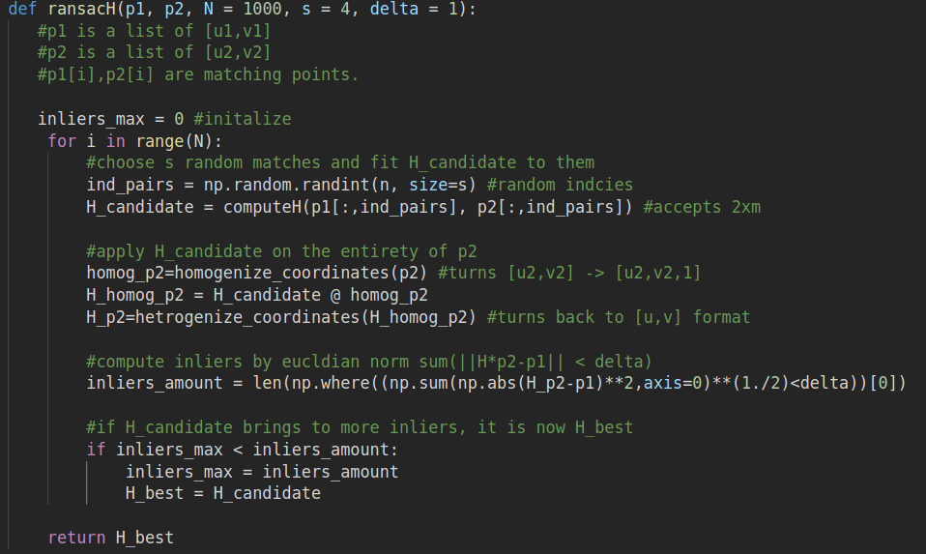

Slide 20
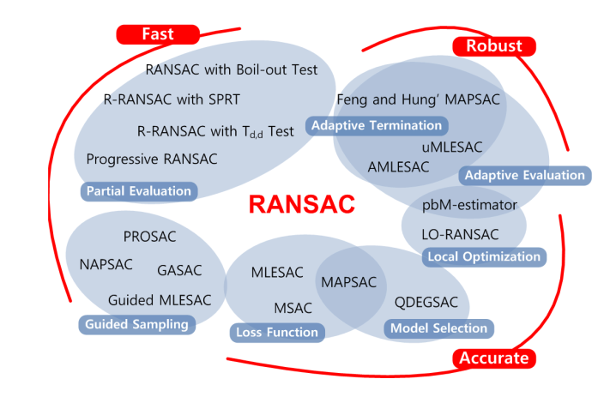
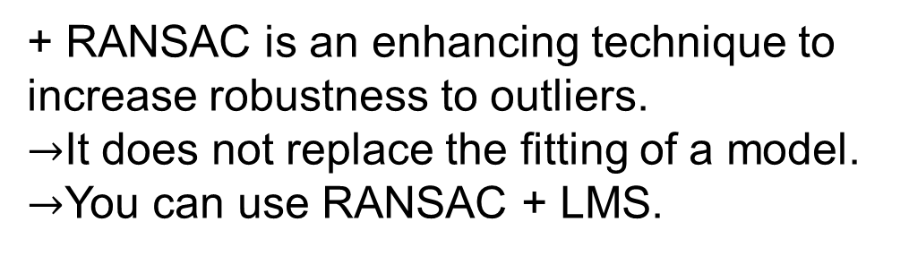
+ RANSAC is an enhancing technique to increase robustness to outliers. $→$It does not replace the fitting of a model. $→$You can use RANSAC + LMS.
+ RANSAC is just the beginning. There are flavors (and other robust fitting techniques)
Computationally expensive, and really bad on a high search spaces
“Performance Evaluation of RANSAC Family” by Sunglok Choi et al.
No learning between iterations
No certification (does not report success/failure)

