Slide 1
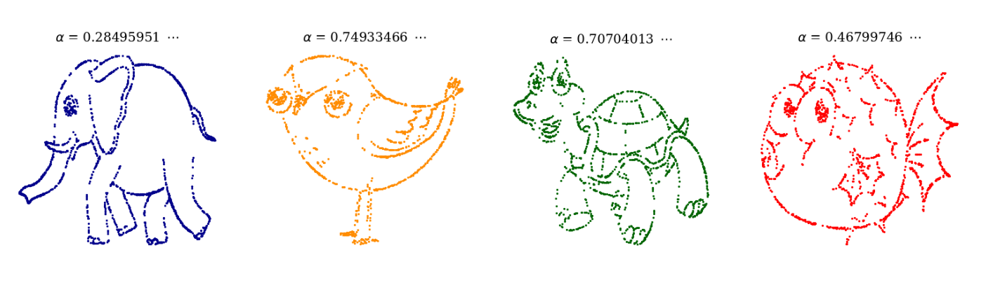

Slide 2
Part 1. Donald Duck - Motivation

Slide 3
Part 2. Mathematical Background
Binary Representation

Slide 4
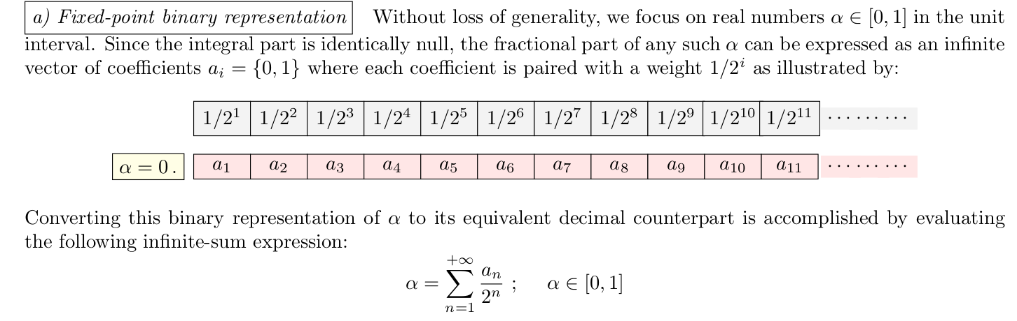

Slide 5
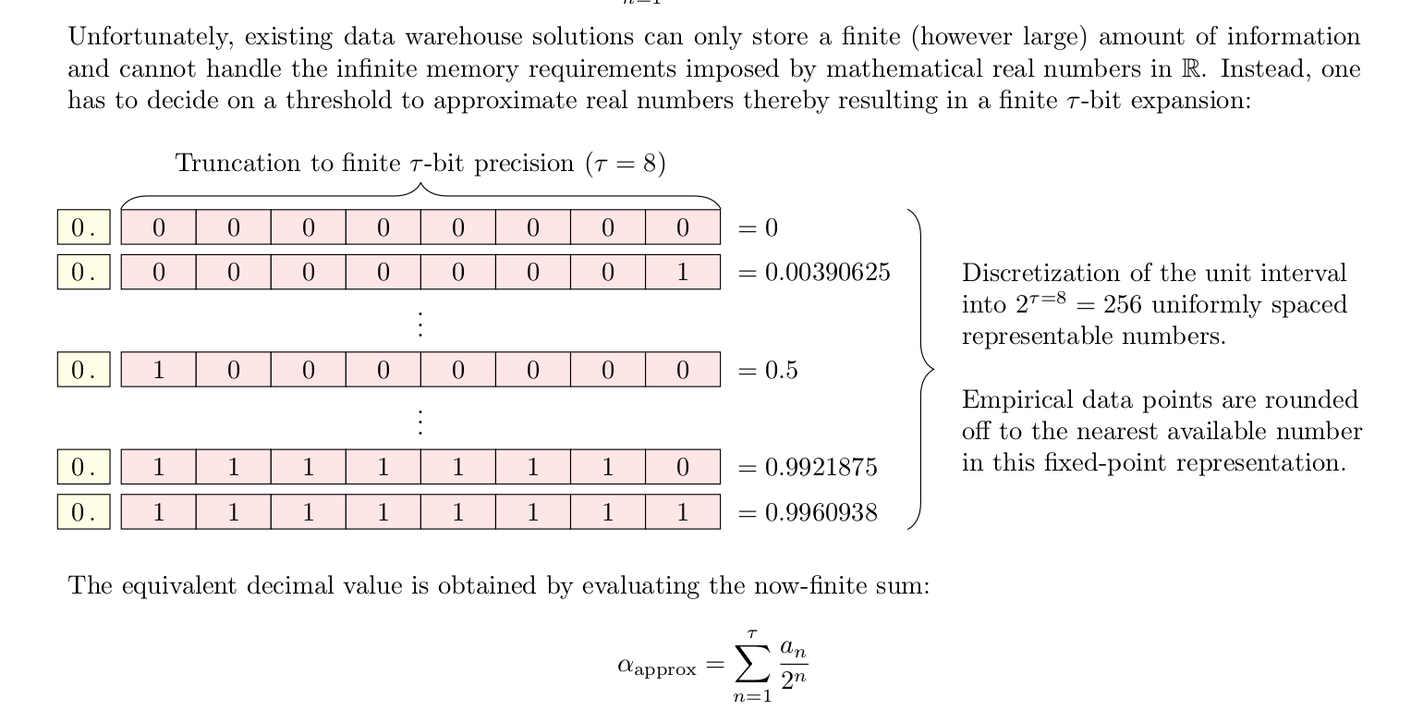

Slide 6
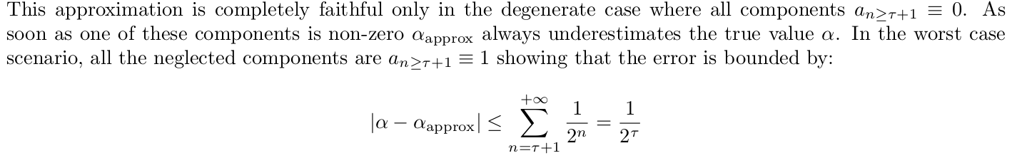

Slide 7
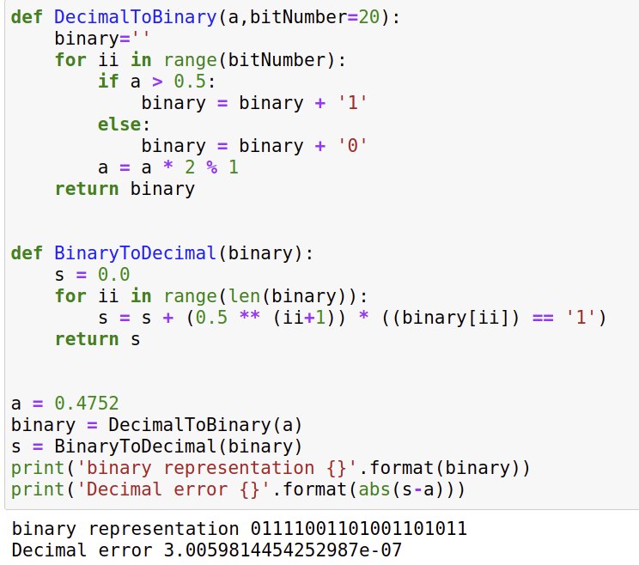

Slide 8
Part 2. Mathematical Background
Encoding

Slide 9
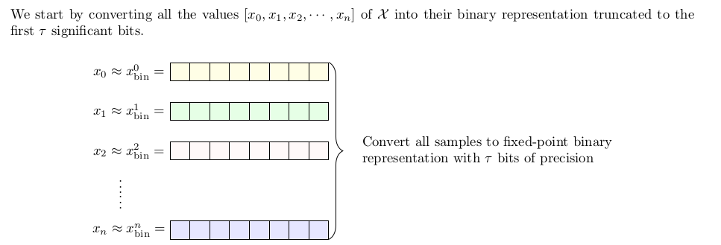

Slide 10
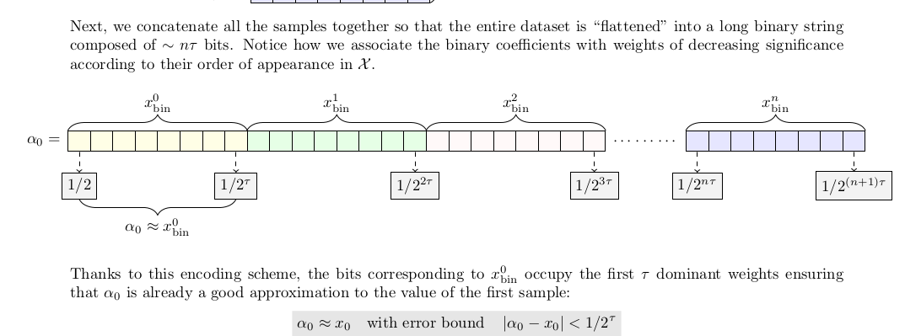

Slide 11
Part 2. Mathematical Background
Decoding

Slide 12
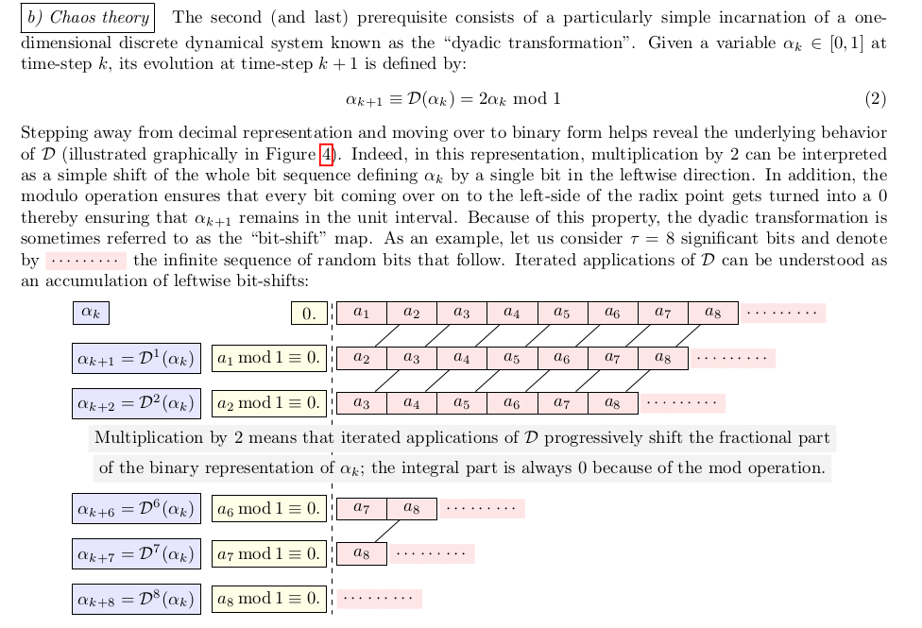

Slide 13
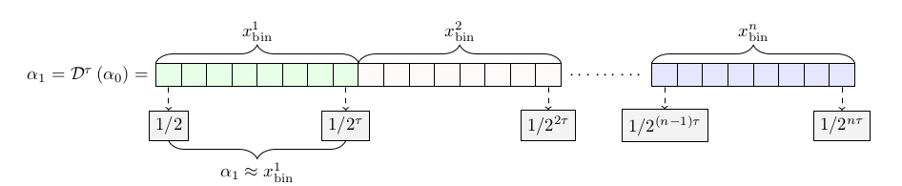
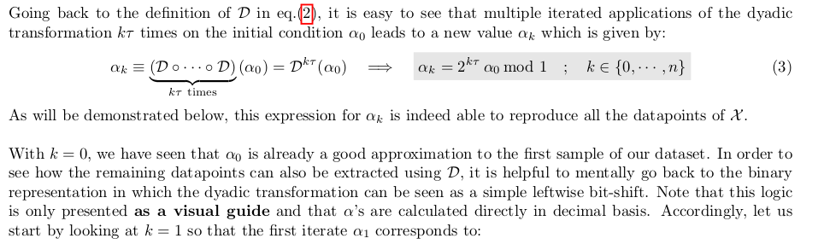

Slide 14
Part 3. Application

