Slide 1
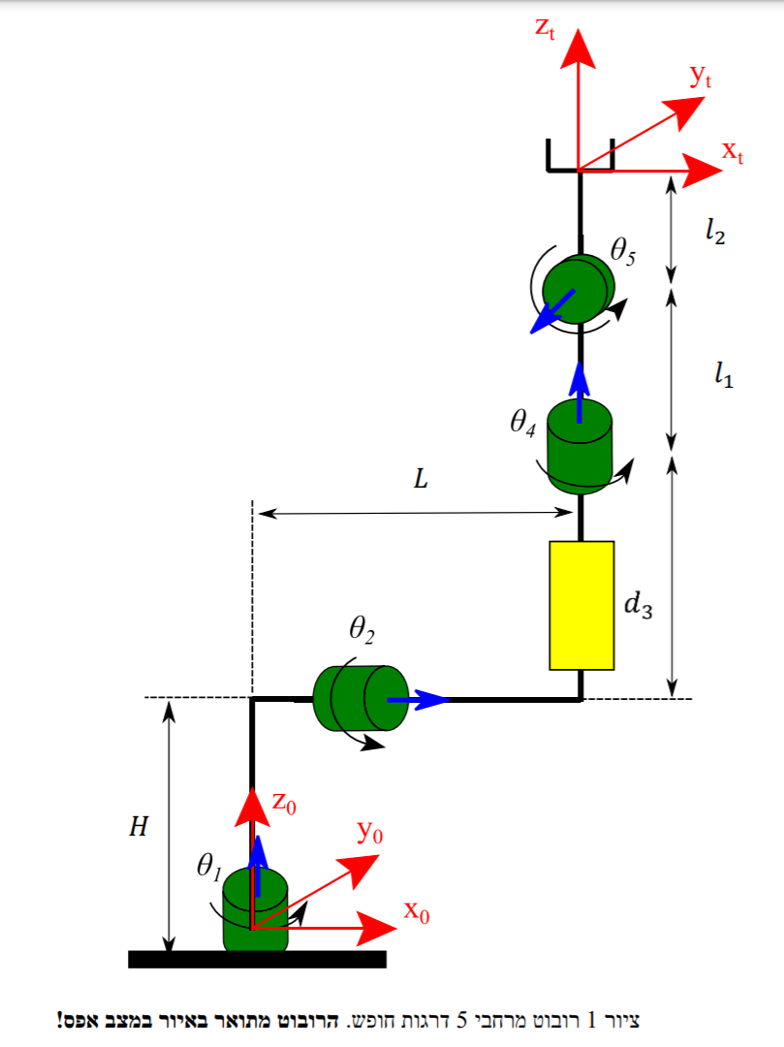












$$z_{4,5}$$
$$y_{4,5}$$
$$x_{4,5}$$
$$z_{3}$$
$$y_{3}$$
$$x_{3}$$
$$z_{1}$$
$$z_{2}$$
$$y_{1}$$
$$y_{2}$$
$$x_{1}$$
$$x_{2}$$

Slide 2

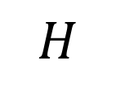








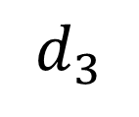

$$z_{t}$$
$$y_{t}$$
$$x_{t}$$
$$CG_{4}$$
$$CG_{3}$$
$$d_{3}$$
$$L$$
$$CG_{2}$$
$$θ_{2}$$
$$CG_{1}$$
$$H$$
$$θ_{1}$$

Slide 3
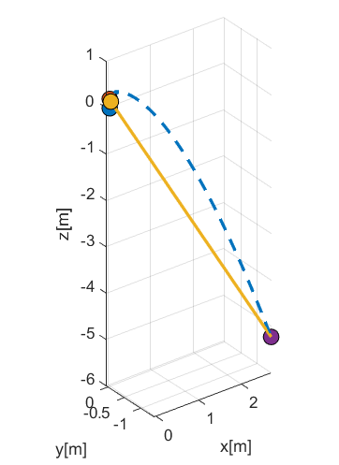
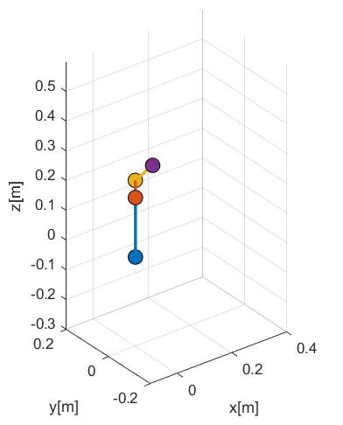


$$t=0[s]$$
$$t=2[s]$$

Slide 4
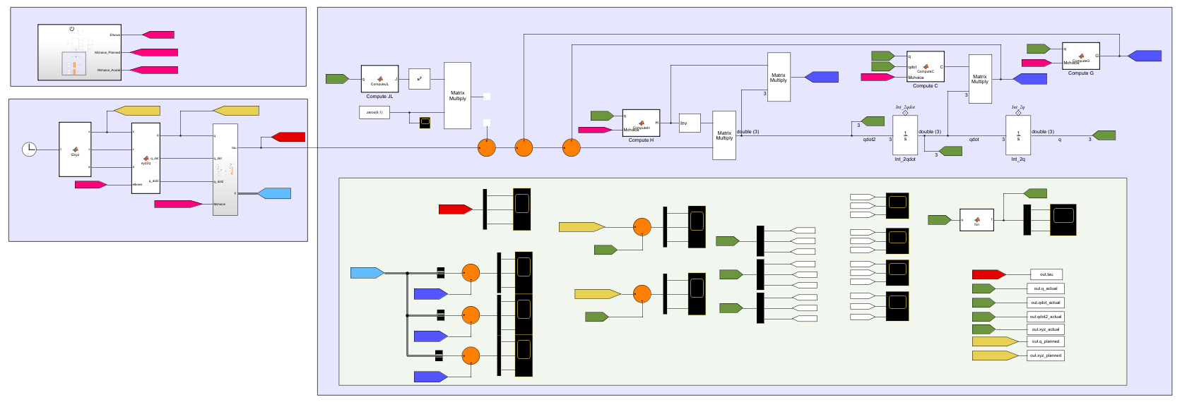
State Initializing
Plant
Open-loop Controller
Scoping and Verifying Model

Slide 5
