Slide 1



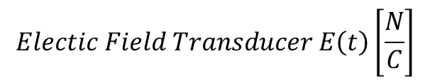

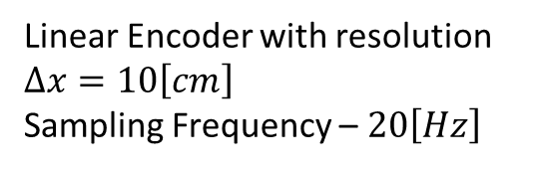
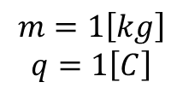

$$θ\left(t\right)$$
$$L=1\left[m\right]$$
$$Electic Field Transducer E\left(t\right)\left[\frac{N}{C}\right]$$
$$m=1\left[kg\right]$$
$$q=1\left[C\right]$$
$$F=Eq$$
$$mg$$
Linear Encoder with resolution $Δx=10\left[cm\right]$
Sampling Frequency – $20\left[Hz\right]$
$$Lsin\left(θ\right)$$

Slide 2


$$θ\left(t\right)$$
$$L=1\left[m\right]$$
$$M=1\left[kg\right]$$
$$F(t)$$
$$mg$$
Linear Encoder with resolution $Δx=10\left[cm\right]$
Sampling Frequency – $20\left[Hz\right]$
$$Lsin\left(θ\right)$$

Slide 3
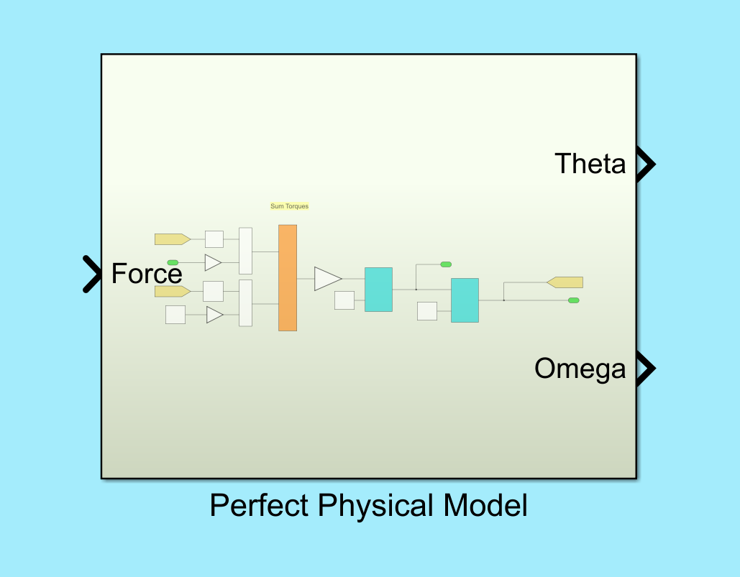
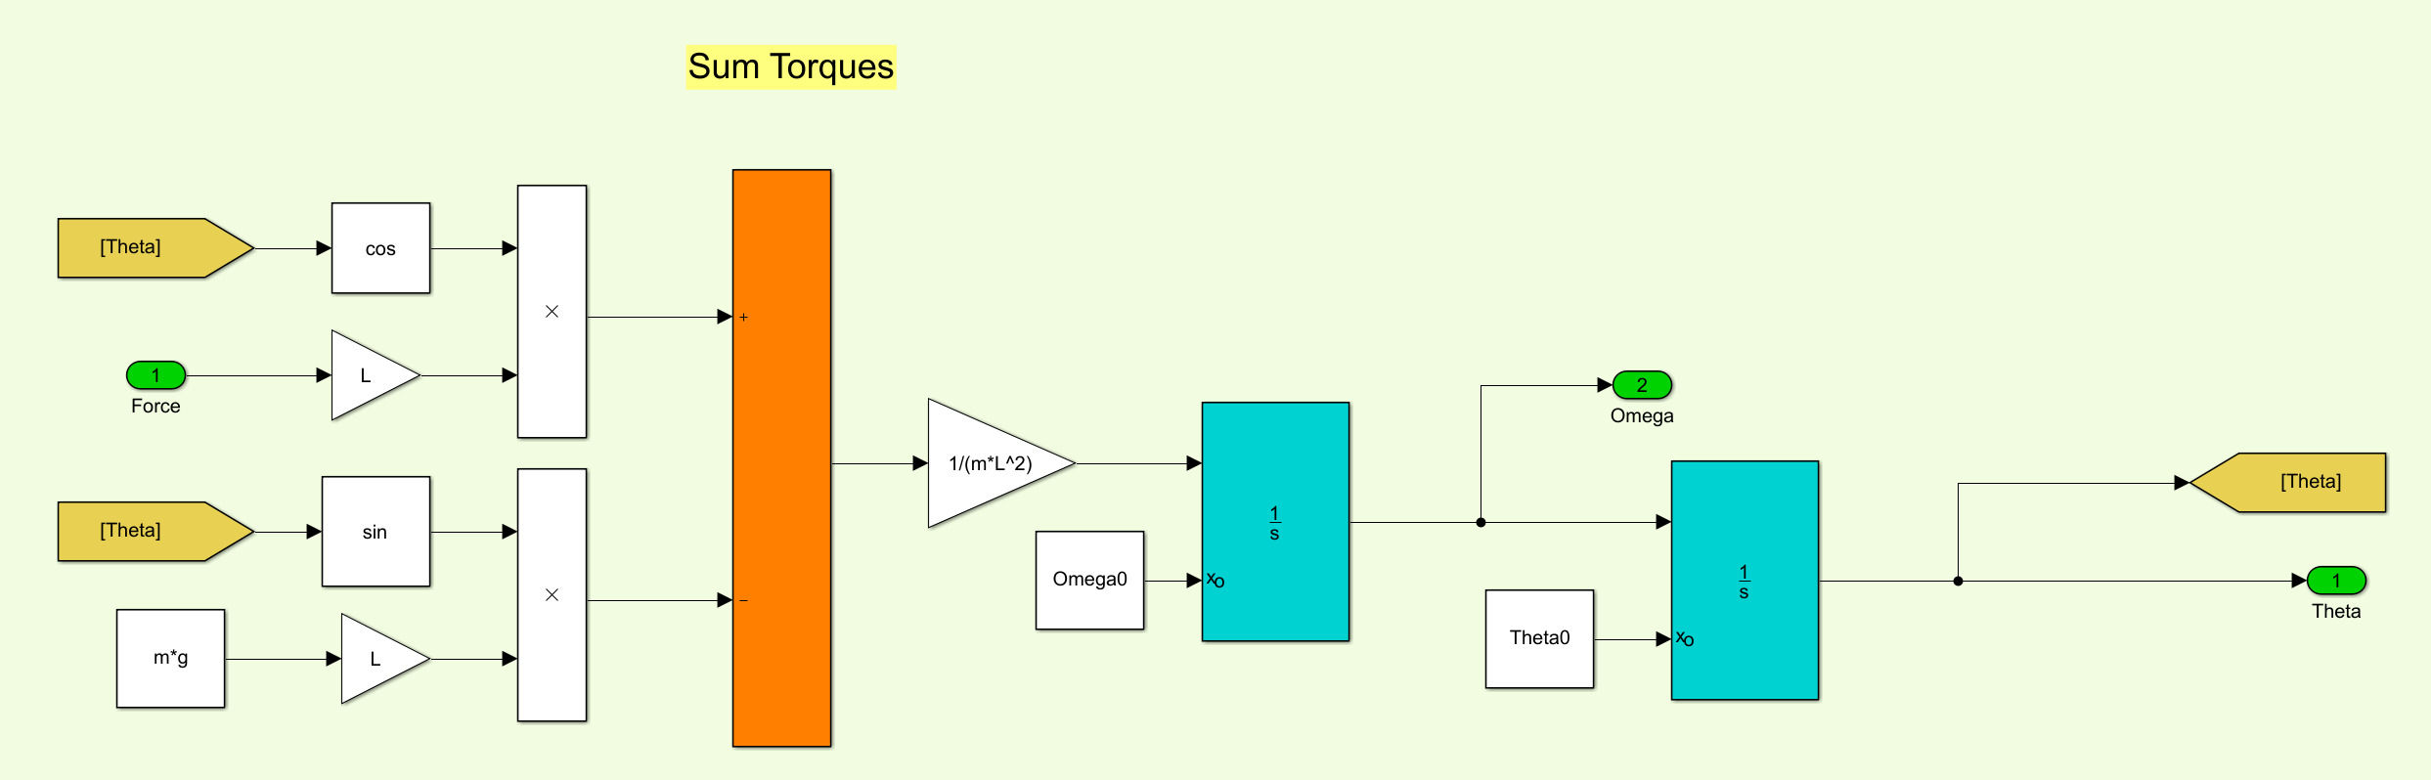

Slide 4
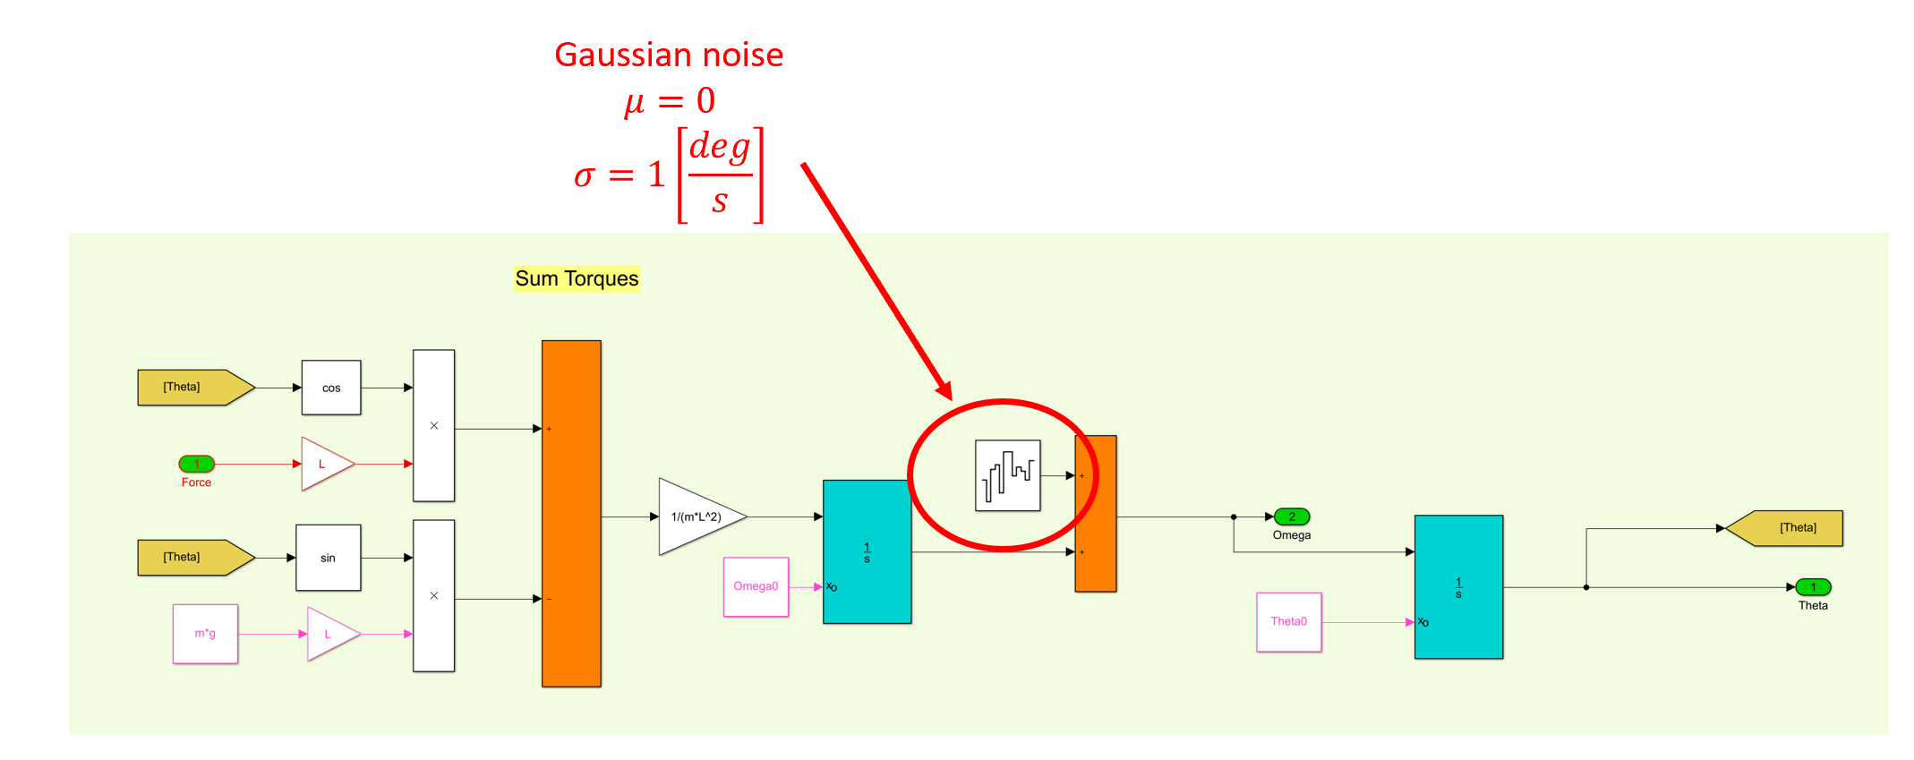

Slide 5
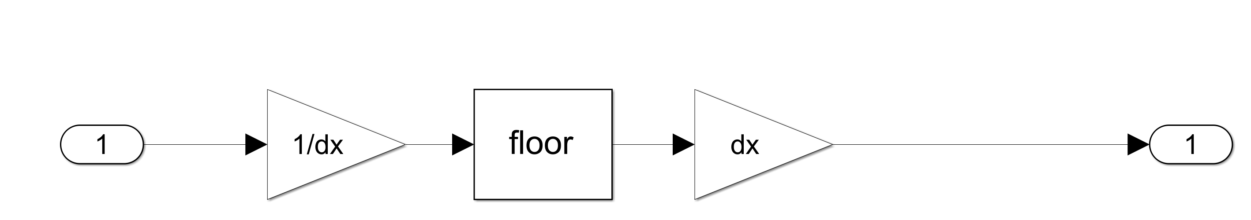
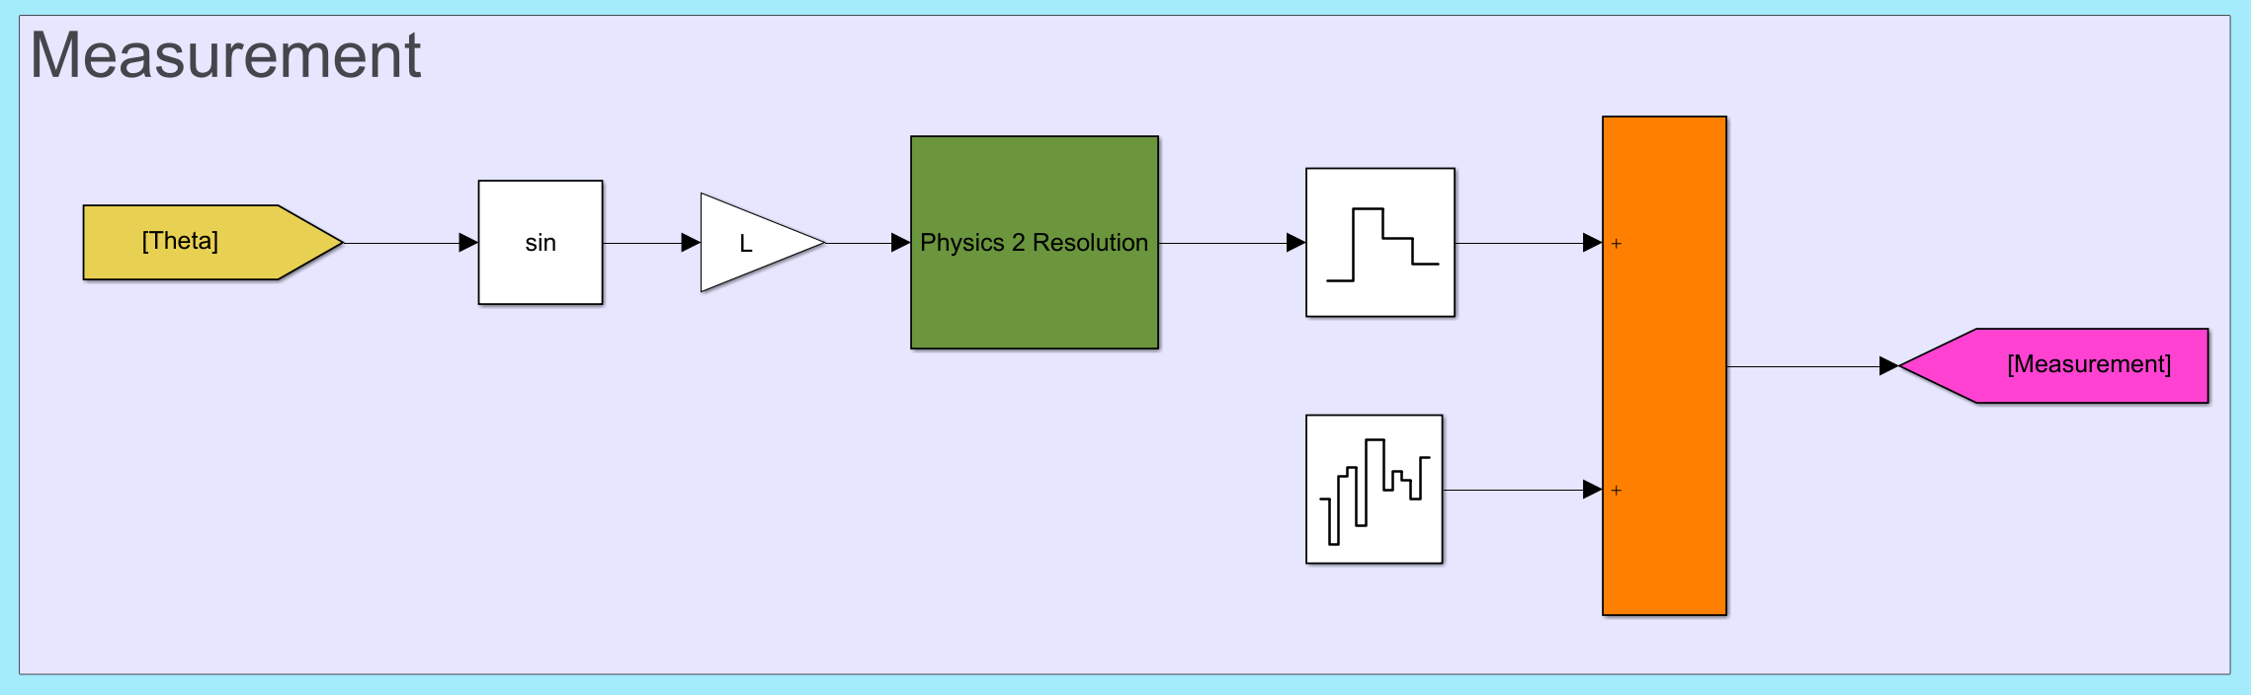
Rate Transition from continuous to Control Time Zero Order Hold

