Slide 1
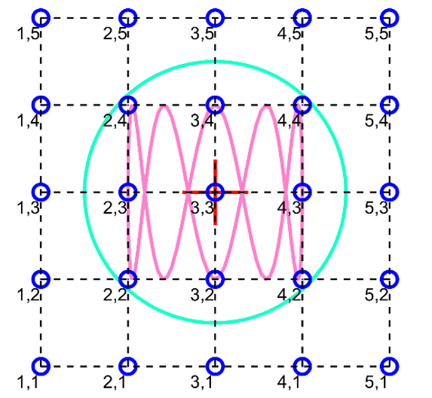

Slide 2
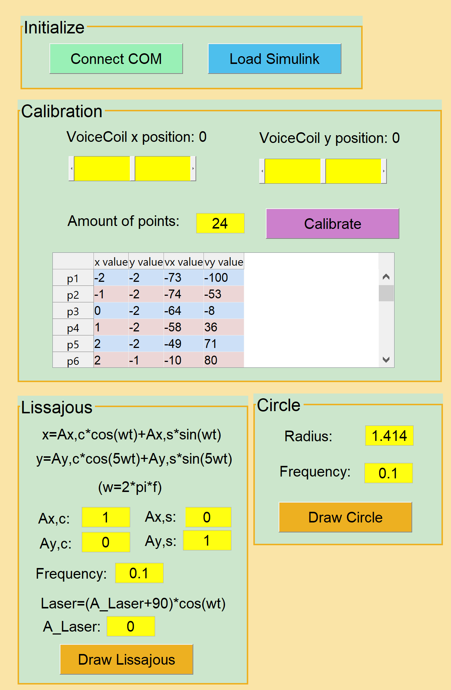
Assignment 1
Assignment 1
Assignment 2b and 2c

Slide 3
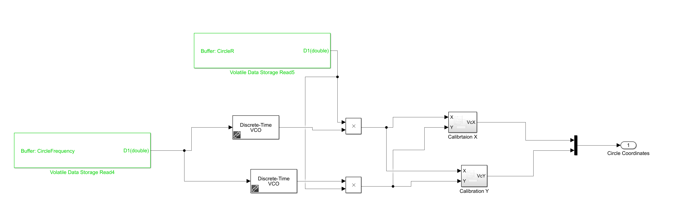
Circle Radius (UART)
Output to motors
Circle frequency (UART)
Construct Cosine and Sine
Multiply X,Y by calibration coefficient vectors (UART) to obtain vxc and vcy

Slide 4
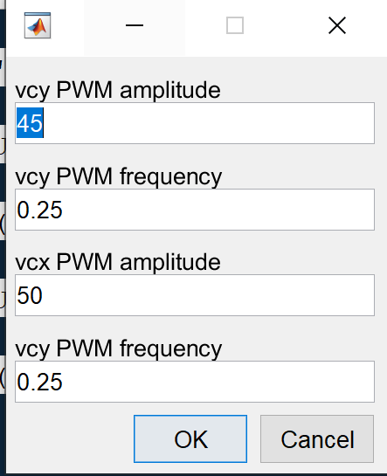

Slide 5
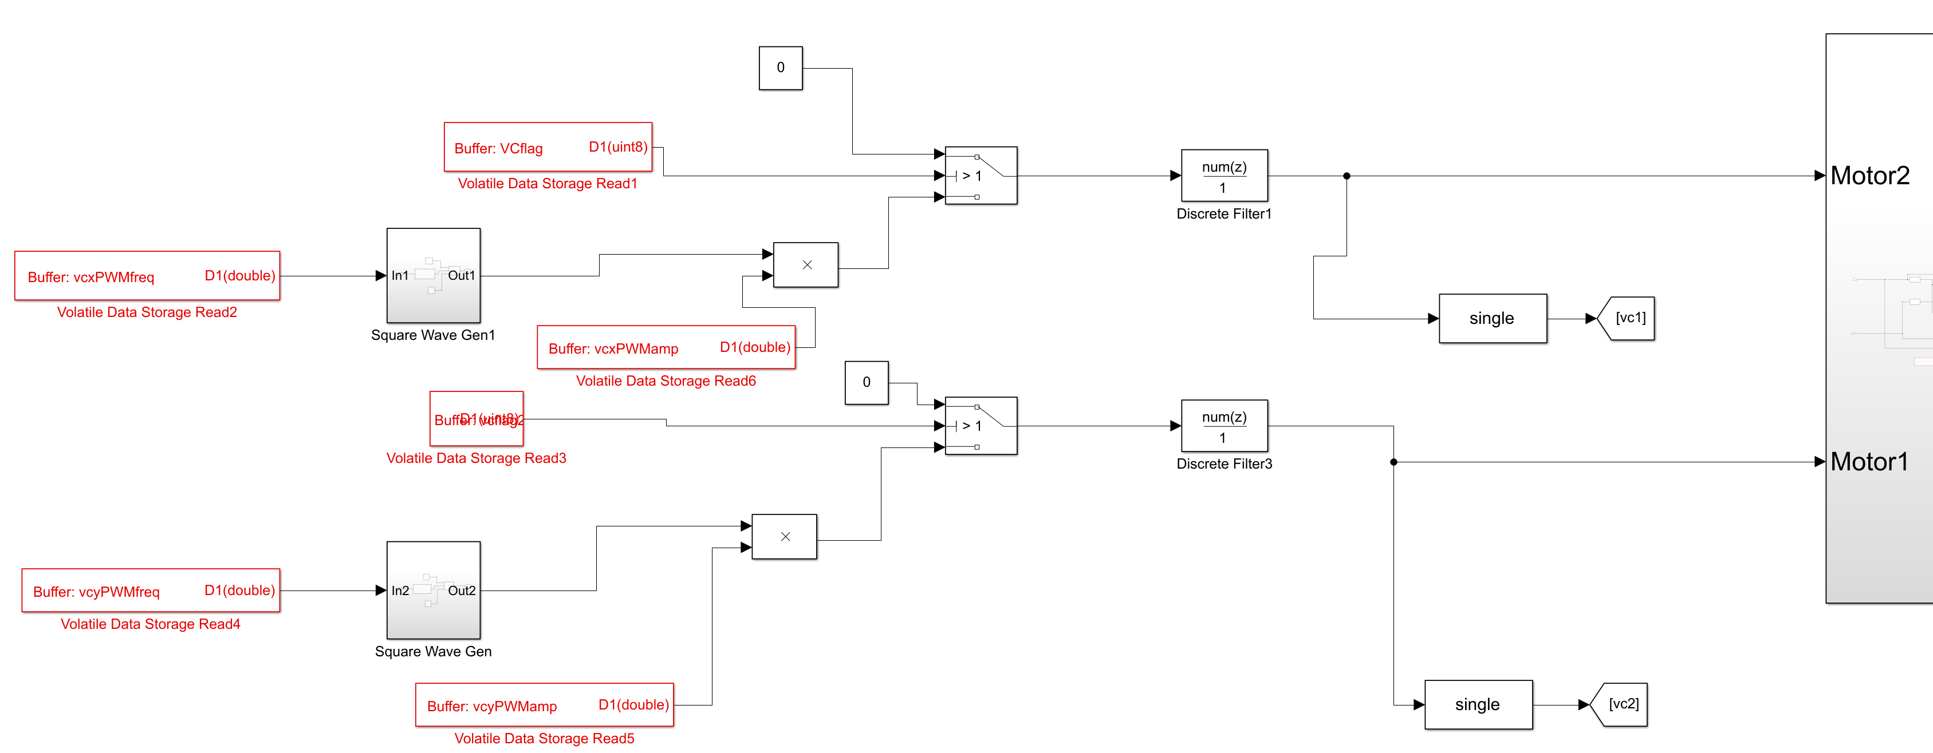
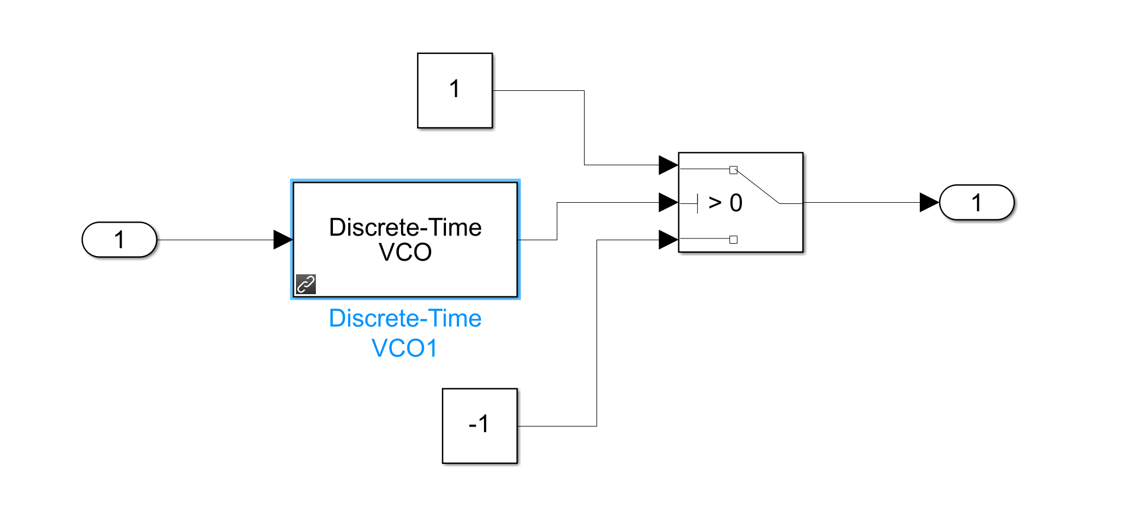


FIR filter
Multiply be amplitudes (from UART)
$v_{cx}$ frequency (UART)
$v_{cy}$ frequency (UART)
Switch statements for activation
Square wave generators
Block: Square wave gen

Slide 7
