Slide 1
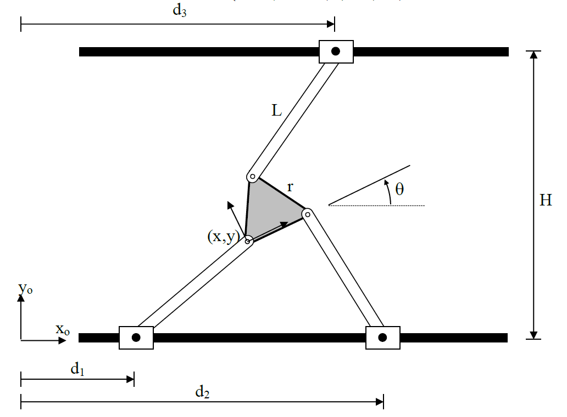






$$D_{3}$$
$$C$$
$$B$$
$$A$$
$$D_{1}$$
$$D_{2}$$

