Slide 1
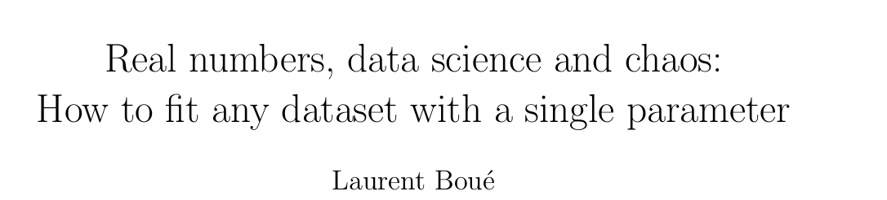
From…

Slide 2
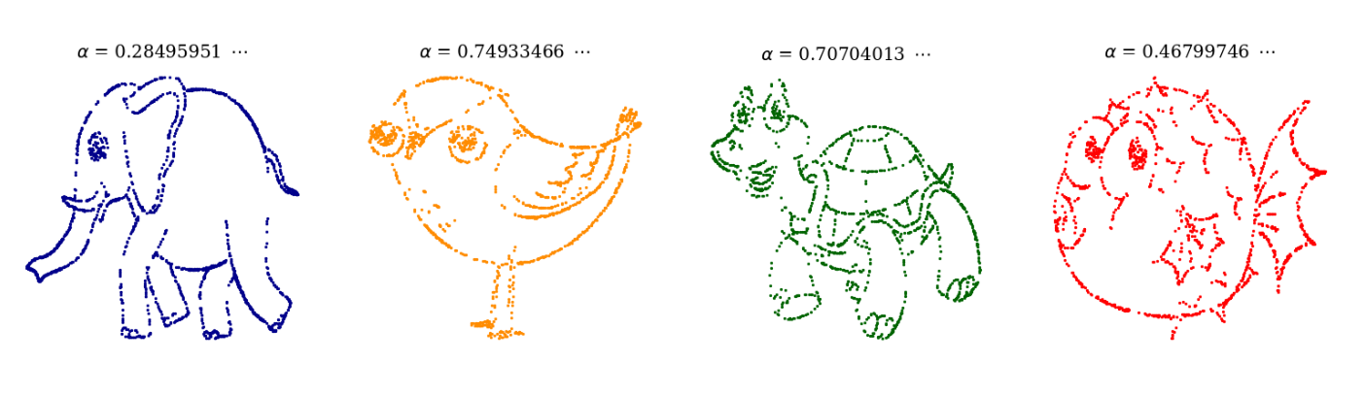
Part 1: Motivation

Slide 3
Part 2: Mathematical Background
Binary Representation

Slide 4
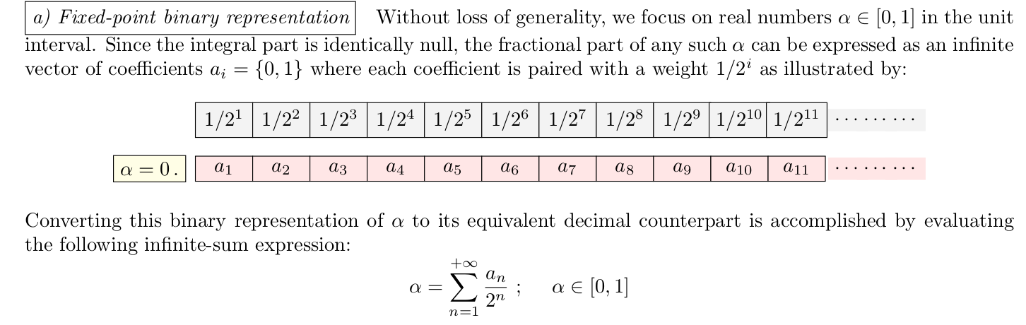

Slide 5
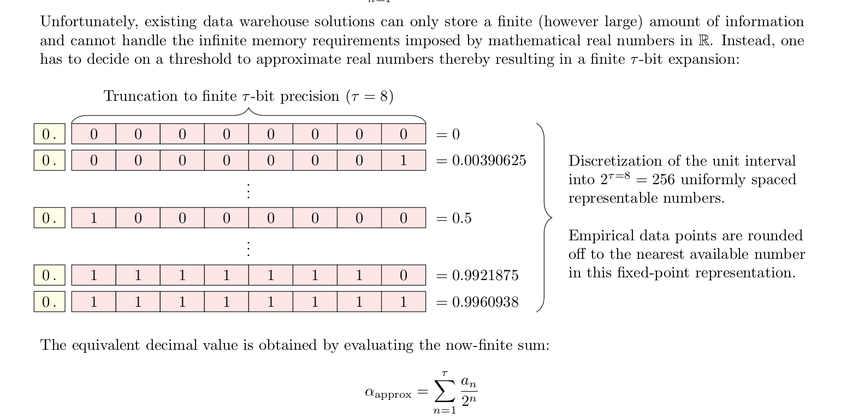

Slide 6
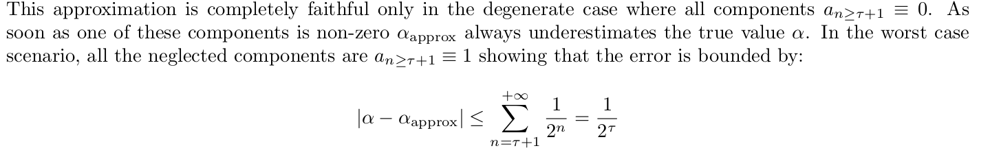

Slide 7
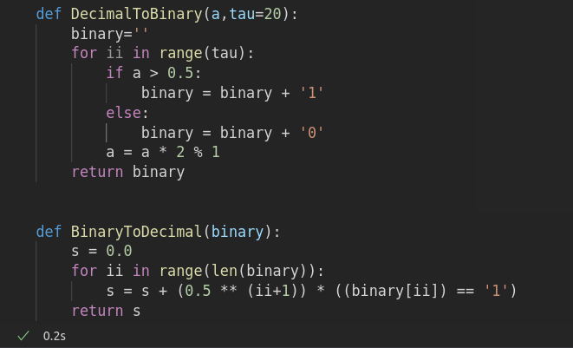
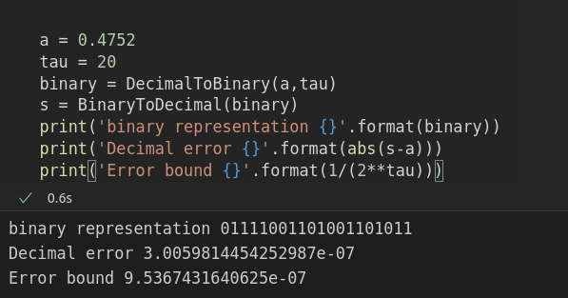

Slide 8
Part 2: Mathematical Background
Encoding

Slide 9
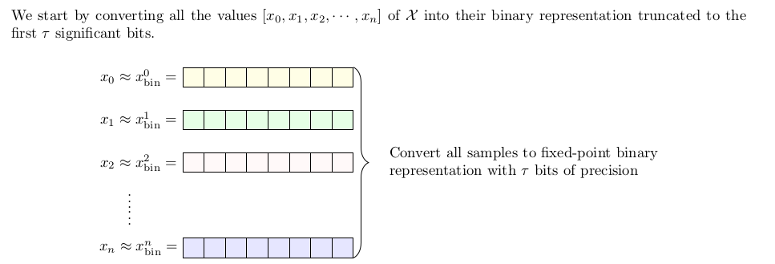
Encoding Step 1:

Slide 10
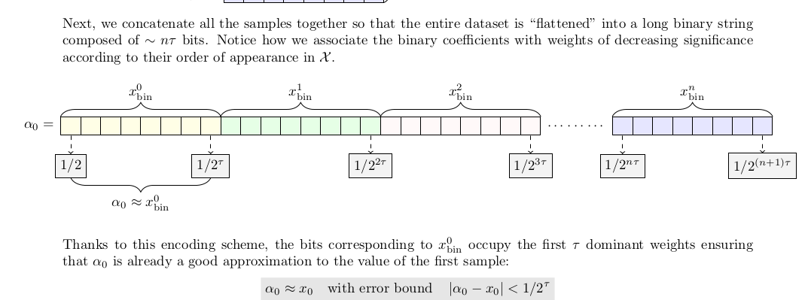
Encoding Step 2:

Slide 11
Encoding Step 3:
Computing $α_{0}$ by applying BinaryToDecimal on the binary string we created previously

Slide 12
Part 2: Mathematical Background
Decoding

Slide 13
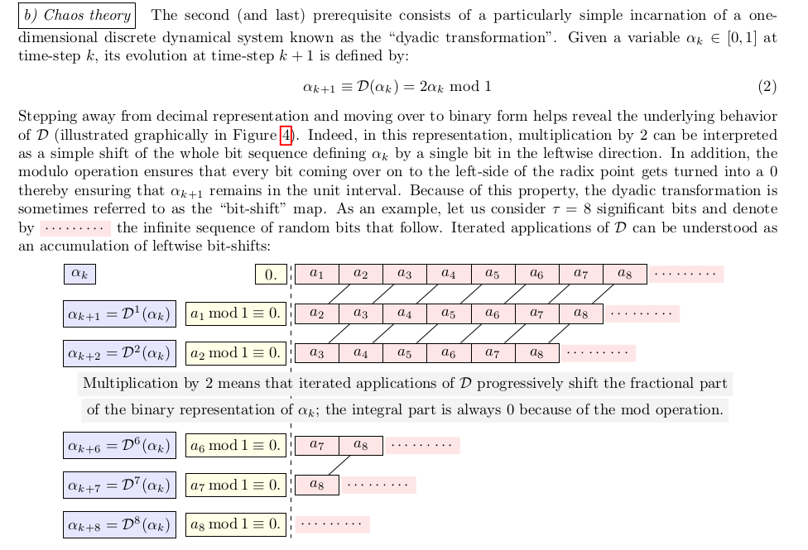

Slide 14
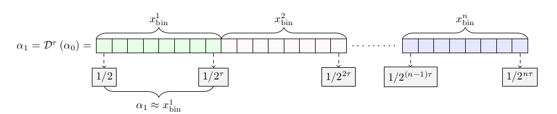
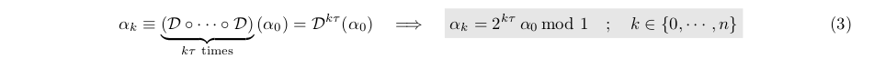

Slide 15
Part 3: Application
Jupyter notebooks: Presentation_sine.ipynb
Presentation_effiency.ipynb

