Slide 1
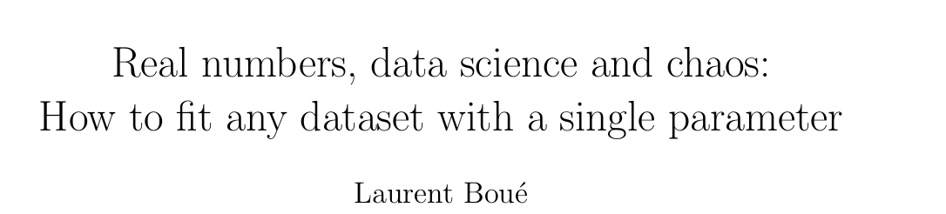
From…

Slide 2
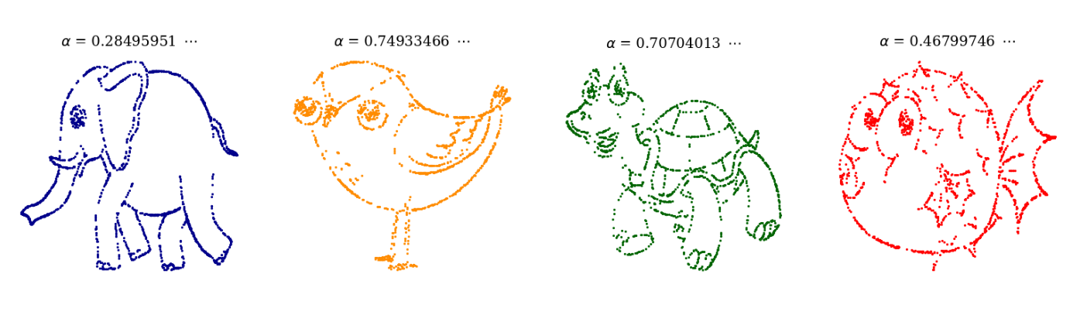
Part 1: Motivation

Slide 3
Part 2: Mathematical Background
Binary Representation

Slide 4
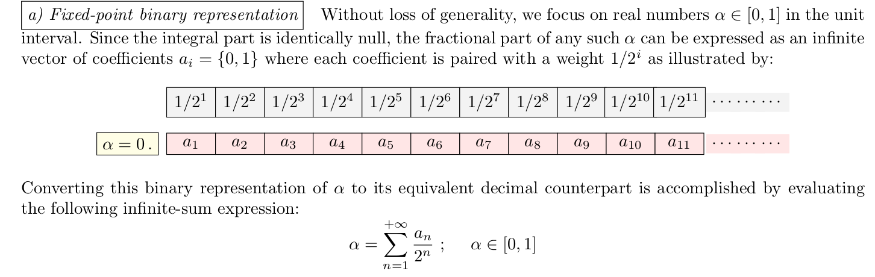

Slide 5
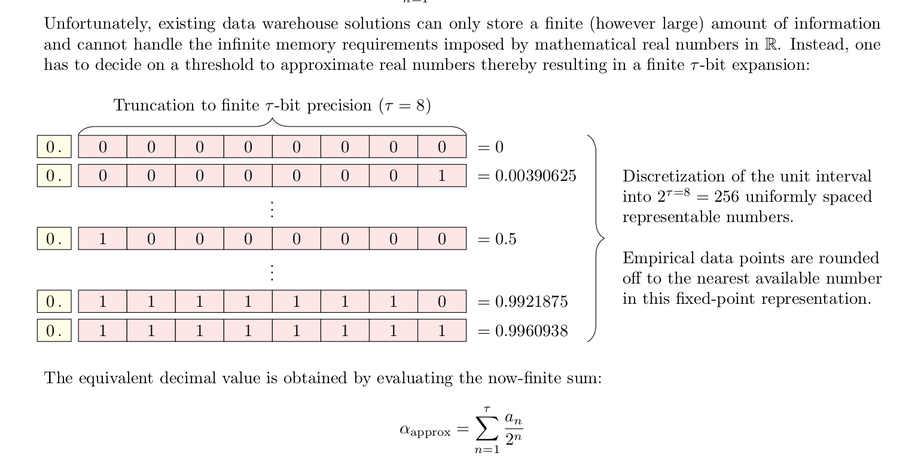

Slide 6
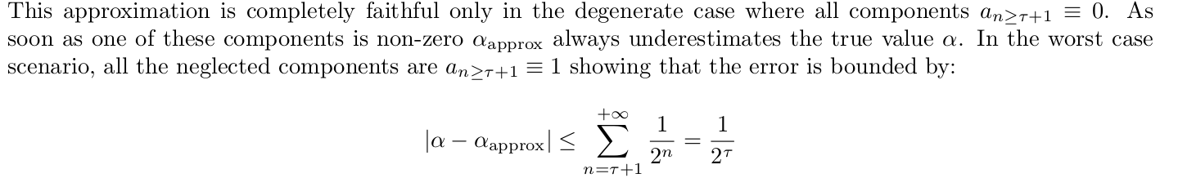

Slide 7
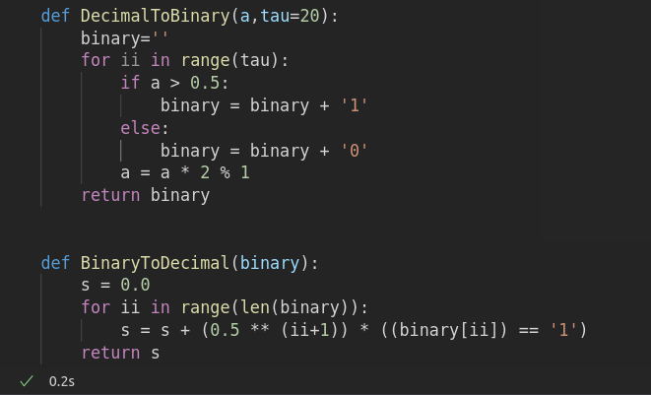
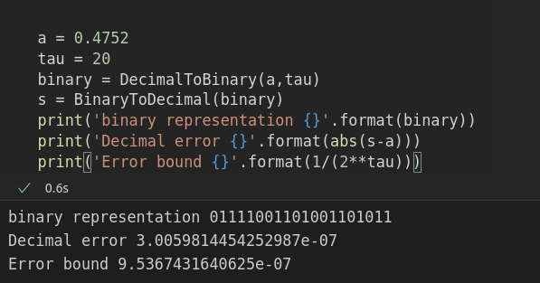

Slide 8
Part 2: Mathematical Background
Encoding

Slide 9
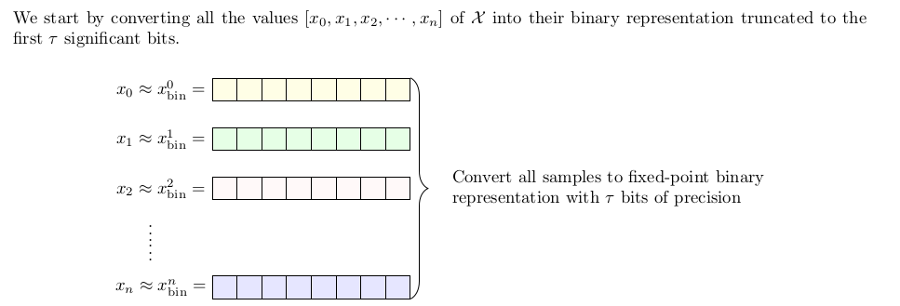
Encoding Step 1:

Slide 10
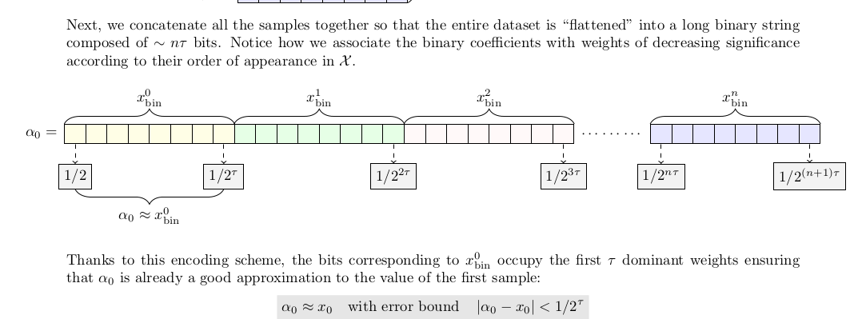
Encoding Step 2:

Slide 11
Encoding Step 3:
Computing $α_{0}$ by applying BinaryToDecimal on the binary string we created previously

Slide 12
Part 2: Mathematical Background
Decoding

Slide 13
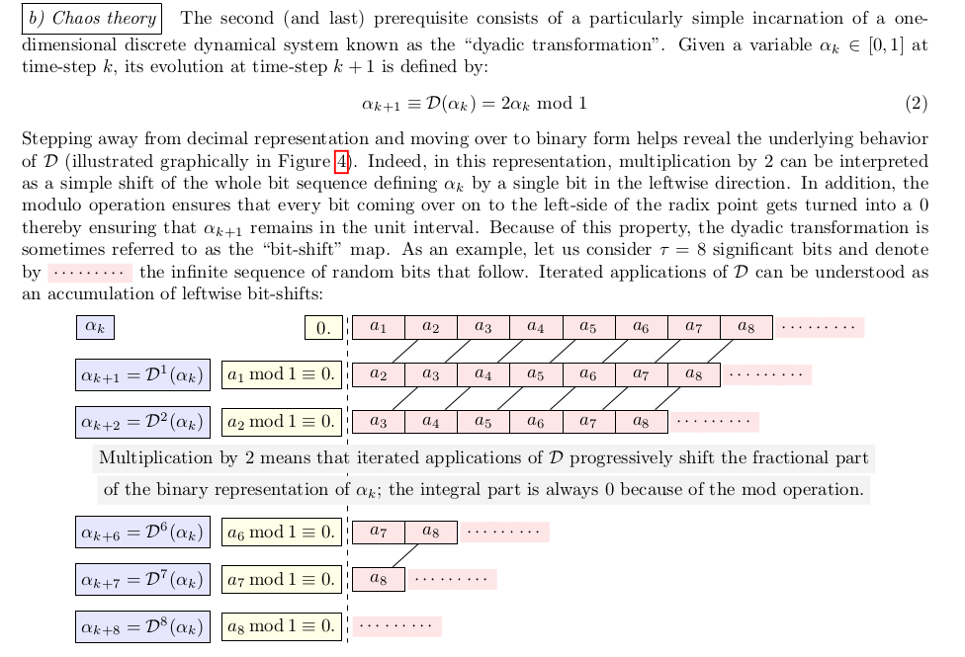

Slide 14
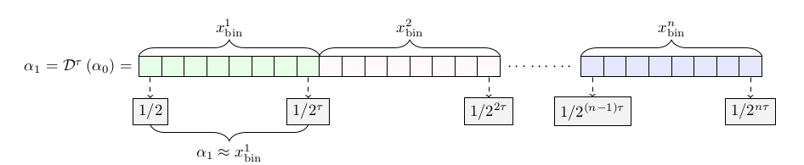
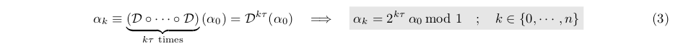

Slide 15
Part 3: Application
Jupyter notebooks: Presentation_sine.ipynb
Presentation_effiency.ipynb

Slide 16

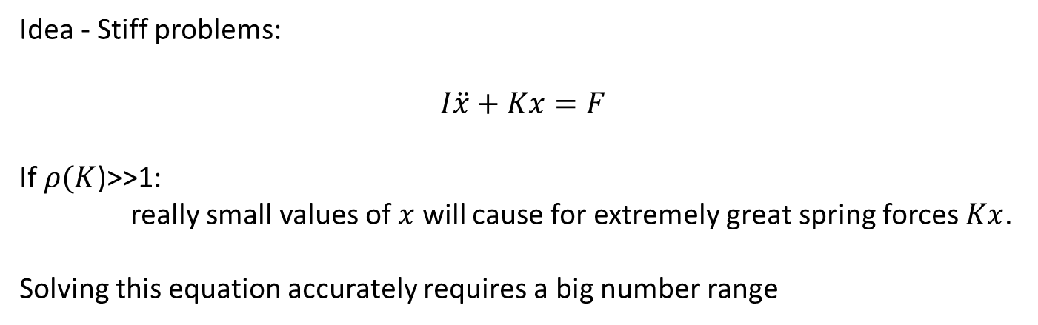
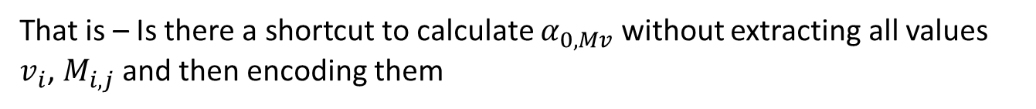
Where can we apply a method that is efficient for the representation of really small numbers?
Idea - Stiff problems:
$$I\ddot{x}+Kx=F$$
If $ρ(K$)>>1:
really small values of $x$ will cause for extremely great spring forces $Kx$.
Solving this equation accurately requires a big number range
Can we learn to do efficient arithmetic using the new method?
$$v\sim α_{0,v},τ,n,1$$
$$M\sim α_{0,M},τ,n,m$$
$$Mv \sim α_{0,Mv},τ,n,m$$
That is – Is there a shortcut to calculate $α_{0,Mv}$ without extracting all values $v_{i}$, $M_{i,j}$ and then encoding them

