Slide 1

Workshop in Information Security
Alon Balassiano

Slide 2
IPS
WordPress Really Simple SSL Plugin Authentication Bypass to RCE

Slide 3
WordPress Really Simple SSL Plugin Authentication Bypass to RCE
Wordpress – A web content management system.
Really Simple SSL – A Wordpress security plugin, offering 2FA (two-factor authentication) as one of its services.
RCE (Remote code execution) – Allows an attacker to execute malware or even gain full control over the vulnerable system.
2FA bypass – A vulnerability that allows attackers to bypass the 2FA mechanism.

Slide 4
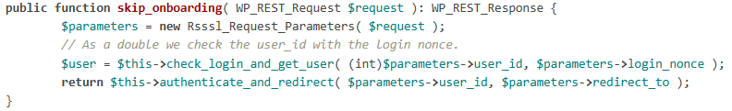
How it works
The attacker accesses the ‘/reallysimplessl/v1/two_fa/skip_onboarding’ route
The following function is invoked:
This function verifies the user using check_login_and_get_user function.

Slide 5
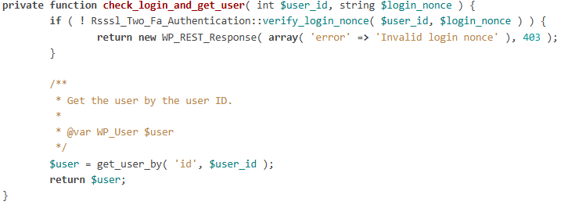
How it works
This function validates users using the user ID and login_nonce provided by the server.

Slide 6
Vulnerability
When given an invalid login_nonce parameter, check_login_and_get_user returns an error response.
The function skip_onbarding does not handle this case and invokes authentication anyway.
Unauthenticated users can bypass 2FA using an invalid login_nonce and any user_id (even administrators)!

Slide 7
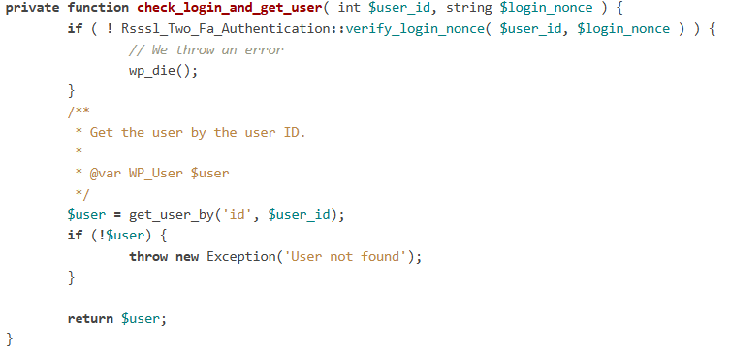
Fix
In check_login_and_get_user, an error is thrown if login_nonce is invalid.

Slide 8
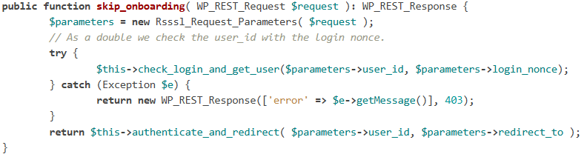
Fix
The function skip_onboarding now catches the exception and returns an error response instead of invoking authenticate_and_redirect.

Slide 9
Firewall Protection
We need to prevent access to the vulnerable route when an invalid login_nonce is used.
The firewall monitors traffic:
  If the server sends a login_nonce to the client, we store it.
  When a user accesses the vulnerable route, we verify the nonce against the stored value.

Slide 10
DLP
Detecting C code

Slide 11
Approach
C code differs from natural language texts in many features: structure, syntax, vocabulary etc.
One key observation:
  Natural language mainly consists of alphabets, punctuation marks and whitespaces.
  C code heavily uses special symbols in addition to these.

Slide 12
Approach
We identify special characters that are frequently used in C code but rarely appear in regular text.
We analyze their frequency in both cases and determine the likelihood of a given text being C code.

Slide 13
Analysis
After analyzing about 22,000 C files (including code and header files) from the Linux kernel, and 1,000 books from Project Gutenberg (an online library), I counted the occurrences of each character and compared their distribution.

Slide 14
Conclusion
The following chart shows
the special characters used for
comparison and their frequency
in both C code and textbooks.
These were the characters
with a ratio greater than 5
(i.e., appearing significantly
more in C code than in text).
char | c code | text | ratio
# | 0.007964 | 0.000065 | 122.52307692308
( | 0.009173 | 0.001205 | 7.61244813278
) | 0.009183 | 0.001206 | 7.61442786070
* | 0.017301 | 0.000522 | 33.14367816092
+ | 0.000629 | 0.000087 | 7.22988505747
= | 0.002231 | 0.000236 | 9.45338983051
@ | 0.000878 | 0.00001 | 87.80000000000
\ | 0.001402 | 0.000109 | 12.86238532110
^ | 0.000025 | 0.000004 | 6.25000000000
_ | 0.051688 | 0.000399 | 129.54385964912
{ | 0.001397 | 0.000036 | 38.80555555556
| | 0.00055 | 0.000067 | 8.20895522388
} | 0.001397 | 0.000036 | 38.80555555556
~ | 0.000078 | 0.000001 | 78.00000000000
Total fraction | 0.103896 | 0.003983

Slide 15
Implementation
My DLP system in the firewall counts the frequency of special characters in raw data sent by the client via HTTP and SMTP.
Based on the previous analysis:
  Data containing more than 0.02 fraction of special characters
  (the geometric mean of both fractions above) is classified as C code.
  The firewall blocks such data to prevent leakage of source code.

Slide 16
Thank You!
Any questions?

