Slide 1
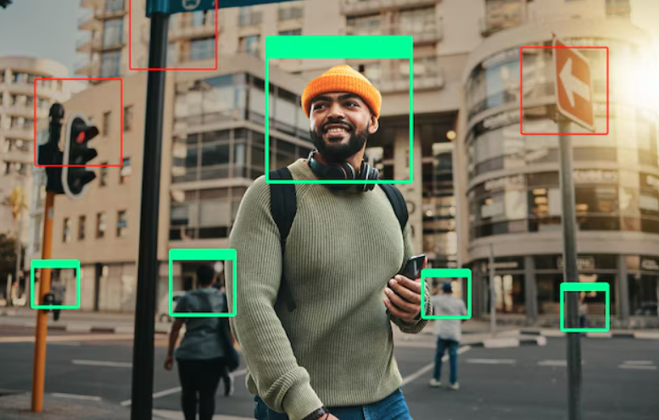
Object Detection and Annotation system

Slide 2
Project Overview
This project implements an object detection and description system using state-of-the-art models such as YOLO for detection and a Groq API for generating detailed descriptions of detected objects. The system also includes semantic segmentation to accurately isolate objects within images.

Slide 3


Setup Instructions
1. Clone the repository and navigate to the project directory.
2. Install required libraries using pip:
- streamlit
- opencv-python
- torch
- ultralytics
- transformers
- groq
3. Set up your environment variables, including the Groq API key.
4. Run the Streamlit app using the command:
streamlit run app.py

Slide 4
Usage Guidelines
1. Upload an image using the provided file uploader.
2. The system will detect objects, segment them, and generate descriptions.
3. Results, including segmented images and object details, will be displayed on the interface.
4. Review the outputs and interact with the segmented images.

Slide 5
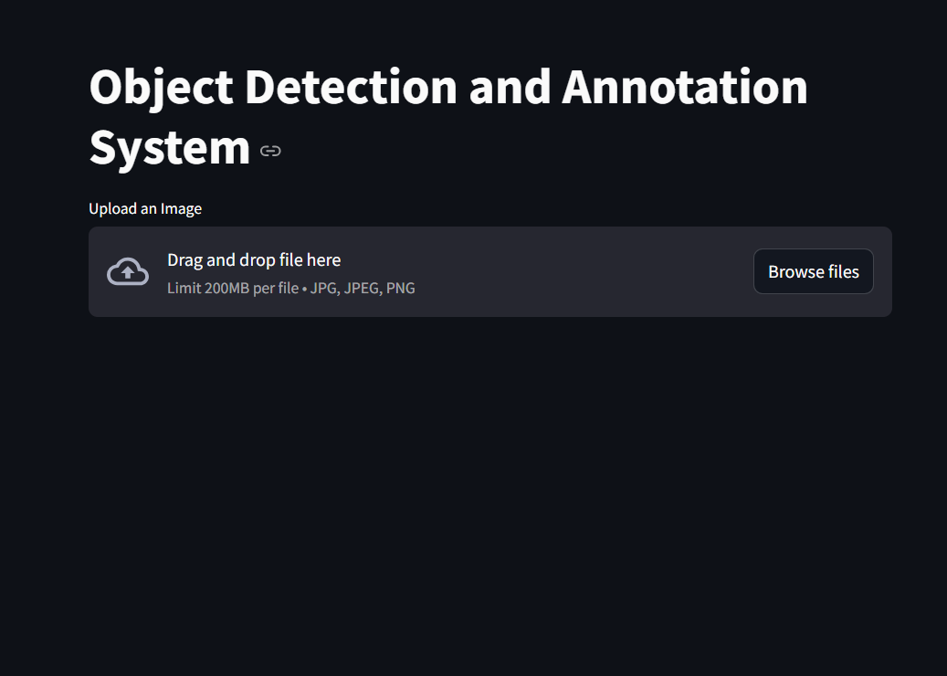
App overview

Slide 6
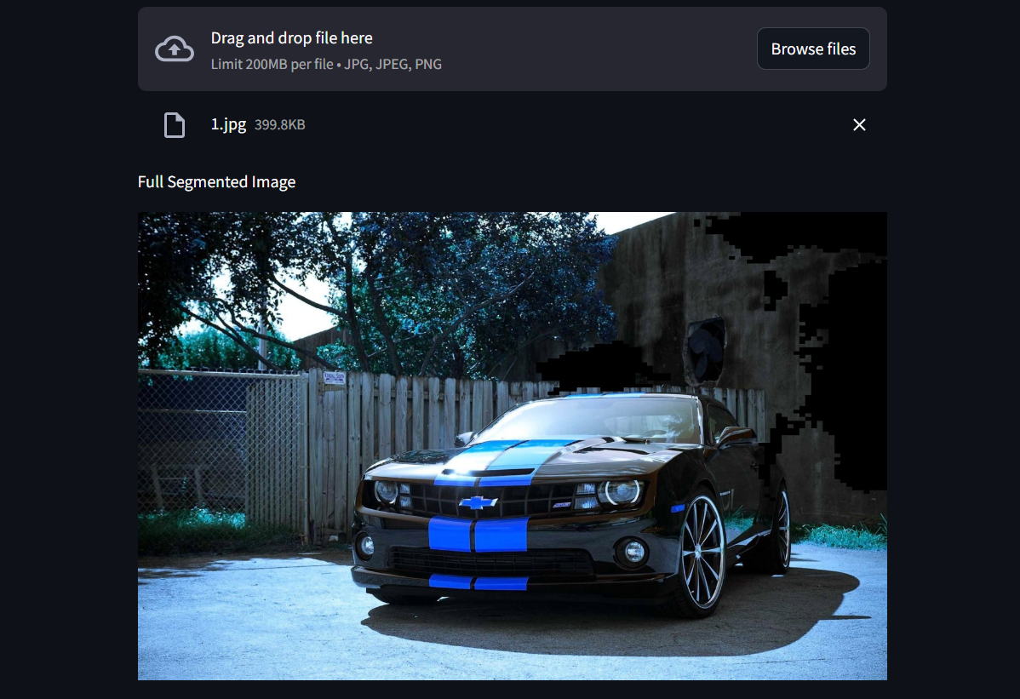
Segmented image

Slide 7
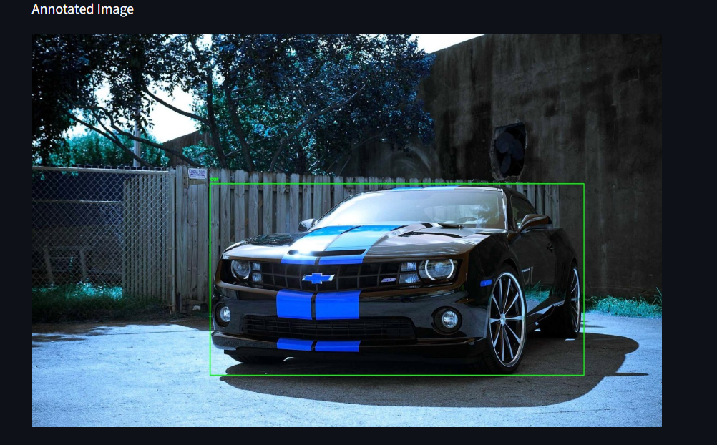
Annotated image

Slide 8
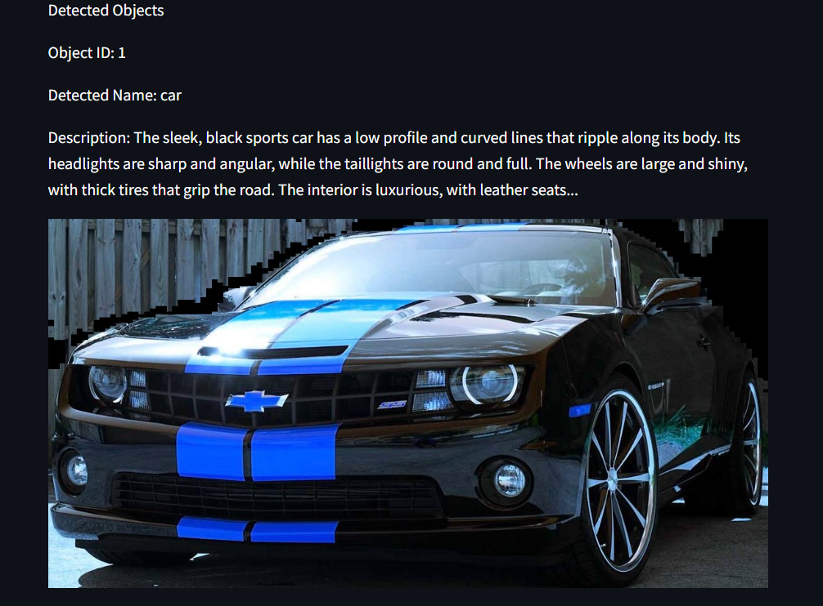
Detected Object with description

