Slide 1
Chapter 6: Formal Relational Query Languages

Slide 2
Chapter 6: Formal Relational Query Languages
Relational Algebra
Tuple Relational Calculus
Domain Relational Calculus

Slide 3
Relational Algebra
Procedural language
Six basic operators
  select: σ
  project: ∏
  union: ∪
  set difference: –
  Cartesian product: x
  rename: ρ
The operators take one or two relations as inputs and produce a new relation as a result.

Slide 4
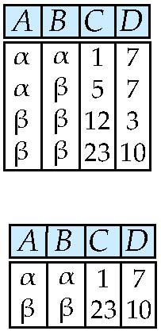
Select Operation – Example
Relation r
σ_{A=B ^ D > 5} (r)

Slide 5
Select Operation
Notation: σ _{p}(r)
p is called the selection predicate
Defined as:
σ_{p}(r) = {t | t ∈ r and p(t)}
Where p is a formula in propositional calculus consisting of terms connected by : ∧ (and), ∨ (or), ¬ (not)
Each term is one of:
<attribute> op <attribute> or <constant>
where op is one of: =, ≠, >, ≥. <. ≤
Example of selection:
σ _{dept_name=“Physics”}(instructor)

Slide 6
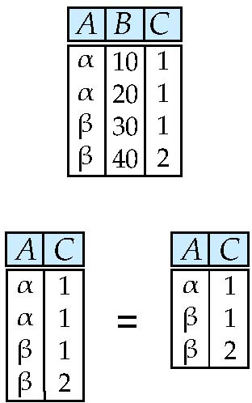
Project Operation – Example
Relation r:
∏_{A,C} (r)

Slide 7
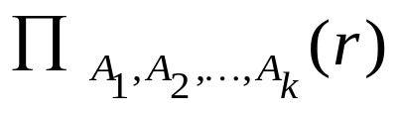
Project Operation
Notation:
where A₁, A₂ are attribute names and r is a relation name.
The result is defined as the relation of k columns obtained by erasing the columns that are not listed
Duplicate rows removed from result, since relations are sets
Example: To eliminate the dept_name attribute of instructor
∏_{ID, name, salary} (instructor)

Slide 8
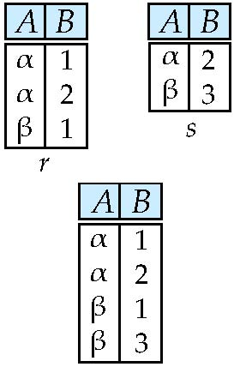
Union Operation – Example
Relations r, s:
r ∪ s:

Slide 9
Union Operation
Notation: r ∪ s
Defined as:
r ∪ s = {t | t ∈ r or t ∈ s}
For r ∪ s to be valid.
1. r, s must have the same arity (same number of attributes)
2. The attribute domains must be compatible (example: 2nd column
of r deals with the same type of values as does the 2nd
column of s)
Example: to find all courses taught in the Fall 2009 semester, or in the Spring 2010 semester, or in both
∏_{course_id} (σ _{semester=“Fall” Λ year=2009} (section)) ∪
∏_{course_id} (σ _{semester=“Spring” Λ year=2010} (section))

Slide 10
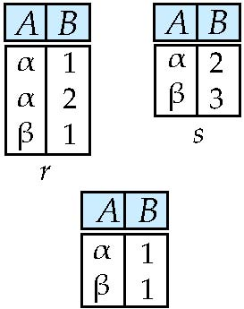
Set difference of two relations
Relations r, s:
r – s:

Slide 11
Set Difference Operation
Notation r – s
Defined as:
r – s = {t | t ∈ r and t ∉ s}
Set differences must be taken between compatible relations.
  r and s must have the same arity
  attribute domains of r and s must be compatible
Example: to find all courses taught in the Fall 2009 semester, but not in the Spring 2010 semester
∏_{course_id} (σ _{semester=“Fall” Λ year=2009} (section)) −
∏_{course_id} (σ _{semester=“Spring” Λ year=2010} (section))

Slide 12
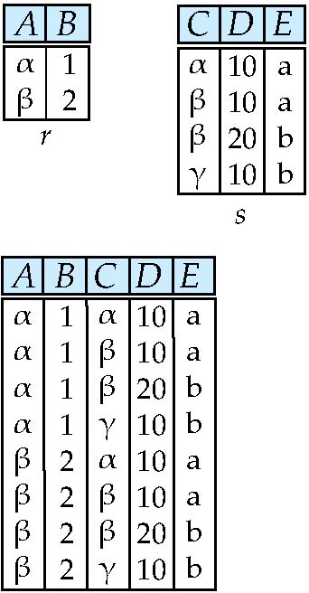
Cartesian-Product Operation – Example
Relations r, s:
r x s:

Slide 13
Cartesian-Product Operation
Notation r x s
Defined as:
r x s = {t q | t ∈ r and q ∈ s}
Assume that attributes of r(R) and s(S) are disjoint. (That is, R ∩ S = ∅).
If attributes of r(R) and s(S) are not disjoint, then renaming must be used.

Slide 14
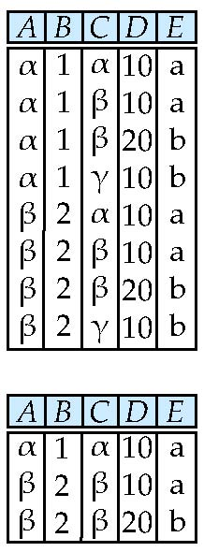
Composition of Operations
Can build expressions using multiple operations
Example: σ_{A=C}(r x s)
r x s
σ_{A=C}(r x s)

Slide 15
Example Queries
Find the names of all instructors in the Physics department, along with the course_id of all courses they have taught
  Query 1
  ∏_{instructor.ID,course_id} (σ_{dept_name=“Physics”} (
  σ _{instructor.ID=teaches.ID} (instructor x teaches)))
  Query 2
  ∏_{instructor.ID,course_id} (σ_{instructor.ID=teaches.ID} (
  σ _{dept_name=“Physics”} (instructor) x teaches))

Slide 16
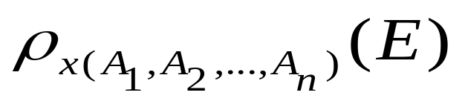
Rename Operation
Allows us to name, and therefore to refer to, the results of relational-algebra expressions.
Allows us to refer to a relation by more than one name.
Example:
ρ _{x} (E)
returns the expression E under the name X
If a relational-algebra expression E has arity n, then
returns the result of expression E under the name X, and with the
attributes renamed to A₁ , A₂ , …., A_{n} .

Slide 17
Example Query
Find the largest salary in the university
  Step 1: find instructor salaries that are less than some other instructor salary (i.e. not maximum)
      using a copy of instructor under a new name d
    ∏_{instructor.salary} (σ _{instructor.salary < d.salary}
    (instructor x ρ_{d} (instructor)))
  Step 2: Find the largest salary
    ∏_{salary} (instructor) –
    ∏_{instructor.salary} (σ _{instructor.salary < d.salary}
    (instructor x ρ_{d} (instructor)))

Slide 18
Formal Definition
A basic expression in the relational algebra consists of either one of the following:
  A relation in the database
  A constant relation
Let E₁ and E₂ be relational-algebra expressions; the following are all relational-algebra expressions:
  E₁ ∪ E₂
  E₁ – E₂
  E₁ x E₂
  σ_{p} (E₁), P is a predicate on attributes in E₁
  ∏_{s}(E₁), S is a list consisting of some of the attributes in E₁
  ρ _{x} (E₁), x is the new name for the result of E₁

Slide 19
Additional Operations
We define additional operations that do not add any power to the
relational algebra, but that simplify common queries.
Set intersection
Natural join
Assignment
Outer join

Slide 20
Set-Intersection Operation
Notation: r ∩ s
Defined as:
r ∩ s = { t | t ∈ r and t ∈ s }
Assume:
  r, s have the same arity
  attributes of r and s are compatible
Note: r ∩ s = r – (r – s)

Slide 21
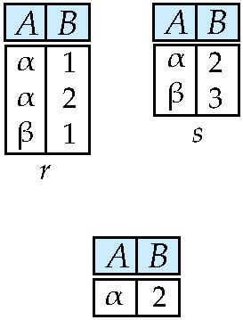
Set-Intersection Operation – Example
Relation r, s:
r ∩ s

Slide 22
Natural-Join Operation
Notation: r s
Let r and s be relations on schemas R and S respectively.
Then, r s is a relation on schema R ∪ S obtained as follows:
  Consider each pair of tuples t_{r} from r and t_{s} from s.
  If t_{r} and t_{s} have the same value on each of the attributes in R ∩ S, add a tuple t to the result, where
    t has the same value as t_{r} on r
    t has the same value as t_{s} on s
Example:
  R = (A, B, C, D)
  S = (E, B, D)
  Result schema = (A, B, C, D, E)
  r s is defined as:
  ∏_{r.A, r.B, r.C, r.D, s.E} (σ_{r.B = s.B ∧ r.D = s.D} (r x s))

Slide 23
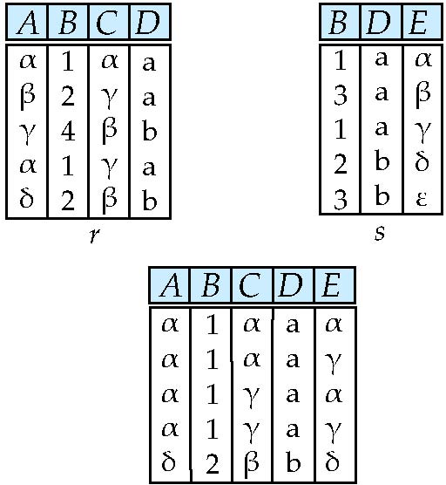
Natural Join Example
Relations r, s:
r s

Slide 24
Natural Join and Theta Join
Find the names of all instructors in the Comp. Sci. department together with the course titles of all the courses that the instructors teach
  ∏ _{name, title} (σ _{dept_name=“Comp. Sci.”} (instructor teaches course))
Natural join is associative 结合律
  (instructor teaches) course is equivalent to
  instructor (teaches course)
Natural join is commutative 交换律
  instruct teaches is equivalent to
  teaches instructor
The theta join operation r _{θ} s is defined as
  r _{θ} s = σ_{θ} (r x s)

Slide 25
Assignment Operation
The assignment operation (←) provides a convenient way to express complex queries.
  Write query as a sequential program consisting of
    a series of assignments
    followed by an expression whose value is displayed as a result of the query.
  Assignment must always be made to a temporary relation variable.

Slide 26
Outer Join
An extension of the join operation that avoids loss of information.
Computes the join and then adds tuples form one relation that does not match tuples in the other relation to the result of the join.
Uses null values:
  null signifies that the value is unknown or does not exist
  All comparisons involving null are (roughly speaking) false by definition.
    We shall study precise meaning of comparisons with nulls later

Slide 27
Outer Join – Example
Relation instructor1
ID
name
dept_name
10101
12121
15151
Srinivasan
Wu
Mozart
Comp. Sci.
Finance
Music
Relation teaches1
ID
course_id
10101
12121
76766
CS-101
FIN-201
BIO-101

Slide 28
Outer Join – Example
Join
instructor teaches
ID
name
dept_name
course_id
10101
12121
Srinivasan
Wu
Comp. Sci.
Finance
CS-101
FIN-201
Left Outer Join
instructor teaches
ID
name
dept_name
course_id
10101
12121
15151
Srinivasan
Wu
Mozart
Comp. Sci.
Finance
Music
CS-101
FIN-201
null

Slide 29
Outer Join – Example
Right Outer Join
instructor teaches
ID
name
dept_name
course_id
10101
12121
76766
Srinivasan
Wu
null
Comp. Sci.
Finance
null
CS-101
FIN-201
BIO-101
Full Outer Join
instructor teaches
ID
name
dept_name
course_id
10101
12121
15151
76766
Srinivasan
Wu
Mozart
null
Comp. Sci.
Finance
Music
null
CS-101
FIN-201
null
BIO-101

Slide 30
练习
检索不学C2课的学生姓名与年龄。
π_{SNAME，AGE}（S）－π_{SNAME，AGE}(σ _{CNO='C2'}（S SC）)
1：设教学数据库中有3个关系：
学生关系S(SNO,SNAME,AGE,SEX)
学习关系SC(SNO,CNO,GRADE)
课程关系C(CNO,CNAME,TEACHER)
下面用关系代数表达式表达每个查询语句。
检索学习课程号为C2的学生学号与成绩。

Slide 31
Null Values
It is possible for tuples to have a null value, denoted by null, for some of their attributes
null signifies an unknown value or that a value does not exist.
The result of any arithmetic expression involving null is null.
Aggregate functions simply ignore null values (as in SQL)
For duplicate elimination and grouping, null is treated like any other value, and two nulls are assumed to be the same (as in SQL)

Slide 32
Null Values
Comparisons with null values return the special truth value: unknown
  If false was used instead of unknown, then not (A < 5)
  would not be equivalent to A >= 5
Three-valued logic using the truth value unknown:
  OR: (unknown or true) = true,
  (unknown or false) = unknown
  (unknown or unknown) = unknown
  AND: (true and unknown) = unknown,
  (false and unknown) = false,
  (unknown and unknown) = unknown
  NOT: (not unknown) = unknown
  In SQL “P is unknown” evaluates to true if predicate P evaluates to unknown
Result of select predicate is treated as false if it evaluates to unknown

Slide 33
Division Operator
Given relations r(R) and s(S), such that S ⊂ R, r ÷ s is the largest relation t(R-S) such that
t x s ⊆ r
E.g. let r(ID, course_id) = ∏_{ID, course_id} (takes ) and
s(course_id) = ∏_{course_id} (σ_{dept_name=“Biology”}(course )
then r ÷ s gives us students who have taken all courses in the Biology department
Can write r ÷ s as
temp1 ← ∏_{R-S} (r )
temp2 ← ∏_{R-S} ((temp1 x s ) – ∏_{R-S,S} (r ))
result = temp1 – temp2
  The result to the right of the ← is assigned to the relation variable on the left of the ←.
  May use variable in subsequent expressions.

Slide 34
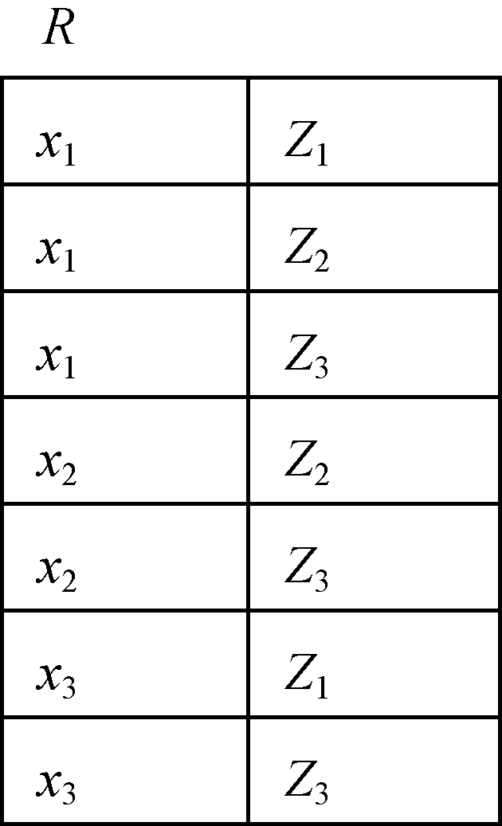
Division Operator
x₁在R中的象集
Z_{x1} ={Z1，Z2，Z3}，
x₂在R中的象集
Z_{x2} ={Z2，Z3}，
x₃在R中的象集
Z_{x3}={Z1，Z3}
象集举例

Slide 35
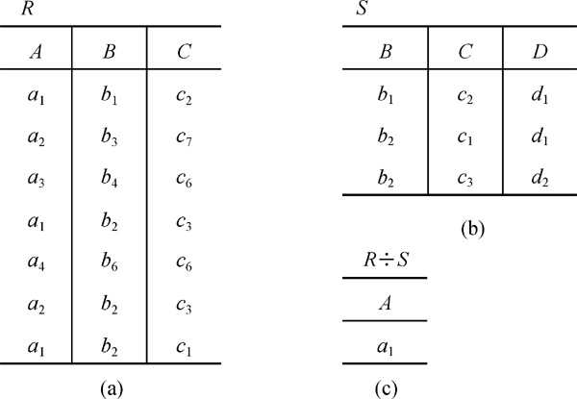
Division Operator
[例6]设关系R、S分别为下图的(a)和(b)，R÷S的结果为图(c)
An Introduction to Database System

Slide 36
分析
在关系R中，A可以取四个值{a1，a2，a3，a4}
  a₁的象集为 {(b₁，c₂)，(b₂，c₃)，(b₂，c₁)}
  a₂的象集为 {(b₃，c₇)，(b₂，c₃)}
  a₃的象集为 {(b₄，c₆)}
  a₄的象集为 {(b₆，c₆)}
S在(B，C)上的投影为
{(b1，c2)，(b2，c1)，(b2，c3) }
只有a₁的象集包含了S在(B，C)属性组上的投影
所以 R÷S ={a₁}
An Introduction to Database System

Slide 37
Extended Relational-Algebra-Operations
Generalized Projection
Aggregate Functions

Slide 38

Generalized Projection
Extends the projection operation by allowing arithmetic functions to be used in the projection list.
E is any relational-algebra expression
Each of F₁, F₂, …, F_{n} are arithmetic expressions involving constants and attributes in the schema of E.
Given relation instructor(ID, name, dept_name, salary) where salary is annual salary, get the same information but with monthly salary
∏_{ID, name, dept_name, salary/12} (instructor)

Slide 39
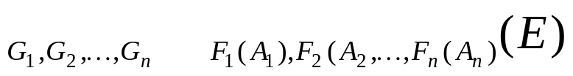

Aggregate Functions and Operations
Aggregation function takes a collection of values and returns a single value as a result.
avg: average value
min: minimum value
max: maximum value
sum: sum of values
count: number of values
Aggregate operation in relational algebra
E is any relational-algebra expression
  G₁, G₂ …, G_{n} is a list of attributes on which to group (can be empty)
  Each F_{i} is an aggregate function
  Each A_{i} is an attribute name
Note: Some books/articles use γ instead of (Calligraphic G)

Slide 40
Aggregate Operation – Example
Relation r:
A
B
C
α
α
β
β
α
β
β
β
7
7
3
10
_{sum(c)} (r)
sum(c )
27

Slide 41
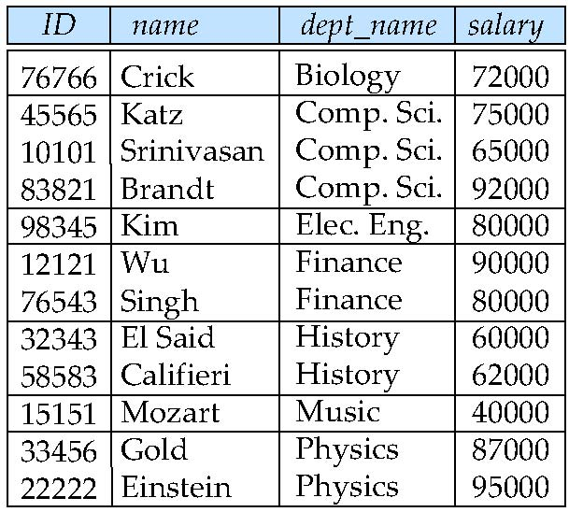
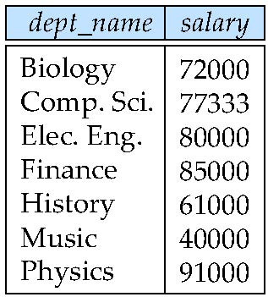
Aggregate Operation – Example
Find the average salary in each department
_{dept_name} _{avg(salary)} (instructor)
avg_salary

Slide 42
Aggregate Functions (Cont.)
Result of aggregation does not have a name
  Can use rename operation to give it a name
  For convenience, we permit renaming as part of aggregate operation
_{dept_name} _{avg(salary) as avg_sal} (instructor)

Slide 43
讨论
设计查询信息的关系代数表达式

Slide 44
Review

Slide 45
Relational Algebra
Procedural language
Six basic operators
  select: σ
  project: ∏
  union: ∪
  set difference: –
  Cartesian product: x
  rename: ρ
The operators take one or two relations as inputs and produce a new relation as a result.

Slide 46
Additional Operations
We define additional operations that do not add any power to the
relational algebra, but that simplify common queries.
Set intersection
Natural join
Assignment
Outer join
Division

Slide 47
Extended Relational-Algebra-Operations
Generalized Projection
Aggregate Functions

Slide 48
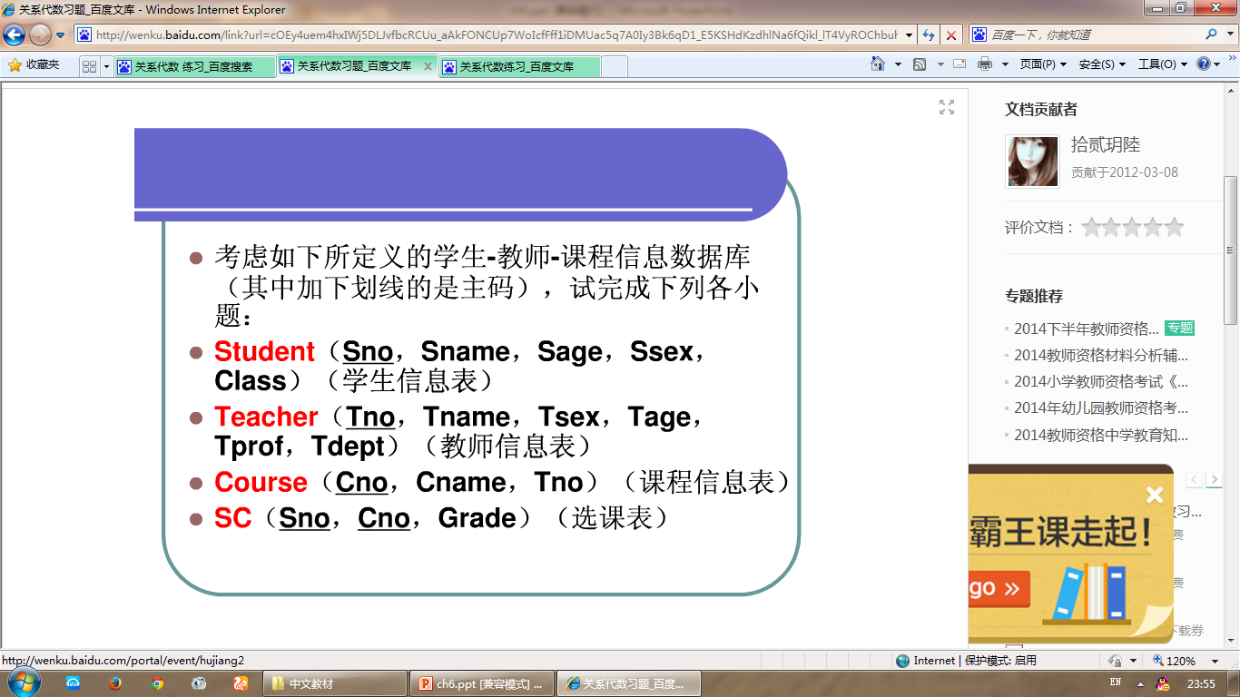
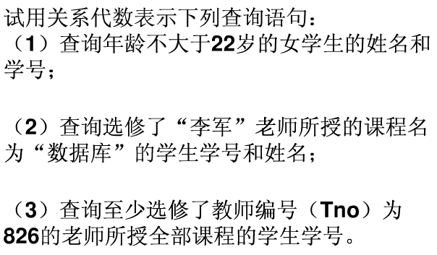

Slide 49
设教学数据库中有3个关系：
学生关系S(SNO,SNAME,AGE,SEX)
学习关系SC(SNO,CNO,GRADE)
课程关系C(CNO,CNAME,TEACHER)
下面用关系代数表达式表达每个查询语句。
试用关系代数查询：学习课程号为C2的学生的人数。

Slide 50
Modification of the Database
The content of the database may be modified using the following operations:
  Deletion
  Insertion
  Updating
All these operations can be expressed using the assignment operator

Slide 51
Multiset Relational Algebra
Pure relational algebra removes all duplicates
  e.g. after projection
Multiset relational algebra retains duplicates, to match SQL semantics
  SQL duplicate retention was initially for efficiency, but is now a feature
Multiset relational algebra defined as follows
  selection: has as many duplicates of a tuple as in the input, if the tuple satisfies the selection
  projection: one tuple per input tuple, even if it is a duplicate
  cross product: If there are m copies of t1 in r, and n copies of t2 in s, there are m x n copies of t1.t2 in r x s
  Other operators similarly defined
    E.g. union: m + n copies, intersection: min(m, n) copies
    difference: min(0, m – n) copies

Slide 52
SQL and Relational Algebra
select A1, A2, .. An
from r1, r2, …, rm
where P
is equivalent to the following expression in multiset relational algebra
∏ _{A1, .., An} (σ _{P} (r1 x r2 x .. x rm))
select A1, A2, sum(A3)
from r1, r2, …, rm
where P
group by A1, A2
is equivalent to the following expression in multiset relational algebra
_{A1, A2} _{sum(A3)} (σ _{P} (r1 x r2 x .. x rm)))

Slide 53
SQL and Relational Algebra
More generally, the non-aggregated attributes in the select clause may be a subset of the group by attributes, in which case the equivalence is as follows:
select A1, sum(A3)
from r1, r2, …, rm
where P
group by A1, A2
is equivalent to the following expression in multiset relational algebra
∏ _{A1,sumA3}( _{A1,A2} _{sum(A3)} _{as sumA3}(σ _{P} (r1 x r2 x .. x rm)))

Slide 54
Tuple Relational Calculus

Slide 55
Tuple Relational Calculus
A nonprocedural query language, where each query is of the form
{t | P (t ) }
It is the set of all tuples t such that predicate P is true for t
t is a tuple variable, t [A ] denotes the value of tuple t on attribute A
t ∈ r denotes that tuple t is in relation r
P is a formula similar to that of the predicate calculus

Slide 56
Predicate Calculus Formula
1. Set of attributes and constants
2. Set of comparison operators: (e.g., <, ≤, =, ≠, >, ≥)
3. Set of connectives: and (∧), or (v)‚ not (¬)
4. Implication (⇒): x ⇒ y, if x if true, then y is true
x ⇒ y ≡ ¬x v y
5. Set of quantifiers:
  ∃ t ∈ r (Q (t )) ≡ ”there exists” a tuple in t in relation r
  such that predicate Q (t ) is true
  ∀t ∈ r (Q (t )) ≡ Q is true “for all” tuples t in relation r

Slide 57
Example Queries
Find the ID, name, dept_name, salary for instructors whose salary is greater than $80,000
{t | t ∈ instructor ∧ t [salary ] > 80000}
As in the previous query, but output only the ID attribute value
{t | ∃ s ∈ instructor (t [ID ] = s [ID ] ∧ s [salary ] > 80000)}
Notice that a relation on schema (ID) is implicitly defined by
the query

Slide 58
Example Queries
Find the names of all instructors whose department is in the Watson building
{t | ∃s ∈ instructor (t [name ] = s [name ]
∧ ∃u ∈ department (u [dept_name ] = s[dept_name] “
∧ u [building] = “Watson” ))}
Find the set of all courses taught in the Fall 2009 semester, or in
the Spring 2010 semester, or both
{t | ∃s ∈ section (t [course_id ] = s [course_id ] ∧
s [semester] = “Fall” ∧ s [year] = 2009
v ∃u ∈ section (t [course_id ] = u [course_id ] ∧
u [semester] = “Spring” ∧ u [year] = 2010)}

Slide 59
Example Queries
Find the set of all courses taught in the Fall 2009 semester, and in
the Spring 2010 semester
{t | ∃s ∈ section (t [course_id ] = s [course_id ] ∧
s [semester] = “Fall” ∧ s [year] = 2009
∧ ∃u ∈ section (t [course_id ] = u [course_id ] ∧
u [semester] = “Spring” ∧ u [year] = 2010)}
Find the set of all courses taught in the Fall 2009 semester, but not in
the Spring 2010 semester
{t | ∃s ∈ section (t [course_id ] = s [course_id ] ∧
s [semester] = “Fall” ∧ s [year] = 2009
∧ ¬ ∃u ∈ section (t [course_id ] = u [course_id ] ∧
u [semester] = “Spring” ∧ u [year] = 2010)}

Slide 60
Safety of Expressions
It is possible to write tuple calculus expressions that generate infinite relations.
For example, { t | ¬ t ∈ r } results in an infinite relation if the domain of any attribute of relation r is infinite
To guard against the problem, we restrict the set of allowable expressions to safe expressions.
An expression {t | P (t )} in the tuple relational calculus is safe if every component of t appears in one of the relations, tuples, or constants that appear in P

Slide 61
Universal Quantification
Find all students who have taken all courses offered in the Biology department
  {t | ∃ r ∈ student (t [ID] = r [ID]) ∧
  (∀ u ∈ course (u [dept_name]=“Biology” ⇒
  ∃ s ∈ takes (t [ID] = s [ID ] ∧
  s [course_id] = u [course_id]))}
  Note that without the existential quantification on student, the above query would be unsafe if the Biology department has not offered any courses.

Slide 62
Domain Relational Calculus

Slide 63
Domain Relational Calculus
A nonprocedural query language equivalent in power to the tuple relational calculus
Each query is an expression of the form:
{ < x₁, x₂, …, x_{n} > | P (x₁, x₂, …, x_{n})}
  x₁, x₂, …, x_{n} represent domain variables
  P represents a formula similar to that of the predicate calculus

Slide 64
Example Queries
Find the ID, name, dept_name, salary for instructors whose salary is greater than $80,000
  {< i, n, d, s> | < i, n, d, s> ∈ instructor ∧ s > 80000}
As in the previous query, but output only the ID attribute value
  {< i> | < i, n, d, s> ∈ instructor ∧ s > 80000}
Find the names of all instructors whose department is in the Watson building
{< n > | ∃ i, d, s (< i, n, d, s > ∈ instructor
∧ ∃ b, a (< d, b, a> ∈ department ∧ b = “Watson” ))}

Slide 65
Example Queries
Find the set of all courses taught in the Fall 2009 semester, or in
the Spring 2010 semester, or both
{<c> | ∃ a, s, y, b, r, t ( <c, a, s, y, b, t > ∈ section ∧
s = “Fall” ∧ y = 2009 )
v ∃ a, s, y, b, r, t ( <c, a, s, y, b, t > ∈ section ] ∧
s = “Spring” ∧ y = 2010)}
This case can also be written as
{<c> | ∃ a, s, y, b, r, t ( <c, a, s, y, b, t > ∈ section ∧
( (s = “Fall” ∧ y = 2009 ) v (s = “Spring” ∧ y = 2010))}
Find the set of all courses taught in the Fall 2009 semester, and in
the Spring 2010 semester
{<c> | ∃ a, s, y, b, r, t ( <c, a, s, y, b, t > ∈ section ∧
s = “Fall” ∧ y = 2009 )
∧ ∃ a, s, y, b, r, t ( <c, a, s, y, b, t > ∈ section ] ∧
s = “Spring” ∧ y = 2010)}

Slide 66
Safety of Expressions
The expression:
{ < x₁, x₂, …, x_{n} > | P (x₁, x₂, …, x_{n} )}
is safe if all of the following hold:
All values that appear in tuples of the expression are values from dom (P ) (that is, the values appear either in P or in a tuple of a relation mentioned in P ).
For every “there exists” subformula of the form ∃ x (P₁(x )), the subformula is true if and only if there is a value of x in dom (P₁) such that P₁(x ) is true.
For every “for all” subformula of the form ∀_{x} (P₁ (x )), the subformula is true if and only if P₁(x ) is true for all values x from dom (P₁).

Slide 67
Universal Quantification
Find all students who have taken all courses offered in the Biology department
  {< i > | ∃ n, d, tc ( < i, n, d, tc > ∈ student ∧
  (∀ ci, ti, dn, cr ( < ci, ti, dn, cr > ∈ course ∧ dn =“Biology”
  ⇒ ∃ si, se, y, g ( <i, ci, si, se, y, g> ∈ takes ))}
  Note that without the existential quantification on student, the above query would be unsafe if the Biology department has not offered any courses.
* Above query fixes bug in page 246, last query

Slide 68
End of Chapter 6

Slide 69
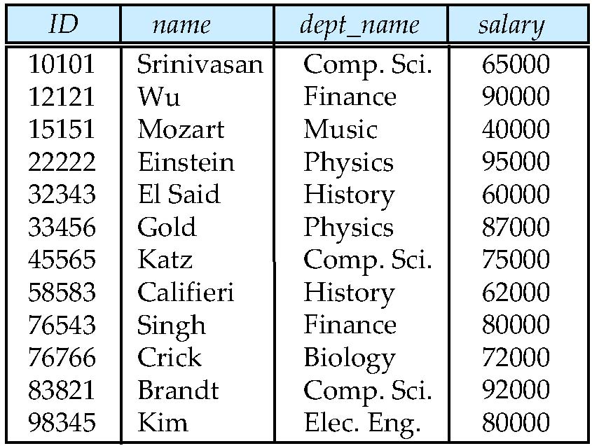
Figure 6.01

Slide 70
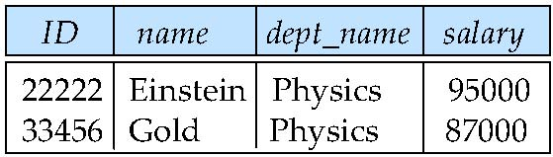
Figure 6.02

Slide 71
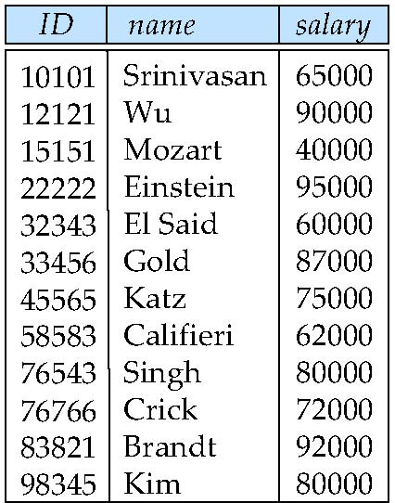
Figure 6.03

Slide 72
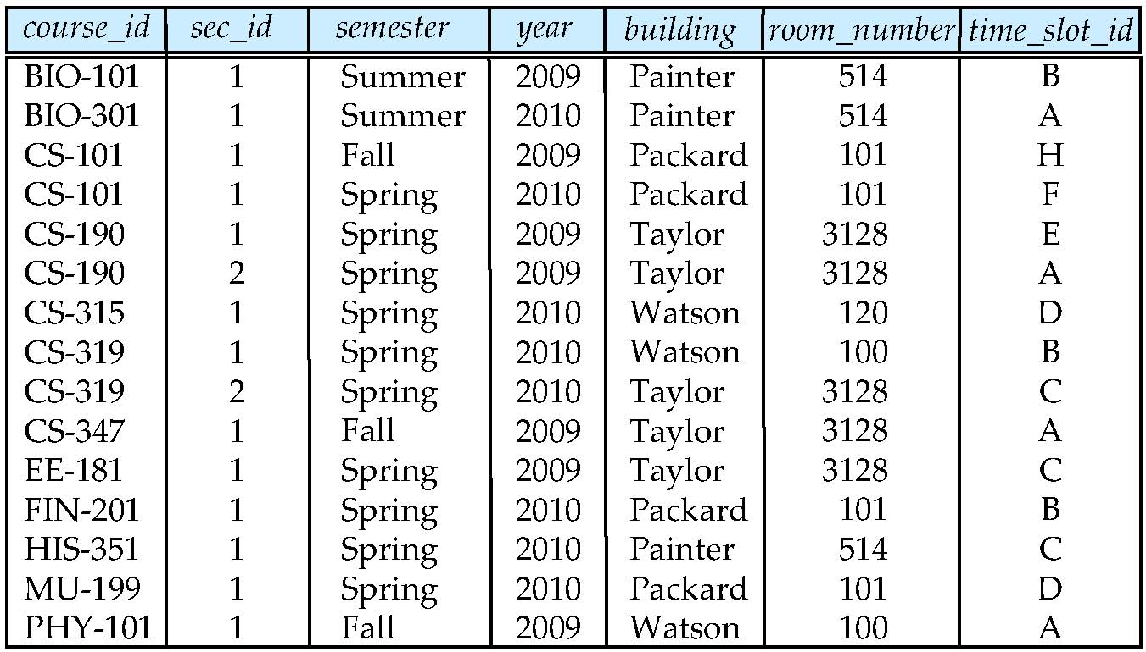
Figure 6.04

Slide 73
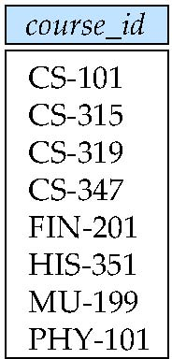
Figure 6.05

Slide 74
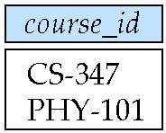
Figure 6.06

Slide 75
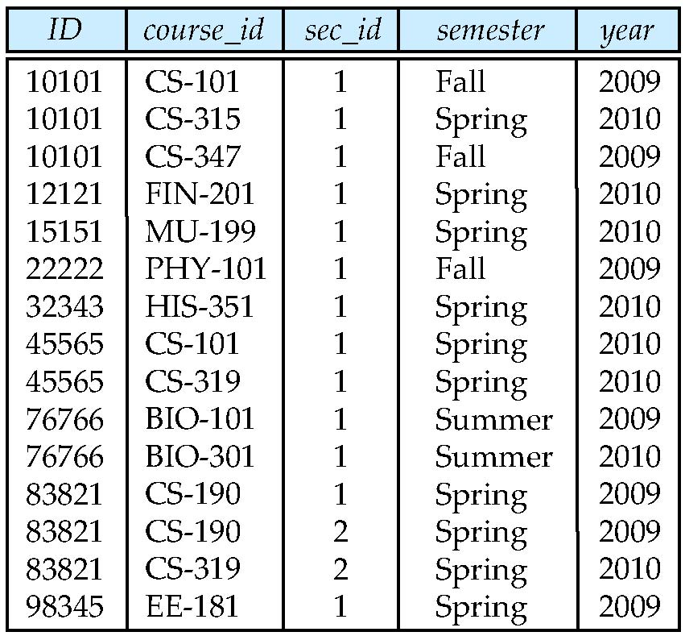
Figure 6.07

Slide 76
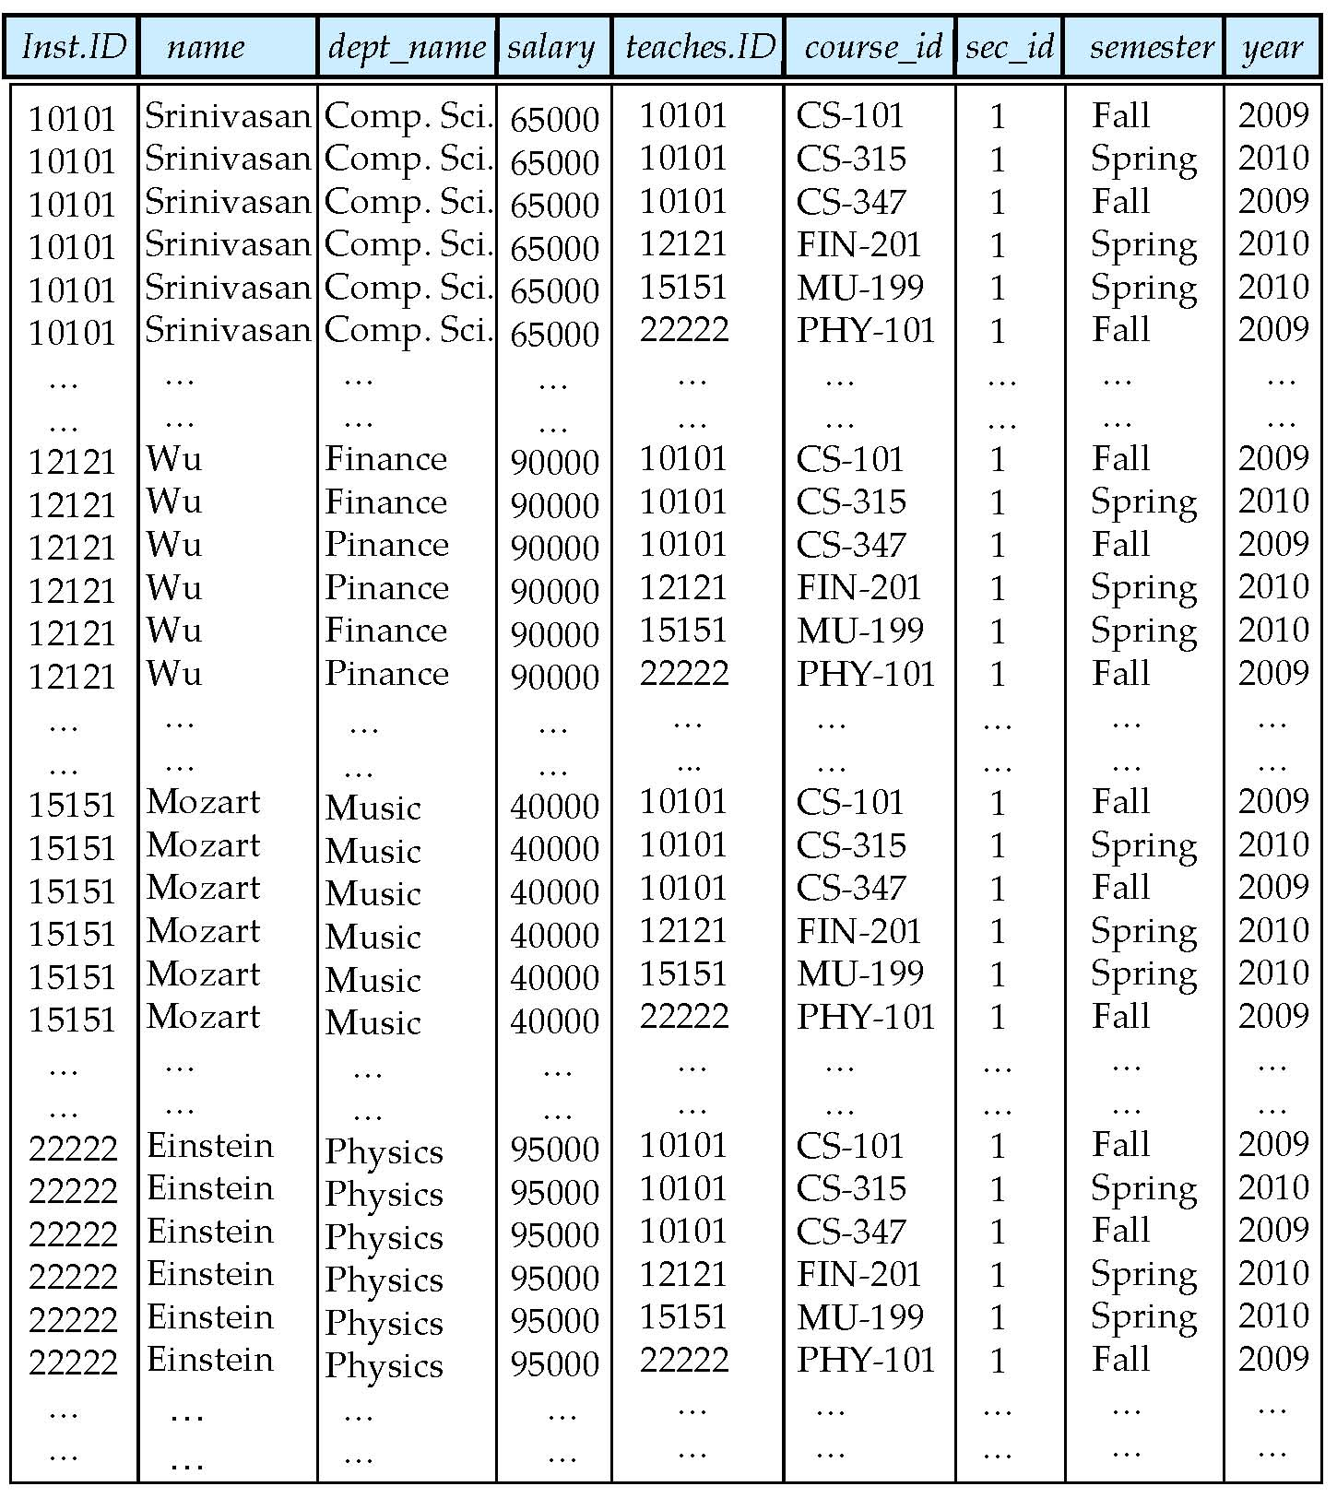
Figure 6.08

Slide 77
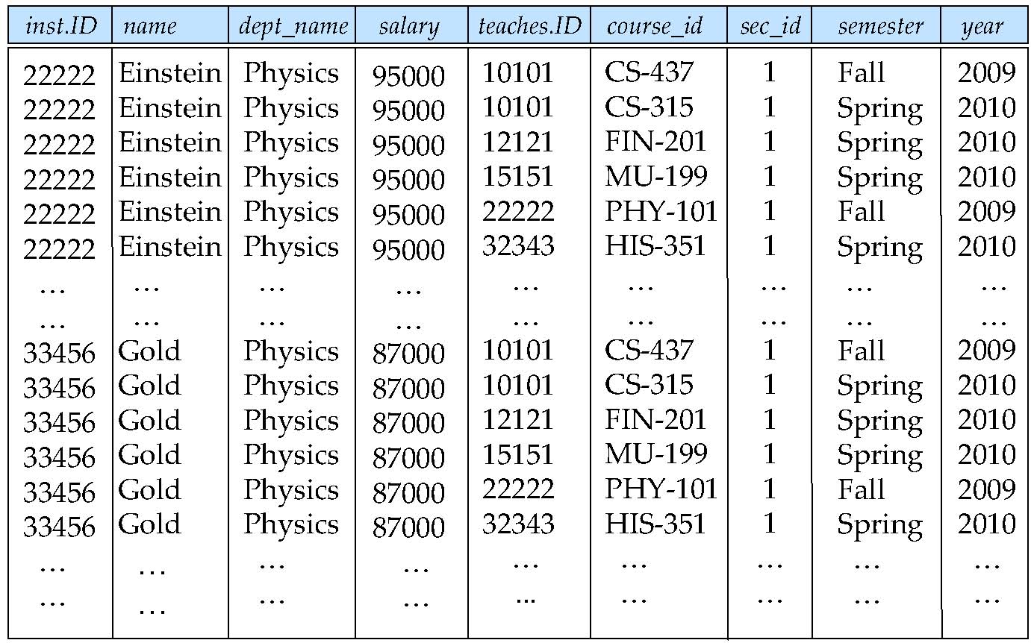
Figure 6.09

Slide 78
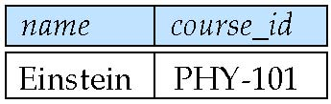
Figure 6.10

Slide 79
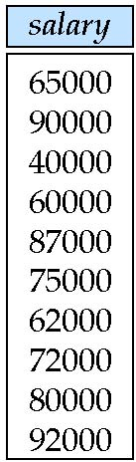
Figure 6.11

Slide 80
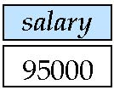
Figure 6.12

Slide 81
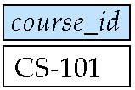
Figure 6.13

Slide 82
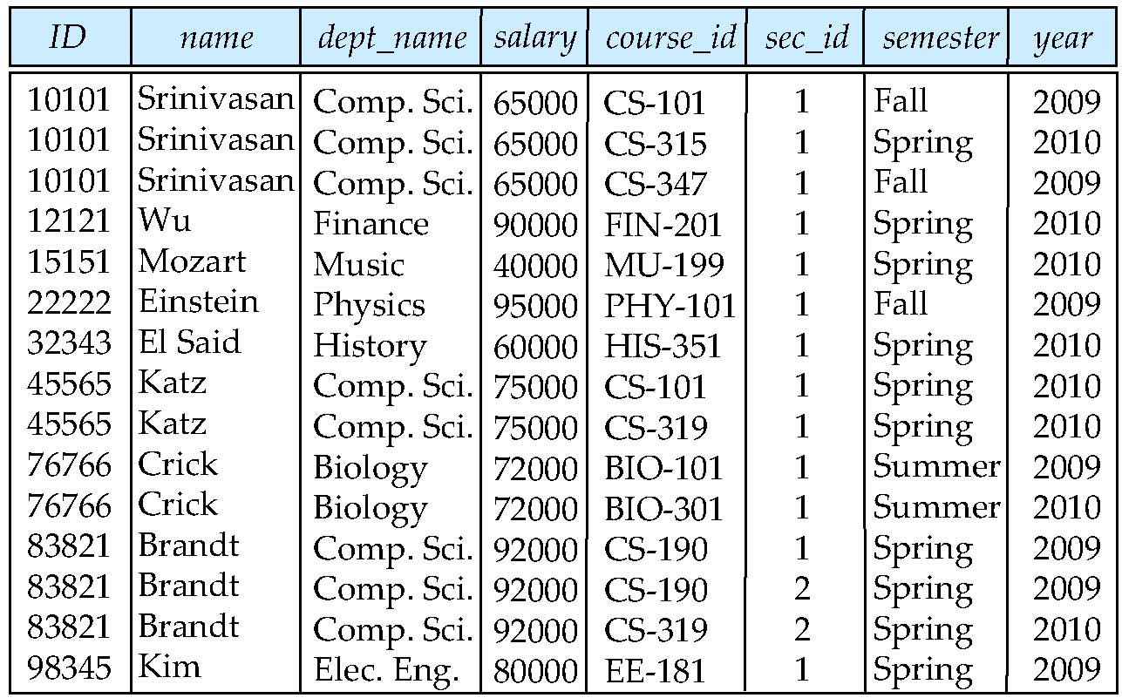
Figure 6.14

Slide 83
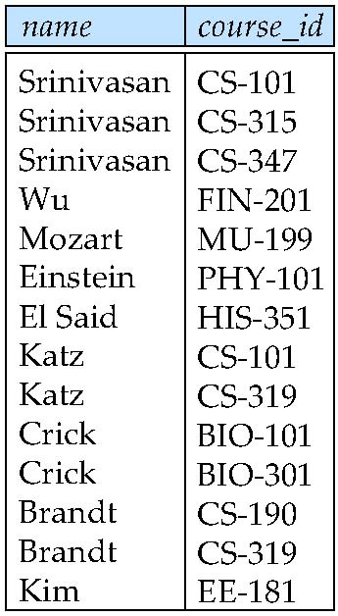
Figure 6.15

Slide 84
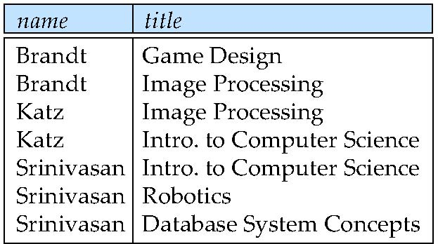
Figure 6.16

Slide 85
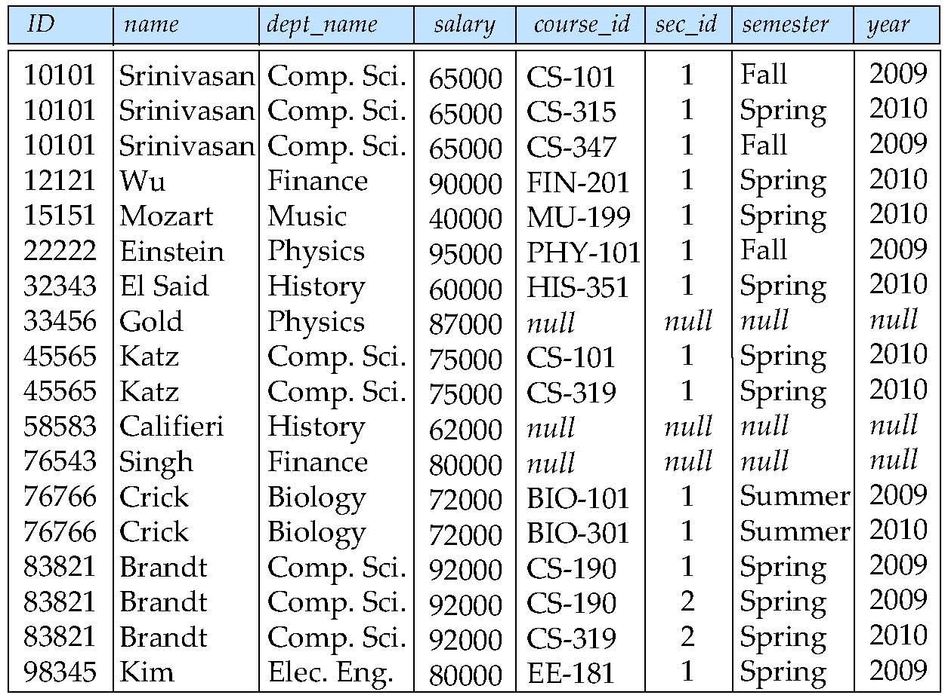
Figure 6.17

Slide 86
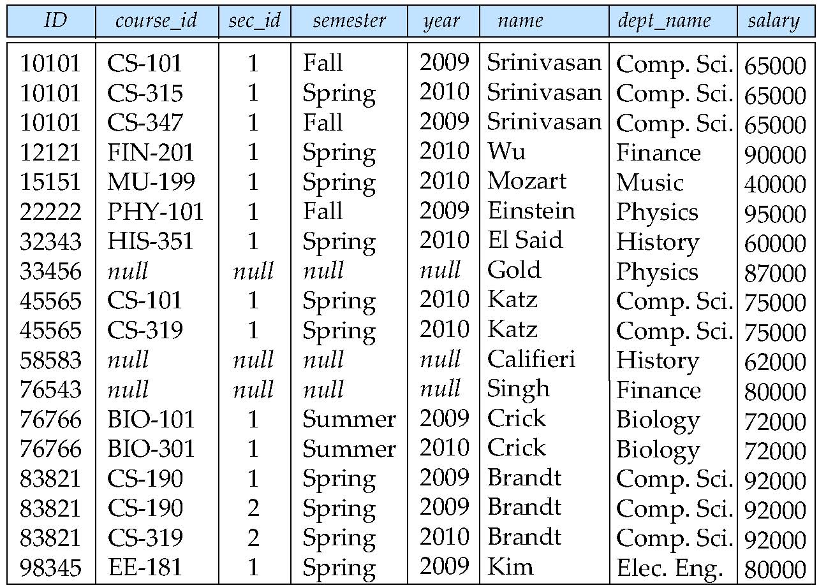
Figure 6.18

Slide 87

Figure 6.19

Slide 88
Figure 6.20

Slide 89
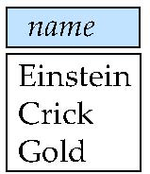
Figure 6.21

Slide 90
Deletion
A delete request is expressed similarly to a query, except instead of displaying tuples to the user, the selected tuples are removed from the database.
Can delete only whole tuples; cannot delete values on only particular attributes
A deletion is expressed in relational algebra by:
r ← r – E
where r is a relation and E is a relational algebra query.

Slide 91
Deletion Examples
Delete all account records in the Perryridge branch.
account ← account – σ _{branch_name = “Perryridge”} (account )
Delete all loan records with amount in the range of 0 to 50
loan ← loan – σ _{amount ≥ 0 and amount ≤ 50} (loan)
Delete all accounts at branches located in Needham.
r₁ ← σ _{branch_city = “Needham”} (account branch )
r₂ ← ∏ _{account_number,} _{branch_name, balance} (r₁)
r₃ ← ∏ _{customer_name, account_number} (r₂ depositor)
account ← account – r₂
depositor ← depositor – r₃

Slide 92
Insertion
To insert data into a relation, we either:
  specify a tuple to be inserted
  write a query whose result is a set of tuples to be inserted
in relational algebra, an insertion is expressed by:
r ← r ∪ E
where r is a relation and E is a relational algebra expression.
The insertion of a single tuple is expressed by letting E be a constant relation containing one tuple.

Slide 93
Insertion Examples
Insert information in the database specifying that Smith has $1200 in account A-973 at the Perryridge branch.
account ← account ∪ {(“A-973”, “Perryridge”, 1200)}
depositor ← depositor ∪ {(“Smith”, “A-973”)}
Provide as a gift for all loan customers in the Perryridge
branch, a $200 savings account. Let the loan number serve
as the account number for the new savings account.
r₁ ← (σ_{branch_name = “Perryridge”} (borrower loan))
account ← account ∪ ∏_{loan_number, branch_name, 200} (r₁)
depositor ← depositor ∪ ∏_{customer_name, loan_number} (r₁)

Slide 94

Updating
A mechanism to change a value in a tuple without charging all values in the tuple
Use the generalized projection operator to do this task
Each F_{i} is either
  the I ^{th} attribute of r, if the I ^{th} attribute is not updated, or,
  if the attribute is to be updated F_{i} is an expression, involving only constants and the attributes of r, which gives the new value for the attribute

Slide 95
Update Examples
Make interest payments by increasing all balances by 5 percent.
account ← ∏ account_number, branch_name, balance * 1.05 (account)
Pay all accounts with balances over $10,000 6 percent interest
and pay all others 5 percent
account ← ∏ account_number, branch_name, balance * 1.06 (σ _{BAL > 10000} (account ))
∪ ∏ account_number, branch_name, balance * 1.05 (σ_{BAL ≤ 10000} (account))

Slide 96
Example Queries
Find the names of all customers who have a loan and an account at bank.
  ∏_{customer_name} (borrower) ∩ ∏_{customer_name} (depositor)
Find the name of all customers who have a loan at the bank and the loan amount
  ∏customer_name, loan_number, amount (borrower loan)

Slide 97
Example Queries
Find all customers who have an account from at least the “Downtown” and the Uptown” branches.
  Query 1
    ∏_{customer_name} (σ_{branch_name = “Downtown”} (depositor account )) ∩
    ∏_{customer_name} (σ_{branch_name = “Uptown”} (depositor account))
  Query 2
  ∏_{customer_name, branch_name} (depositor account)
  ÷ ρ_{temp(branch_name)} ({(“Downtown” ), (“Uptown” )})
  Note that Query 2 uses a constant relation.

Slide 98
Bank Example Queries
Find all customers who have an account at all branches located in Brooklyn city.
∏_{customer_name, branch_name} (depositor account)
÷ ∏_{branch_name} (σ_{branch_city = “Brooklyn”} (branch))

