Slide 1
Chapter 7: Entity-Relationship Model

Slide 2
Chapter 7: Entity-Relationship Model
Design Process
Modeling
Constraints
E-R Diagram
Design Issues
Weak Entity Sets
Extended E-R Features
Design of the Bank Database
Reduction to Relation Schemas
Database Design
UML

Slide 3
Design Process
6 steps：
  Requirement analysis
  Conceptual design
  Logic design
  Physical design
  Database Implementation
  Validation and maintenance
Conceptual model（E-R）
Logical Model
Physical Model
An Introduction to Database System

Slide 4
两大类数据模型 (续)
现实世界
认识
抽象
现实世界 概念模型
数据库设计人员完成
信息世界
概念模型
概念模型 逻辑模型
数据库设计人员完成
DBMS支持的数据模型
  逻辑模型 物理模型
  由DBMS完成
机器世界
现实世界中客观对象的抽象过程
An Introduction to Database Systems

Slide 5
Requirement analysis
功能：
系统应该做些什么?
为什么你想建这个系统?
系统看上去应该是怎样的?
需要些什么报表?
用户需要自己定义新报表吗?
系统的操作者会是谁?

Slide 6
数据需求：
系统界面上需要展现哪些数据?
这些数据应该由谁来提供?
这些数据是如何关联的?
这些工作现在是如何处理的?数据来自哪里?
数据完整性：
哪些数据是必须填写的?(eg: 一条客户记录必须有电话信息吗?)
数据的有效域是什么?(eg: 电话号码是否有格式规定?地址数据应有多长?)
系统是否需要根据邮编来检验城市的有效性?
系统中是否必须在定义了客户之后才能下订单?
系统要求多高的可用性等级?(系统需要7×24的可用性吗?数据的备份频率要多高?)

Slide 7
安全性：
是否每个用户都需要一个不同的密码?
是否需要控制不同的用户所能访问的数据?(eg: 销售代表有权限看到客户的信用卡账号，但订单录入专员却不能)
存储在数据库中的数据是否需要加密?
谁做了什么操作是否需要记录以便于审计?(eg: 记录销售代表提高客户级别的操作，在需要时可以追溯操作的原因)
系统中的客户分成几个级别?每个级别的客户有多少?
是否已有文档记录了用户的工作与权责?

Slide 8
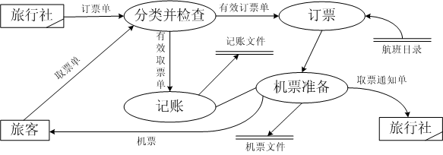
需求文档：
参与者：是指用户在系统中扮演的角色
用例：是指外部可见的系统功能，对系统提供的服务进行描述
关联关系：连接参与者和用例，表示该参与者代表的外部系统实体与该用例描述的系统需求有关
构造数据流图等
机票预订系统
选自：http://blog.csdn.net/xianshengsun/article/details/7439537/

Slide 9
Conceptual Design
Modeling
A database can be modeled as:
  a collection of Entities（实体）,
  Relationship among entities（实体之间的关系）.
An entity is an object that exists and is distinguishable from other objects.
  Example: specific person, company, event, plant
Entities have attributes
  Example: people have names and addresses
An entity set is a set of entities of the same type that share the same properties.
  Example: set of all persons, companies, trees, holidays
Entity Type: properties of the entities of the same type
  instructor = (instructor_ID, instructor_name )

Slide 10
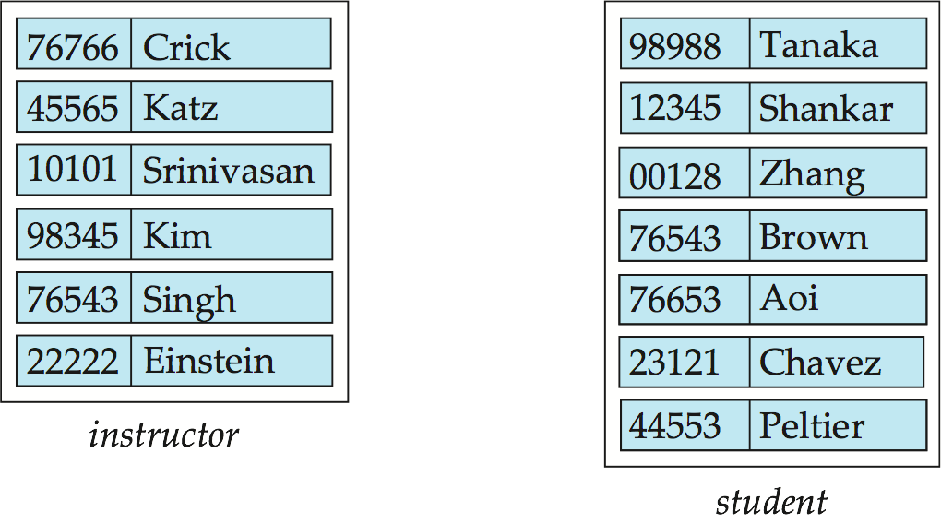
Entity Sets instructor and student
instructor_ID instructor_name student-ID student_name

Slide 11
Relationship Sets
A relationship is an association among several entities
Example:
44553 (Peltier) advisor 22222 (Einstein)
student entity relationship set instructor entity
A relationship set is a mathematical relation among n ≥ 2 entities, each taken from entity sets
{(e₁, e₂, … e_{n}) | e₁ ∈ E₁, e₂ ∈ E₂, …, e_{n} ∈ E_{n}}
where (e₁, e₂, …, e_{n}) is a relationship
  Example:
  (44553,22222) ∈ advisor

Slide 12
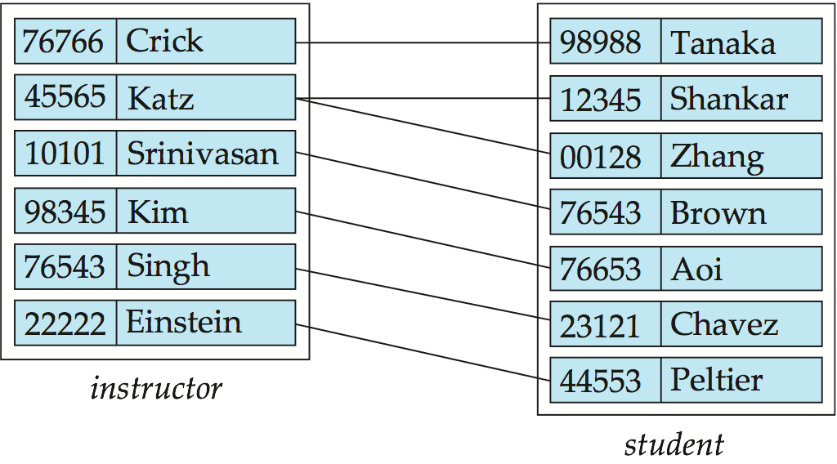
Relationship Set advisor

Slide 13
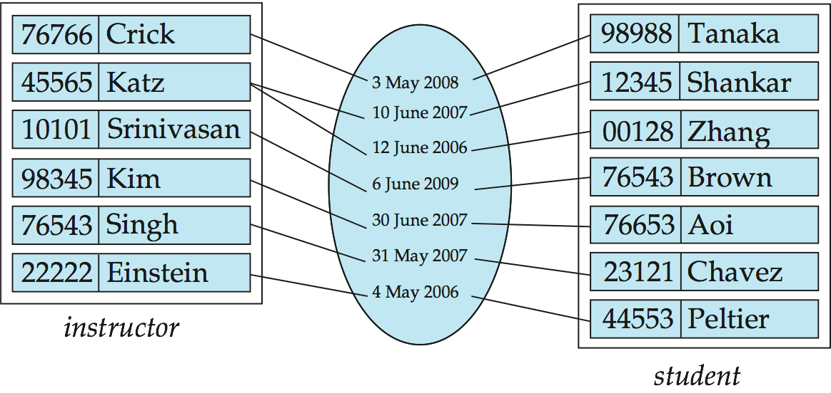
Relationship Sets (Cont.)
An attribute can also be property of a relationship set.
For instance, the advisor relationship set between entity sets instructor and student may have the attribute date which tracks when the student started being associated with the advisor

Slide 14
Attributes
An entity is represented by a set of attributes, that is descriptive properties possessed by all members of an entity set.
  Example:
  instructor = (ID, name, street, city, salary )
  course= (course_id, title, credits)
Domain – the set of permitted values for each attribute
Attribute types:
  Simple and composite attributes.
  Single-valued and multivalued attributes
    Example: multivalued attribute: phone_numbers （tel, mob）
  Derived attributes
    Can be computed from other attributes
    Example: age, given date_of_birth

Slide 15
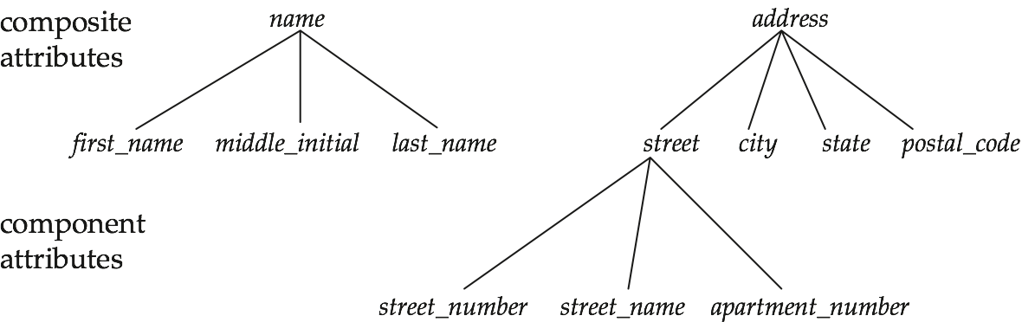
Composite Attributes

Slide 16
Keys
A super key of an entity set is a set of one or more attributes whose values uniquely determine each entity.
A candidate key of an entity set is a minimal super key
  ID is candidate key of instructor
  course_id is candidate key of course
Although several candidate keys may exist, one of the candidate keys is selected to be the primary key.
学生（实体）：学号，身份证号，姓名，性别。
因为通过学号可以找到唯一一个学生，所以{学号}是一个超码，同理{学号,身份证号}、{学号,身份证号,姓名}、{学号,身份证号,姓名，性别}、{身份证号}、{身份证号，姓名}、{身份证号，姓名、性别}也是超码.在这里，因为不同的学生可能拥有相同的姓名，所不可以区别一个学生，既{姓名}不是一个超码，{性别}、{姓名、性别}也不是。

Slide 17
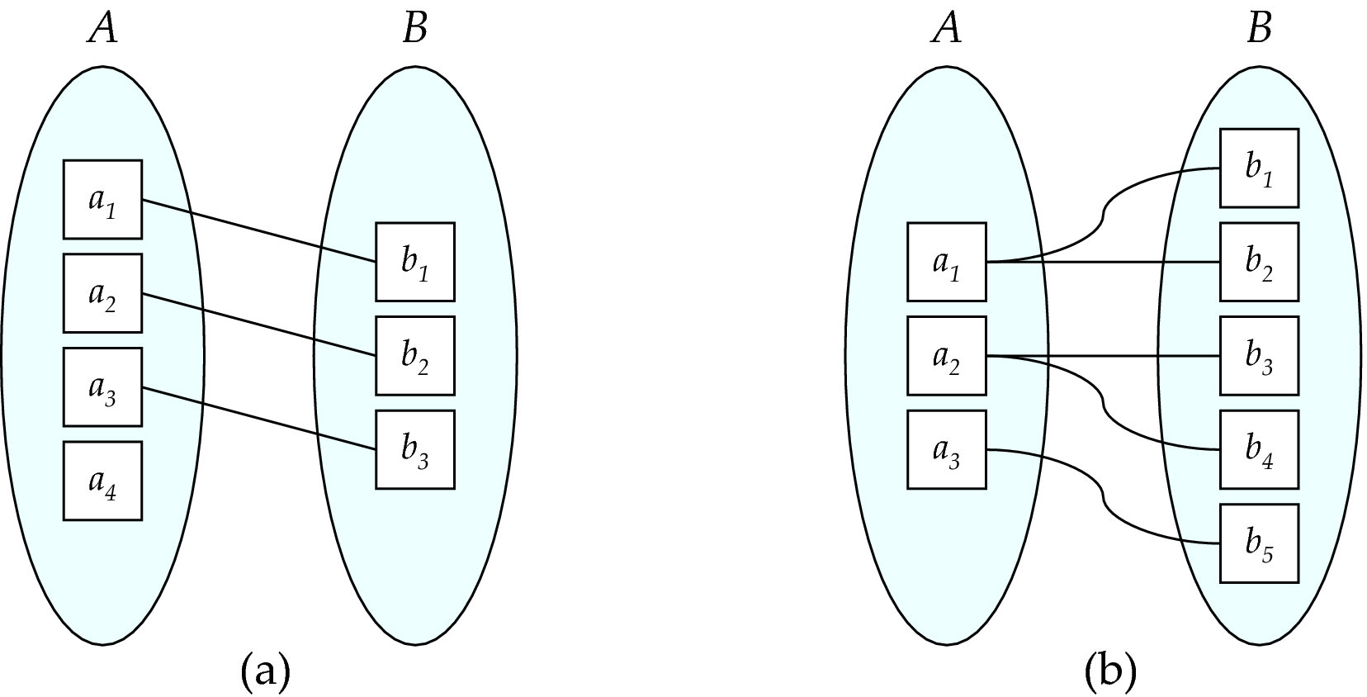
Mapping Cardinalities
One to one
One to many
参与约束：
Note: Some elements in A and B may not be mapped to any
elements in the other set

Slide 18
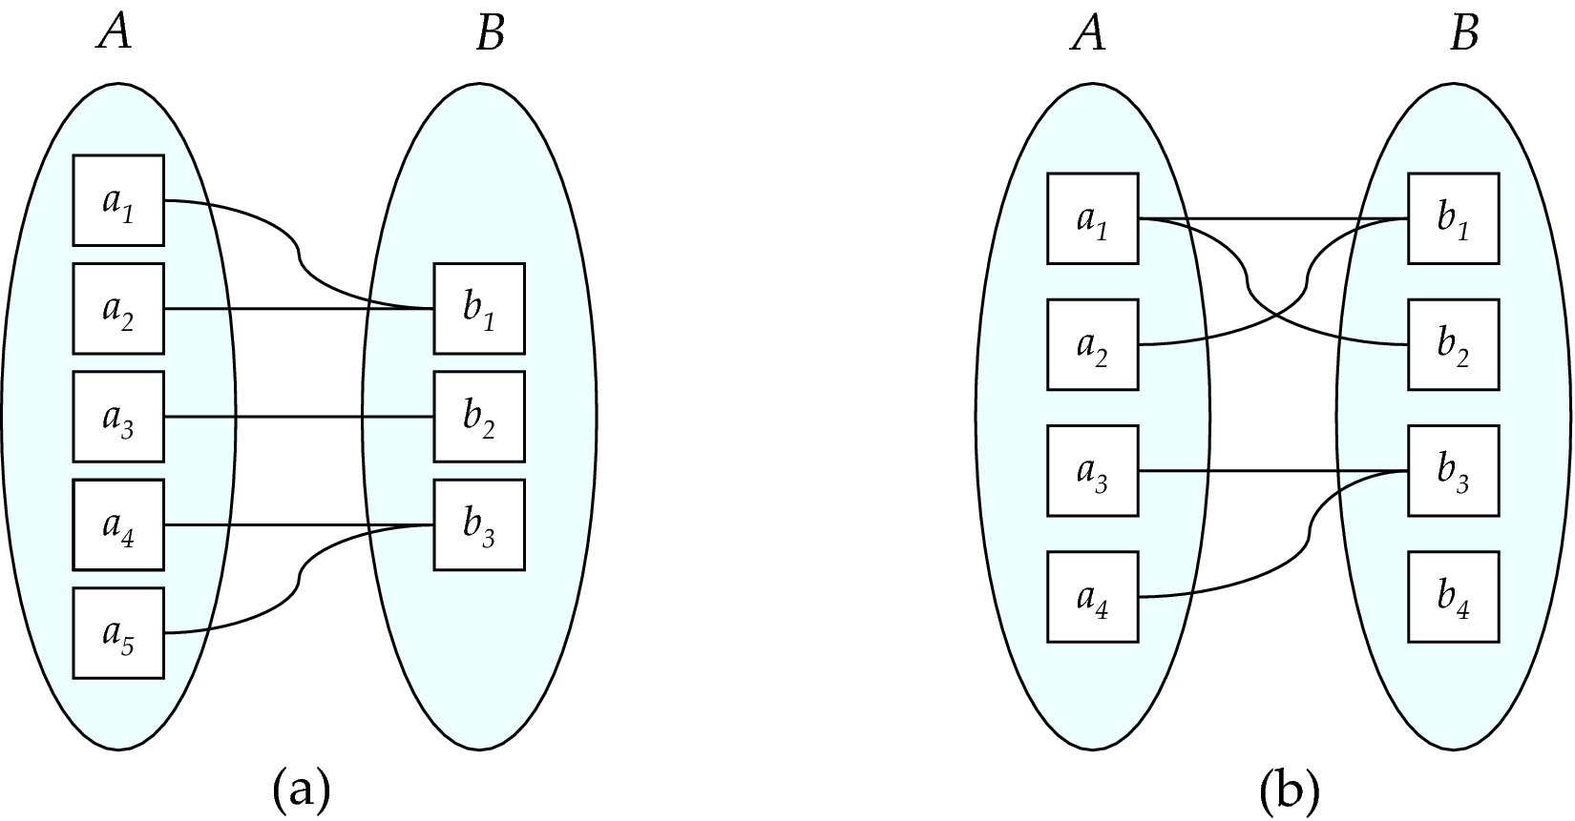
Mapping Cardinalities
Many to one
Many to many
Note: Some elements in A and B may not be mapped to any
elements in the other set

Slide 19
Keys for Relationship Sets
The combination of primary keys of the participating entity sets forms a super key of a relationship set.
  (s_id, i_id) is the super key of advisor
  NOTE: this means a pair of entity sets can have at most one relationship in a particular relationship set.
    Example: if we wish to track multiple meeting dates between a student and her advisor, we cannot assume a relationship for each meeting. We can use a multivalued attribute though
Must consider the mapping cardinality of the relationship set when deciding what are the candidate keys
Need to consider semantics of relationship set in selecting the primary key in case of more than one candidate key

Slide 20
Redundant Attributes
Suppose we have entity sets
  instructor, with attributes including dept_name
  department
  and a relationship
  inst_dept relating instructor and department
Attribute dept_name in entity instructor is redundant since there is an explicit relationship inst_dept which relates instructors to departments
  The attribute replicates information present in the relationship, and should be removed from instructor
  BUT: when converting back to tables, in some cases the attribute gets reintroduced, as we will see.

Slide 21
Relationship Set advisor
E-R Diagrams

Slide 22
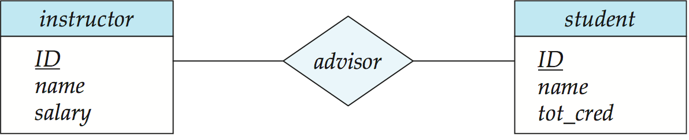
E-R Diagrams
Rectangles represent entity sets.
Diamonds represent relationship sets.
Attributes listed inside entity rectangle
Underline indicates primary key attributes

Slide 23
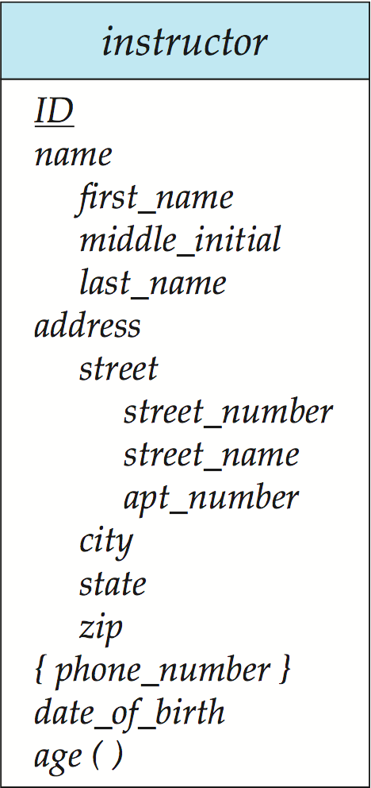
Entity With Composite, Multivalued, and Derived Attributes

Slide 24
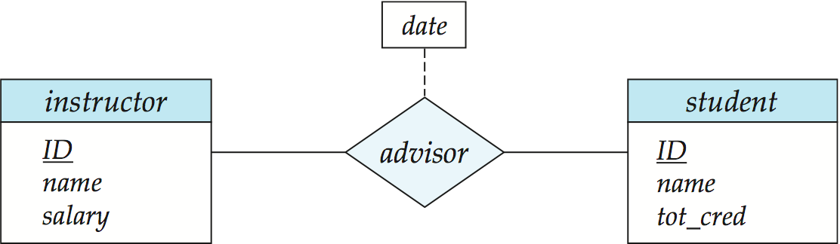
Relationship Sets with Attributes

Slide 25
Cardinality Constraints
We express cardinality constraints by drawing either a directed line (→), signifying “one,” or an undirected line (—), signifying “many,” between the relationship set and the entity set.
One-to-one relationship:
  A student is associated with at most one instructor via the relationship advisor
  A student is associated with at most one department via stud_dept

Slide 26
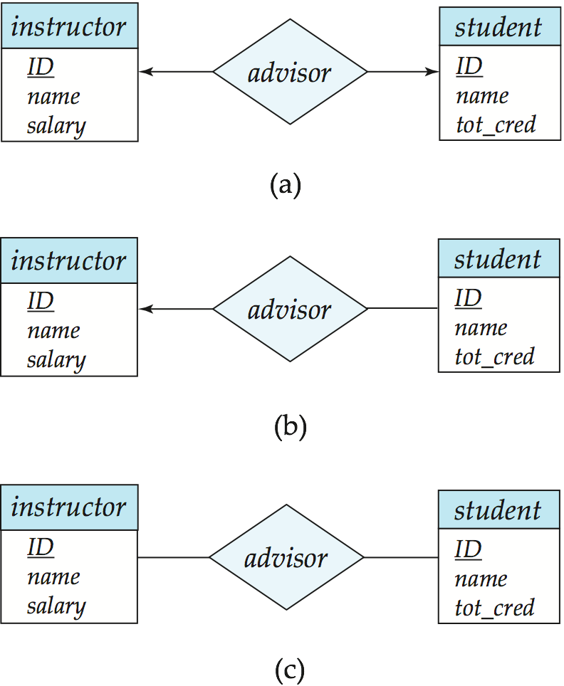
One-to-One Relationship
one-to-one relationship between an instructor and a student
  an instructor is associated with at most one student via advisor
  and a student is associated with at most one instructor via advisor
班级
1
班级-班长
1
班长
1:1联系

Slide 27
One-to-Many Relationship
one-to-many relationship between an instructor and a student
  an instructor is associated with several (including 0) students via advisor
  a student is associated with at most one instructor via advisor,
班级
1
组成
n
学生
1:n联系

Slide 28
Many-to-One Relationships
In a many-to-one relationship between an instructor and a student,
  an instructor is associated with at most one student via advisor,
  and a student is associated with several (including 0) instructors via advisor

Slide 29
Many-to-Many Relationship
An instructor is associated with several (possibly 0) students via advisor
A student is associated with several (possibly 0) instructors via advisor
课程
m
选修
n
学生
m:n联系

Slide 30
Cardinality Constraints on Ternary Relationship
We allow at most one arrow out of a ternary (or greater degree) relationship to indicate a cardinality constraint
E.g., an arrow from proj_guide to instructor indicates each student has at most one guide for a project
If there is more than one arrow, there are two ways of defining the meaning.
  E.g., a ternary relationship R between A, B and C with arrows to B and C could mean
  1. each A entity is associated with a unique entity from B and C or
  2. each pair of entities from (A, B) is associated with a unique C entity, and each pair (A, C) is associated with a unique B
  Each alternative has been used in different formalisms
  To avoid confusion we outlaw more than one arrow

Slide 31
两个以上实体型之间一对多联系
  若实体集E₁，E₂，...，E_{n}存在联系，对于实体集E_{j}（j=1，2，...，i-1，i+1，...，n）中的给定实体，最多只和E_{i}中的一个实体相联系，则我们说E_{i}与E₁，E₂，...，E_{i-1}，E_{i+1}，...，E_{n}之间的联系是一对多的
An Introduction to Database Systems

Slide 32
实例
课程、教师与参考书三个实体型
  一门课程可以有若干个教师讲授，
  一门课程使用若干本参考书，
  每一个教师只讲授一门课程，
  每一本参考书只供一门课程使用
课程
1
讲授
m
n
教师
参考书
两个以上实体型间1:n联系
An Introduction to Database Systems

Slide 33
多个实体型间的一对一联系
多个实体型间的多对多联系
  实例
供应商、项目、零件三个实体型
  一个供应商可以供给多个项目多种零件
  每个项目可以使用多个供应商供应的零件
  每种零件可由不同供应商供给
供应商
m
供应
n
p
项目
零件
两个以上实体型间m:n联系
An Introduction to Database Systems

Slide 34
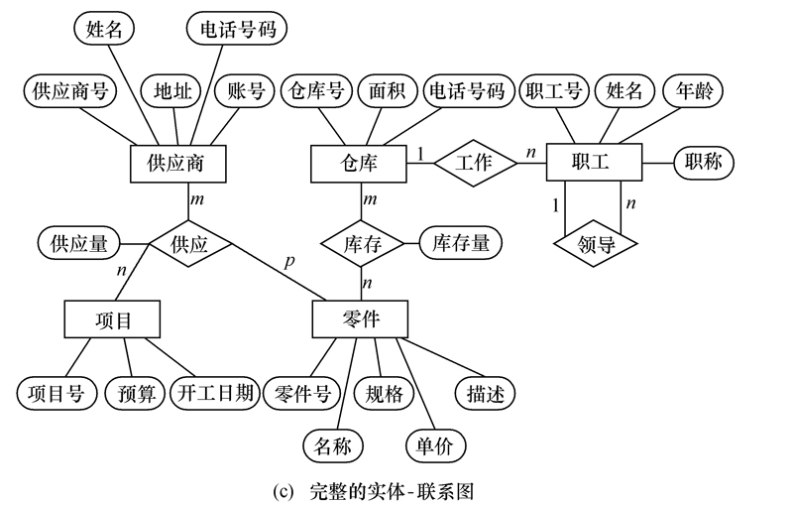
一个实例
An Introduction to Database Systems

Slide 35
讨论
构造出所设计数据库系统中的E-R图

Slide 36
（3）逻辑设计
将现实世界的概念数据模型设计成数据库的一种逻辑模式，即适应于某种特定数据库管理系统所支持的逻辑数据模式。与此同时，可能还需为各种数据处理应用领域产生相应的逻辑子模式。这一步设计的结果就是所谓“逻辑数据库”。

Slide 37
ER模型向关系模型的转换
  1.实体类型转换
    每个实体类型转换成一个关系模式
    实体属性即为关系模式的属性
    实体标识符即为关系模式的键
  注意
    得到的关系模式，有些可能会扩充属性

Slide 38
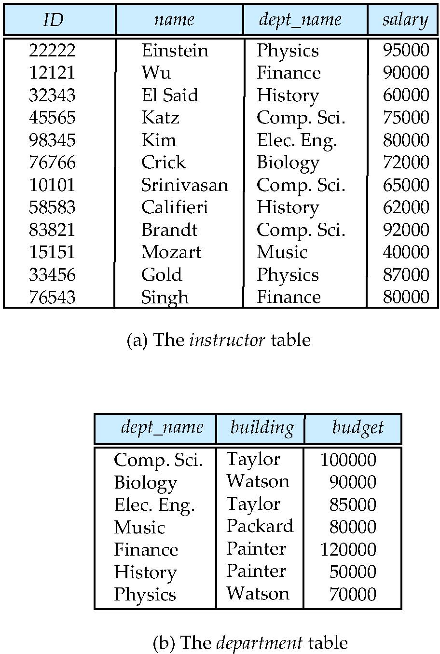
关系模型
关系模式
Instructor（ID, name, dept_name, salary）

Slide 39
Degree of a Relationship Set
binary relationship
  involve two entity sets (or degree two).
  most relationship sets in a database system are binary.
Relationships between more than two entity sets are rare. Most relationships are binary. (More on this later.)
  Example: students work on research projects under the guidance of an instructor.
  relationship proj_guide is a ternary relationship between instructor, student, and project

Slide 40
Mapping Cardinality（映射基数） Constraints
Express the number of entities to which another entity can be associated via a relationship set.
Most useful in describing binary relationship sets.
For a binary relationship set the mapping cardinality must be one of the following types:
  One to one
  One to many
  Many to one
  Many to many

Slide 41
ER模型向关系模型的转换
  2联系类型转换
  二元联系
      1:1联系，联系两端的实体类型转成两个关系模式，在任一个关系模式中加入另一个关系模式的键（作为外键）和联系的属性

Slide 42
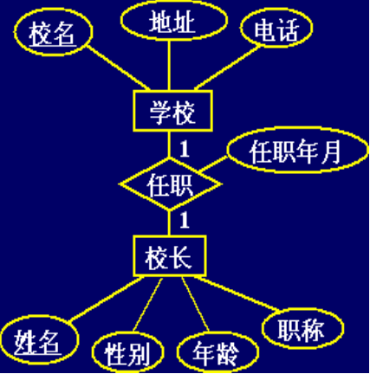
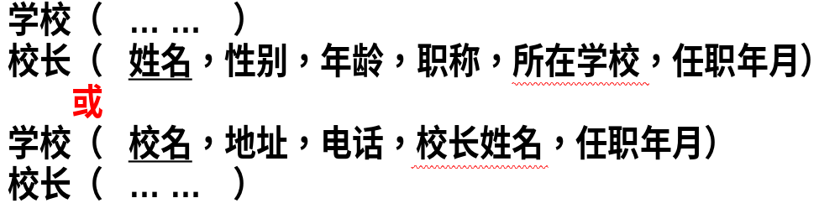
ER模型向关系模型的转换
  2联系类型转换
  二元联系
      示例

Slide 43
ER模型向关系模型的转换
  2联系类型转换
  二元联系
      1:1联系，联系两端的实体类型转成两个关系模式，在任一个关系模式中加入另一个关系模式的键（作为外键）和联系的属性
      1:N联系，在N端实体类型转换成的关系模式中，加入1端实体类型的键（作为外键）和联系的属性
      M:N联系，联系类型需转换为关系模式，属性为两端实体类型的键（分别作为外键）加上联系的属性，而键为两端实体键的组合（特殊情况下，需要扩展）

Slide 44
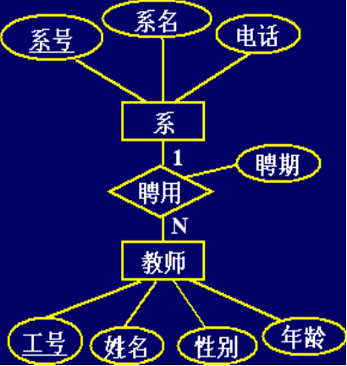
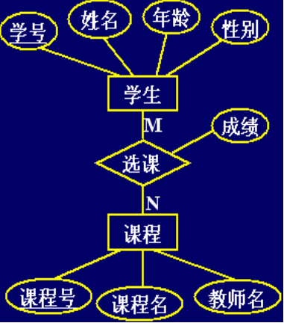

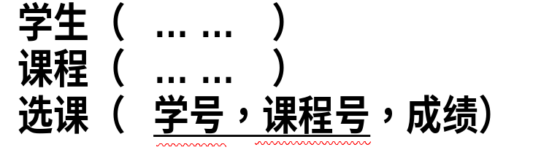
ER模型向关系模型的转换
  联系类型转换
  二元联系
      示例

Slide 45
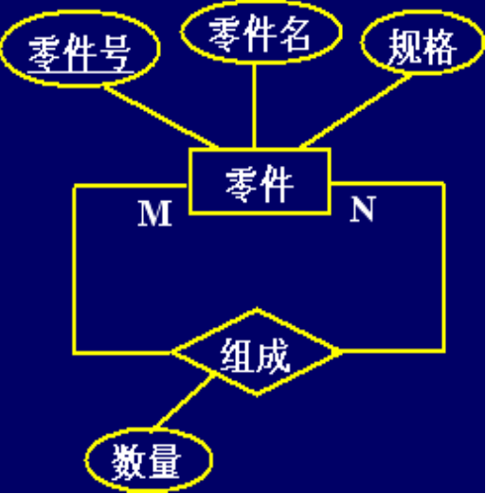
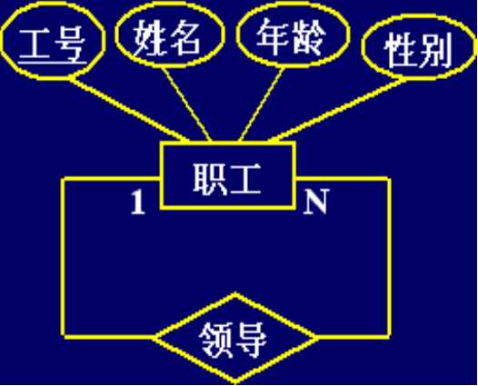

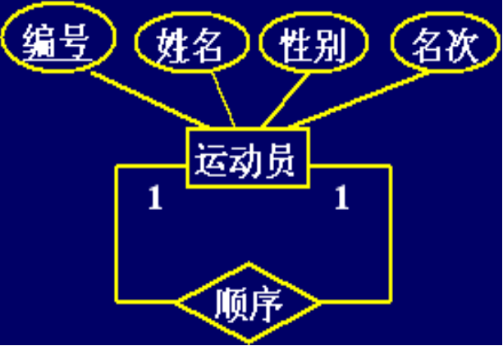
ER模型向关系模型的转换
联系类型转换
  一元联系
      示例

Slide 46
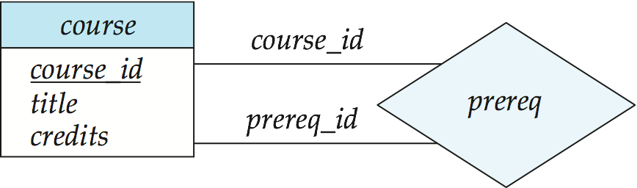
Roles
Entity sets of a relationship need not be distinct
  Each occurrence of an entity set plays a “role” in the relationship
The labels “course_id” and “prereq_id” are called roles.
实体在联系中的作用称为实体的角色。
同一实体集多次参与一个联系。

Slide 47
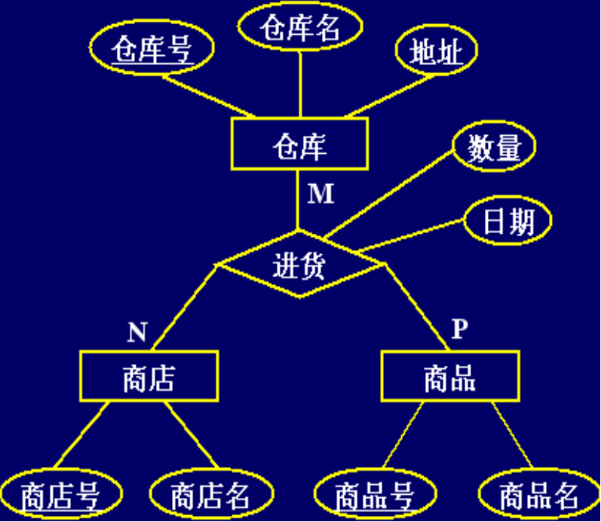
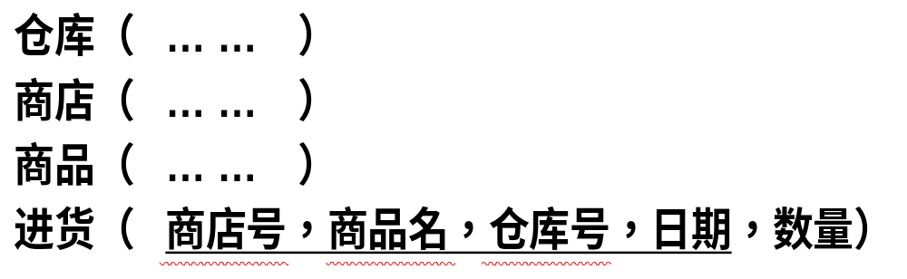
ER模型向关系模型的转换
算法
  2 联系类型转换
    2.3 三元联系
      示例
    注
      M:N的联系类型，转成关系模式时，相关实体键组合有时不足以表达主键，需要扩展主键的属性构成

Slide 48
ER模型向关系模型的转换
  联系类型转换
  三元联系
      1:1:1，转换成的三个关系模式中，在任一个关系模式中加入另两个关系模式的键（作为外键）和联系的属性
      1:1:N，在N端实体类型转换成的关系模式中，加入两个1端实体类型的键（作为外键）和联系的属性
      1:M:N，联系类型需转换为关系模式，属性为M端和N端实体类型的键（分别作为外键）加上联系的属性，而键为M端和N端实体键的组合（特殊情况下，需要扩展）
      M:N:P，联系类型需转换为关系模式，属性为三端实体类型的键（分别作为外键）加上联系的属性，而键为三端实体键的组合（特殊情况下，需要扩展）

Slide 49
习题：
“商店”实体集，属性有商店编号、商店名、地址等；
“商品”实体集，属性有商品号、商品名、规格、单价等；
“职工”实体集，属性有职工编号、姓名、性别、业绩等。
商店与商品间存在“销售”联系，每个商店可销售多种商品，每种商品也可放在多个商店销售，每个商店销售一种商品，有月销售量；商店与职工间存在着“聘用”联系，每个商店有许多职工，每个职工只能在一个商店工作，商店聘用职工有聘期和月薪。
（1）试画出ER图，并在图上注明属性、联系的类型。
（2）将ER图转换成关系模型，并注明主键和外键。

Slide 50
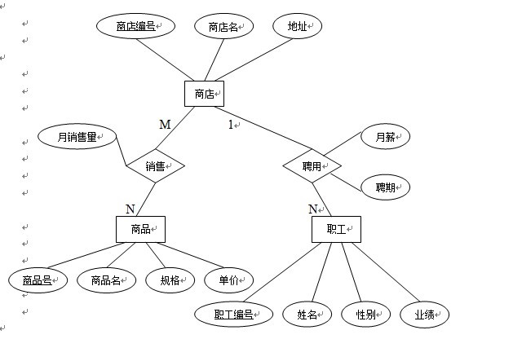
这个ER图可转换4个关系模式：
商店（商店编号，商店名，地址）
职工（职工编号，姓名，性别，业绩，商店编号，聘期，月薪）
商品（商品号，商品名，规格，单价）
销售（商店编号，商品号，月销售量）

Slide 51
讨论
将所设计数据库系统的E-R图进行逻辑设计

Slide 52
（4）物理设计
根据特定数据库管理系统所提供的多种存储结构和存取方法等依赖于具体计算机结构的各项物理设计措施，对具体的应用任务选定最合适的物理存储结构(包括文件类型、索引结构和数据的存放次序与位逻辑等)、存取方法和存取路径等。这一步设计的结果就是所谓“物理数据库”。
关键字不能取空值，或者重复值。

Slide 53
（5）验证设计
在上述设计的基础上，收集数据并具体建立一个数据库，运行一些典型的应用任务来验证数据库设计的正确性和合理性。一般，一个大型数据库的设计过程往往需要经过多次循环反复。当设计的某步发现问题时，可能就需要返回到前面去进行修改。因此，在做上述数据库设计时就应考虑到今后修改设计的可能性和方便性。

Slide 54

概念结构 （E-R模型） | 逻辑结构 （关系模型） | 物理结构 （二维表）
实体 | 元组 | 记录
属性 | 属性 | 字段
实体型 | 关系模式 | 表结构
实体集 | 关系 | 表和视图
码 | 码 | 码
联系 | 联系 | 关联

Slide 55
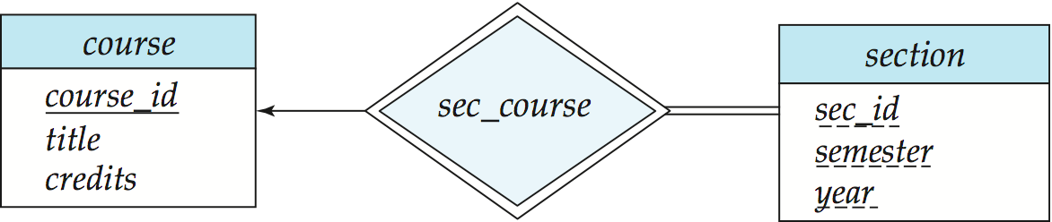
Participation of an Entity Set in a Relationship Set
Total participation (indicated by double line): every entity in the entity set participates in at least one relationship in the relationship set
  E.g., participation of section in sec_course is total
    every section must have an associated course
Partial participation: some entities may not participate in any relationship in the relationship set
  Example: participation of instructor in advisor is partial

Slide 56
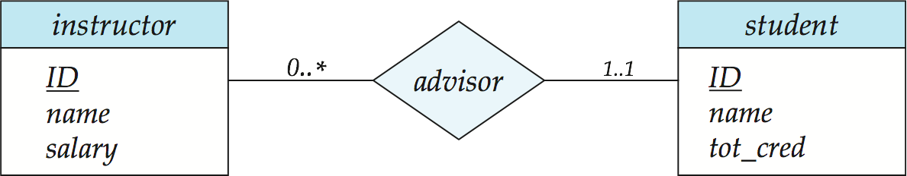
Alternative Notation for Cardinality Limits
Cardinality limits can also express participation constraints

Slide 57
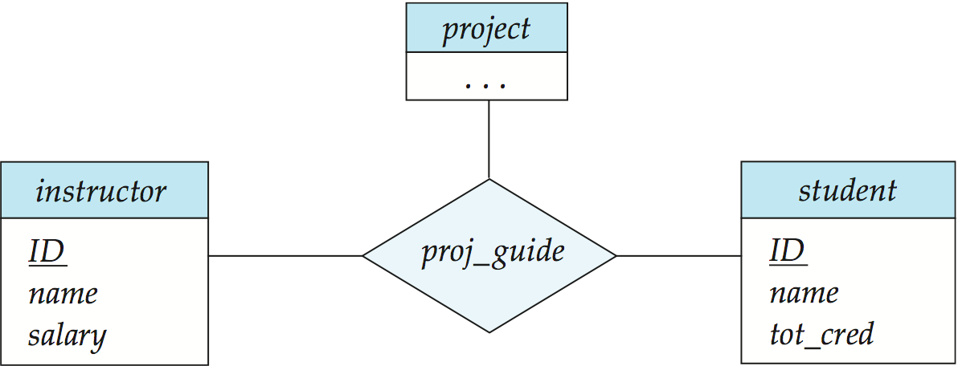
E-R Diagram with a Ternary Relationship

Slide 58
How about doing an ER design interactively on the board?
Suggest an application to be modeled.

Slide 59
Weak Entity Sets
An entity set that does not have a primary key is referred to as a weak entity set.
The existence of a weak entity set depends on the existence of a identifying entity set
  It must relate to the identifying entity set via a total, one-to-many relationship set from the identifying to the weak entity set
  Identifying relationship depicted using a double diamond
The discriminator (or partial key) of a weak entity set is the set of attributes that distinguishes among all the entities of a weak entity set.
The primary key of a weak entity set is formed by the primary key of the strong entity set on which the weak entity set is existence dependent, plus the weak entity set’s discriminator.

Slide 60
Weak Entity Sets (Cont.)
We underline the discriminator of a weak entity set with a dashed line.
We put the identifying relationship of a weak entity in a double diamond.
Primary key for section – (course_id, sec_id, semester, year)

Slide 61
Weak Entity Sets (Cont.)
Note: the primary key of the strong entity set is not explicitly stored with the weak entity set, since it is implicit in the identifying relationship.
If course_id were explicitly stored, section could be made a strong entity, but then the relationship between section and course would be duplicated by an implicit relationship defined by the attribute course_id common to course and section

Slide 62
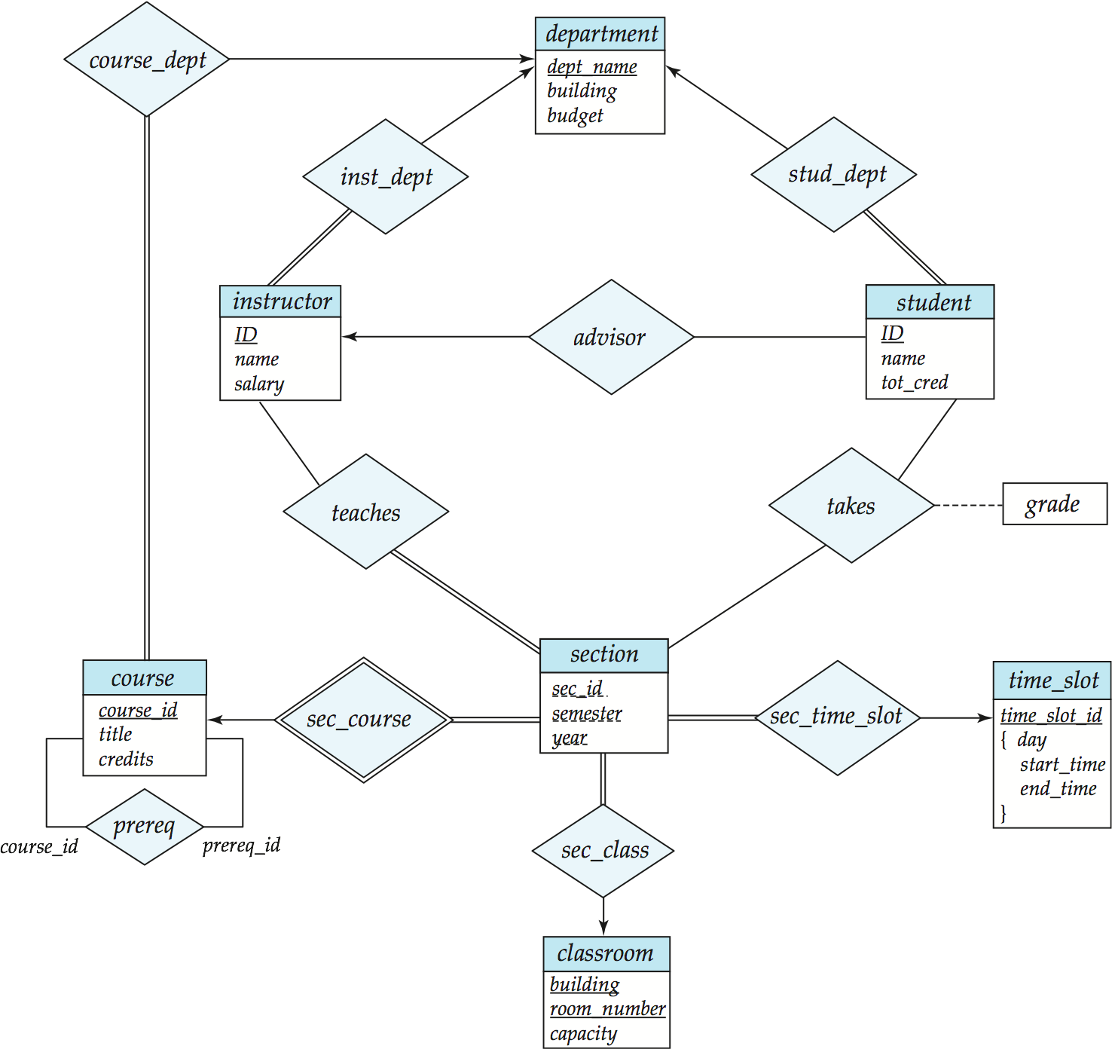
E-R Diagram for a University Enterprise

Slide 63
Reduction to Relational Schemas

Slide 64
Reduction to Relation Schemas
Entity sets and relationship sets can be expressed uniformly as relation schemas that represent the contents of the database.
A database which conforms to an E-R diagram can be represented by a collection of schemas.
For each entity set and relationship set there is a unique schema that is assigned the name of the corresponding entity set or relationship set.
Each schema has a number of columns (generally corresponding to attributes), which have unique names.

Slide 65
Representing Entity Sets With Simple Attributes
A strong entity set reduces to a schema with the same attributes
student(ID, name, tot_cred)
A weak entity set becomes a table that includes a column for the primary key of the identifying strong entity set
section ( course_id, sec_id, sem, year )

Slide 66
Representing Relationship Sets
A many-to-many relationship set is represented as a schema with attributes for the primary keys of the two participating entity sets, and any descriptive attributes of the relationship set.
Example: schema for relationship set advisor
advisor = (s_id, i_id)

Slide 67
Redundancy of Schemas
Many-to-one and one-to-many relationship sets that are total on the many-side can be represented by adding an extra attribute to the “many” side, containing the primary key of the “one” side
Example: Instead of creating a schema for relationship set inst_dept, add an attribute dept_name to the schema arising from entity set instructor

Slide 68
Redundancy of Schemas (Cont.)
For one-to-one relationship sets, either side can be chosen to act as the “many” side
  That is, extra attribute can be added to either of the tables corresponding to the two entity sets
If participation is partial on the “many” side, replacing a schema by an extra attribute in the schema corresponding to the “many” side could result in null values
The schema corresponding to a relationship set linking a weak entity set to its identifying strong entity set is redundant.
  Example: The section schema already contains the attributes that would appear in the sec_course schema

Slide 69
Composite and Multivalued Attributes
Composite attributes are flattened out by creating a separate attribute for each component attribute
  Example: given entity set instructor with composite attribute name with component attributes first_name and last_name the schema corresponding to the entity set has two attributes name_first_name and name_last_name
    Prefix omitted if there is no ambiguity
Ignoring multivalued attributes, extended instructor schema is
  instructor(ID,
  first_name, middle_initial, last_name,
  street_number, street_name,
  apt_number, city, state, zip_code,
  date_of_birth)

Slide 70
Composite and Multivalued Attributes
A multivalued attribute M of an entity E is represented by a separate schema EM
  Schema EM has attributes corresponding to the primary key of E and an attribute corresponding to multivalued attribute M
  Example: Multivalued attribute phone_number of instructor is represented by a schema:
  inst_phone= ( ID, phone_number)
  Each value of the multivalued attribute maps to a separate tuple of the relation on schema EM
    For example, an instructor entity with primary key 22222 and phone numbers 456-7890 and 123-4567 maps to two tuples:
    (22222, 456-7890) and (22222, 123-4567)

Slide 71
Multivalued Attributes (Cont.)
Special case:entity time_slot has only one attribute other than the primary-key attribute, and that attribute is multivalued
  Optimization: Don’t create the relation corresponding to the entity, just create the one corresponding to the multivalued attribute
  time_slot(time_slot_id, day, start_time, end_time)
  Caveat: time_slot attribute of section (from sec_time_slot) cannot be a foreign key due to this optimization

Slide 72
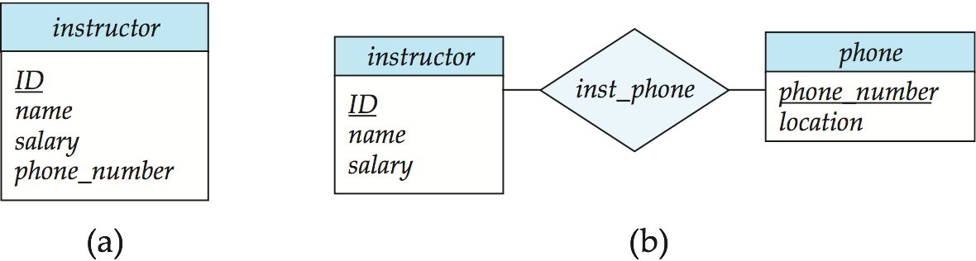
Design Issues
Use of entity sets vs. attributes
Use of phone as an entity allows extra information about phone numbers (plus multiple phone numbers)

Slide 73
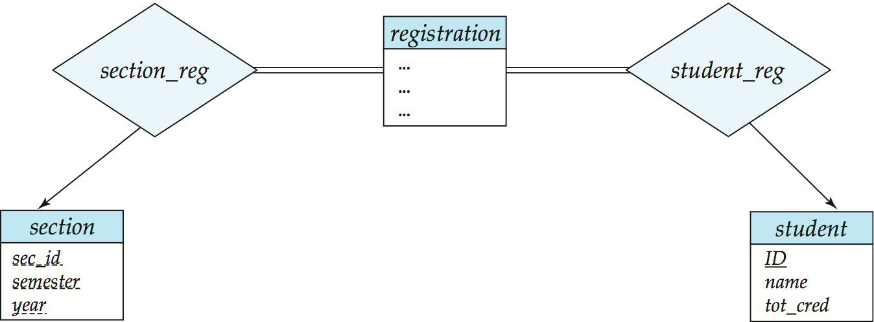
Design Issues
Use of entity sets vs. relationship sets
Possible guideline is to designate a relationship set to describe an action that occurs between entities

Slide 74
Design Issues
Binary versus n-ary relationship sets
Although it is possible to replace any nonbinary (n-ary, for n > 2) relationship set by a number of distinct binary relationship sets, a n-ary relationship set shows more clearly that several entities participate in a single relationship.
Placement of relationship attributes
e.g., attribute date as attribute of advisor or as attribute of student

Slide 75
Binary Vs. Non-Binary Relationships
Some relationships that appear to be non-binary may be better represented using binary relationships
  E.g., A ternary relationship parents, relating a child to his/her father and mother, is best replaced by two binary relationships, father and mother
    Using two binary relationships allows partial information (e.g., only mother being know)
  But there are some relationships that are naturally non-binary
    Example: proj_guide

Slide 76
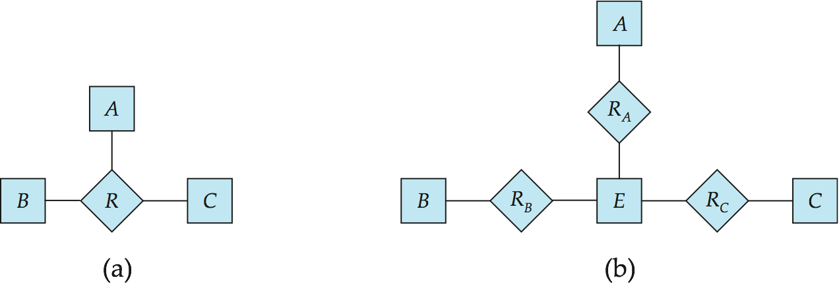
Converting Non-Binary Relationships to Binary Form
In general, any non-binary relationship can be represented using binary relationships by creating an artificial entity set.
  Replace R between entity sets A, B and C by an entity set E, and three relationship sets:
1. R_{A}, relating E and A 2. R_{B}, relating E and B
3. R_{C}, relating E and C
  Create a special identifying attribute for E
  Add any attributes of R to E
  For each relationship (a_{i} , b_{i} , c_{i}) in R, create
1. a new entity e_{i} in the entity set E 2. add (e_{i} , a_{i} ) to R_{A}
3. add (e_{i} , b_{i} ) to R_{B} 4. add (e_{i} , c_{i} ) to R_{C}

Slide 77
Converting Non-Binary Relationships (Cont.)
Also need to translate constraints
  Translating all constraints may not be possible
  There may be instances in the translated schema that
  cannot correspond to any instance of R
    Exercise: add constraints to the relationships R_{A}, R_{B} and R_{C} to ensure that a newly created entity corresponds to exactly one entity in each of entity sets A, B and C
  We can avoid creating an identifying attribute by making E a weak entity set (described shortly) identified by the three relationship sets

Slide 78
Extended ER Features

Slide 79
Extended E-R Features: Specialization
Top-down design process; we designate subgroupings within an entity set that are distinctive from other entities in the set.
These subgroupings become lower-level entity sets that have attributes or participate in relationships that do not apply to the higher-level entity set.
Depicted by a triangle component labeled ISA (E.g., instructor “is a” person).
Attribute inheritance – a lower-level entity set inherits all the attributes and relationship participation of the higher-level entity set to which it is linked.

Slide 80
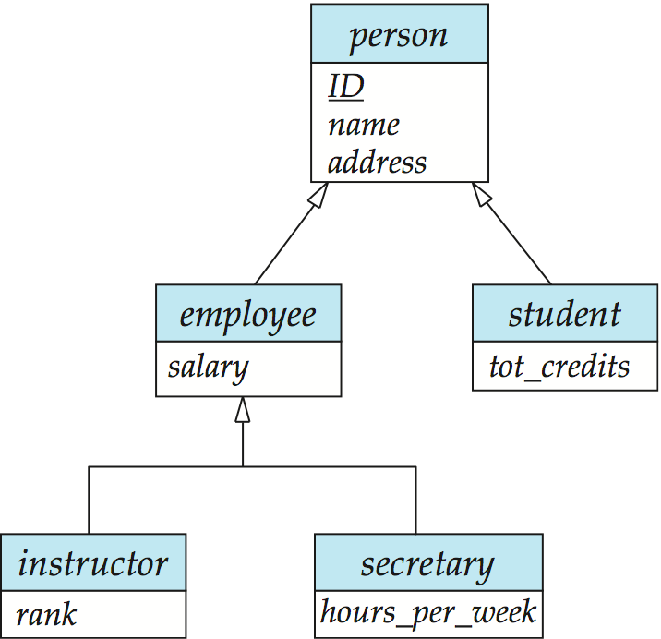
Specialization Example

Slide 81
Extended ER Features: Generalization
A bottom-up design process – combine a number of entity sets that share the same features into a higher-level entity set.
Specialization and generalization are simple inversions of each other; they are represented in an E-R diagram in the same way.
The terms specialization and generalization are used interchangeably.

Slide 82
Specialization and Generalization (Cont.)
Can have multiple specializations of an entity set based on different features.
E.g., permanent_employee vs. temporary_employee, in addition to instructor vs. secretary
Each particular employee would be
  a member of one of permanent_employee or temporary_employee,
  and also a member of one of instructor, secretary
The ISA relationship also referred to as superclass - subclass relationship

Slide 83
Design Constraints on a Specialization/Generalization
Constraint on which entities can be members of a given lower-level entity set.
  condition-defined
    Example: all customers over 65 years are members of senior-citizen entity set; senior-citizen ISA person.
  user-defined
Constraint on whether or not entities may belong to more than one lower-level entity set within a single generalization.
  Disjoint
    an entity can belong to only one lower-level entity set
    Noted in E-R diagram by having multiple lower-level entity sets link to the same triangle
  Overlapping
    an entity can belong to more than one lower-level entity set

Slide 84
Design Constraints on a Specialization/Generalization (Cont.)
Completeness constraint -- specifies whether or not an entity in the higher-level entity set must belong to at least one of the lower-level entity sets within a generalization.
  total: an entity must belong to one of the lower-level entity sets
  partial: an entity need not belong to one of the lower-level entity sets

Slide 85
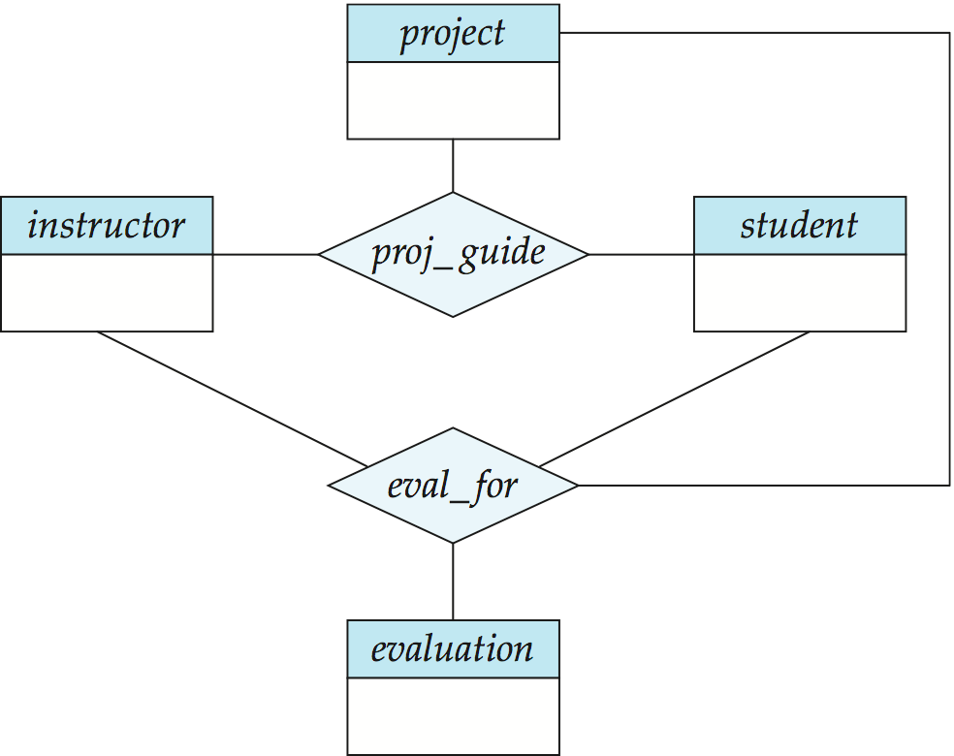
Aggregation
Consider the ternary relationship proj_guide, which we saw earlier
Suppose we want to record evaluations of a student by a guide on a project

Slide 86
Aggregation (Cont.)
Relationship sets eval_for and proj_guide represent overlapping information
  Every eval_for relationship corresponds to a proj_guide relationship
  However, some proj_guide relationships may not correspond to any eval_for relationships
    So we can’t discard the proj_guide relationship
Eliminate this redundancy via aggregation
  Treat relationship as an abstract entity
  Allows relationships between relationships
  Abstraction of relationship into new entity

Slide 87
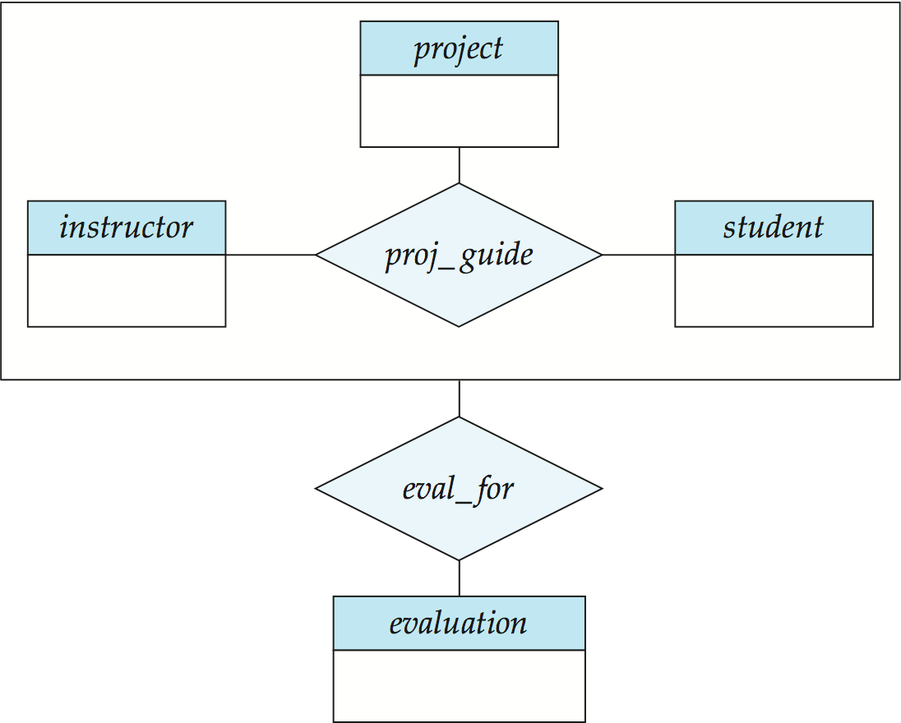
Aggregation (Cont.)
Without introducing redundancy, the following diagram represents:
  A student is guided by a particular instructor on a particular project
  A student, instructor, project combination may have an associated evaluation

Slide 88
Representing Specialization via Schemas
Method 1:
  Form a schema for the higher-level entity
  Form a schema for each lower-level entity set, include primary key of higher-level entity set and local attributes
  schema attributes
  person ID, name, street, city
  student ID, tot_cred
  employee ID, salary
  Drawback: getting information about, an employee requires accessing two relations, the one corresponding to the low-level schema and the one corresponding to the high-level schema

Slide 89
Representing Specialization as Schemas (Cont.)
Method 2:
  Form a schema for each entity set with all local and inherited attributes
  schema attributes
  person ID, name, street, city
  student ID, name, street, city, tot_cred
  employee ID, name, street, city, salary
  If specialization is total, the schema for the generalized entity set (person) not required to store information
    Can be defined as a “view” relation containing union of specialization relations
    But explicit schema may still be needed for foreign key constraints
  Drawback: name, street and city may be stored redundantly for people who are both students and employees

Slide 90
Schemas Corresponding to Aggregation
To represent aggregation, create a schema containing
  primary key of the aggregated relationship,
  the primary key of the associated entity set
  any descriptive attributes

Slide 91
Schemas Corresponding to Aggregation (Cont.)
For example, to represent aggregation manages between relationship works_on and entity set manager, create a schema
eval_for (s_ID, project_id, i_ID, evaluation_id)
Schema proj_guide is redundant provided we are willing to store null values for attribute manager_name in relation on schema manages

Slide 92
E-R Design Decisions
The use of an attribute or entity set to represent an object.
Whether a real-world concept is best expressed by an entity set or a relationship set.
The use of a ternary relationship versus a pair of binary relationships.
The use of a strong or weak entity set.
The use of specialization/generalization – contributes to modularity in the design.
The use of aggregation – can treat the aggregate entity set as a single unit without concern for the details of its internal structure.

Slide 93
How about doing another ER design interactively on the board?

Slide 94
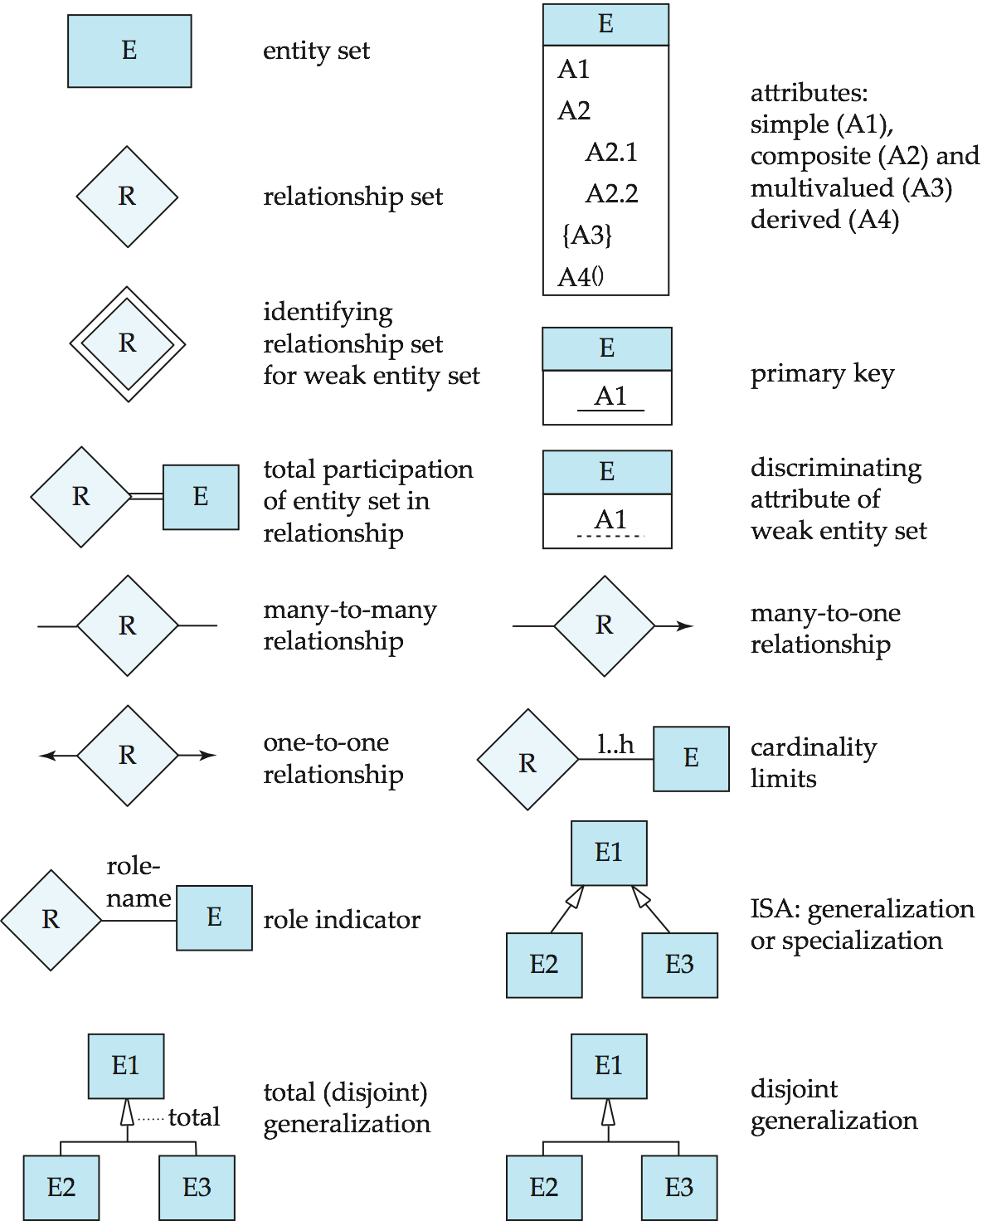
Summary of Symbols Used in E-R Notation

Slide 95
Symbols Used in E-R Notation (Cont.)

Slide 96
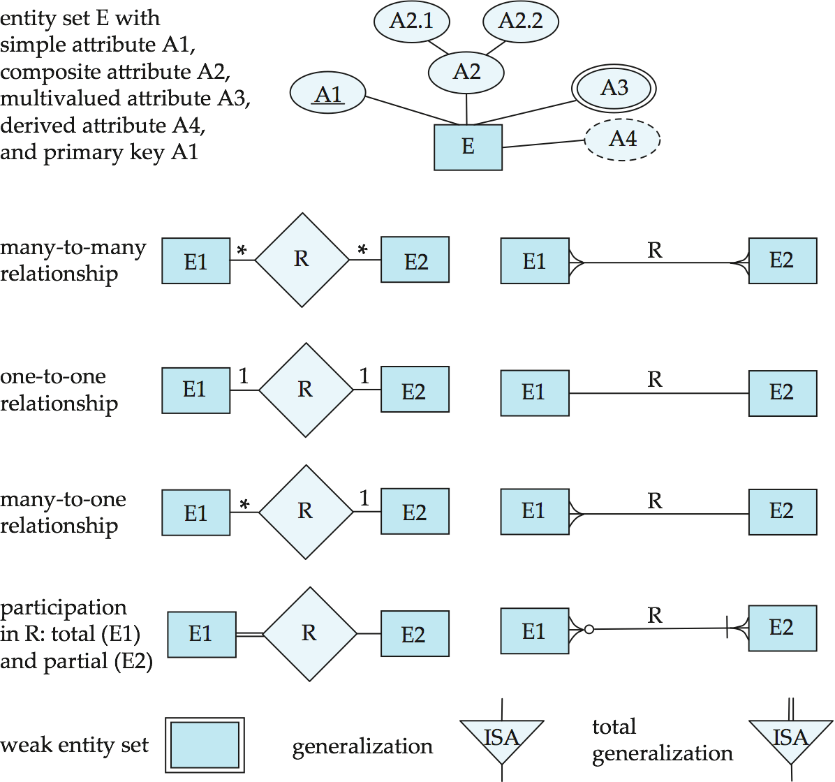
Alternative ER Notations
Chen, IDE1FX, …

Slide 97
Alternative ER Notations
Chen IDE1FX (Crows feet notation)

Slide 98
UML
UML: Unified Modeling Language
UML has many components to graphically model different aspects of an entire software system
UML Class Diagrams correspond to E-R Diagram, but several differences.

Slide 99
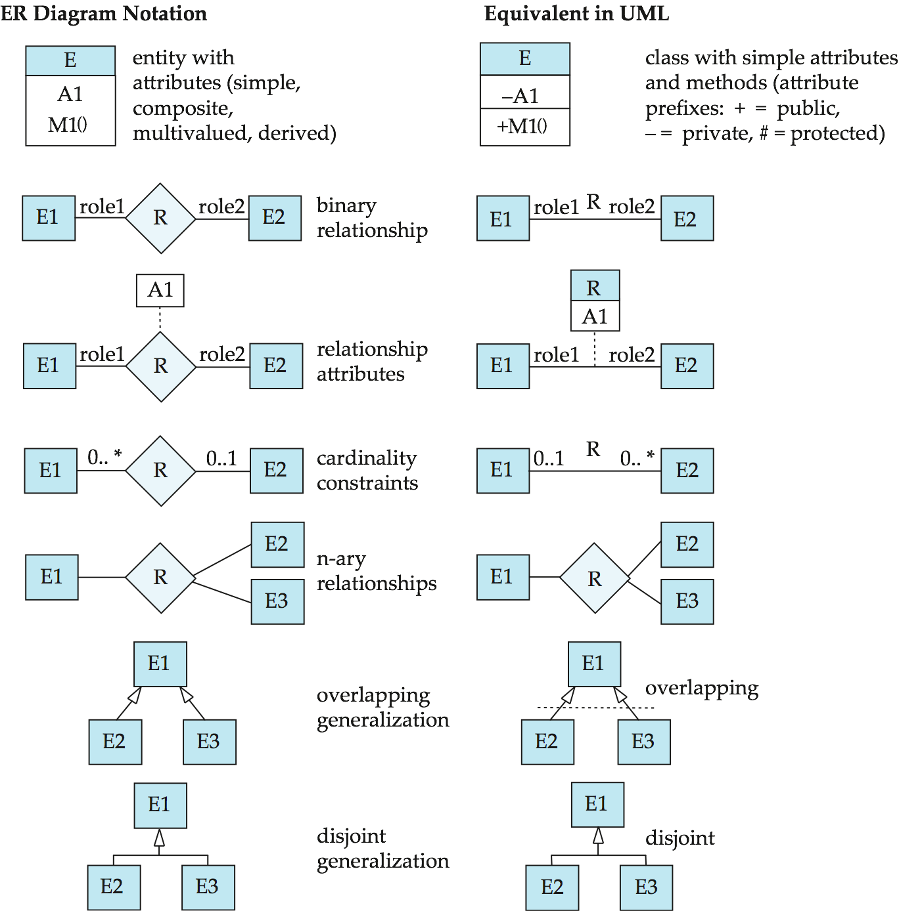
ER vs. UML Class Diagrams
*Note reversal of position in cardinality constraint depiction

Slide 100
ER vs. UML Class Diagrams
ER Diagram Notation
Equivalent in UML
*Generalization can use merged or separate arrows independent
of disjoint/overlapping

Slide 101
UML Class Diagrams (Cont.)
Binary relationship sets are represented in UML by just drawing a line connecting the entity sets. The relationship set name is written adjacent to the line.
The role played by an entity set in a relationship set may also be specified by writing the role name on the line, adjacent to the entity set.
The relationship set name may alternatively be written in a box, along with attributes of the relationship set, and the box is connected, using a dotted line, to the line depicting the relationship set.

Slide 102
End of Chapter 7

Slide 103
Figure 7.01

Slide 104
Figure 7.02

Slide 105
Figure 7.03

Slide 106
Figure 7.04

Slide 107
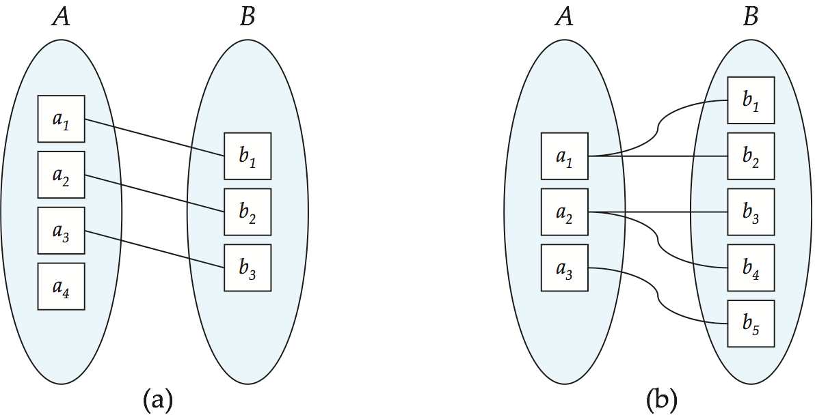
Figure 7.05

Slide 108
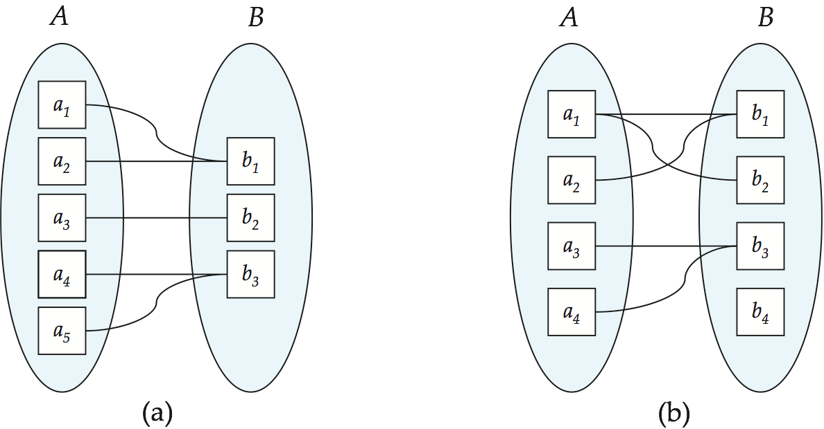
Figure 7.06

Slide 109
Figure 7.07

Slide 110
Figure 7.08

Slide 111
Figure 7.09

Slide 112
Figure 7.10

Slide 113
Figure 7.11

Slide 114
Figure 7.12

Slide 115
Figure 7.13

Slide 116
Figure 7.14

Slide 117
Figure 7.15

Slide 118
Figure 7.17

Slide 119
Figure 7.18

Slide 120
Figure 7.19

Slide 121
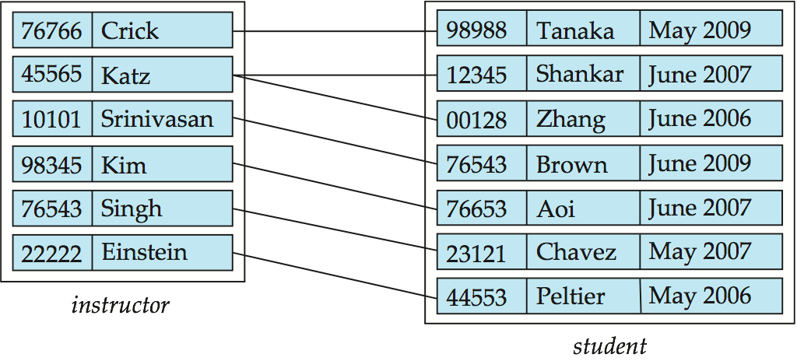
Figure 7.20

Slide 122
Figure 7.21

Slide 123
Figure 7.22

Slide 124
Figure 7.23

Slide 125
Figure 7.24

Slide 126
Figure 7.25

Slide 127
Figure 7.26

Slide 128
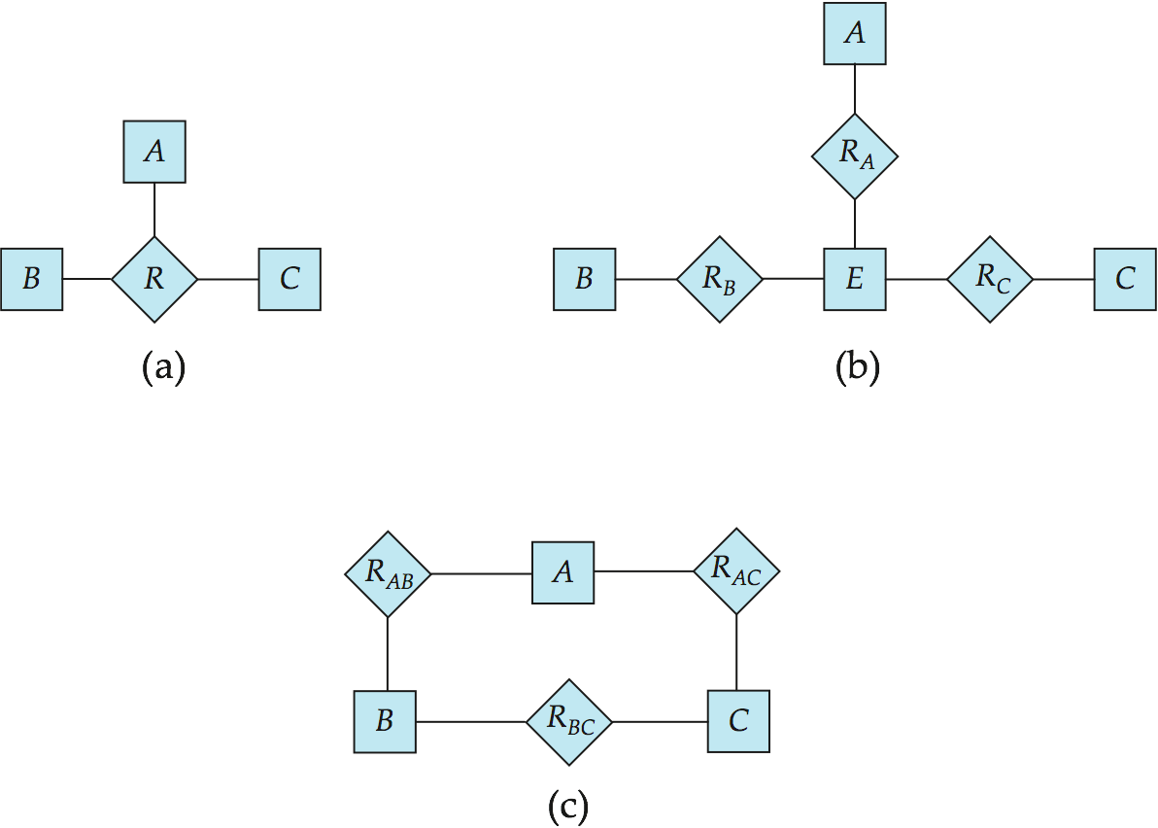
Figure 7.27

Slide 129
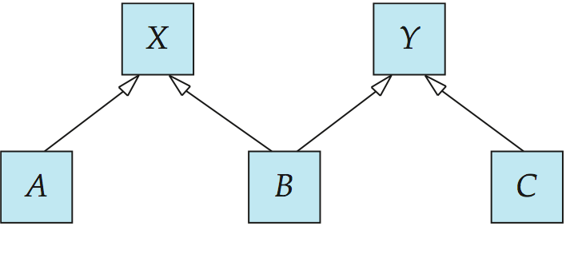
Figure 7.28

Slide 130
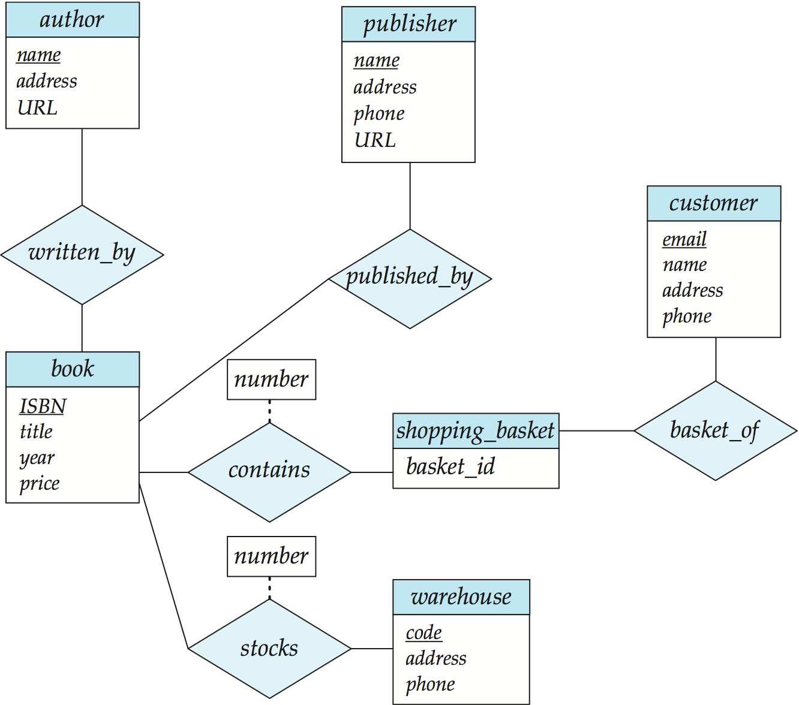
Figure 7.29

