Slide 1
Bootstrap Day1
ENG. Nawal Zaki Abdelhadi
Instructor in iTi Minia

Slide 2
Introduction
1

Slide 3

What is Bootstrap..
Bootstrap is a powerful front-end development.
Framework for faster and easier web.
It is a free collection of tools for creating websites and web applications.
It contains HTML and CSS-based design templates for typography, forms, buttons, navigation and other interface components, as well as optional JavaScript extensions.

Slide 4
What is Bootstrap..
In August 2011, Twitter released Bootstrap as open source.
In June 2014 it was the No.1 project on GitHub with over 73,000 stars.
Bootstrap was developed by Mark Otto and Jacob Thornton at Twitter as a framework to encourage consistency across internal tools.

Slide 5

Why Bootstrap ..
Save lots of time
Responsive features
Consistent design
Easy to use
Compatible with browsers
it is Open Source “this is best part”

Slide 6

Let’s Start ….
2

Slide 7
How to use Bootstrap ..
We have two way to use Bootstrap
Use links from Documentation. “Online”
Download Bootstrap files.
Let’s Try it …
https://getbootstrap.com/

Slide 8
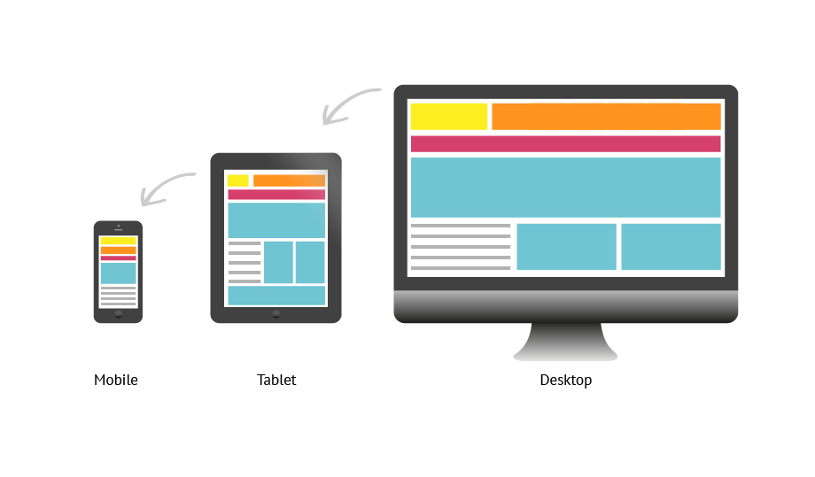
Grid System….
3

Slide 9
Grid-System..
Grid Systems are used for creating page layouts through a series of rows and columns that house your content.
Rows must be placed within a .container (fixed-width) or .container-fluid (full-width) for proper alignment and padding. More
Use rows to create horizontal groups of columns.
Content should be placed within columns, and only columns may be immediate children of rows.

Slide 10
Grid-System..
Predefined grid classes like .row and .col-xs-4 are available for quickly making grid layouts.
Columns create gutters (gaps between column content) via padding.

Slide 11
Grid-System..
Grid columns are created by specifying the number of twelve available columns you wish to span. For example, three equal columns would use three .col-xs-4.
If more than 12 columns are placed within a single row, each group of extra columns will, as one unit, wrap onto a new line.

Slide 12
Grid-System..

Slide 13
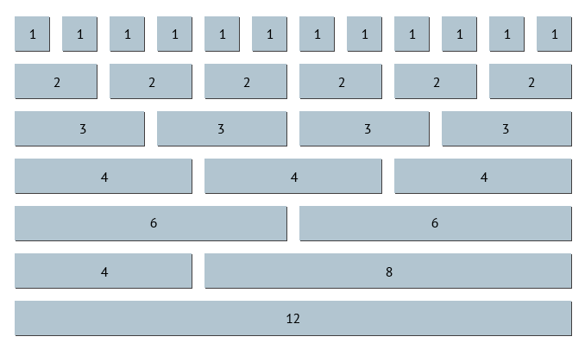
Grid-System..

Slide 14
Grid-System..

Slide 15
Grid-System..

Slide 16
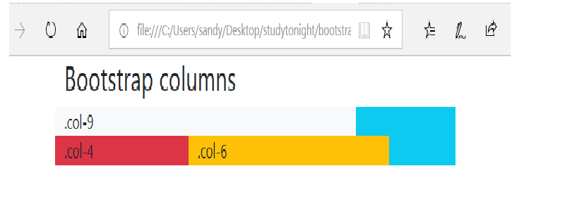
Grid-System..
Column wrapping

Slide 17
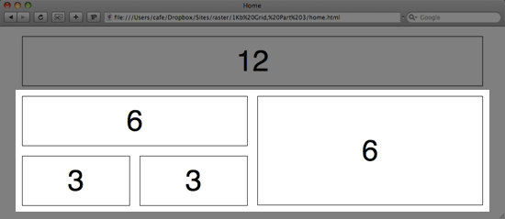
Grid-System..
Nesting Columns

Slide 18
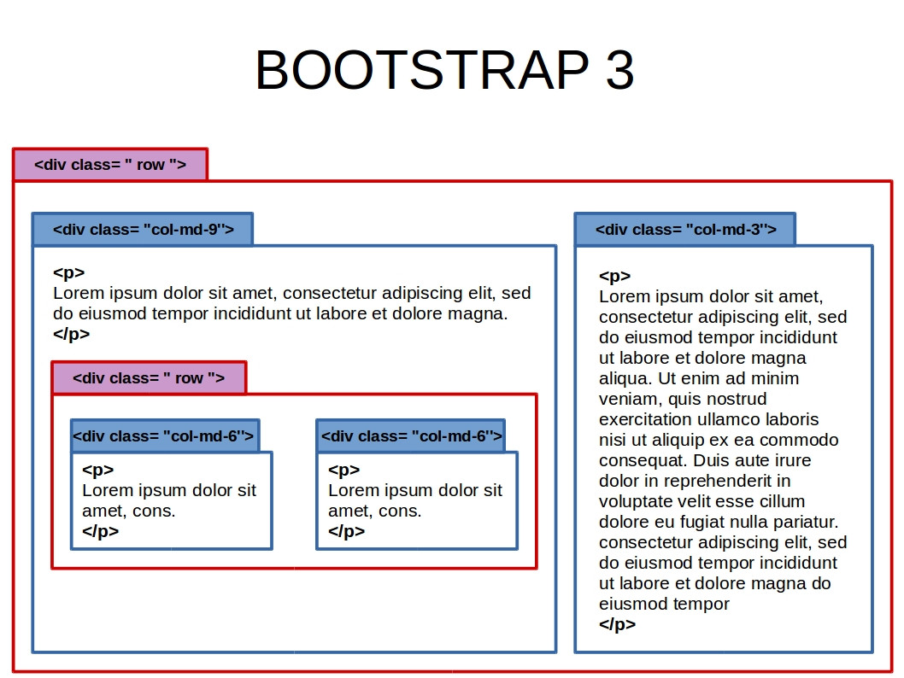
Grid-System..
Nesting Columns

Slide 19
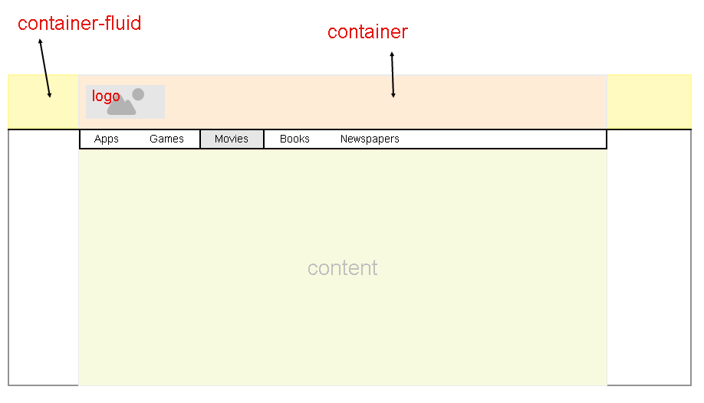
Container-fluid & container

Slide 20
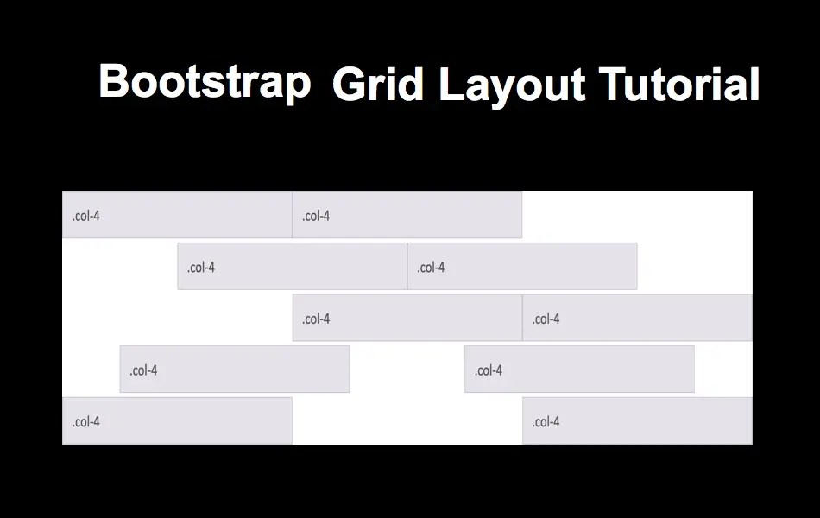
Grid-System..
Offsetting Columns

Slide 21

Bootstrap Typography….
4

Slide 22
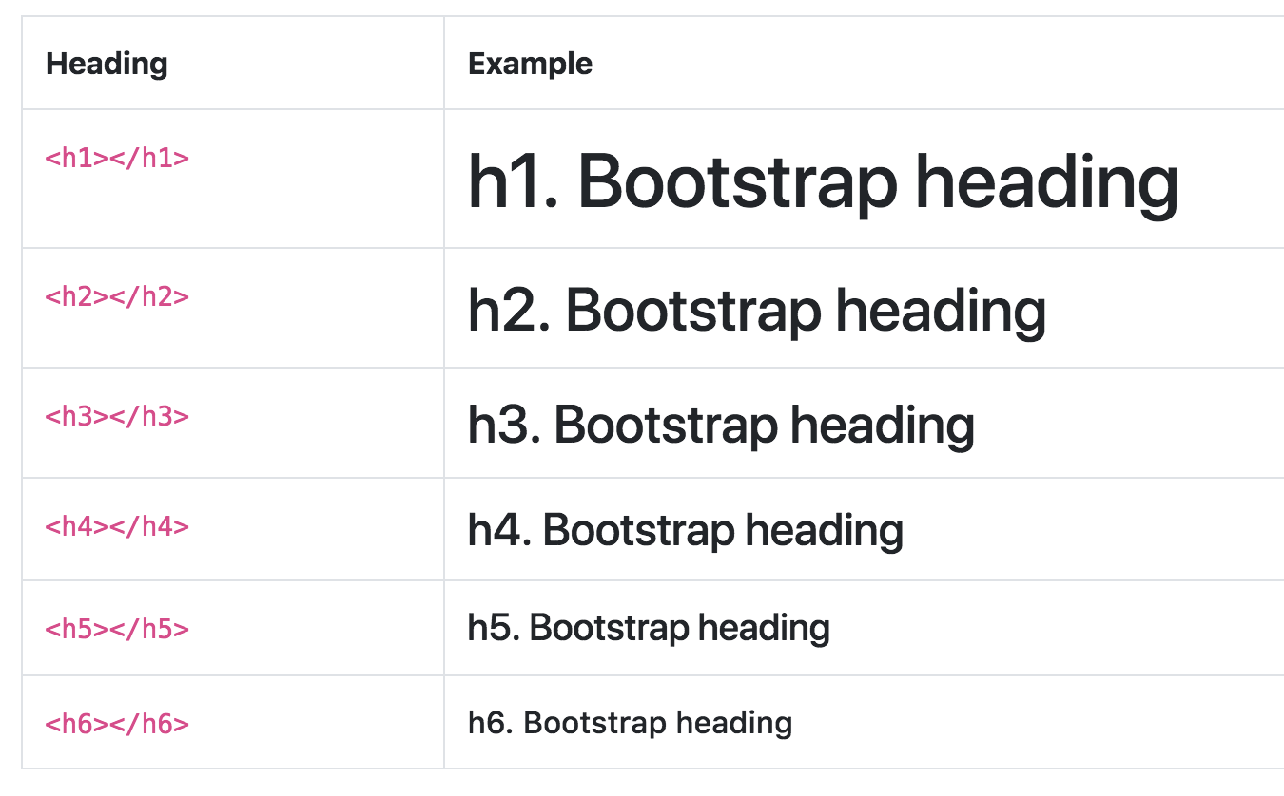
Heading….

Slide 23
Tags….
Let’s Try some Tags

Slide 24
Classes….
Let’s Try some Classes

Slide 25
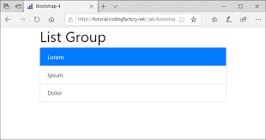
Lists….
Let’s Try

Slide 26

Images…
4

Slide 27
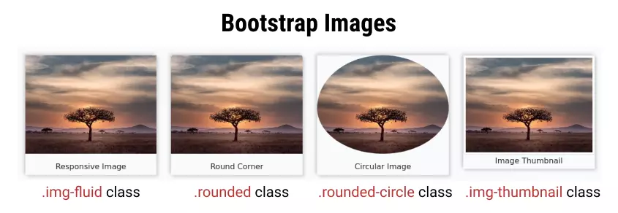
Images….
Let’s Try

Slide 28


