Slide 1
HTML5 & Css3 Day2
ENG. Nawal Zaki Abdelhadi
iTi Staff

Slide 2
Vendor Prefix
1

Slide 3

Vendor Prefix
Organization | Prefix
Mozilla Foundation | -moz-
Microsoft | -ms-
Opera Software | -o-
Safari and Chrome | -webkit-

Slide 4
Box Model
2

Slide 5
Box Model …
The Box Model consists of:
margins, borders, padding, and the actual content.
Margin
Content
Border
Padding

Slide 6
Border
3

Slide 7
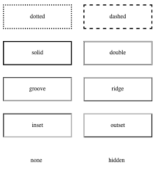
Border…
border : 5px solid blue; //short hand
-moz-border: 5px solid blue;
-webkit-border: 5px solid blue;
-ms-border: 5px solid blue;

Slide 8
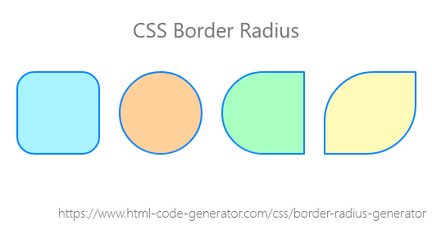
Border Radius…
border-radius:30px;
border-radius:10px 20px 30px 40px;
border-radius:10px 20px 30px 40px/ 20px 30px 40px 50px;
border-radius:10px 20px 30px 40px/10px;
border-radius: 10px 20px;
border-radius: 10px 20px 30px;
border-radius: 50%
heigth:100px;
width: 100px;

Slide 9
Shadow
4

Slide 10
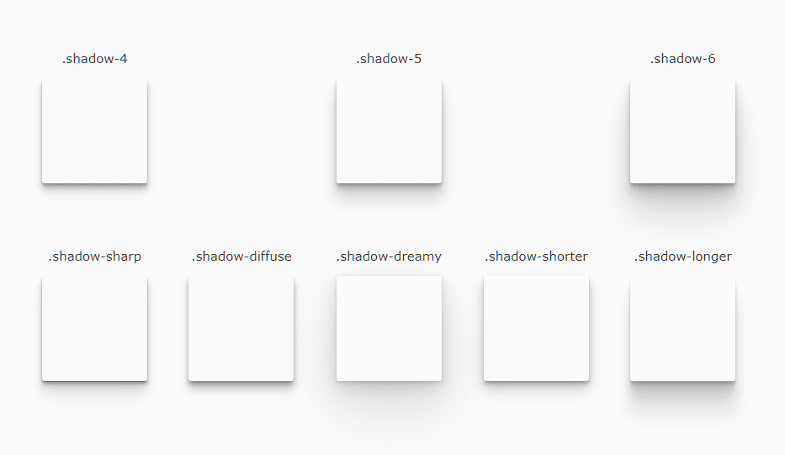
Shadow…
box-shadow: 5px 10px 20px 30px gray inset;
// h-offset v-offset blur spread color inset

Slide 11
Border Image
5

Slide 12

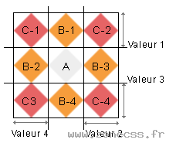
Border Image…
border-image: url(“”);
border-image-slice:30;
border-image-repeat: round / stretch / repeat;
Image slice

Slide 13
Fonts
6

Slide 14
Fonts…
font-family: “Time New Roman”, Times, Serfi;
font-size: 5 em;
font-style:italic;
font-weight:bold;
Try this …..
Fonts Extension:
TTF ➔ “True Type Font”
OTF ➔ “Open Type Font”
WOFF ➔ “web Open Font”
WOFF2 ➔ “Web Open Font2”
SVG ➔ “ Scalable Vector Graphic”

Slide 15
User Fonts…
font-family: “Time New Roman”, Times, Serfi;
font-size: 5 em;
font-style:italic;
font-weight:bold;
Try this …..
Steps :
Download files of font.
Install font.

Slide 16
Server Fonts…
@font-face{
font-family: NewFont;
src: url (“”),url (“”)
}
#div2{
font-family: NewFont , Tahoma;
font-size: 5 em;
}
Try this …..
Try this …..

Slide 17
Web Fonts…
Use Google Fonts
Look for your need and copy link of font .
https://fonts.google.com/

Slide 18
Icons
7

Slide 19
Icons…
Ways to use Icons in your website:
Use Image and change in width and height
Download SVG
Use Font Awesome https://fontawesome.com/

Slide 20
Transform
8

Slide 21
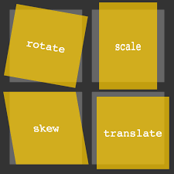
Transform…
Transform has important property
Translate
Rotate
Scale
Skew
Transform: translate(50px,100px)
Transform: rotate(20 deg) //(-20deg)
Transform: scale(2,3)
Transform: skew(20deg ,30deg)
Transform: skew(20deg )
Transform: matrix(scaleX(),skewY(),skewX(),scaleY(),translateX(),translateY())

Slide 22
Transition
9

Slide 23
Transition…
Transition has important property
property
duration
delay
timing-function
Transition-porperty: width / width,height / all
Transition-duration:3 s;
Transition-delay:1 s;
Transition-timing-function: ease
Transition: all 3s;

Slide 24
Animation
10

Slide 25
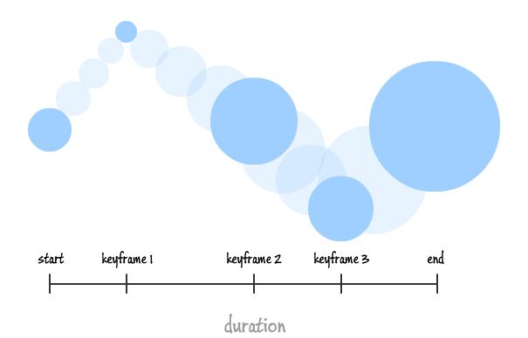
Animation…

Slide 26
Animation…
@keyFrames example{
0% {background-color:red;}
25% {background-color:yellow;}
50% {background-color:orange;}
75% {background-color:blue;}
100% {background-color:black;}
}
div{
animation-name: example;
animation-duration: 4s;
animation: example 4s;
animation-iteration-count: 4 / infinte;
animation-direction: normal / reverse/ alternate
}

Slide 27
Gradient Color
11

Slide 28
Gradient Color…
background: linear-gradiant(red,yellow);
background: linear-gradiant(to right,red,yellow);
background: radial-gradiant(red,yellow);
Try this …..

Slide 29
CSS Columns
12

Slide 30
CSS Columns…
Column-count: 3;
Column-gap: 2px;
Column-rule: solid 3px blue;
Try this …..

Slide 31


