Slide 1
Image compression in python
By Alon Grod

Slide 2
Language evolution
Origin:
  Python is a widely used general-purpose, high-level programming language. It was initially designed by Guido van Rossum in 1991 and developed by Python Software Foundation.
Why this language came out?
  It was mainly developed for emphasis on code readability, and its syntax allows programmers to express concepts in fewer lines of code.

Slide 3
advanced features of the language
Control structures:
In Python, all the statements indented by the same number of character spaces after a programming construct are considered to be part of a single block of code.
  Python programming language provides following types of loops to handle looping requirements.
    While Loop
      Continue the loop until the condition in while is true
    For in Loop
      There is “for in” loop which is similar to for each loop in other languages.
      Syntax:
          for iterator_var in sequence:
          statements(s)
      It can be used to iterate over iterators and a range.
    Nested Loops
      Python programming language allows to use one loop inside another loop.
    Loop Control Statements
      Loop control statements change execution from its normal sequence. When execution leaves a scope, all automatic objects that were created in that scope are destroyed. Python supports the following control statements.
      Continue Statement
      It returns the control to the beginning of the loop.

Slide 4
Data types
Python has the following data types built-in by default, in these categories:
  Text Type: str
  Numeric Types: int, float, complex
  Sequence Types: list, tuple, range
  Mapping Type: dict
  Set Types: set, frozenset
  Boolean Type: bool
  Binary Types: bytes, bytearray, memoryview

Slide 5
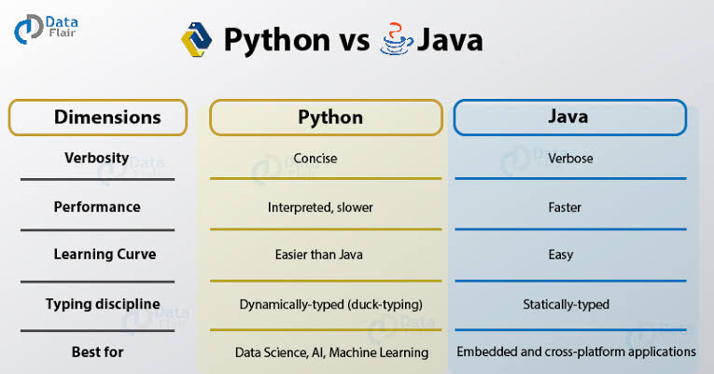
Language comparison

Slide 6
Reason to choose python:
Python is an excellent choice for these types of image processing tasks due to its growing popularity as a scientific programming language and the free availability of many state-of-the-art image processing tools in its ecosystem. [8:53, 1.12.2019] Hasan Fiver: Image compression is the type of data compression applied to digital images to reduce their cost of storage.
The process itself involves some stpes which are done in a sequence to get it done. It involves the following steps:
1.Initially, it starts with the random initialization of the ‘k’ clusters.
2.Then on the basis of some similarity (like euclidean distance metric), it aims to minimize the distance from every data point to the cluster center in each clusters.
3.These iterative steps continue till the centroids sieze to move further from their clusters.
It has many support libraries numpy and matplotlib are one of them. In this project these two are used widely:
Numpy is one of the core libraries in Python programming and provides support for arrays. An image is essentially a standard NumPy array containing pixels of data points. Therefore, by using basic NumPy operations, such as slicing, masking, and fancy indexing, you can modify the pixel values of an image.
matplotlib is an open source Python package that works with NumPy arrays. It implements algorithms and utilities for use in research, education, and industry applications.

Slide 7
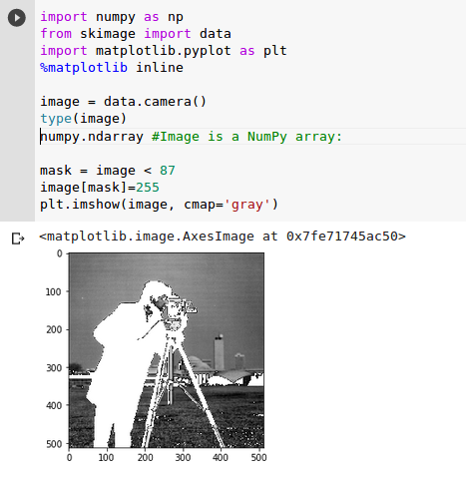
Reason to choose python(Demonstratio):

Slide 8
real-world application program
The problem that I have chosen is the image compression using python. The motivation to choose this as a project is to understand matrix operations and to get a better hold of using numpy arrays in python.
There are two steps in k-means clustering algorithm:
Assignment step – Each data point is assigned to the cluster whose center is nearest to it.
Update step – New means (centroids) are calculated from the data points assigned to the new clusters.

Slide 9
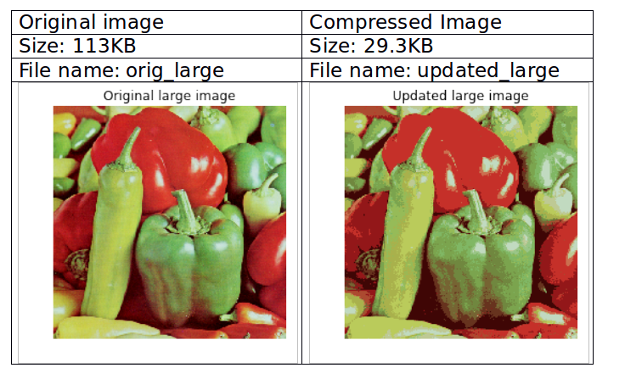
Results

