Slide 1
Preliminary analyss for BlueBerry winery
Exploring physicochemical properties of wine and their correlation to graded wine quality.
Created by: Alon Parag, 05.05.2021 for BlueBerry Wineries
Data by: Modeling wine preferences by data mining from physicochemical properties by Cortez et al.(2009)

Slide 2
Is it possible to predict the quality of wine?
Wine quality could have an effect on wine price and brand value
An informed intervention during production of wine could affect specific wine properties, therefore, if there is a correlation between physicochemical properties to wine quality, and if wine quality could be predicted by properties, BlueBerry winery could act on this information to improve their wine quality,increase revenue and build their brand.

Slide 3
Data:
Data is sourced from a study carried by Cortez et al (2009).
The sample includes data of 4898 white wines and 1599 red wines.
Sample containes physicochemical data and quality grade given by wine experts.

Slide 4
Details about data:
Fixed acidity: acids are major wine properties and contribute greatly to the wine’s taste. Usually, the total acidity is divided into two groups: the volatile acids and the nonvolatile or fixed acids. Among the fixed acids that you can find in wines are the following: tartaric, malic, citric, and succinic. This variable is expressed in g(tartaricacid)/l in the data sets.
Volatile acidity: the volatile acidity is basically the process of wine turning into vinegar. In the U.S, the legal limits of Volatile Acidity are 1.2 g/L for red table wine and 1.1 g/L for white table wine. In these data sets, the volatile acidity is expressed in g(aceticacid)/l. Excessive volatile acidity may result in lower wine quality
Citric acid: one of the fixed acids that you’ll find in wines. It’s expressed in g/l in the two data sets.
Residual sugar: typically refers to the sugar remaining after fermentation stops, or is stopped. It’s expressed in g/l in the red and white data.

Slide 5
Chlorides: Chlorides can be a significant contributor to saltiness in wine. Here, you’ll see that it’s expressed in g(sodiumchloride)/l.
Free sulfur dioxide: the part of the sulfur dioxide that is added to a wine
and that is lost into it is said to be bound, while the active part is said to be free.
The winemaker will always try to get the highest proportion of free sulfur to bind.
This variable is expressed in mg/l in the data.
Total sulfur dioxide: the sum of the bound and the free sulfur dioxide (SO2).
Here, it’s expressed in mg/l. There are legal limits for sulfur levels in wines:
in the EU, red wines can only have 160mg/L, while white and rose wines can have
about 210mg/L. Sweet wines are allowed to have 400mg/L. For the US, the legal limits
are set at 350mg/L, and for Australia, this is 250mg/L.

Slide 6
Density: used as a measure of the conversion of sugar to alcohol. Here, it’s expressed in g/ml.
pH or the potential of hydrogen is a numeric scale to specify the acidity or basicity the wine. As you might know, solutions with a pH less than 7 are acidic, while solutions with a pH greater than 7 are basic. With a pH of 7, pure water is neutral. Most wines have a pH between 2.9 and 3.9 and are therefore acidic.
Sulfates: regular part of winemaking around the world and are considered necessary.
In this case, they are expressed in \frac{g(potassiumsulphate)/l.

Slide 7
Alcohol: wine is an alcoholic beverage, and as you know, the percentage of alcohol can vary from wine to wine. It shouldn’t be surprised that this variable is included in the data sets,
where it’s expressed in % vol. Concentration above 15% halts the fermentation process of wine
Quality: wine experts graded the wine quality between 0 (very bad) and 10 (very excellent).The eventual number is the median of at least three evaluations made by those same wine experts.

Slide 8
Steps Involved
Merged the two different data sets into one data set.
Since most of the samples (3915 wines out of 6497 has a quality score of 6 or 7, I added another property named “Quality label”, with the categories “low”(wine rated under 6), “medium”(wine rated 6\7), and “high”(wine rated above 7) to simplify preliminary analysis.
Wine was also classified to their respective types(red, white).
ANOVA test was performed on the data set to find out if wines in different quality label have different means of physicochemical properties with confidence level of 95%
Pairwise analysis was then performed on the numerical values of data with confidence level of 95%
A bivariate correlation test was performed on the sample.

Slide 9
Insights summary:
Chlorides, total sulfur dioxide and alcohol are a strong indicators for the quality of wine.
Almost every propery in a quality category
has a maximal value, that is surpassed in other wine quality categories (outliers). These outliers might
be used to exclude a wine from a quality category.

Slide 10
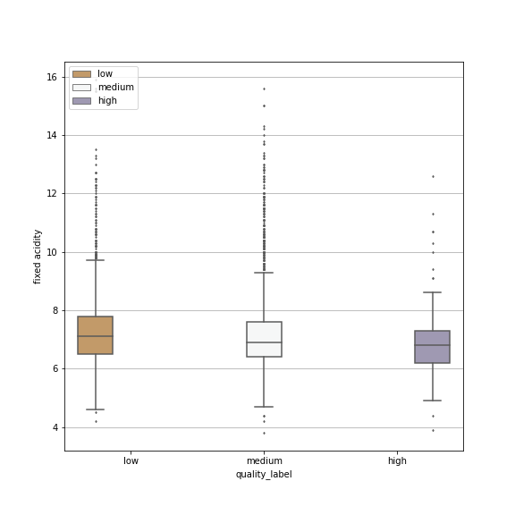
Fixed Acidity
low quality wine will have on average 0.166 higher fixed acidity than medium quality wine
medium quality wine will have on avergage 0.313 higher fixed acidity than high quality wine
a wine with lower fixed acidity could indicate a higher quality wine

Slide 11
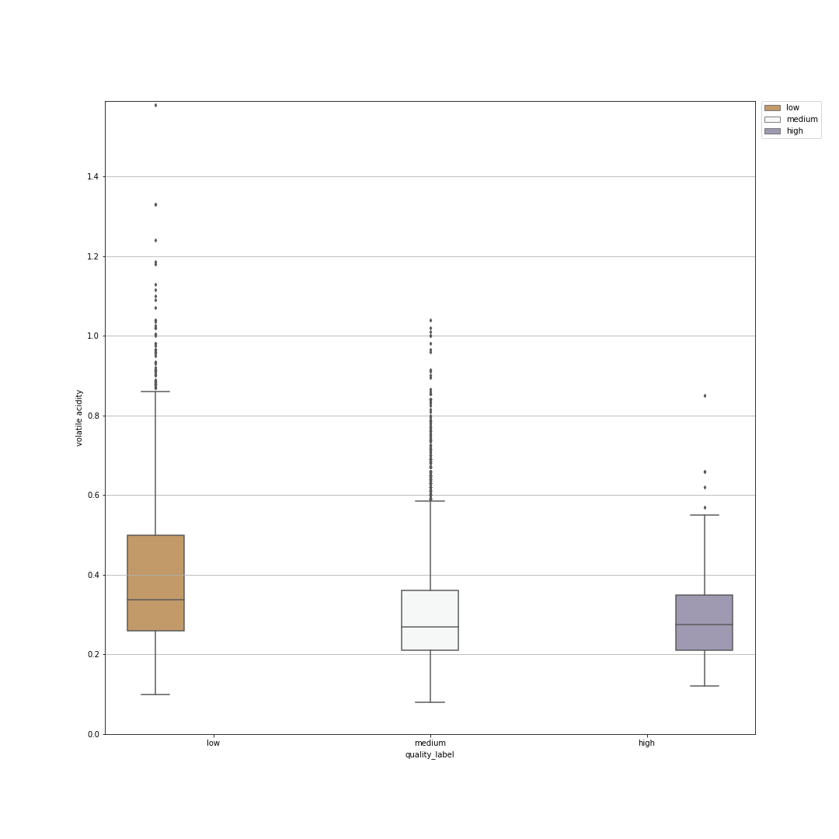
Volatile acidity
low quality wine have by average 0.1 more volatile acids than high quality, and 0.09 more than medium

Slide 12
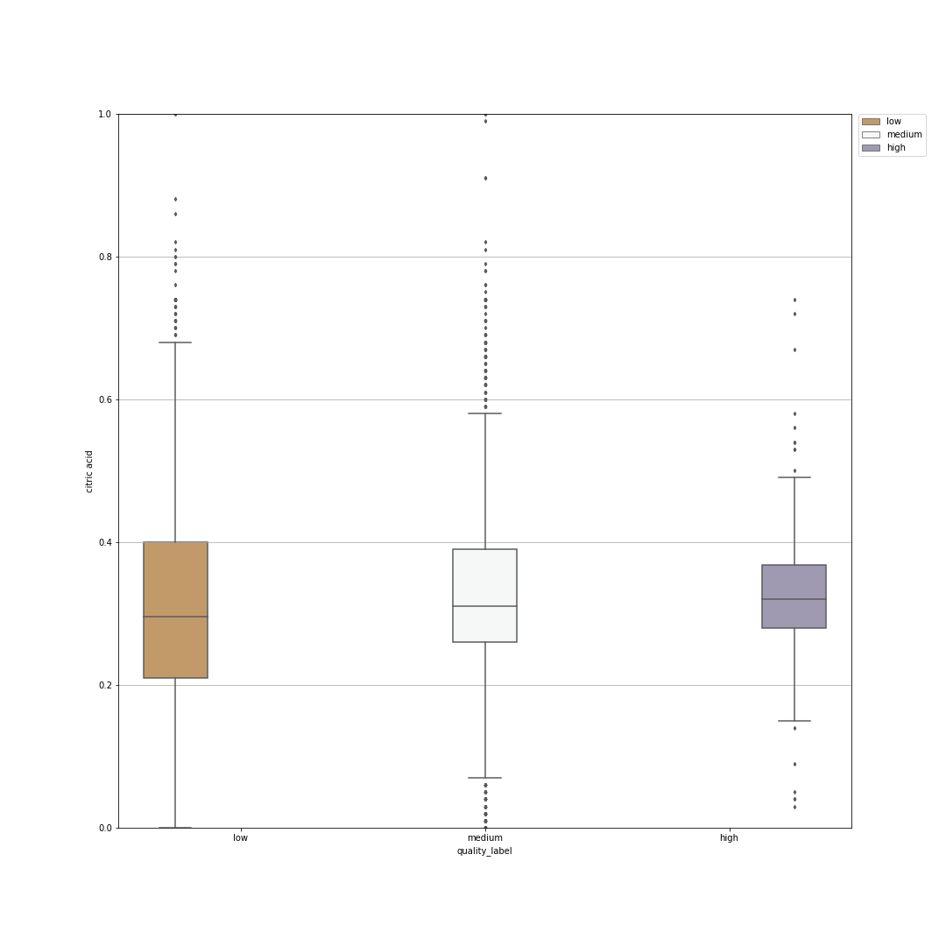
Citric acid
Low quality wine has on average 0.029 lower count than high quality, and on average 0.023 higher than medium quality

Slide 13
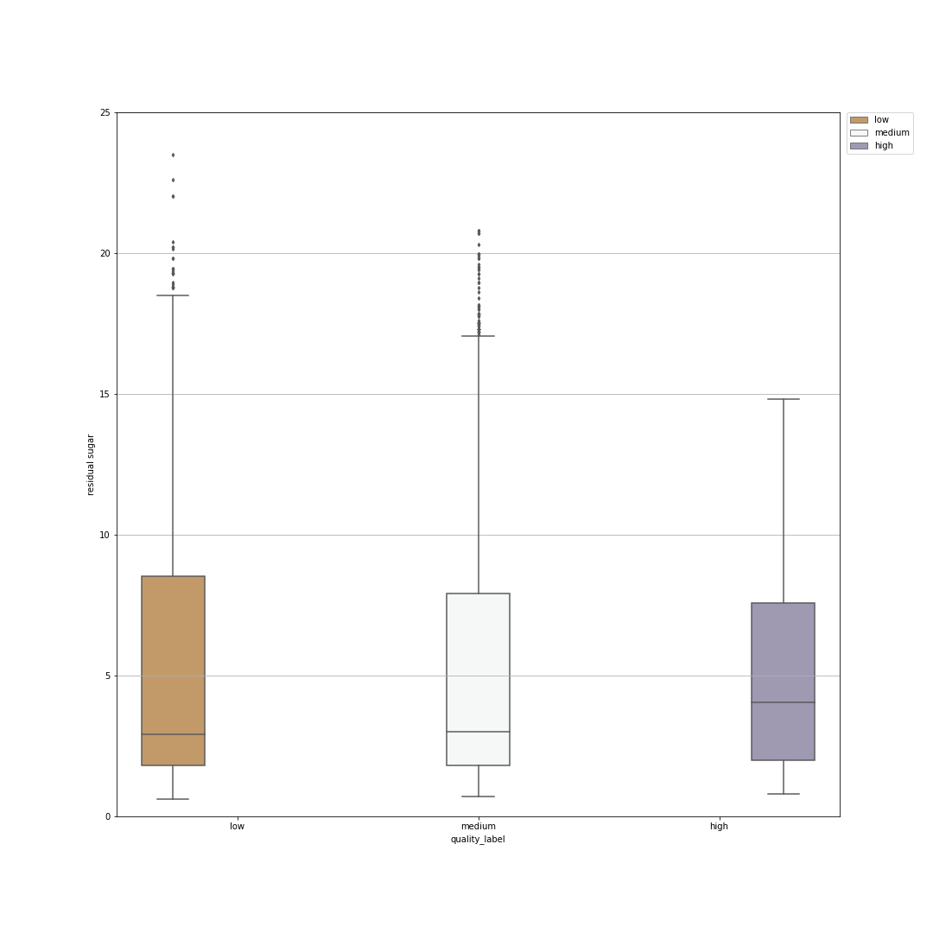
Residual sugar
Low quality wine has on average 0.32 more residual sugar than medium quality wine

Slide 14
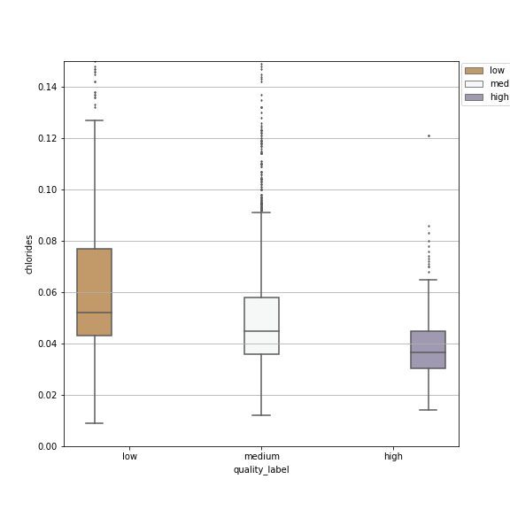
Chlorides
Low quality wine has on average 0.01 more chlorides than medium quality wine, and on average 0.236 more chlorides than high quality wine
medium quality wine has on average 0.01 more chlorides than high quality wine

Slide 15
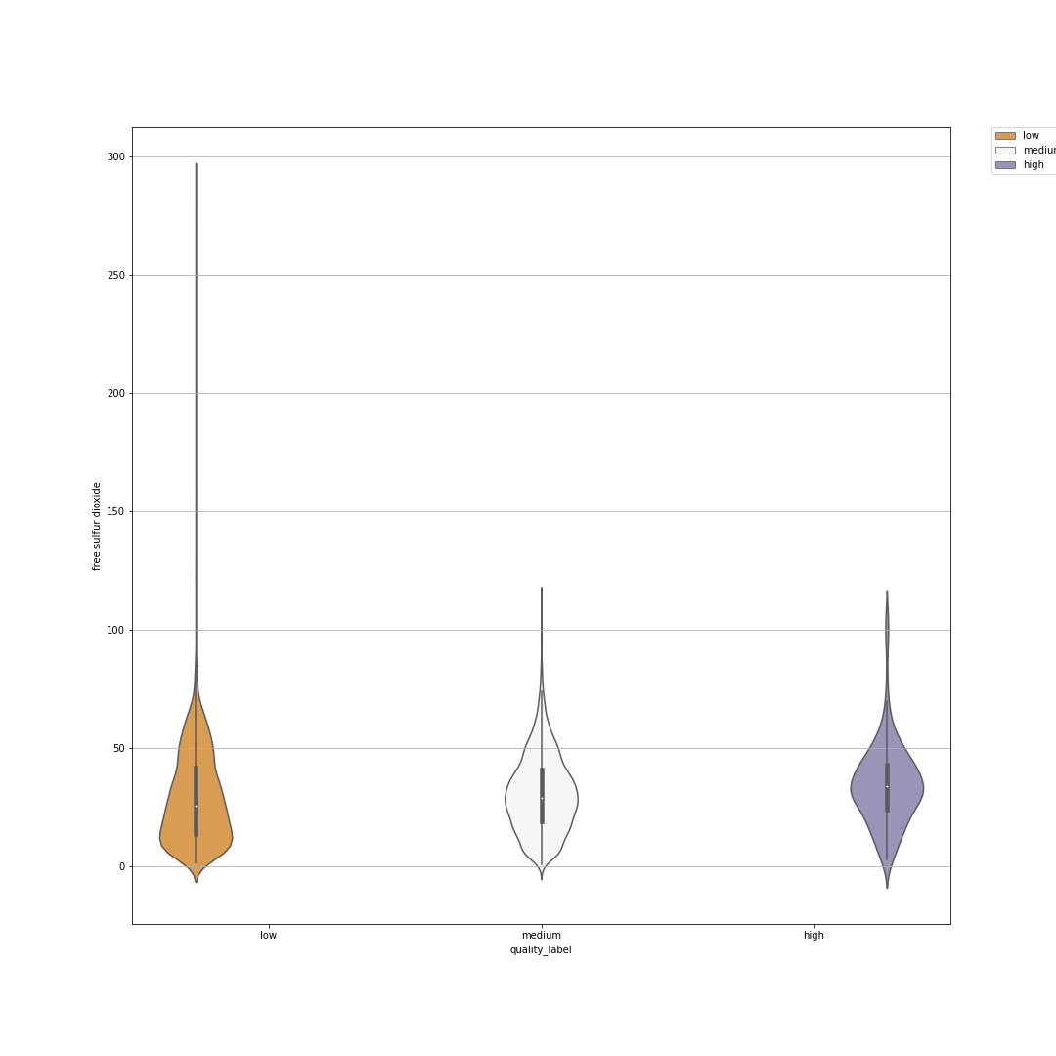
Free Sulfur Dioxide
Low quality wine has one average 1.4798 less free sulfur dioxide than medium quality wine, and on average 5.024 less free sulfur dioxide than high quality wine
Medium quality wine has on average 3.54 less free sulfur dioxide than high quality win

Slide 16
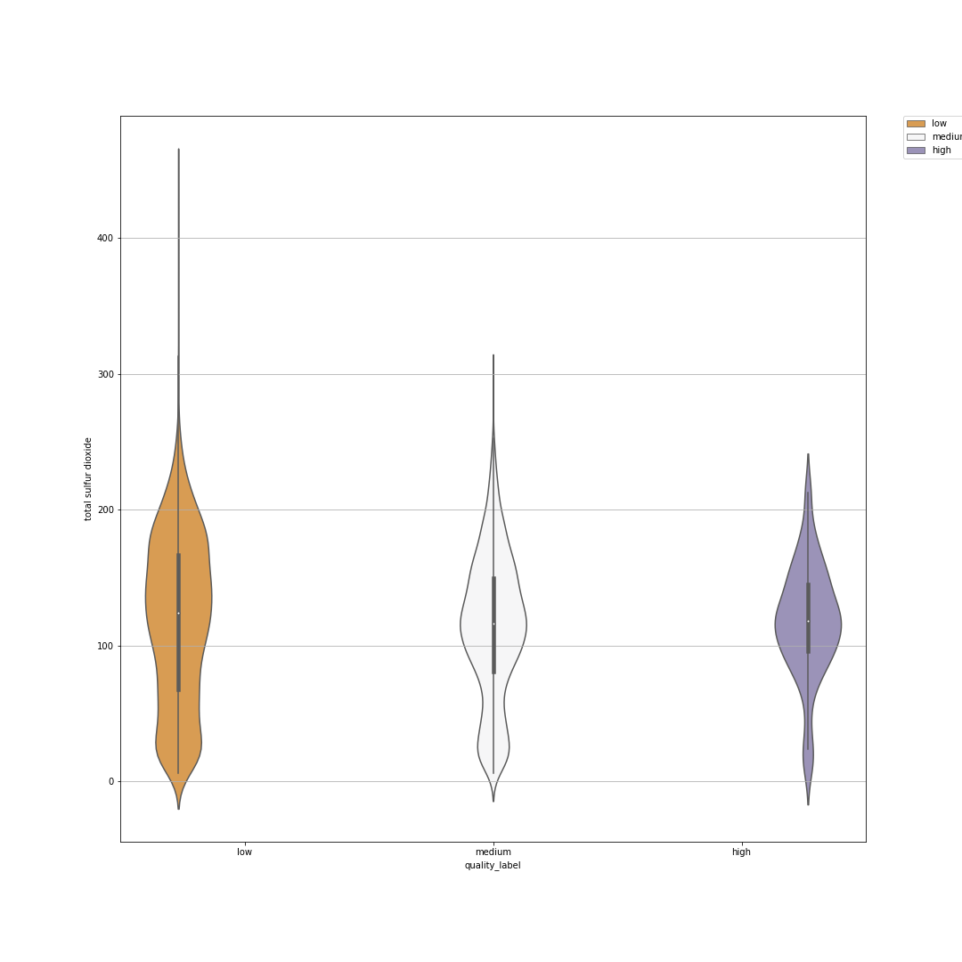
Total Sulfur Dioxide
Low quality wine has on average 5.7713 more sulfur dioxie than medium quality wine

Slide 17
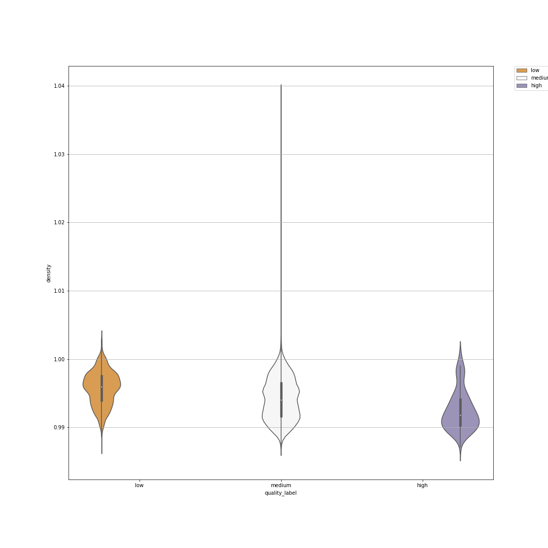
Density
Low quality wine has on average 0.0016 higher density than medium quality wine, and 0.0033 higher density than high quality wine
Medium quality wine has on average 0.0017 higher density than high quality wine

Slide 18
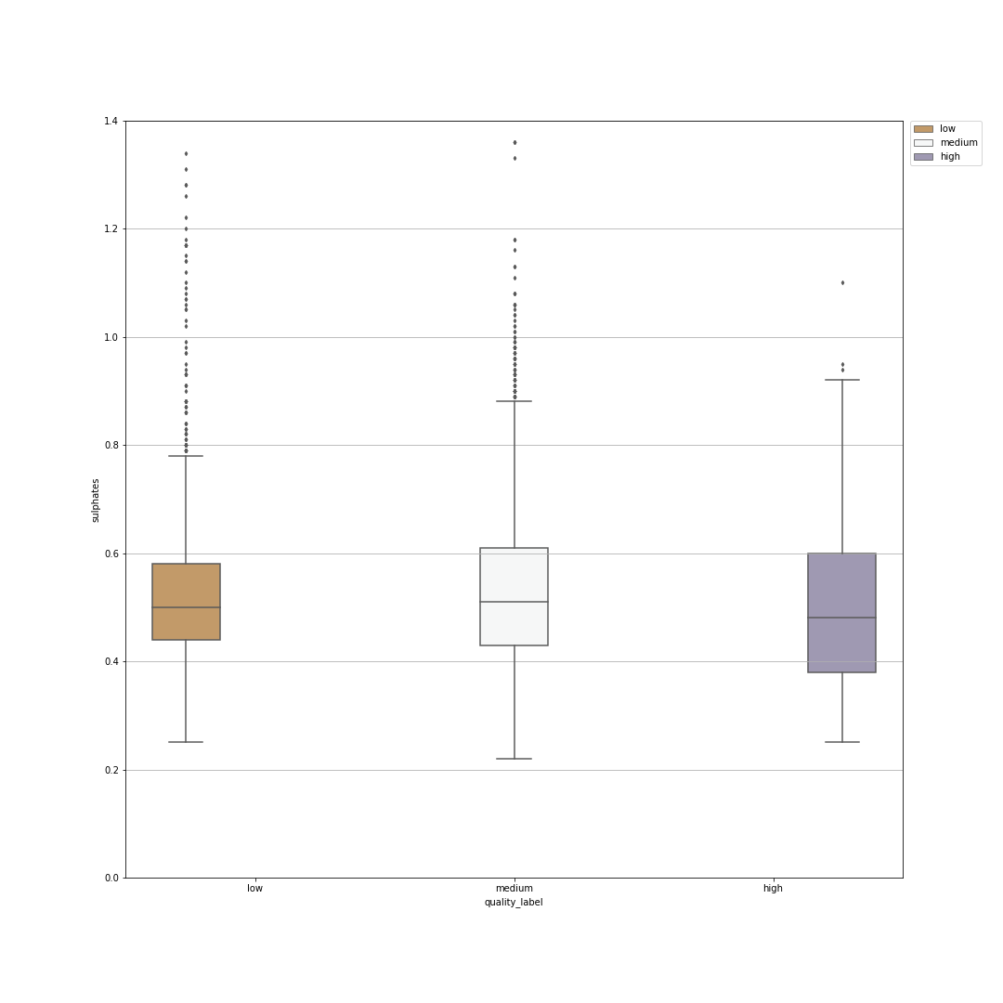
Sulphates
Low quality wine has on average 0.0123 less sulphates than medium quality wine

Slide 19
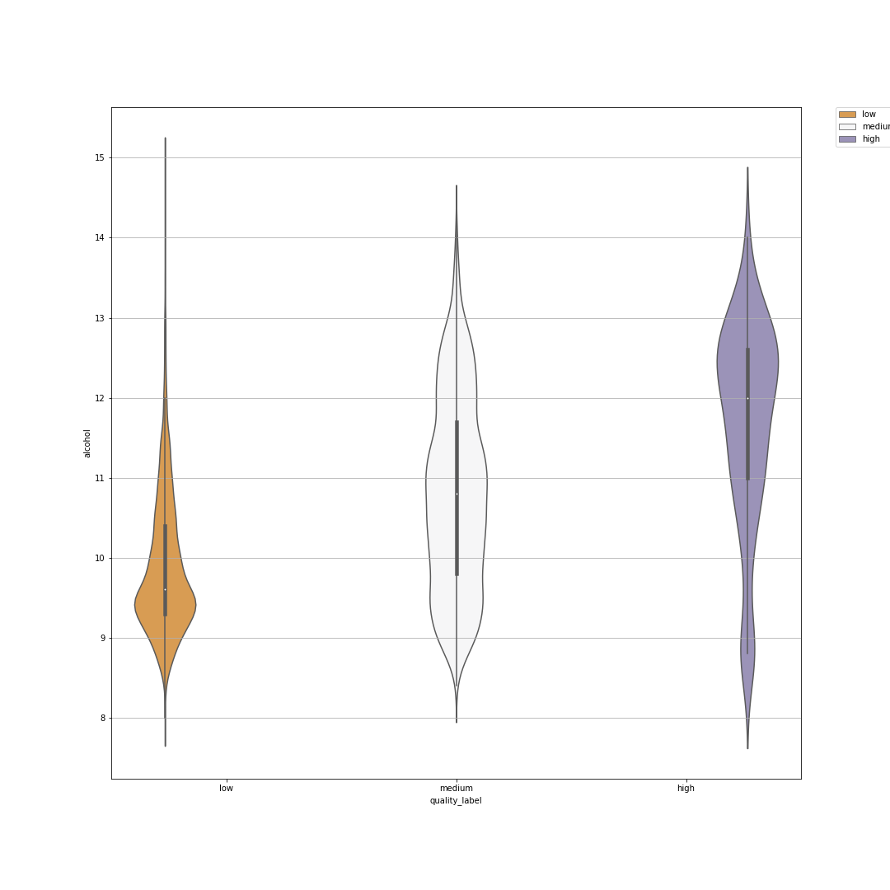
Alcohol
Low quality wine has on average 0.9341 less alcohol than medium quality wine, and on average 1.8179 less alcohol than high quality wine
Medium quality wine has on average 0.8838 less alcohol than high quality wine.

Slide 20
Recommendations
More data is needed for wine with quality rating 8 or higher
A prediction is feasable.

Slide 21
Thank you for listening!

