Slide 1

Syrian Arab Republic
Ministry of higher education
Tishreen University
Mechanical & Electronical Engineering faculty
DLRA
Deep Learning for a Robotic Arm
Final project
Mechatronics Engineering
July 2017

Slide 2
Contents
Project statement.
Application and motivations.
Why deep learning?
Algorithm discussion.
Algorithm implementation.
Simulation experiment.
Real world experiment.
Results.
Development.

Slide 3
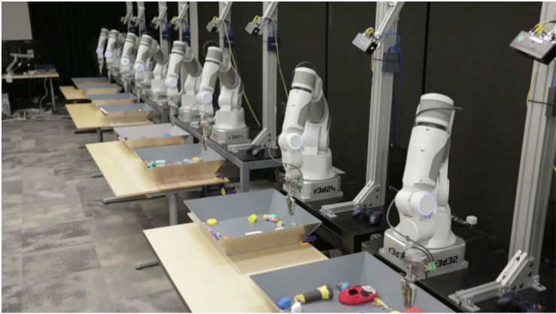
Project statement
Apply and asses algorithm that give a robotic arm the ability to learn how to achieve a mission inside its work space.

Slide 4
Applications and motivations
Robot arms became an essential tool in industrial process.
Deep robotic learning is an ongoing research topic.
Robot arms can learn industrial mission like reaching an object, pick and place, welding, etc...

Slide 5
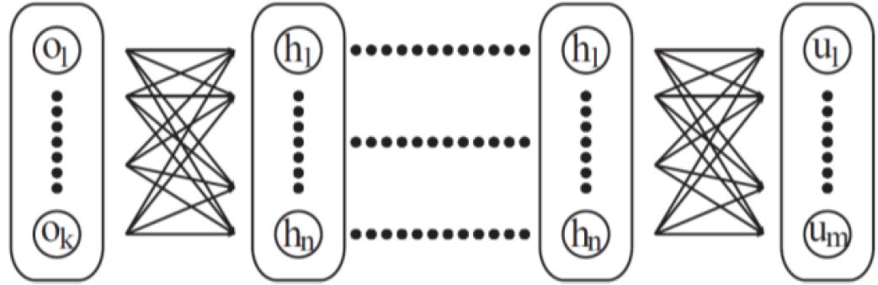
Why deep learning?
Standard Robotic Control
Deep Robotic Control
Observations
State
Estimation
Motion
Planning
Low-level
Controller
Motor
torques
Observations
Motor
torques

Slide 6
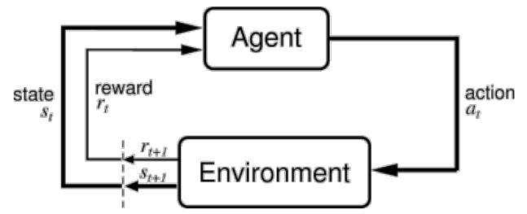
Reinforcement learning
A branch of machine learning
The objective is to maximize the expected reward

Slide 7
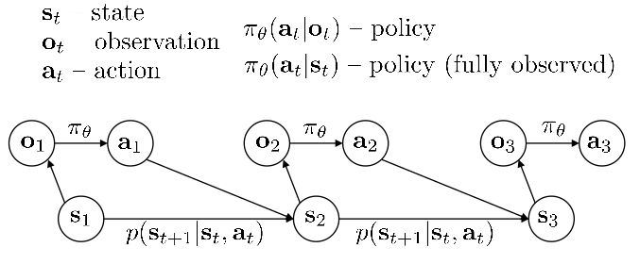
Reinforcement learning
Markov Decision Process

Slide 8
Reinforcement vs Supervised learning
The objective of the learning is to maximize
Supervised learning
x – images
y – labels
Reinforcement learning
s – state
a – actions
(from actor network)

Slide 9
Algorithm discussion
DDPG
Deep Deterministic Policy Gradients
Lillicrap’16
Deep Q learning + Actor-critic = DDPG

Slide 10
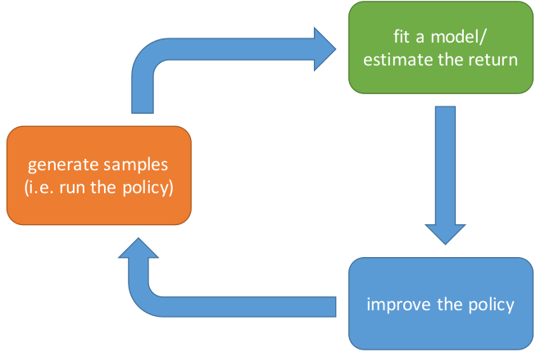
Policy gradients

Slide 11
Policy gradients
Gradient vector of policy:
gives the direction
in the parameters space
to increase the probability of x
Score (reward) Function:
by multiplying with score
samples with higher score
will have higher expectation

Slide 12
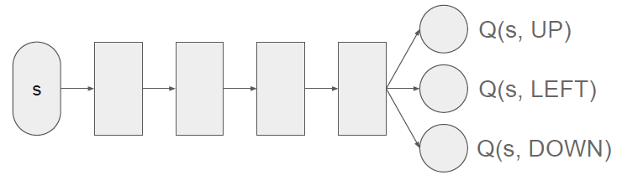
Deep Q learning
Mnih’13
approximate Q(s,a) using
a deep neural network
Q(s,a) is the reward function

Slide 13
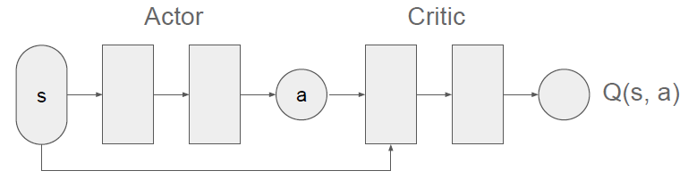
Actor Critic
Actor implements deterministic policy function
Evaluate actions using a critic network Q(s,a)

Slide 14
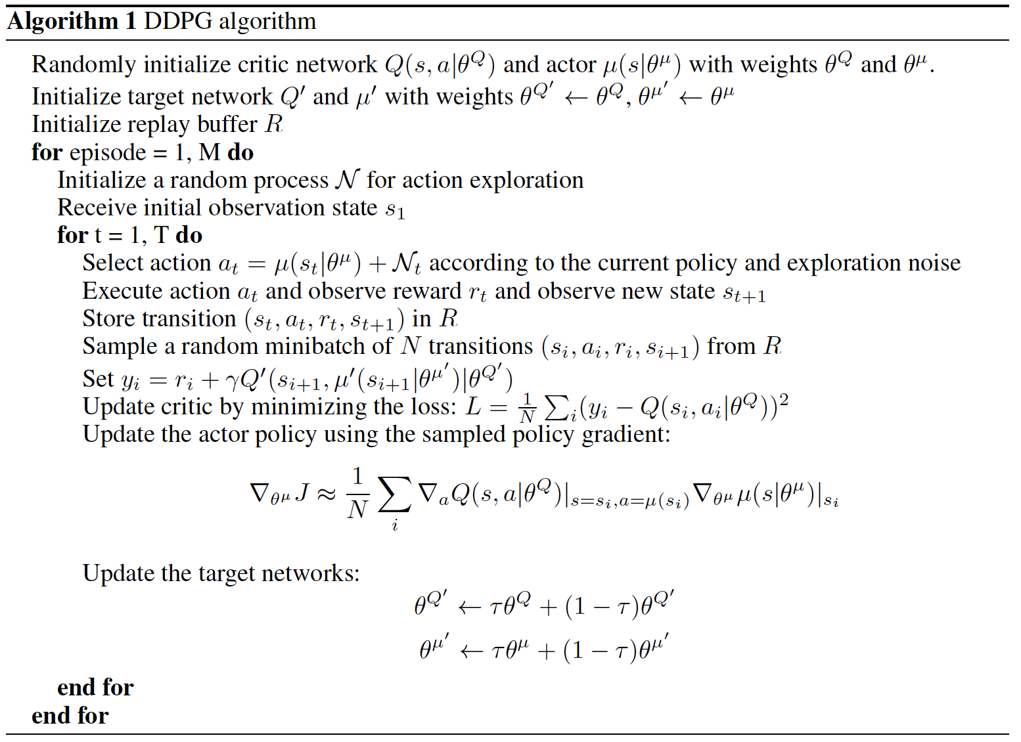

Slide 15

Algorithm implementation
Python
The code contains 2 parts:
Algorithm structure (shared for all missions).
Environment (depends on mission).
Model-free algorithm

Slide 16
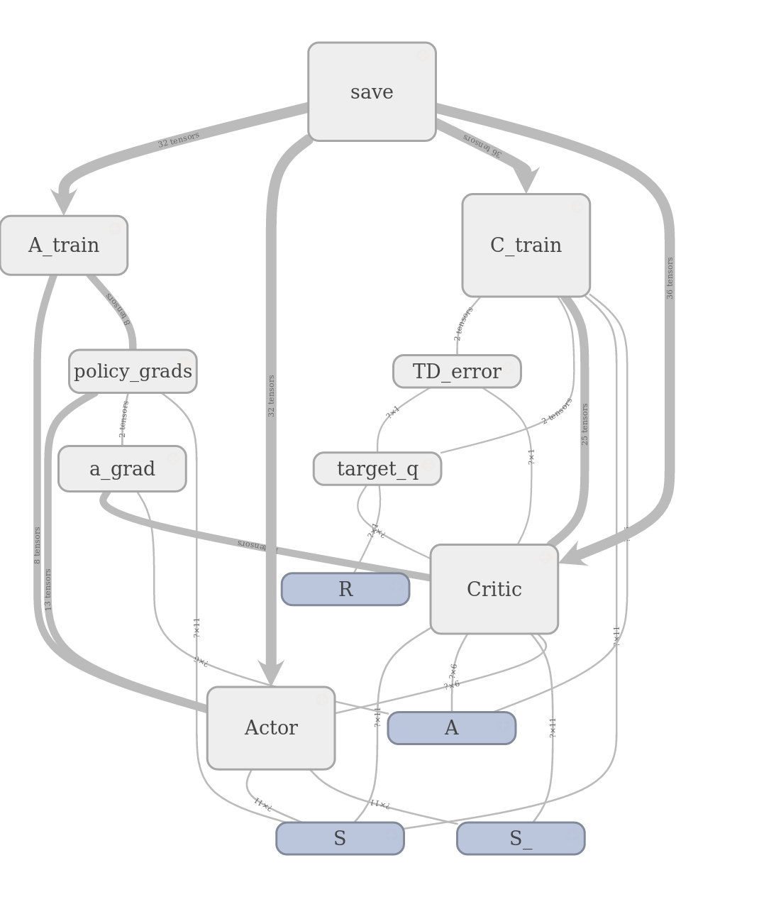

Slide 17
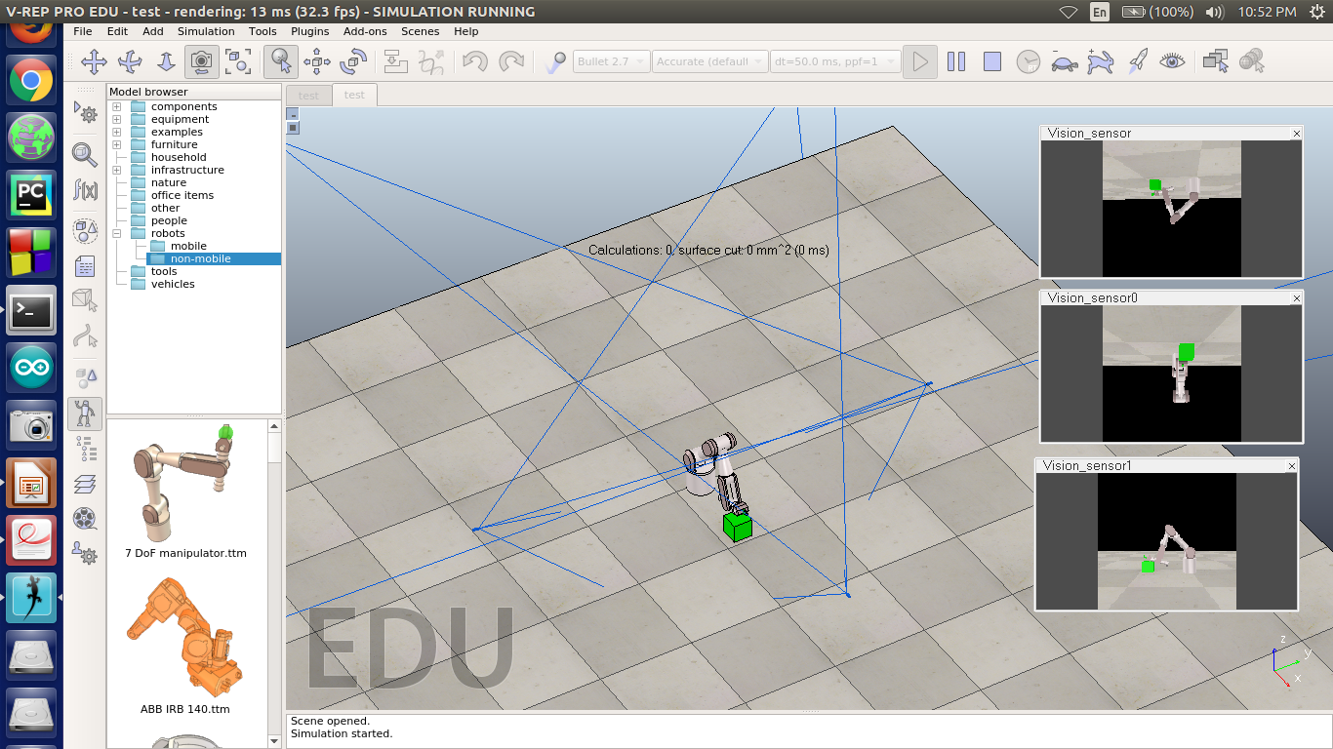
Simulation Environment

Slide 18
Simulation Environment
V-REP + Python remoteAPI + OpenCV.
State:
Joint angles + coordinates
Reward:
-1*square of distances
+ when done

Slide 19
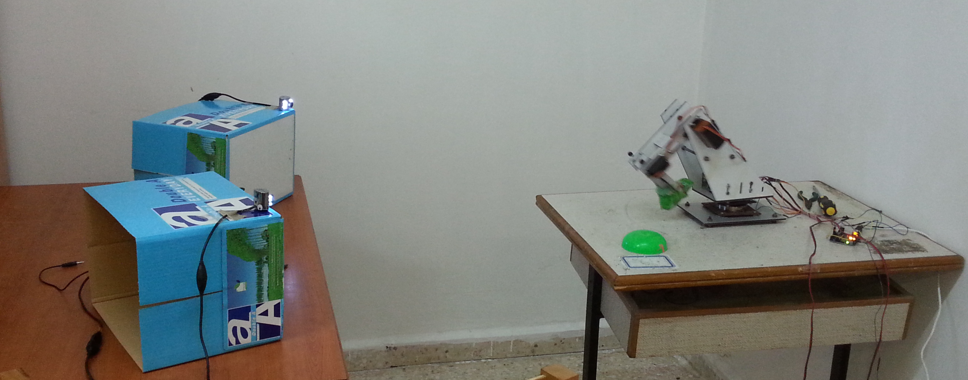
Real world experiment
2 Cameras + 3 DOF robot arm only
Because of USB bandwidth limitation

Slide 20
Real world experiment
At the beginning of training:

Slide 21
Real world experiment
After 1 hour:

Slide 22
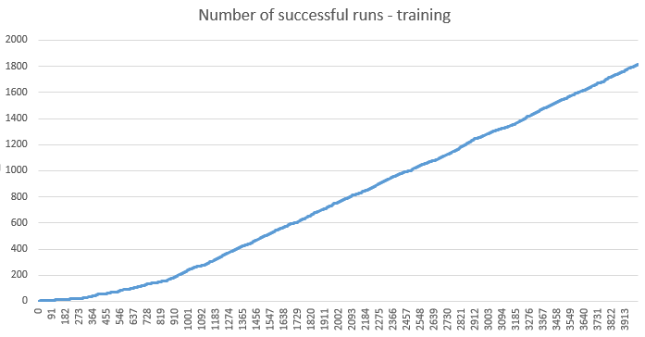
Reults
Simulation environment:
5 hours of training -4000 episode
Success rate 1800/4000 ≈ 45 %

Slide 23
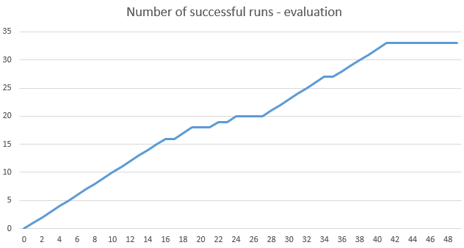
Reults
Simulation environment:
Evaluation for 50 episodes Max steps 50.
Success rate 33/50 ≈ 66 %

Slide 24
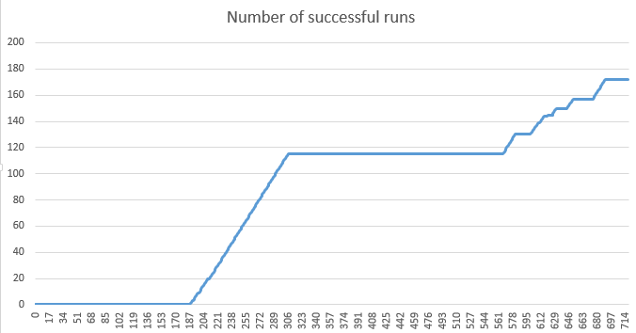
Reults
Real world environment:
1 hour in simulation ≈ 2.5 in real world
Success rate 175/715 ≈ 25 %

Slide 25
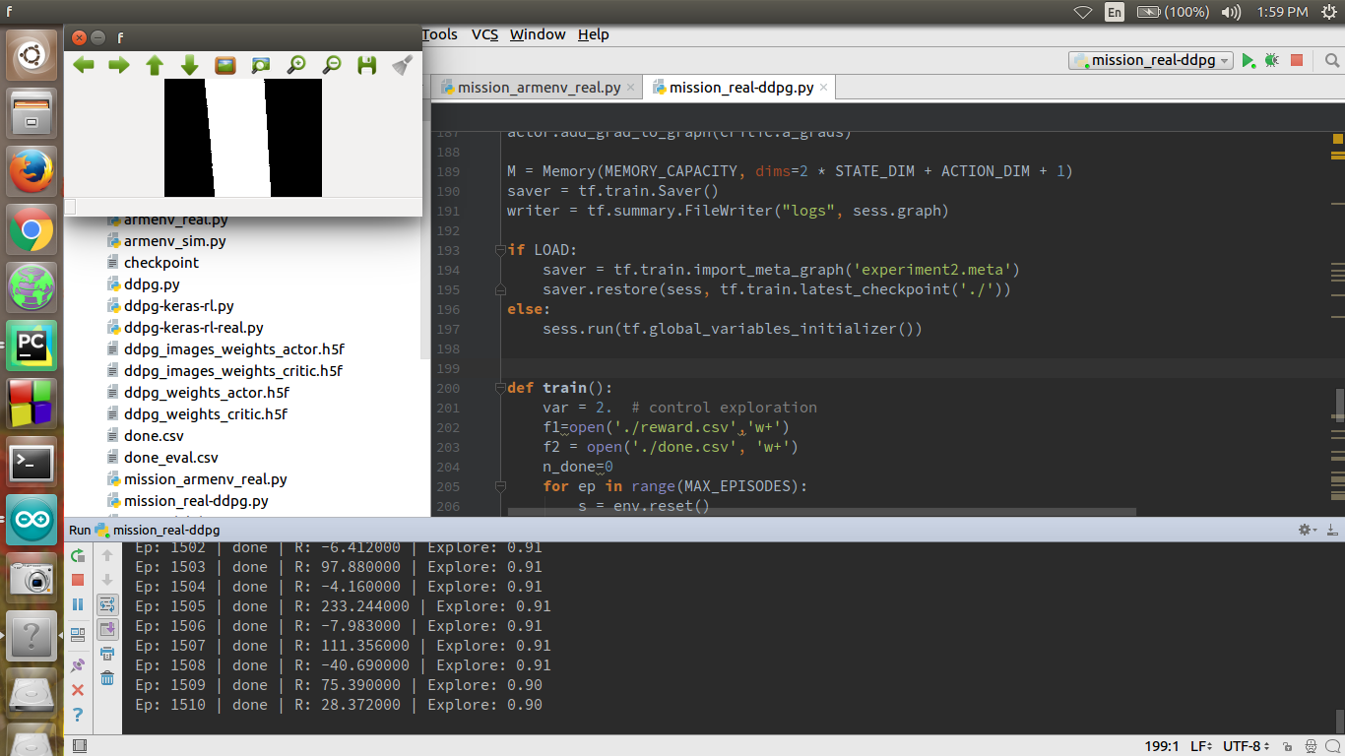
Development
New mission
(Flexibility of DDPG algorithm):
Follow a black line with zoom constraints
Simulate welding process

