Slide 1



RESEARCH DAYS - NOVEMBER 2020
Continuously learning complex tasks via symbolic analysis
Presented by Ali Younes, Ecole Polytechnique, ENSTA

Slide 2
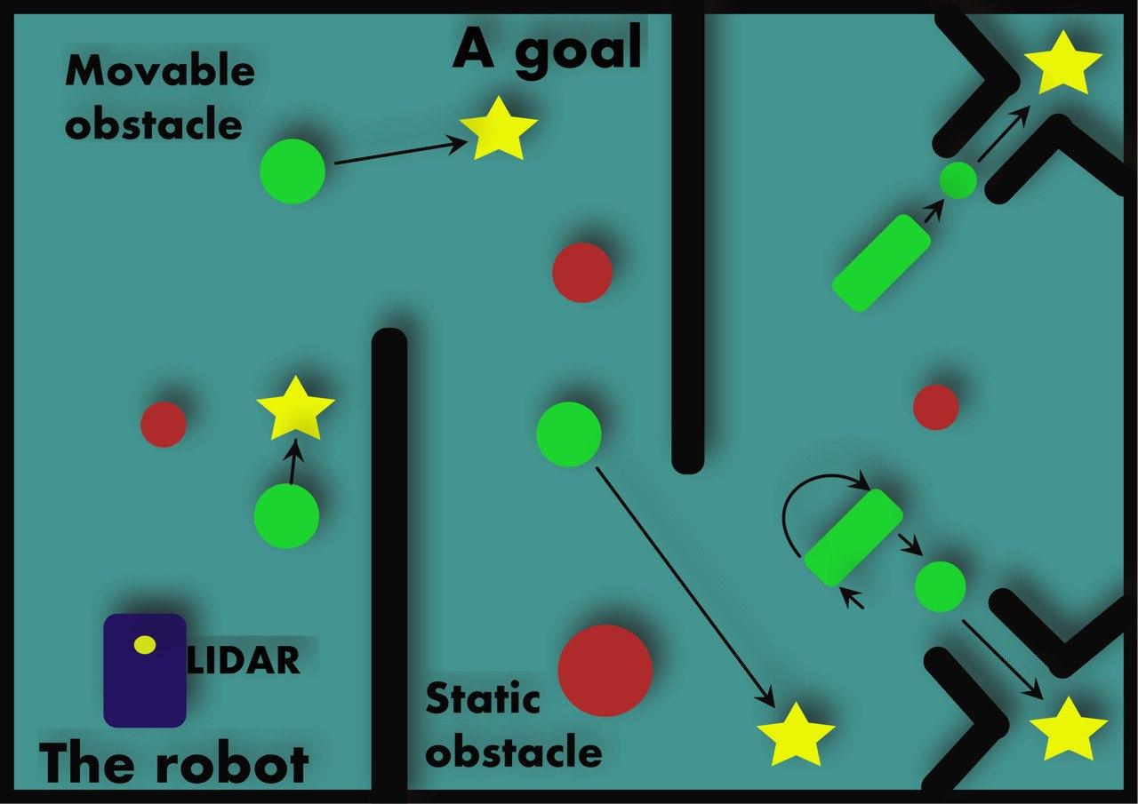
Continual Learning
The Continual learning problem is defined as the ability to incrementally learn and expand the knowledge by gaining new skills and expertise.
A system of a mobile robot pushing object to goals could represent a continual learning problem.

Slide 3
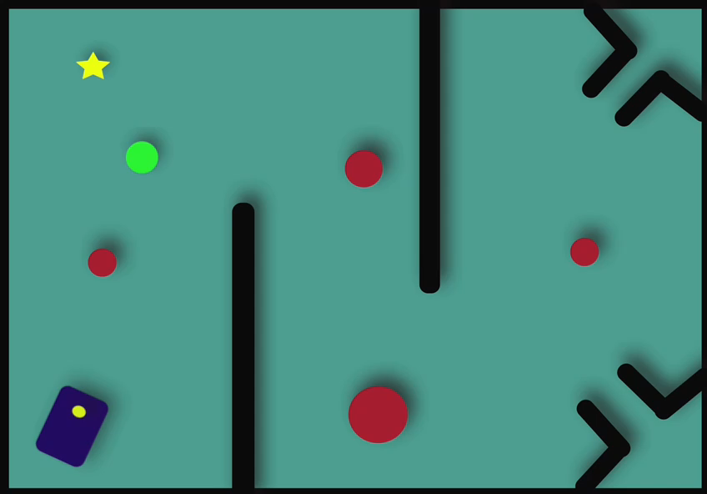
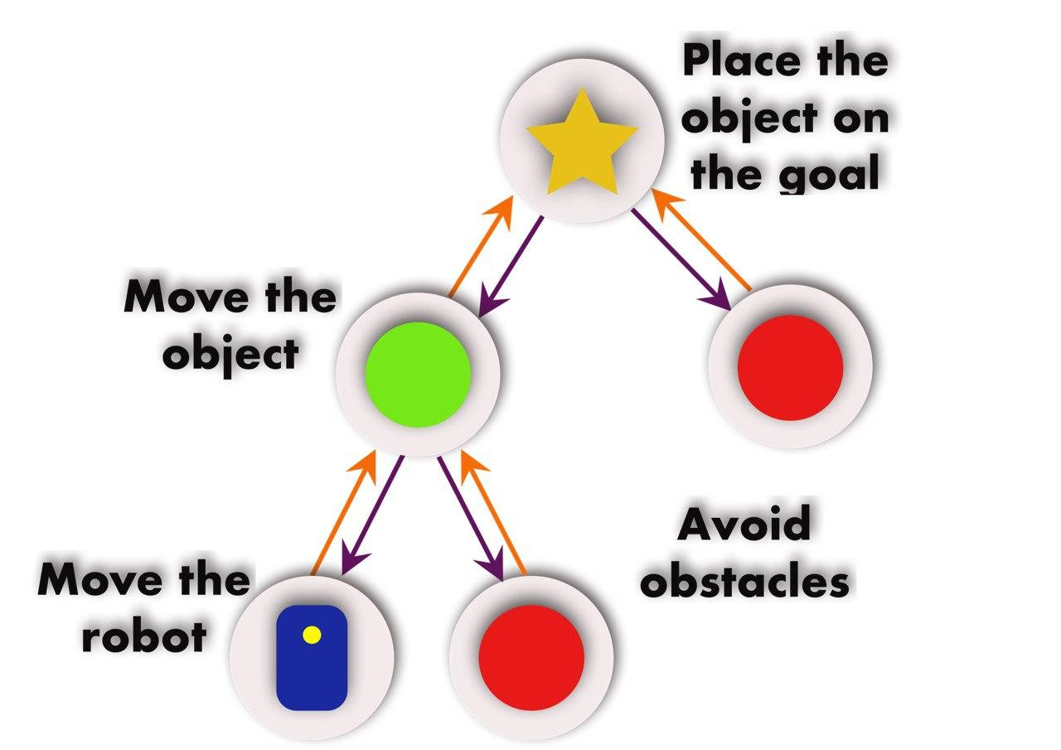
Hierarchical continual Learning
The robot dissect the task into simpler tasks, and build a hierarchy of skills to solve the task.
In the first part of the task, the robot use the hierarchy:

Slide 4
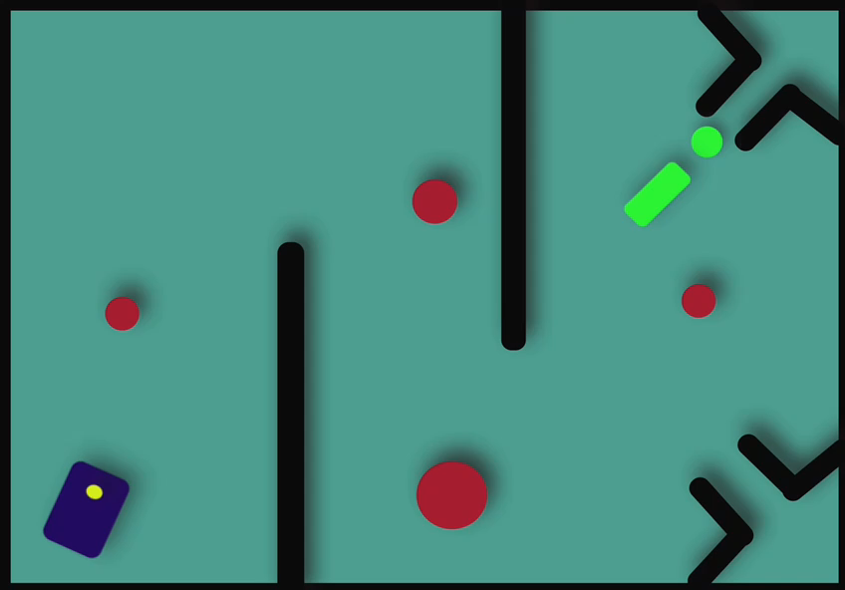
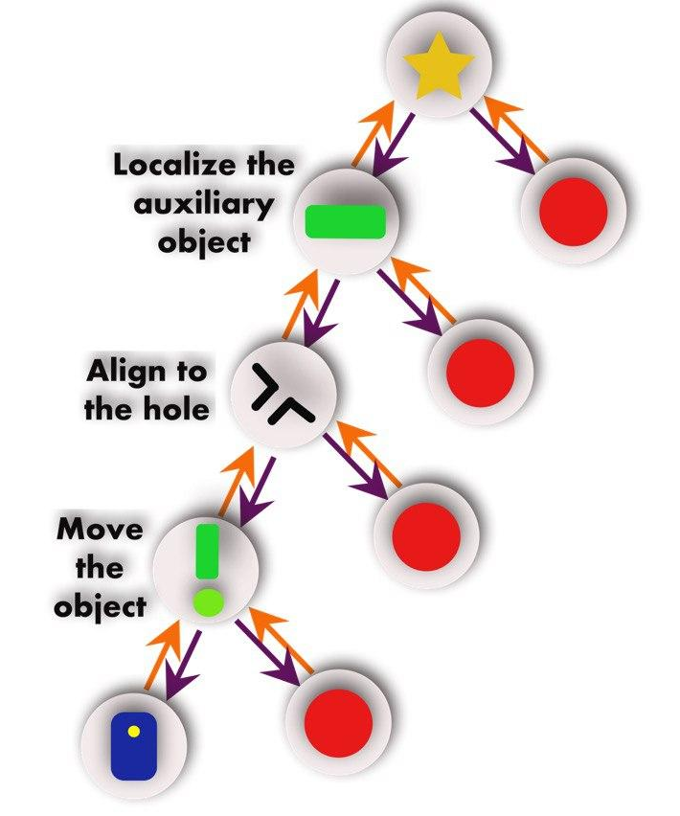
Hierarchical continual Learning
The robot dissect the task into simpler tasks, and build a hierarchy of skills to solve the task.
In the second part of the task, the robot has to extend the hierarchy:

Slide 5
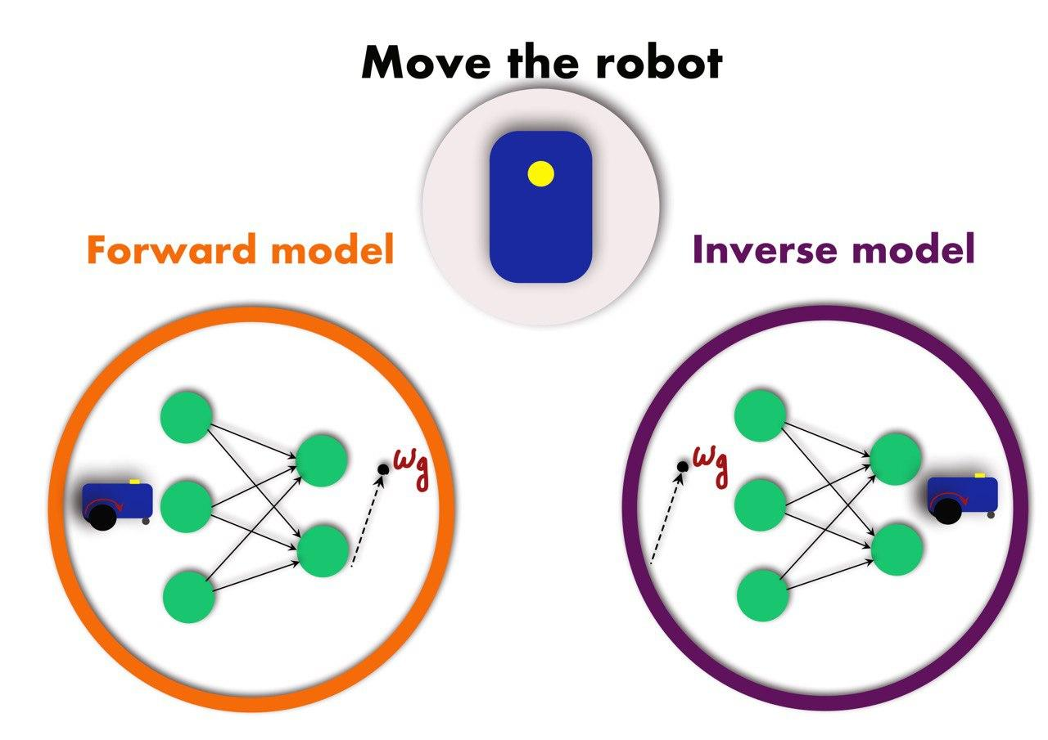
Planning in hierarchical learning
Each skill has a forward and an inverse model.

Slide 6
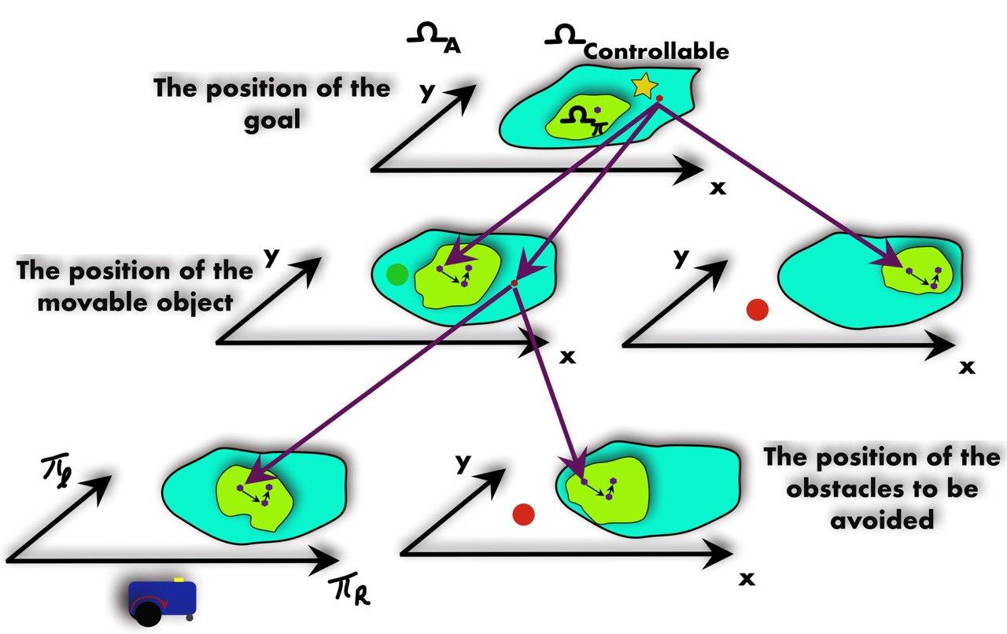
Planning in hierarchical learning
Inverse models from various skills are used for planning over the hierarchy.

Slide 7
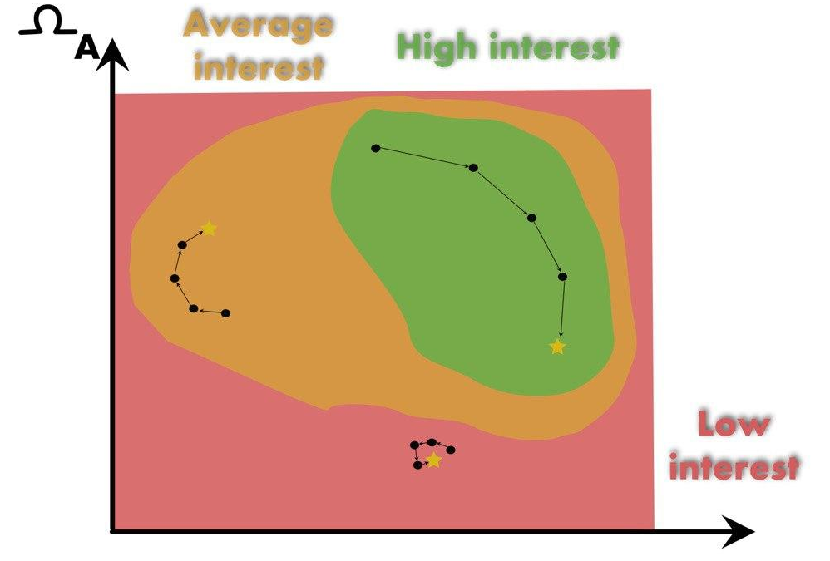
Intrinsic motivation
The learning process is guided by intrinsic motivation, i.e. sampled goals leads to explore regions with high interest of the state space (corresponds to higher learning progress).

Slide 8
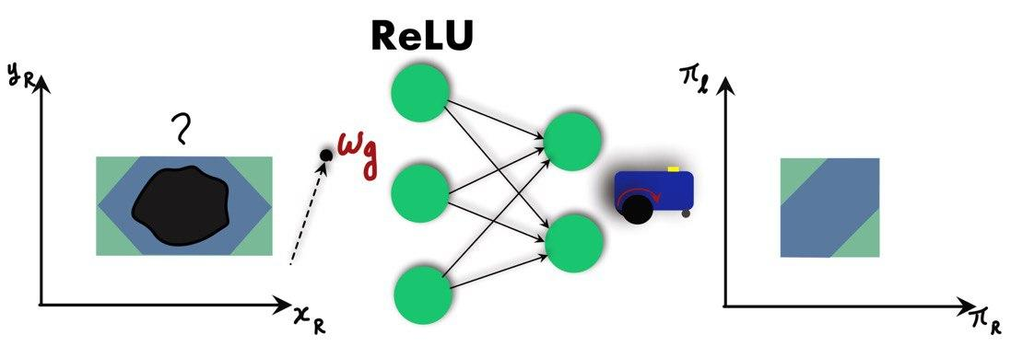
Using symbolic analysis
Current hierarchical learning approaches struggles with data-efficiency as the hierarchy grows (for complex tasks).
We propose using set-based methods (e.g. abstract interpretation) as a way to reduce the number of training samples.
Inferring over sets is more efficient than inferring over points in the common sense, but we may need special abstract domains for NN with ReLU activation functions.

Slide 9
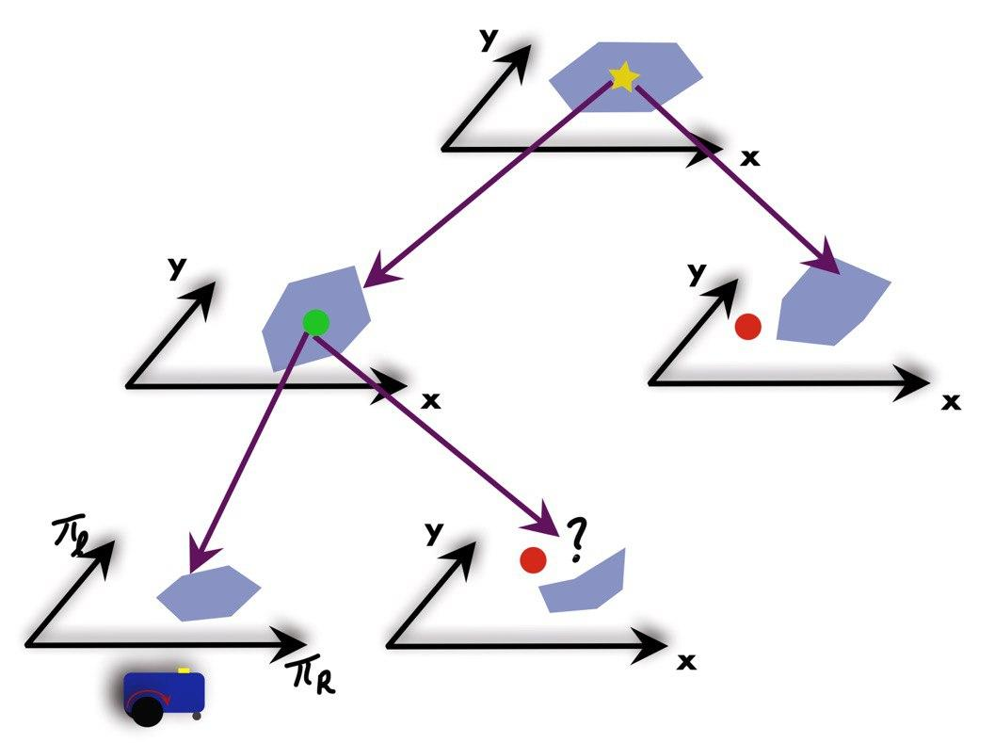
Using symbolic analysis
New planning is needed for set-based methods as well, in which controllable regions would be the output of the inverse model. This leads to an improved planning over the conventional method.

Slide 10
Objectives and Challenges
A life-long learning algorithm, uses symbolic analysis for efficient hierarchical learning.
Novel abstract domains (for abstract interpretation); exploring the trade-offs between precision and computational cost.
Novel algorithms for efficient planning in goal oriented hierarchical structures.
Experiments in simulation, and with real-world robots (mobile robots, manipulators), gradually increasing the complexity of the environment.

