Slide 1
Open Agent Hackathon 2026 · GenAI.Works / HackOS
VeriAgent Why
the agent that explains why a KPI dropped
hypotheses
row-level proof
traceability check
decision memo
Track 02 · “The Agent That Can Explain Why”
Alonso Alvira Ballano (solo)
github.com/AlonsoAlviraa/veriagent-why
Notes:
Hi, I'm Alonso. This is VeriAgent Why, my solo entry for Track 02, The Agent That Can Explain Why. It answers one question an ops analyst gets every week: why did this KPI drop? It proposes causes, proves them with rows from the data, checks that every citation can be re-found, and writes a short decision memo.

Slide 2
A KPI drops, and the first plausible story wins
Target user: an e-commerce ops analyst who must explain the drop before the meeting
on-time delivery rate
carrier SLA breach?
one carrier in one region got slow
illustrative
why?
promotion?
a campaign flooded one category
seasonality?
everything got a bit worse
baseline window
comparison period
ad-hoc SQL under time pressure
the first plausible story wins
leading questions get confirmed
2
Notes:
Picture the ops analyst on a Monday. On-time delivery fell, and there are three easy stories: the carrier slipped, the promotion flooded the warehouse, or it's just the season. Today this is ad-hoc SQL under time pressure, so the first plausible story wins. And if the boss asks "was it the promotion?", that leading question usually gets confirmed.

Slide 3
Ask a leading question, get the data’s answer
Tests competing causes against Zetaris data · every claim cites its rows · confidence is a formula
promotion: REFUTED
49 promo shipments, 3 late · share of the excess late shipments: −0.1%
Analyst asks
“Did the Home week South promotion cause the drop in on-time delivery?”
VeriAgent
Why
carrier SLA breach: SUPPORTED
CarrierB / North on-time rate 93.0% → 44.2%
planted trap
confidence 100
round(100·(0.45C + 0.35A + 0.20(1−R)))
2 / 2 claims pass
Traceability Check
row click-through
v_logistics row S000977
Live run, 26 Oct 2026: Zetaris JDBC + Meterless Nightshift 1.2.7 (output_examples/example_5_live_zetaris_nightshift.json). Synthetic data, planted promotion trap.
3
Notes:
VeriAgent Why tests competing causes against the data in Zetaris instead of picking a story. In this live run the question blames the Home week promotion in the South. That's a planted trap. The agent checks: 49 promo shipments, only 3 late, no share of the drop. It names the real cause, a carrier breach in the North, and cites the exact rows. Confidence comes from a formula, not from the model.

Slide 4
Six agents, one deterministic check, two feedback loops
Why did this KPI drop? hypotheses · row-level proof · traceability check · decision memo
A · LIVE: KPI-drop investigator (python -m app.pipeline · UI · API)
evidence gap → back to Planner
max 3 rounds · Meterless Markovian
claim not re-found
→ rewrite (max 2)
User / UI
ops analyst
Planner
Ultra · S2
Agentic
Retriever
Lightning · S1
S1 Filter
Lightning · S1
Evidence
Eval
Lightning · S1
Cause
Analyst
Ultra · S2
Writer
Ultra · S2
Traceability
Check
deterministic
Memo
row IDs +
confidence
SQL
re-runs SQL for every cited number / row
Data layer (same SQL on both)
Zetaris: 5 federated views over JDBC
DuckDB snapshot: SAMPLE_MODE fallback,
flagged in the memo
Meterless
Nightshift 1.2.7: model calls + receipts
H-MEM: hypothesis / evidence graph
Markovian: Evaluator → Planner rounds
Receipts & logs
receipts JSONL: agent, request id, model
trace JSONL: every step
H-MEM ledger per run
Green = runs in the product today · Amber = benchmark harness only
4
Notes:
Six agents work in a chain. The Planner proposes causes, the Retriever queries Zetaris, a fast filter keeps the relevant evidence, and the Evidence Evaluator tests each cause. If evidence is missing it sends the Planner back, up to three rounds, driven by Meterless Markovian. The Cause Analyst ranks, the Writer drafts, and a deterministic check re-runs every cited query. If a claim can't be re-found, it goes back for a rewrite.

Slide 5
Zetaris is the data layer: five federated views, one SQL path
Retriever, Evidence Evaluator and Traceability Check all query the same views over JDBC
live data path (Zetaris Lightning 2.4.3, local hackathon platform)
PostgreSQL 16
veriagent_pg
v_orders · v_logistics
v_returns
Zetaris SchemaStore
container veriagent
Agents query it
Retriever (SQL templates)
Evidence Evaluator (re-queries)
Traceability Check (re-runs cited SQL)
v_orders
1,818 rows
v_logistics
1,818 rows
JDBC
REST JSON source
veriagent_rest
v_tickets · v_promotions
v_returns
117 rows
v_tickets
112 rows
v_promotions
1 row
Live, 26 Oct 2026
3 demo scenarios over Zetaris JDBC
+ Nightshift: 72 / 72 receipts OK
Public Olist dataset
federated in container olist (CC BY-NC-SA 4.0)
27 / 27 claims green; 1-row mutation → red
SAMPLE_MODE fallback
same view names, same SQL on a DuckDB
snapshot; memo says “SAMPLE MODE: no Zetaris”
Green = runs in the product today · Amber = benchmark harness only
5
Notes:
Zetaris is where the data lives. Orders, logistics and returns sit in Postgres, tickets and promotions come from a REST source, and Zetaris federates them into five views. Every agent query and every re-check goes through these views over JDBC. On the 26th of October all three demo scenarios ran live this way. Without Zetaris, the same SQL runs on a DuckDB snapshot, and the memo says so.

Slide 6
Meterless runs every model call, with a receipt
Nightshift 1.2.7 is the primary model provider; H-MEM and Markovian run through a Node bridge
Nightshift 1.2.7
primary model provider; pinned S1 / S2
pin check at start, receipt per call
H-MEM
hypotheses, retrieval calls, evidence,
support / refute edges + trust ledger
Markovian
one chunk per Evaluator → Planner
round (max 3), then [TASK_COMPLETE]
agent | tier | routed_model | latency_s | ok | pin_ok | client_request_id
planner | s2 | nvidia/nemotron-3-ultra-550b-a55b | 3.29 s | true | true | 9106722d…
retriever | s1 | nvidia/nemotron-3.5-lightning-30b-a3b | 2.45 s | true | true | 075c0f95…
s1_filter | s1 | nvidia/nemotron-3.5-lightning-30b-a3b | 2.37 s | true | true | 5aa93a3c…
evidence_evaluator | s1 | nvidia/nemotron-3.5-lightning-30b-a3b | 0.74 s | true | true | 04b0fd7e…
cause_analyst | s2 | nvidia/nemotron-3-ultra-550b-a55b | 2.86 s | true | true | 9542bd34…
writer | s2 | nvidia/nemotron-3-ultra-550b-a55b | 2.80 s | true | true | f1d75927…
Real rows (first call per agent) from eval/nightshift_live/v2_agent_ids/zetaris-receipts-example-002.jsonl: live Zetaris + Nightshift, 26 Oct 2026, planted-trap run. 25 / 25 receipts OK, fallback never triggered. Ids truncated.
calls in this run: planner 1 · retriever 9 · s1_filter 6 · evidence_evaluator 5 · cause_analyst 1 · writer 1 · pin checks 2
All 3 live scenarios:
72 / 72 receipts OK, 0 failed
Green = runs in the product today · Amber = benchmark harness only
6
Notes:
Every model call goes through Meterless Nightshift, pinned to two NVIDIA Nemotron models: Lightning for the fast agents, Ultra for planning and writing. At start-up we check the pins and stop if routing differs. Each call leaves a receipt with the agent name and a request id. These are real rows from the live trap run. H-MEM stores the hypotheses and evidence, and Markovian drives the investigation rounds.

Slide 7
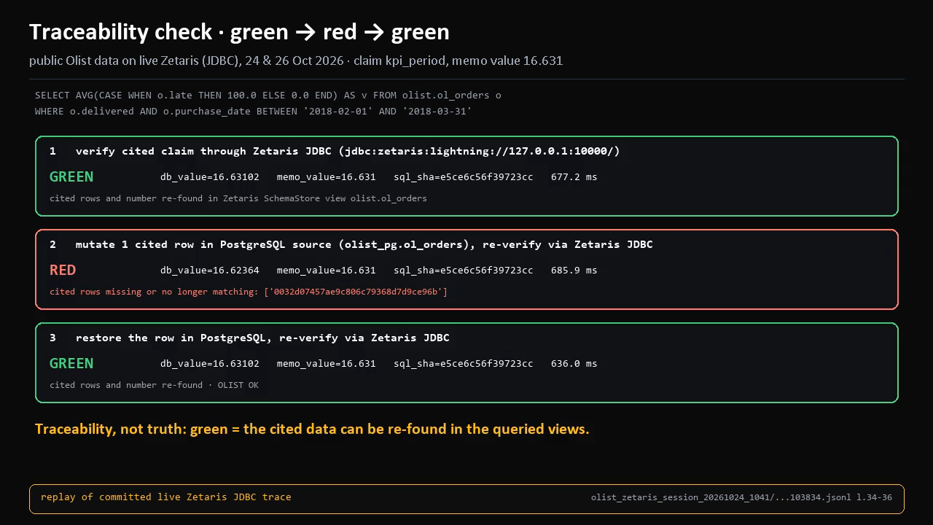
Change one cited row and the claim turns red
The Traceability Check re-runs the cited query through Zetaris and re-finds the cited rows and numbers
GREEN
claim cites rows; re-run via Zetaris; rows + number re-found
RED
1 cited row mutated in PostgreSQL: “cited rows missing or no longer matching”
GREEN
row restored; re-run via Zetaris; claim passes again
Traceability, not truth.
Green means the cited data can be re-found in the queried views, not that the claim is true.
Clip: replay of live Zetaris JDBC trace on public Olist data (24 Oct). Also verified: verify_live_demo.py --backend zetaris (DEMO OK), olist_demo.py --mutate (OLIST OK).
7
Notes:
This is the part I'm proudest of. Every claim in the memo carries the query and row ids it came from. The Traceability Check re-runs that query through Zetaris. In the demo I change one cited row in the Postgres source: the claim turns red. I restore it: green again. To be clear, green means the cited data can be re-found. It's traceability, not truth.

Slide 8
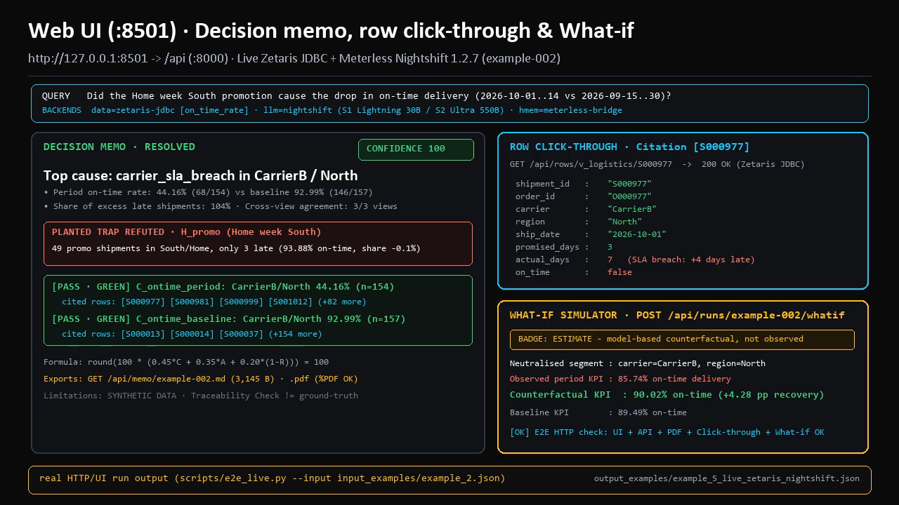
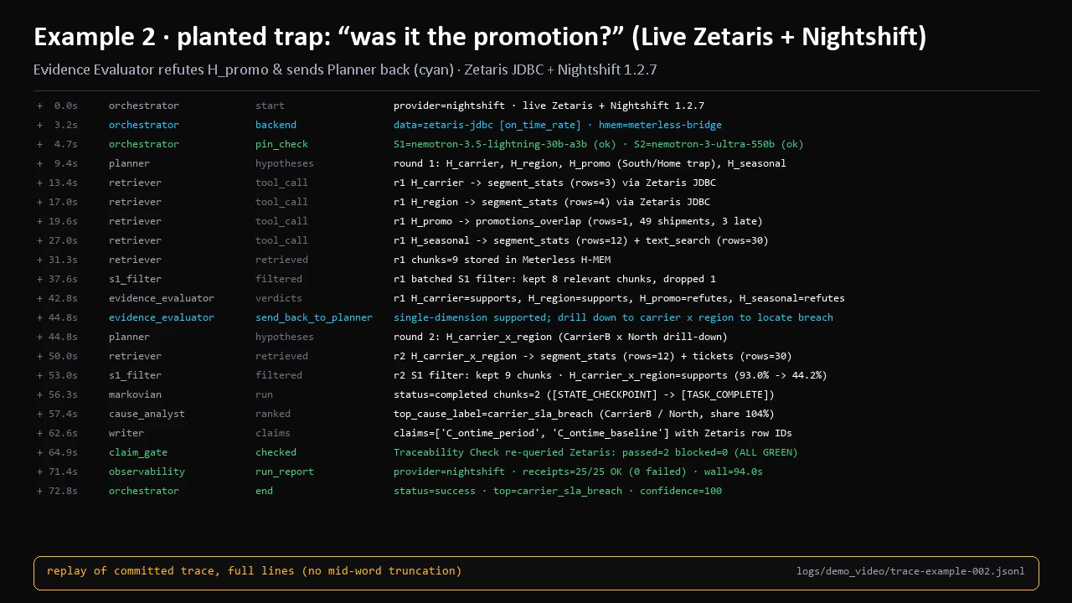
What the analyst sees: a memo, and the trace behind it
Web UI (:8501) over the FastAPI service (:8000); every run writes a JSONL trace
Web UI (:8501) over FastAPI (:8000): decision memo with [PASS · GREEN] claims, row-level click-through to Zetaris JDBC, and What-if counterfactual simulator.
Replay of the committed trace for the planted-trap example: hand-offs, the Evaluator sending the Planner back (cyan), claims passing the check (green).
output_examples/example_5_live_zetaris_nightshift.json · Live Zetaris + Nightshift
logs/demo_video/trace-example-002.jsonl · Live Zetaris JDBC + Nightshift 1.2.7
8
Notes:
This is the product view. On the left, the memo screen: top cause, cited rows you can click, the confidence score and the limits. On the right, the trace from the trap example. You can see each hand-off, and the Evidence Evaluator sending the Planner back to drill down from carrier to carrier by region, before the check passes both claims.

Slide 9
Technical stack: plain Python, no agent framework
Own orchestrator (app/pipeline.py) and own agentic retriever; numbers always come from SQL
interface
FastAPI API :8000 · web UI :8501 · CLI run.py · memo PDF (fpdf2)
orchestration
own Python orchestrator · own agentic retriever (SQL templates + BM25 / dense)
models
NVIDIA Nemotron 3.5 Lightning 30B (S1) + Nemotron 3 Ultra (S2) via Meterless Nightshift 1.2.7
memory & rounds
Meterless H-MEM + Markovian (vendored, Apache-2.0) via Node bridge
data
Zetaris Lightning over JDBC (JayDeBeApi) · DuckDB snapshot for SAMPLE_MODE
ops & evidence
Docker compose · pytest + GitHub CI · JSONL traces, receipts, H-MEM ledgers
MIT licence · secrets only in a local .env (gitignored) · secret scan clean
9
Notes:
The stack is deliberately plain. My own Python orchestrator, no agent framework. FastAPI for the API, a small web UI, and a CLI. Models are NVIDIA Nemotron through Meterless Nightshift; H-MEM and Markovian run through a small Node bridge. Data comes from Zetaris over JDBC, or a DuckDB snapshot offline. It ships with Docker compose, pytest and GitHub CI, and JSONL logs for every step.

Slide 10
Evidence it works: a pre-registered benchmark run
TableBench, n = 361, single run, no tuning (docs/V11_RESULTS.md) · benchmark lane, not the live KPI pipeline
B · BENCHMARK-ONLY: bench/run.py · V7 answers + V9_full confidence
V7 agent
48.2%
0.834
V9_full confidence AUROC
36.6% → 77.3%
answers 36.6% of questions,
77.3% accurate when it answers
plain RAG
32.7%
8.3%
wrong answers given, of all
questions (target ≤ 10%)
+0.199 vs −0.346
net score (+1 right, −1 wrong,
0 abstain): V7+V9 vs RAG
+15.5 pp (95% CI +11.1 to +20.2)
semantic accuracy, paired bootstrap
The live KPI memo does not use V7 / V9: its confidence is the fixed formula in app/confidence.py.
Green = runs in the product today · Amber = benchmark harness only
10
Notes:
Separately from the live product, I tested the answer and confidence layer on a fresh public benchmark, TableBench, 361 questions, pre-registered and run once. The agent got 48.2 percent right against 32.7 for plain RAG. The confidence score separates right from wrong answers with an AUROC of 0.83. When it chooses to answer, it's right 77 percent of the time. This is the benchmark harness only; the live memo uses a fixed formula.

Slide 11
Honest limits, and what comes next
All numbers from the README Status section and the linked reports
limits
next steps
traceability ≠ correctness
140 of 171 wrong test500 answers passed the check
sign / scale / range checks on numbers
dev 21/22 vs plain RAG 12/22 is in-sample
deterministic rules alone also score 21/22; plain RAG is below the trivial rule (13/22)
Markovian control in the app (today: benchmark only)
V9 confidence on hard sets
not better than cheap signals; conformal guarantee fails on DocFinQA
a non-author evaluation set
narrative check over-flags
173 of 400 correct answers flagged (43%)
more KPI families
abstains often
63% of TableBench questions get no answer
Green = runs in the product today · Amber = benchmark harness only
11
Notes:
Here are the limits, stated plainly. Green on the check means traceable, not correct: 140 of 171 wrong benchmark answers still passed it. The 21 of 22 dev score is in-sample, and my deterministic rules score the same; plain RAG was even below a trivial rule. The confidence model is not better than cheap signals on hard sets, the narrative check over-flags, and it abstains a lot. Next: numeric sanity checks, Markovian control in the app, and an evaluation set I didn't write.

Slide 12
AI usage, pre-existing work, and how to run it
Declared in README “AI and Model Usage” and docs/PRE_EXISTING_WORK.md
AI and Model Usage
Pre-existing work
Run it (no credentials)
Runtime: Nemotron 3.5 Lightning 30B (S1) and Nemotron 3 Ultra (S2) through Meterless Nightshift, pinned and receipted per call.
Code: written during the build window by AI coding agents (Grok Bot) under the author’s direction; reviewed, tested and committed by the author.
Cursor was not used to write this code; the organisers’ announcement of 22 Oct 2026 made it optional.
Environment setup (Zetaris platform, API keys), a throwaway connectivity scaffold not in this repo, design material (diagrams v2–v6.2, architecture documents) and the empty repository skeleton.
Open-source Meterless engines (Apache-2.0) and the public Olist dataset (CC BY-NC-SA 4.0) used under their licences.
git clone https://github.com/
AlonsoAlviraa/veriagent-why
cd veriagent-why
pip install -r requirements.txt
python run.py --input \
input_examples/example_1.json
SAMPLE_MODE fallback: DuckDB, no model
Thanks
Zetaris · Meterless · NVIDIA
Olist data (CC BY-NC-SA 4.0) · MIT licence
github.com/AlonsoAlviraa/veriagent-why
12
Notes:
Quick declarations. At runtime the product uses NVIDIA Nemotron through Meterless Nightshift. The code was written in the build window by AI coding agents under my direction, and I reviewed, tested and committed it. Cursor was not used; the organisers made it optional on the 22nd of October. Pre-existing work is environment setup, design material and an empty repo skeleton. You can run it from a clean clone with no credentials. Thanks to Zetaris, Meterless and NVIDIA.

Slide 13
appendix
Everything generated
replays of committed traces, receipts and results · recordings to add · file list
Every clip is a replay of a committed file, not a live screen recording.
Notes:
Appendix. Replays of what the system generated, and a list of every output in the repo. Not part of the three-minute talk.

Slide 14
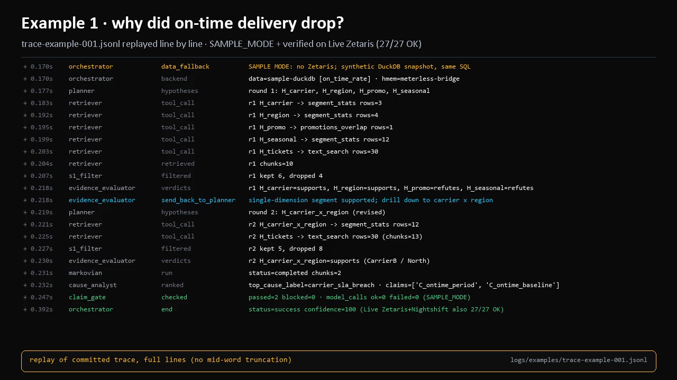
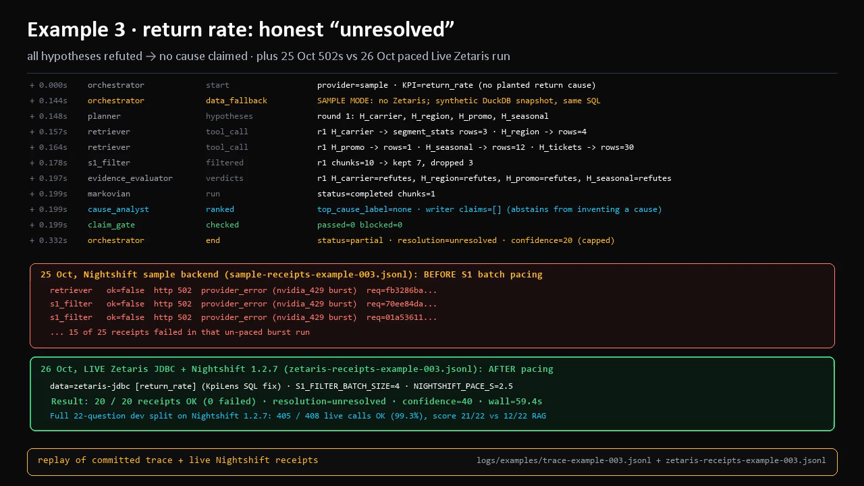
Replays: example 1 and the honest “unresolved” case
Committed traces in logs/examples/ (SAMPLE_MODE, synthetic data)
Example 1, on-time drop: two rounds, send-back to the Planner, carrier_sla_breach, confidence 100. Source: logs/examples/trace-example-001.jsonl (16 s).
Example 3, return rate: every hypothesis refuted, no cause claimed (confidence 20 sample / 40 live). Also shows the 15 of 25 failed calls of the 25 Oct run, fixed by pacing: 20/20 OK live on 26 Oct (16.5 s).
14
Notes:
Two replays. Example 1 is the standard carrier breach. Example 3 is the honest case: nothing explains the return-rate change, so the agent says unresolved instead of inventing a cause. It also shows the failed calls from the 25 October run, before pacing, and the clean live run on the 26th.

Slide 15
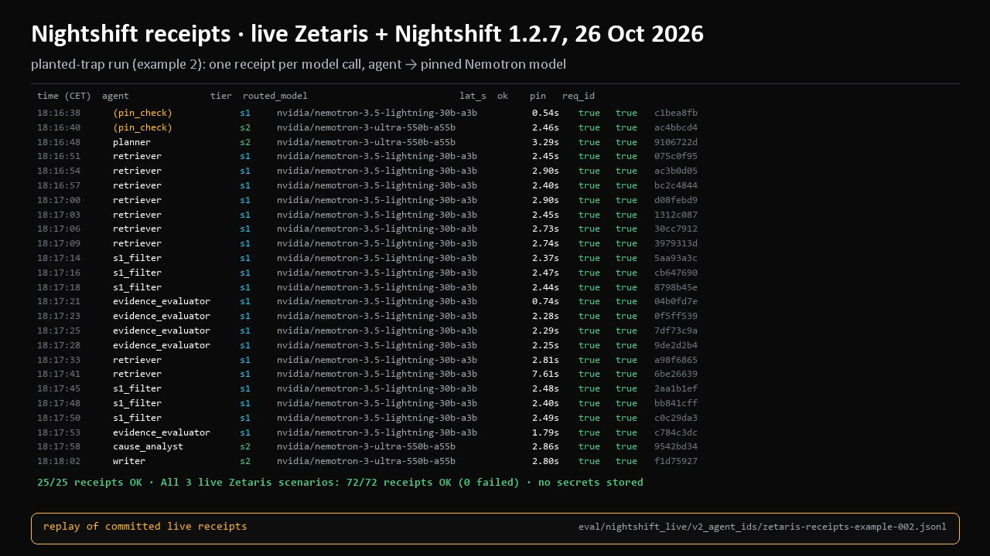
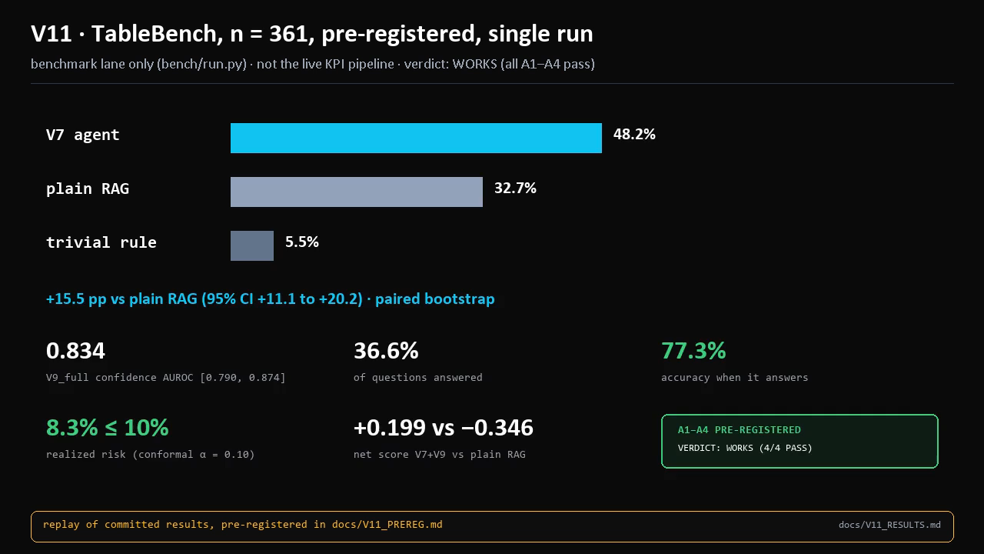
Replays: per-call receipts and the benchmark result
Live receipts from 26 Oct 2026 · V11 numbers from docs/V11_RESULTS.md
All 25 receipts of the live planted-trap run: agent, tier, pinned Nemotron model, latency, ok, pin_ok, request id (truncated). Source: eval/nightshift_live/v2_agent_ids/zetaris-receipts-example-002.jsonl (15.6 s).
V11 TableBench (n = 361, pre-registered, single run): V7 48.2% vs plain RAG 32.7%, AUROC 0.834, 77.3% accurate at 36.6% coverage. Benchmark lane only (16 s).
15
Notes:
On the left, every receipt of the live trap run, one per model call, each routed to the pinned model. On the right, the benchmark result replayed from the committed report.

Slide 16
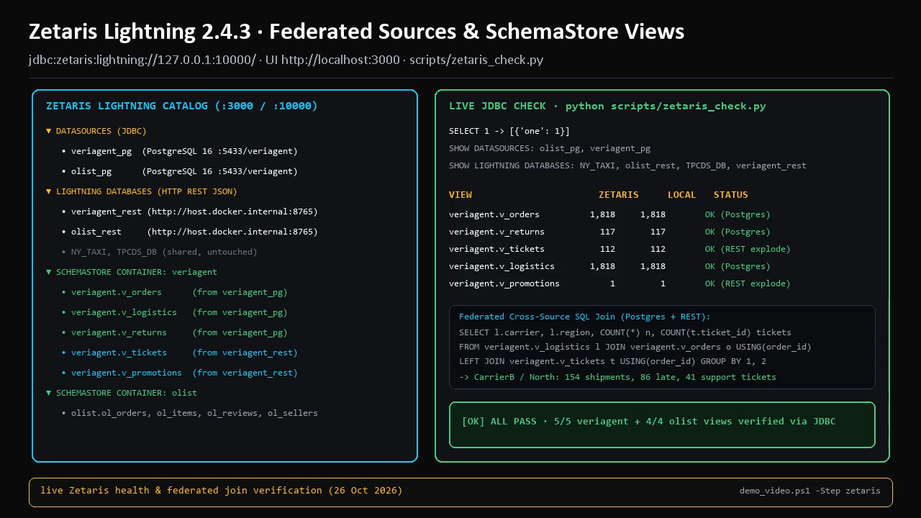
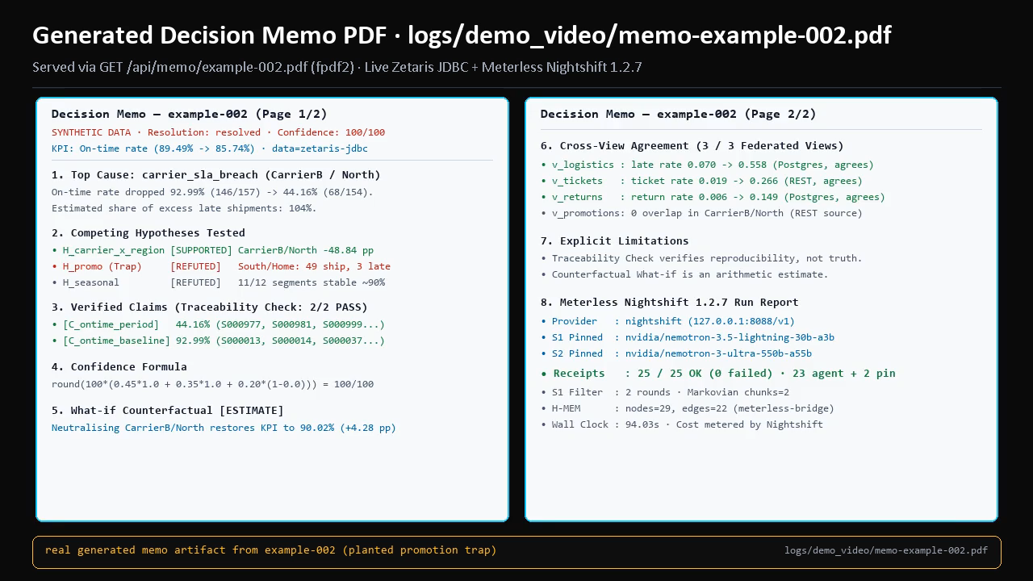
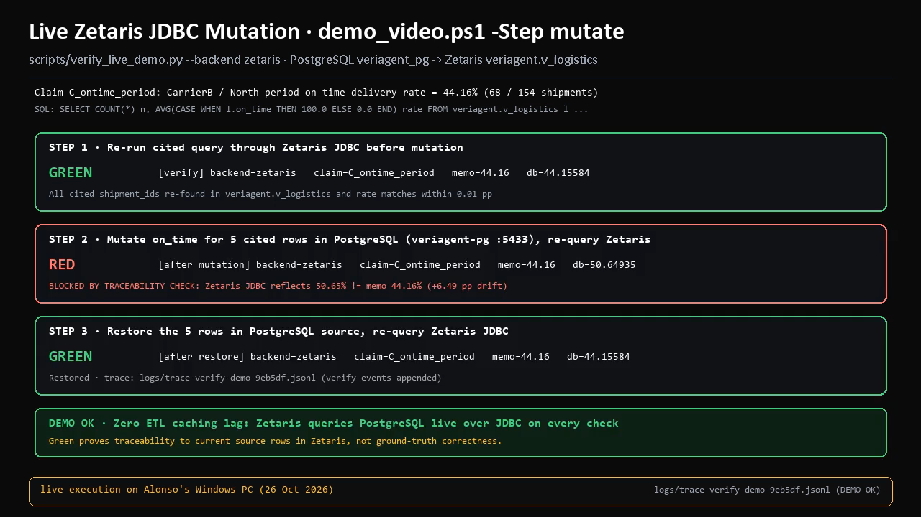
Live machine clips: Zetaris, memo PDF, and mutation
Captured on Alonso’s PC (UI :8501 · API :8000 · Zetaris :3000/:10000 · PostgreSQL :5433 · REST :8765)
Zetaris Lightning 2.4.3 catalog & live JDBC check: veriagent_pg (PostgreSQL 16) + veriagent_rest (HTTP JSON) federated into 5 SchemaStore views and verified via cross-source SQL join.
Generated 2-page Decision Memo PDF for example-002: refuted promotion trap (93.88% on-time), 3/3 cross-view agreement, and 25/25 Meterless Nightshift receipts.
Live Zetaris JDBC mutation check: mutating 5 cited rows in PostgreSQL flips claim C_ontime_period GREEN (44.16%) → RED (50.65% drift) → GREEN (44.16% restored).
scripts/zetaris_check.py · 5/5 veriagent + 4/4 olist views OK
GET /api/memo/example-002.pdf · logs/demo_video/memo-example-002.pdf
demo_video.ps1 -Step mutate · logs/trace-verify-demo-9eb5df.jsonl
All 3 clips above are embedded from live executions on this machine (Zetaris JDBC :10000, FastAPI :8000, Web UI :8501, Meterless Nightshift :8088).
16
Notes:
These three frames are for recordings from my machine, where the UI, the API and Zetaris run. They are left empty on purpose: nothing here is a fake recording.

Slide 17
Everything generated: files in the repository
github.com/AlonsoAlviraa/veriagent-why (main @ ee3db6a)
outputs & runs
live sessions & receipts
evaluation & benchmarks
output_examples/example_1..3.json
SAMPLE_MODE outputs
output_examples/example_4_live_nightshift.json
output_examples/example_5_live_zetaris_nightshift.json
logs/examples/trace-example-00{1,2,3}.jsonl
logs/examples/memo-example-00{1,2,3}.md
logs/examples/hmem-ledger-example-00{1,2,3}.jsonl
eval/nightshift_live/v2_agent_ids/
zetaris-receipts-example-00{1,2,3}.jsonl
sample-receipts-example-00{1,2,3}.jsonl
logs/olist_zetaris_session_20261024_1041/
traces, results, memos olist_q1..q3
logs/zetaris_session_20261024_1015/
docs/OLIST_ZETARIS_SESSION_20261024.md
eval/RESULTS_dev_nightshift.md
eval/RESULTS_dev_nvidia.md, RESULTS_dev_sample.md
docs/V11_RESULTS.md + docs/v11/MANIFEST.sha256
docs/V10_RESULTS.md, TEST500_RESULTS.md
docs/V9_GENERALIZATION_RESULTS.md
docs/TEST_BATTERY_REPORT.md
docs/trace_audit/TEST500_ERRORS.md
Also: docs/diagrams/veriagent_why_arch_FINAL.png · docs/PRE_EXISTING_WORK.md · README (setup, AI and Model Usage, limits) · clips in this deck replay these files.
Green = runs in the product today · Amber = benchmark harness only
17
Notes:
For reference, everything the system generated that is committed in the repo: outputs, traces, memos, ledgers, live receipts, the live Zetaris sessions, and the evaluation and benchmark reports.

