Slide 1
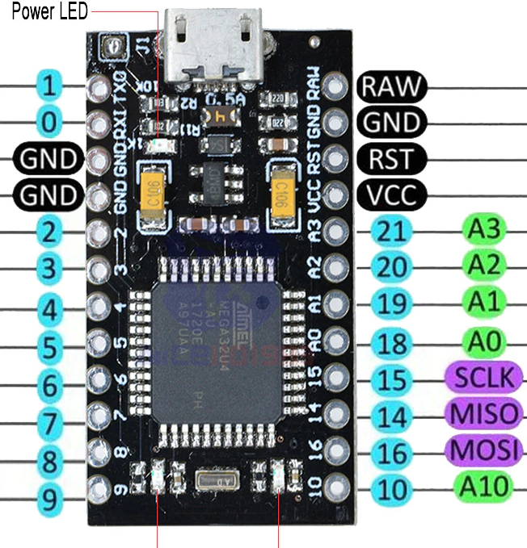
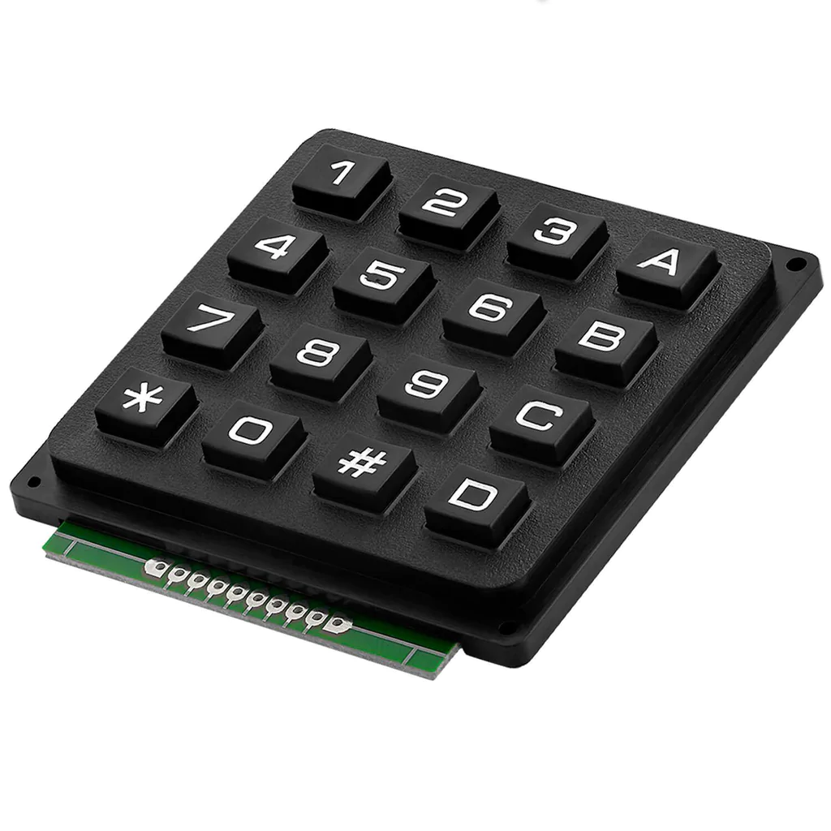
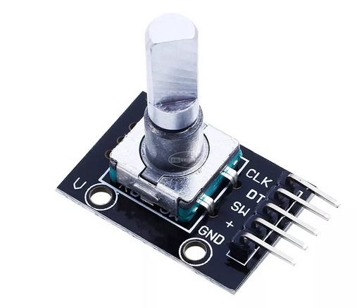
Pro micro Vcc
2k2
Pro micro A3
1k
1k
Pro micro 16
Pro micro 14
Pro micro 15
Pro micro 2
Pro micro 0
Pro micro 1
(n.c.)
(n.c.)
Pro micro 10
Pro micro 9
Pro micro 8
Pro micro 7
Pro micro 6
Pro micro 5
Pro micro 4
Pro micro 3
Pro micro Vcc
Pro micro Gnd

Slide 2
Asignación de funciones
1 | 2 | 3 | A
4 | 5 | 6 | B
7 | 8 | 9 | C
* | 0 | # | D
6
Rotate
canvas
Q (Freehand selection tool temp.) | T (Move tool temp.) | Ctrl-D (Deselect) | SPC (Pan canvas)
S (Isolate layer) | R (Select layer) | BackSpace (Fill with backColor) | Shift BackSpace (Fill with frontColor)
X (Exchange front and back color) | Ctrl < (Shade color selector) | V (Lines) | Tab (Only canvas)
Del | Ctrl Z (Undo) | Alt Z (Redo) | Ctrl (Color picker)
Push
5 (Reset rotation)
- +
Zoom
canvas
Push
2 (Fit page)
7 9
Brush size
Push
E (Toggle eraser)

