Slide 1
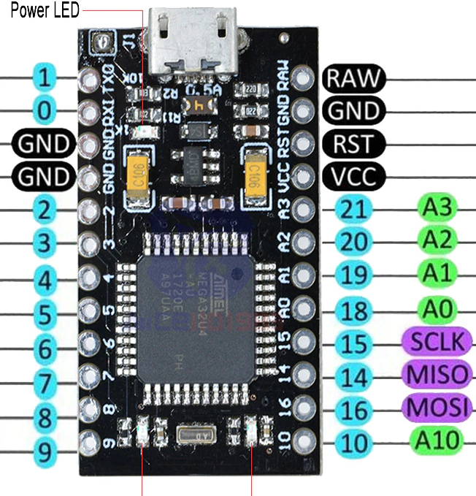
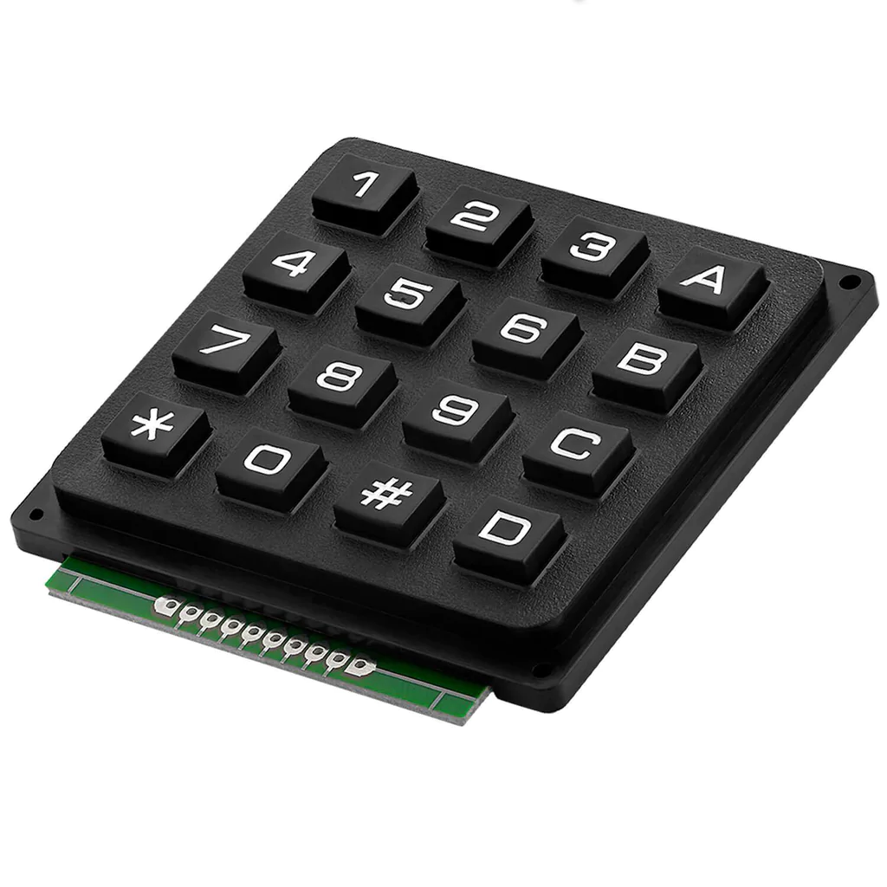
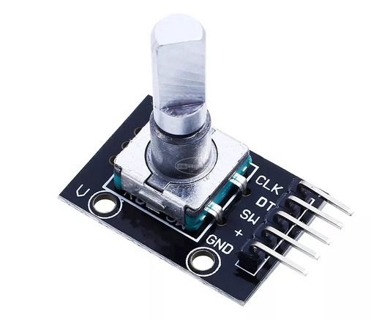
Pro micro Vcc
2k2
Pro micro A3
1k
1k
Pro micro 16
Pro micro 14
Pro micro 15
Pro micro 2
Pro micro 0
Pro micro 1
(n.c.)
(n.c.)
Pro micro 10
Pro micro 9
Pro micro 8
Pro micro 7
Pro micro 6
Pro micro 5
Pro micro 4
Pro micro 3
Pro micro Vcc
Pro micro Gnd

Slide 2
Key settings
1 | 2 | 3 | A
4 | 5 | 6 | B
7 | 8 | 9 | C
* | 0 | # | D
6
Rotate
canvas
Q (Freehand select. temp.) | T (Move tool temp.) | Ctrl-D (Deselect) | Local Shift
Tab (Only canvas) | S (Isolate layer) | R (Select layer) | BackSpace (Fill with backColor)
Shift | Ctrl < (Shade color selector) | Z (Pie menu) | Ctrl SPC (Zoom)
Ctrl (Color picker) | Ctrl Z (Undo) | M (Mirror) | SPC (Pan canvas)
Push:
5 (Reset rotation)
- +
Zoom
canvas
Push:
2 (Fit page)
7 9
Brush size
Push:
E (Toggle eraser)
LocalShift:
First press -> Temporary Shift mode
Second press-> Permanent Shift mode
Third press -> Return to normal mode (main settings configuration , see previous page)
Long press -> Enter in Test mode (no keys are sent to the computer)
Long press again -> Exit test mode
While in test mode -> Long press (2 seconds) in “Reset rotation” change to MIDI mode

Slide 3
Key settings after pressing localShift
1 | 2 | 3 | A
4 | 5 | 6 | B
7 | 8 | 9 | C
* | 0 | # | D
6
Rotate
canvas
Ctrl T (Transform tool) | Ctrl U (HSV adj.) | F3 (Properties) | Local Shift
Ctrl A (Select all) | Ctrl G (Group) | Alt G (Clipping Group) | Enter + B (Enter and Brush tool)
X (Exchange fg/bg color) | Ctrl B (Color balance) | Ctrl K (Invert selecction) | Ctrl L (Levels)
Ctrl X (Cut) | Ctrl C (Copy) | Ctrl V (Paste) | Shift V (Paste in same layer)
Push:
5 (Reset rotation)
- +
Zoom
canvas
Push:
2 (Fit page)
7 9
Brush size
Push:
E (Toggle eraser)

Slide 4
MIDI settings (for using with Mobius)
1 | 2 | 3 | A
4 | 5 | 6 | B
7 | 8 | 9 | C
* | 0 | # | D
CC102 CC103
Pan
Trk1 Rec/Overdub (CC 64) | Trk2 Rec/Overdub (CC 65) | Trk3 Rec/Overdub (CC 66) | Undo (Note 6)
Trk4 Rec/Overdub (CC 67) | Trk5 Rec/Overdub (CC 68) | Trk6 Rec/Overdub (CC 69) | Multiply (CC 62)
Trk7 Rec/Overdub (CC 70) | Trk8 Rec/Overdub (CC 71) | Trk - (CC 58) | Trk - (CC 59)
Rec/Overdub Active track (CC 45) | Pause (CC 42) | Global reset (CC 46) | Mute (CC 41)
Push: PAN middle (CC 108)
(Long press: change to Keyboard mode)
CC104 CC105
Feedback
Push:
Previous loop (CC 109)
CC106 CC107
Output Volume
Push:
Next loop (CC 110)

