Slide 1
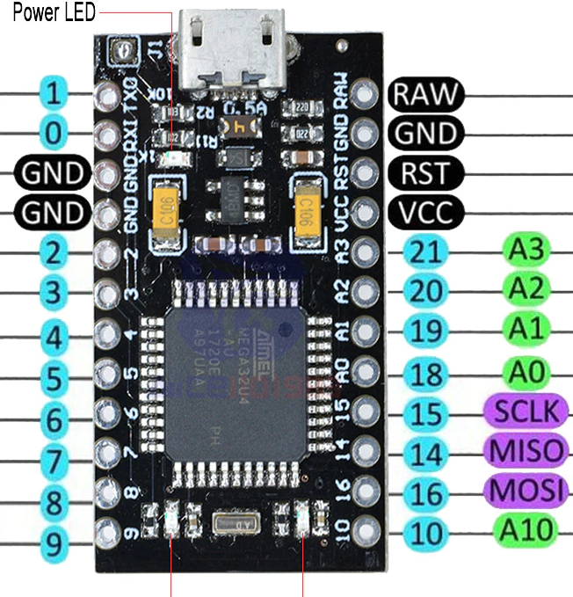
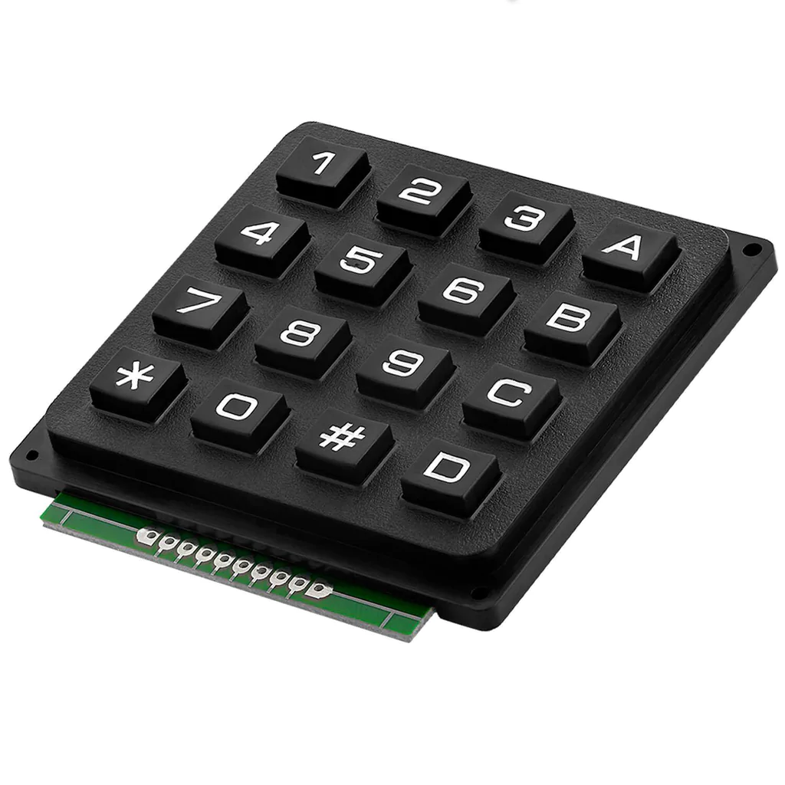
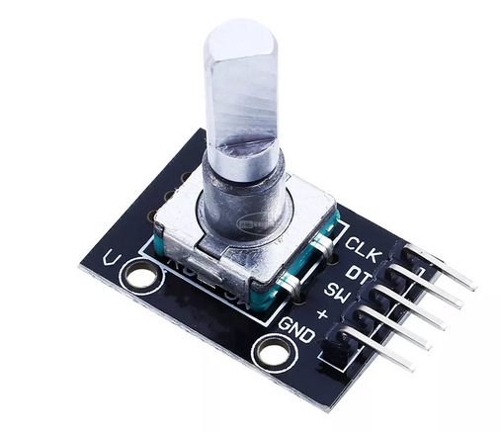
Pro micro Vcc
2k2
Pro micro A3
1k
1k
Pro micro 16
Pro micro 14
Pro micro 15
Pro micro 2
Pro micro 0
Pro micro 1
(n.c.)
(n.c.)
Pro micro 10
Pro micro 9
Pro micro 8
Pro micro 7
Pro micro 6
Pro micro 5
Pro micro 4
Pro micro 3
Pro micro Vcc
Pro micro Gnd

Slide 2
Key settings
1 | 2 | 3 | A
4 | 5 | 6 | B
7 | 8 | 9 | C
* | 0 | # | D
6
Rotate
canvas
Q (Freehand select. temp.) | T (Move tool temp.) | Ctrl-D (Deselect) | Local Shift
Tab (Only canvas) | S (Isolate layer) | R (Select layer) | BackSpace (Fill with backColor)
Shift | Ctrl < (Shade color selector) | Z (Pie menu) | Ctrl SPC (Zoom)
Ctrl (Color picker) | Ctrl Z (Undo) | M (Mirror) | SPC (Pan canvas)
Push:
5 (Reset rotation)
- +
Zoom
canvas
Push:
2 (Fit page)
7 9
Brush size
Push:
E (Toggle eraser)
LocalShift: Change settings to the alternative configuration (See next page)

Slide 3
Key settings after pressing localShift
1 | 2 | 3 | A
4 | 5 | 6 | B
7 | 8 | 9 | C
* | 0 | # | D
6
Rotate
canvas
Ctrl T (Transform tool) | Ctrl U (HSV adj.) | F3 (Properties) | Local Shift
Ctrl A (Select all) | Ctrl G (Group) | Alt G (Clipping Group) | Enter + B (Enter and Brush tool)
X (Exchange fg/bg color) | Ctrl B (Color balance) | Ctrl K (Invert selecction) | Ctrl L (Levels)
Ctrl X (Cut) | Ctrl C (Copy) | Ctrl V (Paste) | Shift V (Paste in same layer)
Push:
5 (Reset rotation)
- +
Zoom
canvas
Push:
2 (Fit page)
7 9
Brush size
Push:
E (Toggle eraser)
LocalShift: Return to main settings configuration (See previous page)

