Slide 1
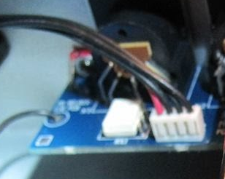
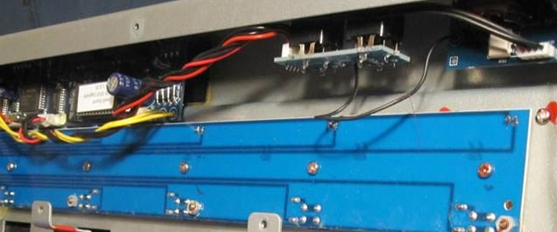
Optoacoplador interno de la
Entrada MIDI del FCB1010
Vcc
Gnd
/out
H11L1
+ Diode -

Slide 2
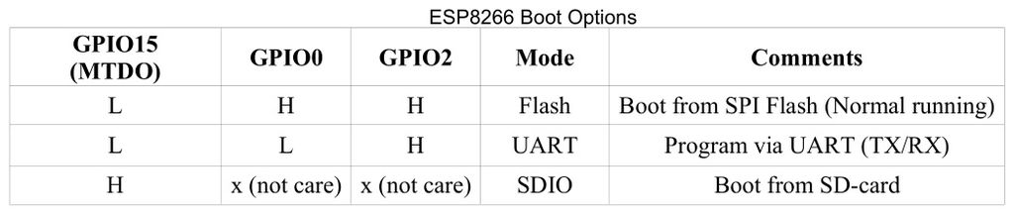
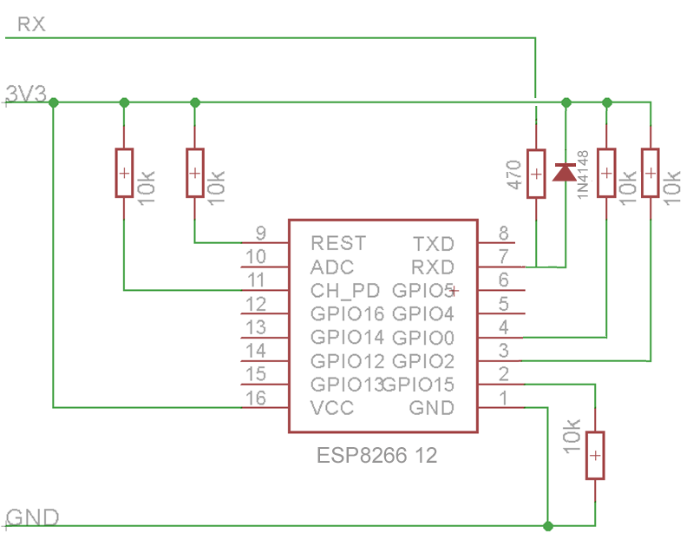
FCB1010
MIDI board connector
5V
to
3.3V
MIDI Out
MIDI In
+5V
Gnd

