Slide 1
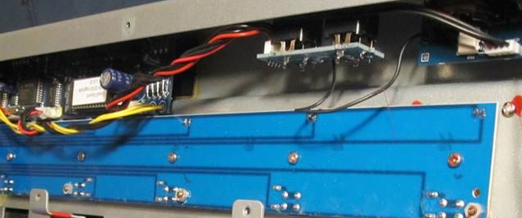
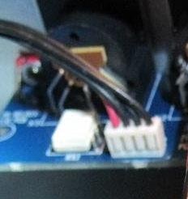
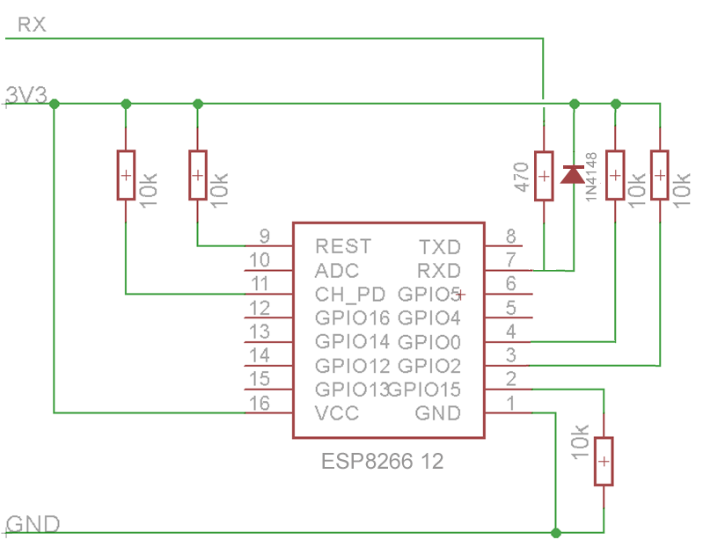
gris
FCB1010
MIDI board connector
5V
to
3.3V
MIDI Out
MIDI In
Blanco
+5V
Negro
Gnd

Slide 2
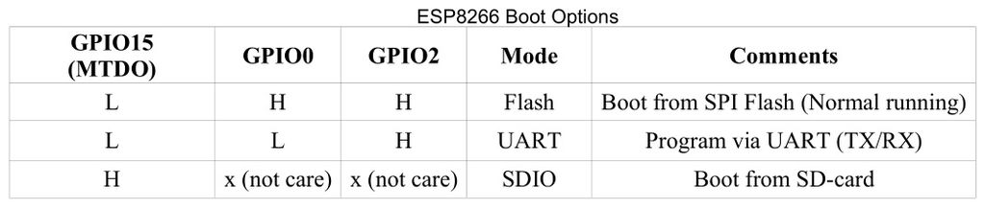
Optocoupler inside FCB1010 (MIDI input)
Vcc
Gnd
/out
H11L1
+ Diode -

