Slide 1
Optoacoplador interno de la
Entrada MIDI del FCB1010
Vcc
Gnd
/out
H11L1
+ Diode -

Slide 2
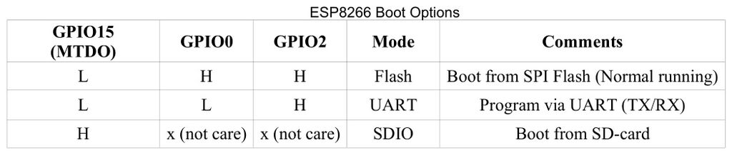
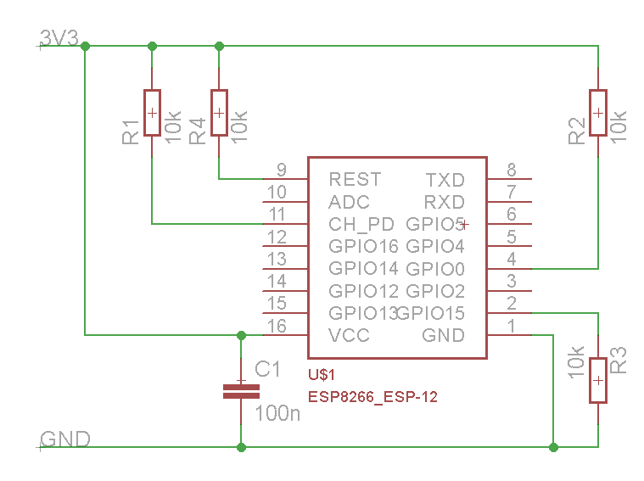
FCB1010
MIDI board connector
MIDI Out
MIDI In
+5V
Gnd
5V to 3.3V

