Slide 1


VTHD project:
IPv6 deployment
ITU-T IP/Optical workshop – Chitose, July 9th 2002
T. Ben Meriem, C. Guillemot, L. Thual, M. Carugi

Slide 2
Presentation Overview
VTHD project
  project objectives, applications
  VTHD network
Introduction of IPv6 in VTHD
  phase 1 deployment
  IPV6 roadmap
The Evolution of VTHD IPV6
  IPV6 in VTHD++

Slide 3
VTHD Project
Project objectives
  To experiment optical internetworking
  To develop new applications and to ensure that they can be put in use in the broader global Internet.
    to assess scalable capacity upgrading techniques
    to assess traffic management tools necessary to operate a QoS capable test-bed
  To deploy and operate a high performance network that provides high capacity interconnection facilities among laboratories at the IP level.
Project framework
  Partially french government funded project (initiative for research on networking technologies) : RNRT (Réseau National de la Recherche en Télécommunications). Partners from the academic world.
  European extensions/connections through IST projects were fostered.
  The VTHD project ended in december 2001. Follow-up VTHD++ project will cover years 2002 and 2003.

Slide 4
Applications
Video-streaming
  Video-on-demand, Scheduled live-transmission, TV broadcasting (FTR&D)
Real time applications
  Tele-education (High Telecommunications Engineering Schools)
  Tele-medecine (G. Pompidou hospital)
  Voice over IP (FTR&D)
  Video-conferencing (FTR&D)
Data applications
  Grid-computing (INRIA)
  3D virtual environment (INRIA)
  Data base recovery, data replication (FTR&D)
  Distributed caching (Eurecom Institute)

Slide 5
VTHD network: description
Links
  2.5 Gbit/s based on WDM network of France Telecom production Network
Core network
  2.5 Gb/s STM16c POS WDM links
Access network
  Aggregation routers using Giga Ethernet access links to VTHD backbone and offering client applications up to 1 Gb/s throughput
Optical cross-connects
  « Intelligent » X-connects : pre- MPLS (proprietary) Control Plane
Caen
Lannion
Rouen
Nancy
Rennes
Paris
Lyon
Grenoble
Sophia

Slide 6
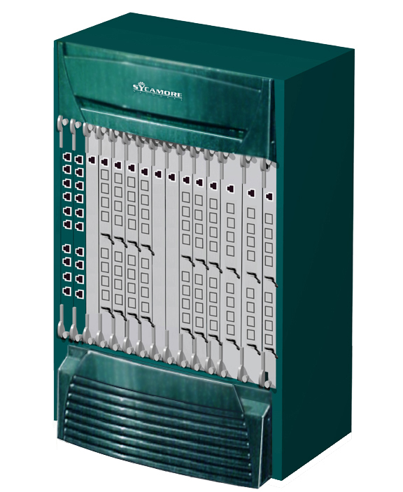
VTHDv4: Routers and Optical X- Connects
& WDM Systems
9 backbone routers
18 aggregation routers
Cisco 12000
Cisco 6509
Avici
TSR
GigaEthernet
Cisco 7200
Sycamore SN16000
X-connect
STM1/OC 3
Juniper M40
Juniper M20
CPE
FT/BD
FTR&D
2.5 Gb/s STM-16 POS
INRIA
CPE
FTR&D
4 channel
STM-16
ring
FTR&D
FTR&D
CPE
ENST
INRIA
INRIA
ENST
INT
HEGP
INRIA
FT/BD
CPE
CPE
FTR&D
EURECOM
INRIA
FTR&D

Slide 7
VTHDv6: phase 1 - Q2-Q4 2001
Solution for a Q2 2001 deployment
  Additional edge routers at the border of the VTHD network:
    with well-known/robust IPv6 implementation : Cisco router
    these IPv6 edge routers must be interconnected through IPv4 VTHD network
  Interconnection solutions:
    IPv6 in IPv4:
      Well-known technique,
      but overhead, performance problem in the context of a high speed network
    IPv6 over MPLS:
      RFC 2547bis technique to build an IPv6 MPLS VPN (6PE) to offer IPv6 connectivity was seen as a good MPLS approach: but not available.
      MPLS VLL alternative (but not optimal) techniques available since april 2000:
        CCC: Circuit Cross Connection (Juniper)
        ATOM: Any Transport Over MPLS (Cisco)

Slide 8

VTHDv6: Deployment
(Phase 1 - Edge routers connections)
Cisco 12000 IPv4 only (LSR/LER MPLS)
Juniper M40 IPv4 only (LER/LSR)
Cisco 6509
Cisco 7200
IPv6
GigaEthernet
Sycamore SN16000
X-connect
STM1/OC 3
Avici TSR IPv4 only (LSR)
Juniper M20 IPv4 only (LER)
FTR&D
Caen
Nancy
Paris Aubervillier
Rouen
2.5 Gb/s STM-16 POS
INRIA
Lannion
FTR&D
4 channel
STM-16
ring
Grenoble
FTR&D
FTR&D
Rennes
Paris Montsouris
ENST
Paris St Amand
Sophia (Nice)
FTR&D
Issy Les Moulineaux
(Paris)
FTR&D

Slide 9
VTHDv6: Deployment
(Phase 1 - MPLS tunnelling)
Cisco 12000 IPv4 only (LSR/LER MPLS)
Juniper M40 IPv4 only (LER/LSR)
Cisco 6509
Cisco 7200
IPv6
GigaEthernet
Sycamore SN16000
X-connect
STM1/OC 3
Avici TSR IPv4 only (LSR)
Juniper M20 IPv4 only (LER)
MPLS tunnel
(VLL Juniper)
MPLS tunnel
(VLL Cisco or IPv6inIPv4)
Paris Aubervillier
Nancy
Rouen
2.5 Gb/s STM-16 POS
INRIA
4 channel
STM-16
ring
Grenoble
Rennes
Paris Montsouris
ENST
Paris St Amand
Sophia (Nice)
FTR&D
MPLS VLL Gateway : An IPv6 router is connected to other IPv6 routers using both tunnelling techniques
Issy Les Moulineaux
(Paris).

Slide 10
VTHDv6 backbone phase 1
6bone
FT R&D
Caen
Opentransit
Paris
Juniper router
JUNOS 5.1. Dual Stack
FT R&D
Lannion
Rouen
STM1
IPv6 Backbone node
Cisco 7200 router
P6R2/
6bone
Paris St Lambert
LORIA
INRIA
Nancy
2 Mbit/s
Rennes
ENST B
Rennes
FT R&D Issy (Paris)
FT R&D
Rennes
IPv6 over MPLS (VLL)
Grenoble
Temporarily IPv6
over IPv4 (then MPLS)
VTHD Backbone
AS 20603
Future (short term)
Sophia-Antipolis
Nice

Slide 11
VTHDv6: IPv6 roadmap
Phase 1:
  Q2-Q4 2001:
  Was only a first step of IPv6 connectivity service (IPv6 edge router / tunnelling interconnection (MPLS or IPv4))
Phase 2:
  Q4 2001-Q2 2002:
  Start of introduction of IPv6 in VTHD backbone: dual stack approach on some gigarouters: toward an IPv6 capacity of 800 Mbit/s.
  Tunnelling:
    Efficient IPv6inIPv4 tunnelling (to bypass non IPv6 gigarouter)
    Study of IPv6 over MPLS without overheads (Cisco 6PE, …)
Phase 3: VTHD++ (follow-up of VTHD)
  Q2 2002-…:
  availability of IPv6 links (dual stack) up to 2,5 Gigabit/s
  IPv6 over MPLS (6PE, …)

Slide 12
VTHDv6 phase 3 (Q2 2002-…)
6bone
Backbone node: Juniper
router
Backnone node: Cisco
router with 6PE
IPv6 over MPLS : 6PE
IPv6 over MPLS : 6PE
Native IPv6 (dual stack)
OC48c
Rouen
Opentransit (FT)
Paris Bagnolet
155 Mbit/s
Nancy
ENST B
Rennes
Rennes
Paris
Montsouris
Paris
St Lambert
2 Mbit/s
Grenoble
P6R2/6bone
VTHD Backbone
AS 20603
Sophia-Antipolis
Nice

Slide 13
VTHDv6 recap
Phase 1 to 3 are focusing only on IPv6 connectivity service (with high speed aspects)
Future work will treat other aspects:
  IPv6 services should be (almost) equal to IPv4 services
    Multicast, VPN, CoS,…
  Or more IPv6 specific services:
    Transition services, DNSsec,…
Before the end of VTHD++ (December 2003): VTHD IPv6 network topology should be the same as IPv4 network (dual stack for all the nodes).

Slide 14
VTHD++ IPv6 WG: objectives / partners
VTHD++: follow-up of VTHD (2002-2003) agreed by RNRT
  Working-Group 3: IPv6 trials
  Objectives:
    getting an experiment of sharing an infrastructure (VTHD) for IPv4/IPv6 networks
    offer new services to (with) our partners (particulary involved in IPv6 developments: research, standardization)
    run new IPv6 applications (which require bandwidth) on a nation-wide IPv6 network
    getting an experiment of a high-speed (beyond 155 Mbit/s) IPv6 network
    deploying a RNRT platform useful for future mobile service trials
  Partnership of this WG: ENST, ENST-Bretagne, INRIA, FT R&D (leader of WG) and the new partner IMAG (Mathematical high engineering school in Grenoble)

Slide 15
VTHD++ IPv6 WG: organization (1/2)
WG3 Task 1: services and network engineering
  Task 1.1: IPv6 backbone aspects : deployment using MPLS technology, using dual-stack approach, multihoming
  Task 1.2: IPv6 services aspects
    DNS: Dynamic updates, DNSsec
    IPv6 VPN
    IPv6 Web, mail hosting
    Transition services
WG3 Task 2: performances
  Evaluation of end to end performances for the IPv6 network engineering approaches (based on MPLS, classical tunnelling, dual-stack)
  Evaluation of transition services performances

Slide 16
VTHD++ IPv6 WG: organization (2/2)
WG3 Task 3 : IPv6 network management
  Task 3.1 (FT) : using operational (manufacturer) tools (MIB equipments, management platform…). Integration in existing VTHD Back-Office.
  Task 3.2 (LORIA/INRIA) : development by the partner of specific tools (monitoring application, …)
WG4 Task 4 :
  Tests over a nation wide IPv6 network of IPv6 metacomputing applications requiring high bandwidth, low delays

