Slide 1
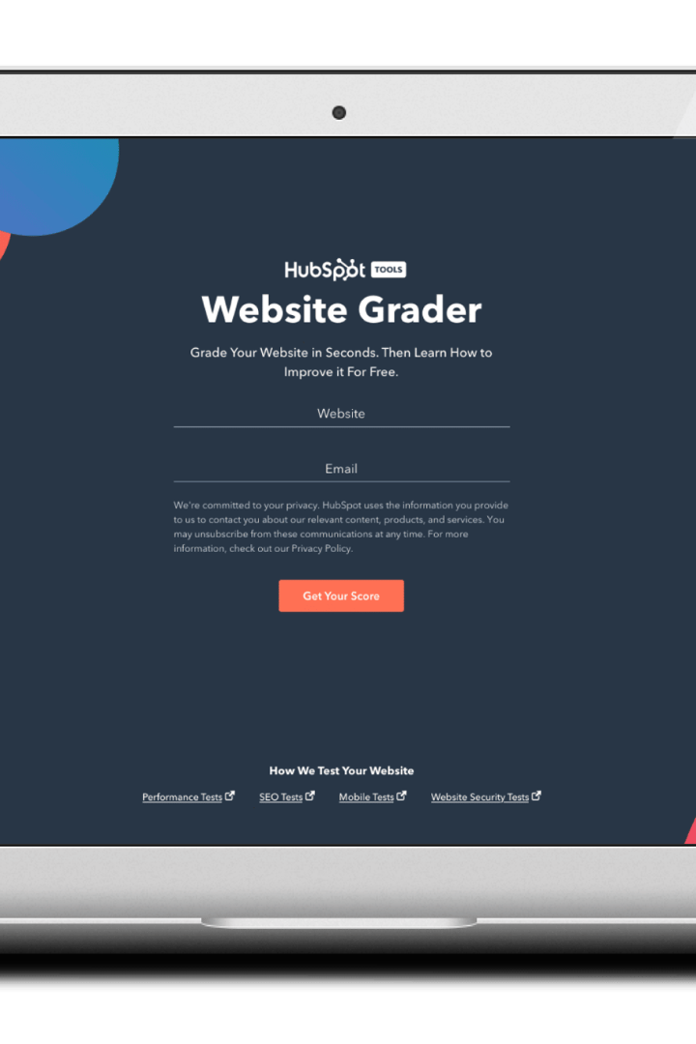

Website Builder
Creating a website has never been easier! Our team of experts builds beautiful websites for businesses and individuals at an incredibly low cost. Let us know what you need, and we'll handle the rest!

Slide 2
Create Your Own Online Presence
Take your business to the next level by creating a unique online presence with our website builder. We've got everything you need to create a stunning website, from beautiful templates to advanced customization options. Let's get started today!
Easy to Use
Fast & Reliable
Customizable Designs
Our website builder is user-friendly and perfect for beginners. Choose from our templates and customize your site with ease.
Our website builder is fast and reliable, ensuring that your website is always online and running smoothly.
Choose from hundreds of themes and customize your website according to your unique style and needs. Make it truly yours!

Slide 3
Our Services
We offer a variety of services to help you create a successful website that meets your needs. Check out some of our popular services below:
Website Design
Website Development
Choose from a wide range of website designs and templates to create a unique website for your business.
Need something more advanced? We can help you develop custom features and functionality to meet all your website needs.
Search Engine Optimization
Social Media Integration
Get your website noticed! We'll help optimize your site's search engine ranking for maximum visibility and success.
Connect your website to your social media profiles and increase your reach and engagement with the world.

Slide 4

Choose Your Plan
Our website builder offers tiered plans based on your specific needs. Choose the one that's right for you and start building your website today!
Basic
Pro
Premium
Perfect for individuals or small businesses who want to create a simple website. Easy to use and affordable.
For businesses that need more features and functionality. Recommended for those with more advanced website needs.
Our most comprehensive plan, perfect for larger businesses or those with complex website needs. Includes all the features and support you need to succeed.
3 Pages
10 Pages
10 Images
50 Images
Basic Support
Premium Support
Unlimited Pages
Unlimited Images
Premium Support

Slide 5
Why Choose Us?
There are many website builders out there, but we're confident that our service is the best in the business. Here's why:
1
Affordable Pricing
2
Reliable Service
Our pricing is some of the most competitive in the industry. Get started today at a price you can afford.
We pride ourselves on providing reliable service that you can count on. Your website will always be online and accessible.
3
User-Friendly
4
Customizable Designs
Our website builder is designed with you in mind. It's easy to use and perfect for beginners.
Choose from hundreds of themes and customize your website according to your unique style and needs. Make it truly yours!

Slide 6
Frequently Asked Questions
Got questions? We've got answers! Check out some of our most frequently asked questions below:
What's Included in Your Website Builder?
We offer a wide range of features and tools to help you create a unique and beautiful website. From templates to customization options, we've got everything you need to get started.
Can I Change My Website's Template?
Yes! With our website builder, you can change your website's template at any time. Choose the one that's right for you.
Do You Offer Website Hosting?
Yes! We offer website hosting as part of our service. Your website will always be online and accessible.
How Do I Get Started?
Simply sign up for a free trial and start building your website today! If you need any help, our support team is always available to assist you.

Slide 7

Get Started Today
Ready to take the plunge and create a stunning website? Sign up for our free trial and start building today!

