Slide 1
COVID-19 Responses and Tourism
Alex Lopes
Johnson and Wales University
DATA 5700: Capstone
Professor Olatunde Kamson

Slide 2
Introduction
COVID-19 is the most recent pandemic to impact the world starting in early 2020 as a global pandemic.
Tourism was though as a resilient industry used to
help foster relationships and build capacity for economic development (Holzner, 2011)
impacting global tourism more than
September 11 attacks,
2003 SARS outbreak,
2009 global recession and the
2015 MERS outbreak (Gössling et al., 2020)
Some types of responses include
school closings,
travel restrictions,
bans on public gatherings,
emergency investments in healthcare facilities,
new forms of social welfare provision, and contact tracing (Hale et al., 2020).

Slide 3
Objective
With this pandemic shutting down international tourism in an effort to contain the spread. Did those countries/economies more reliant on tourism have stronger responses to the COVID-19 pandemic.
Calculating and defining the tourism levels, dependency, and COVID-19 responses among different countries

Slide 4
The Data
Multiple datasets from World Bank data sources.
geographic information
Containment measure responses of each country
economic indicators of countries

Slide 5
Methods
Correlation – Reduce Multicollinearity
Principal Component Analysis (PCA) – Dimension Reduction
Latent Dirichlet Allocation (LDA) – Defining Tourism Responses
Interquartile Range (IQR) – Define Variable Levels
XG Boost – Prediction and feature importance
United States and European Union as individual entries.
Notes:
With this pandemic shutting down international tourism in an effort to contain the spread. Did those countries/economies more reliant on tourism have stronger responses to the COVID-19 pandemic. We use a combination of Principal component analysis and a latent dirichlet allocation to define our measures as well as predict the responses of various countries using and XG Boost algorithm. We were able to determine that those with a greater dependence on tourism had strong responses to the COVID-19 pandemic.

Slide 6
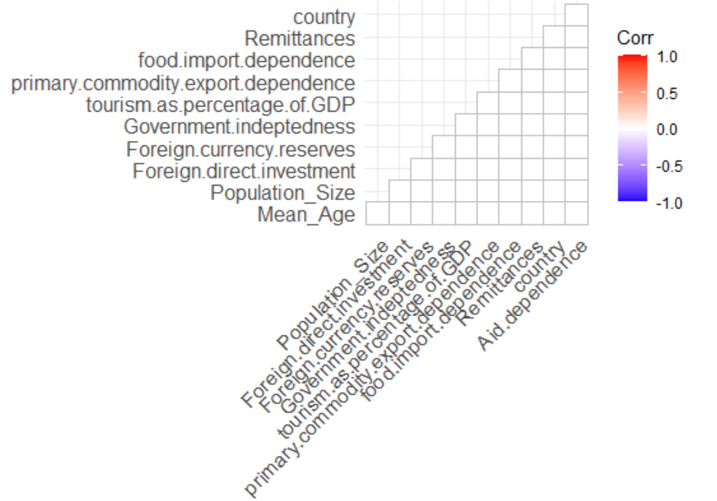
Correlation Plot
Full independent variables
Do not repeat the same story

Slide 7
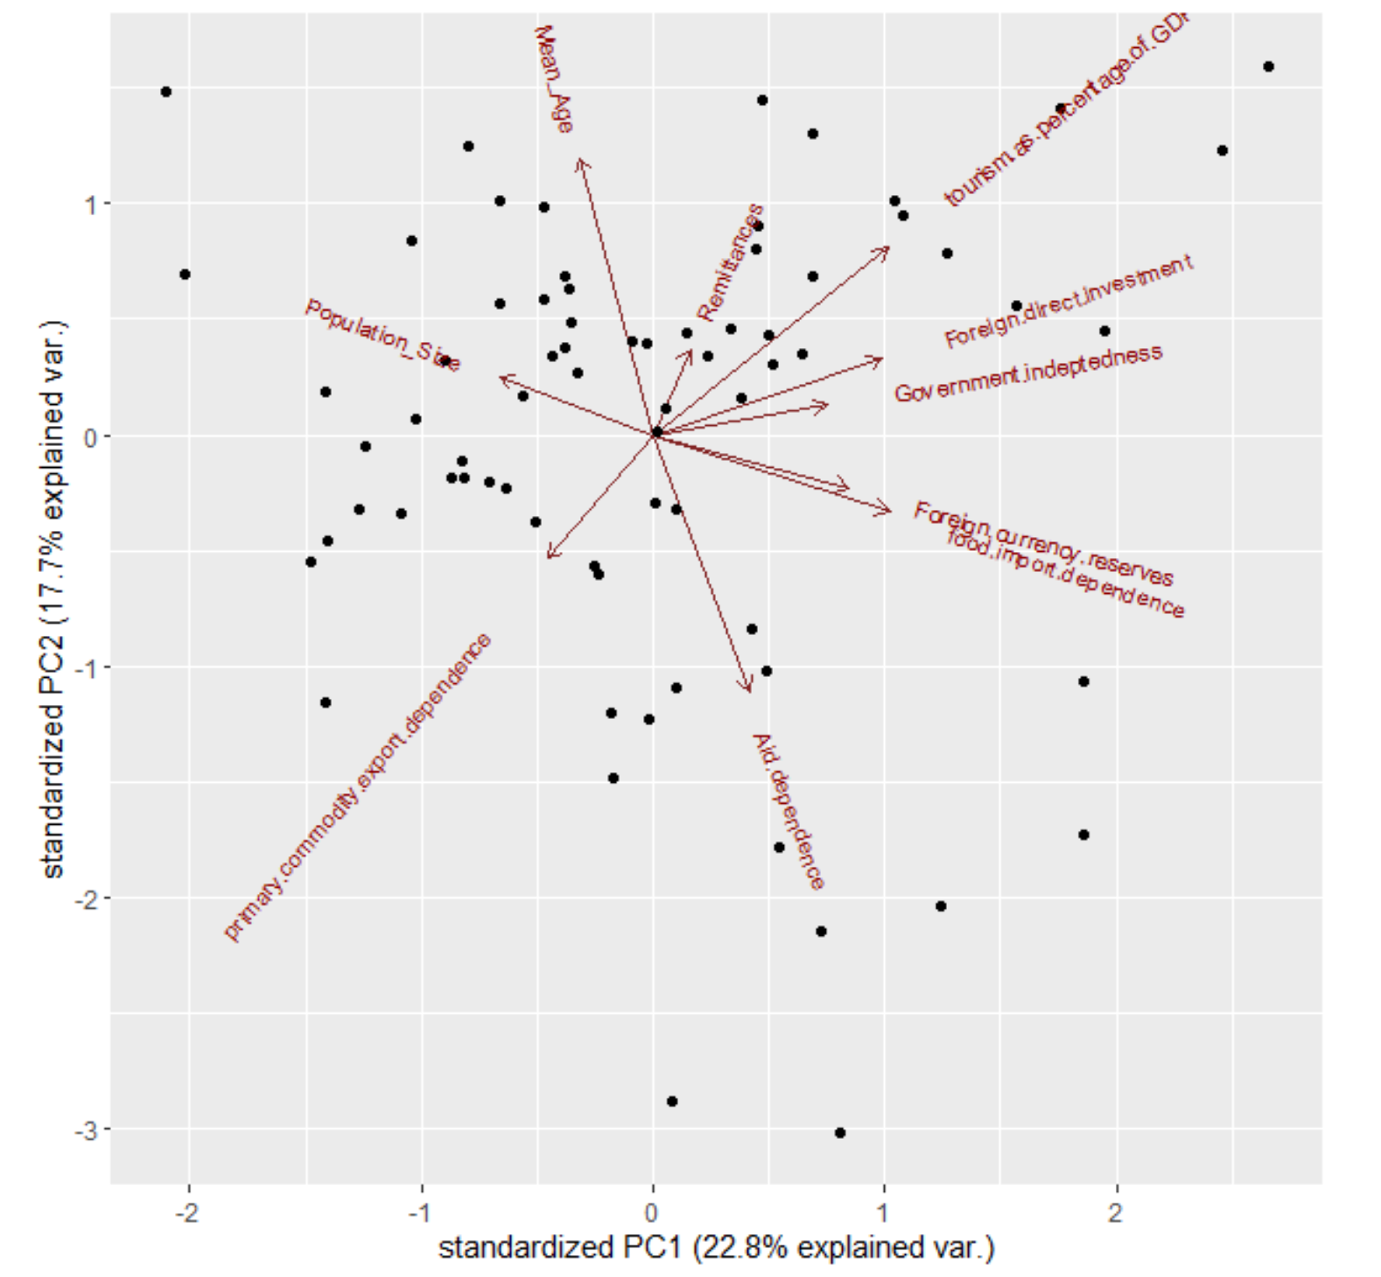
PCA
Most explanatory variables
Mean Age
Tourism as percentage of GDP
Aid Dependence
Food import dependence
Foreign Direct Investment

Slide 8
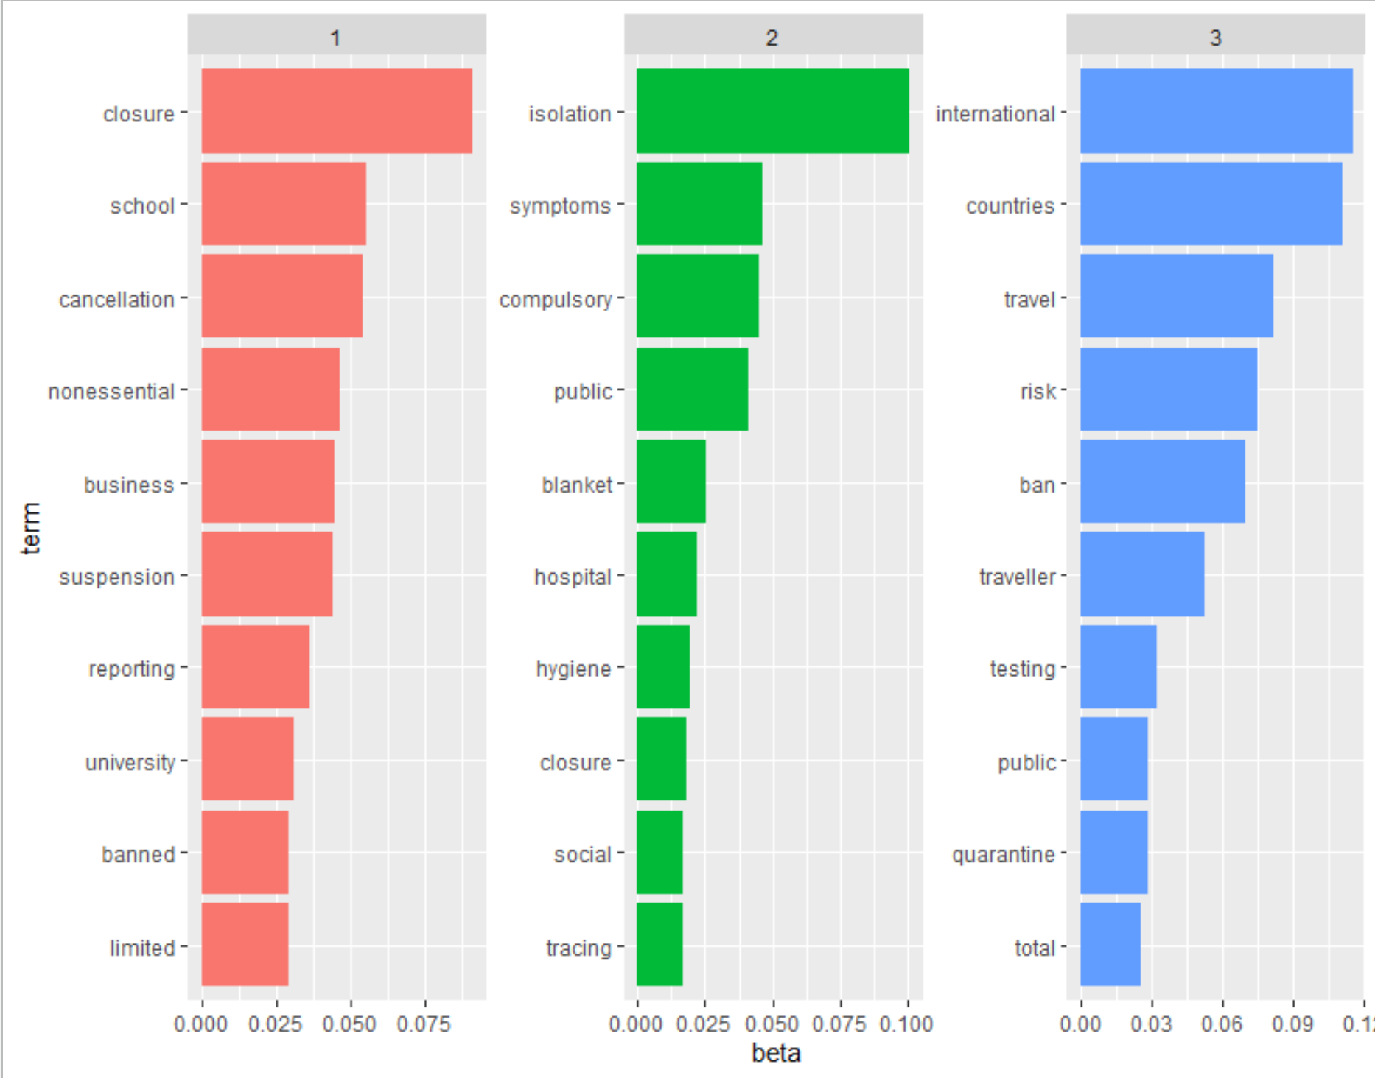
LDA – Top Terms per group
Variables that define our groups
groups seem to be about case:
Social Response
Public Health Response
Travel Response

Slide 9
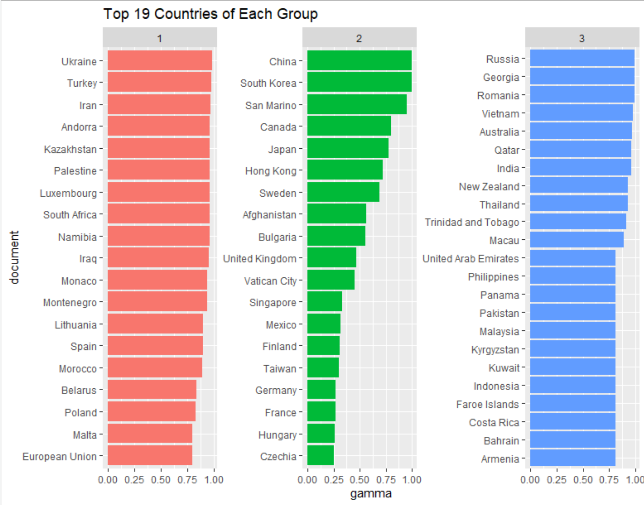
Top 19 in each group

Slide 10
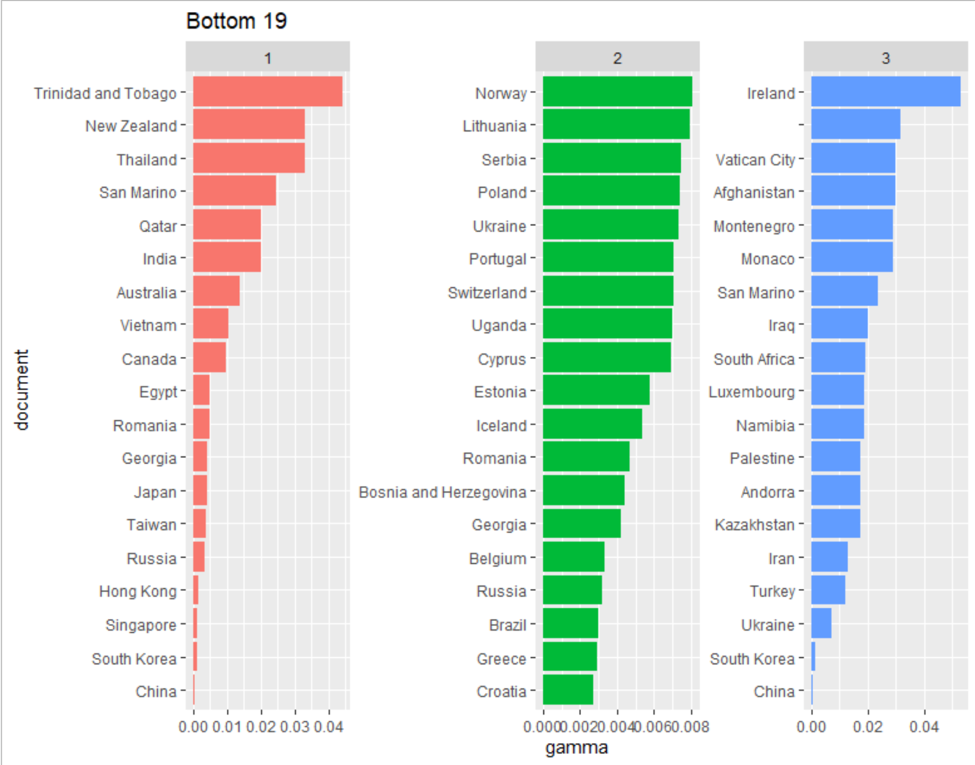
Bottom in each group

Slide 11
Bottom vs Top

Slide 12
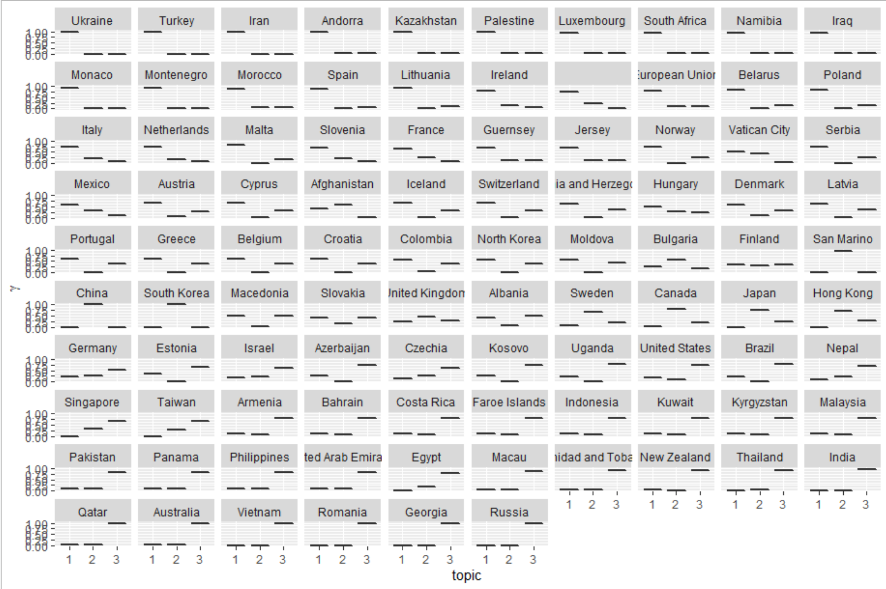
Response Distribution Observations

Slide 13
IQR Definitions
Variables defined by 1st and 3rd Quantile Ranges
Tourism Dependence
Population Size
Tourism
Variables set as HIGH, Normal, Low

Slide 14
Final Dataset
191 observations by 17 variables
PCA Variables
LDA Groups
based on Strong/Weak for each group
Overall Strong or Weak response
True if Strong in any LDA category

Slide 15
Exploratory Data Analysis
Strong and Weak Responses
Strong 2 Response countries weaker in other groups
Taiwan,
Hong Kong
South Korea
Singapore
Japan
Canada
SARS/MERS outbreak countries

Slide 16
Strong Responses
70.83%, of strong responses have either High tourism OR tourism dependence strong
58.33%, strong responses have high tourism
46.42%, high tourism did not have a strong response
18.75%, High Tourism dependence did a Strong Response
24.47%, High Tourism dependence did not have a strong response

Slide 17
Strong tourism sector and strong responses
Qualified by High Tourism and Tourism Dependence
Each strong in different groups
Only weak response was Thailand with Social Response
Mexico - Public Health
Morocco – Social Response
Thailand - International response

Slide 18
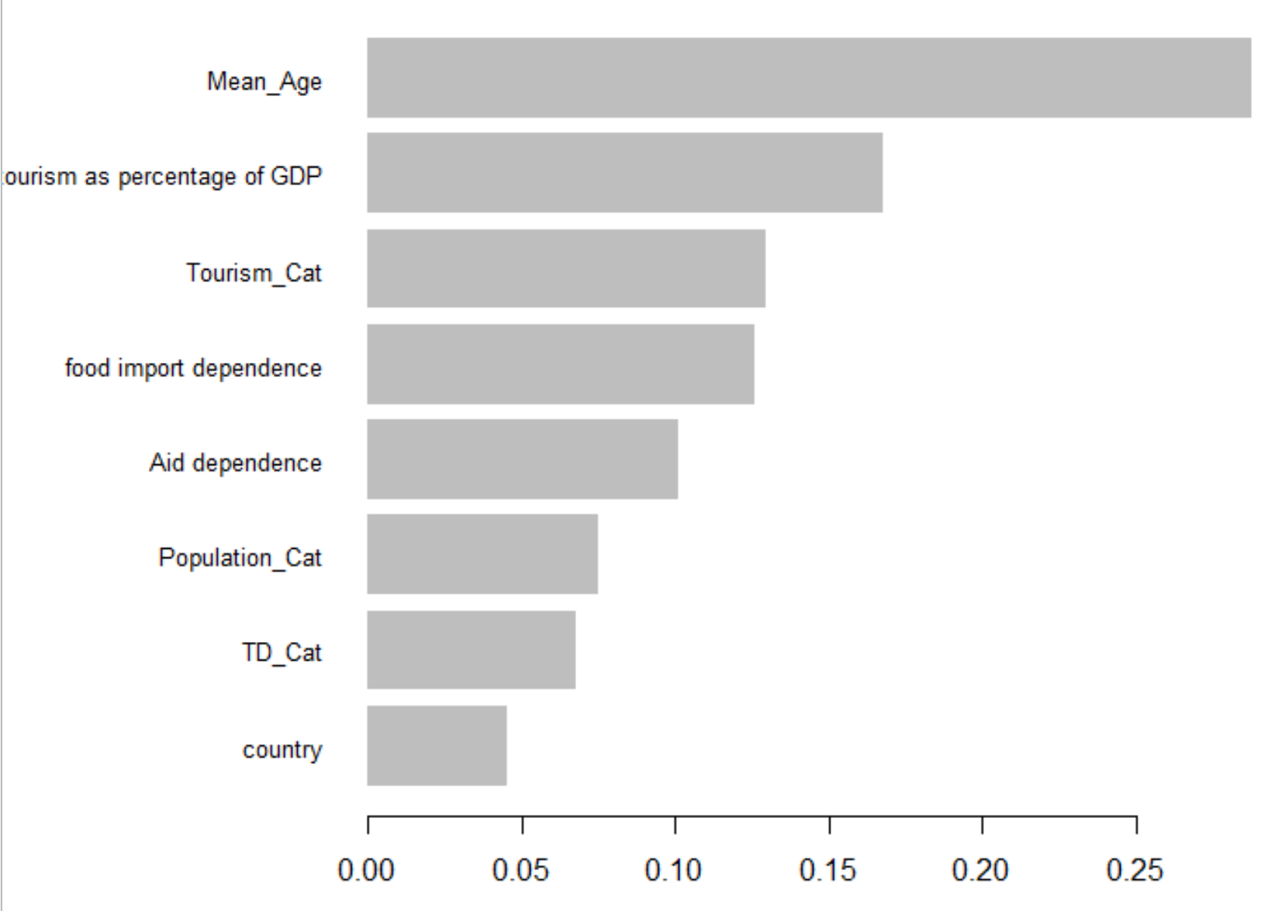
Strong Public Health – XG Boost
Error Rate:
.0626565

Slide 19
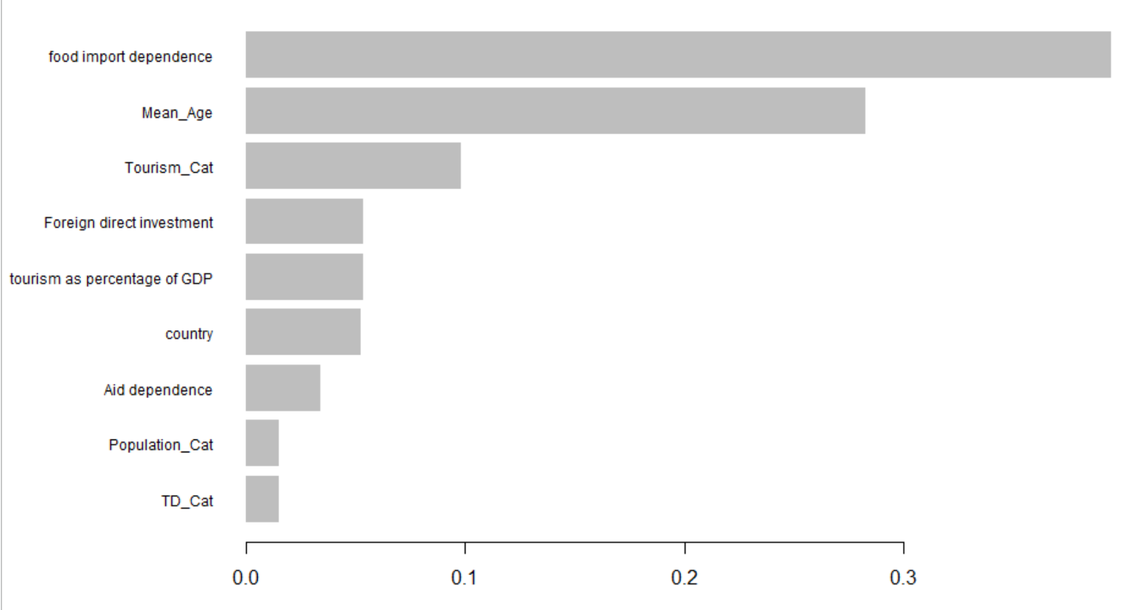
Strong Travel Response – XG Boost
Error Rate:
0.004534654

Slide 20
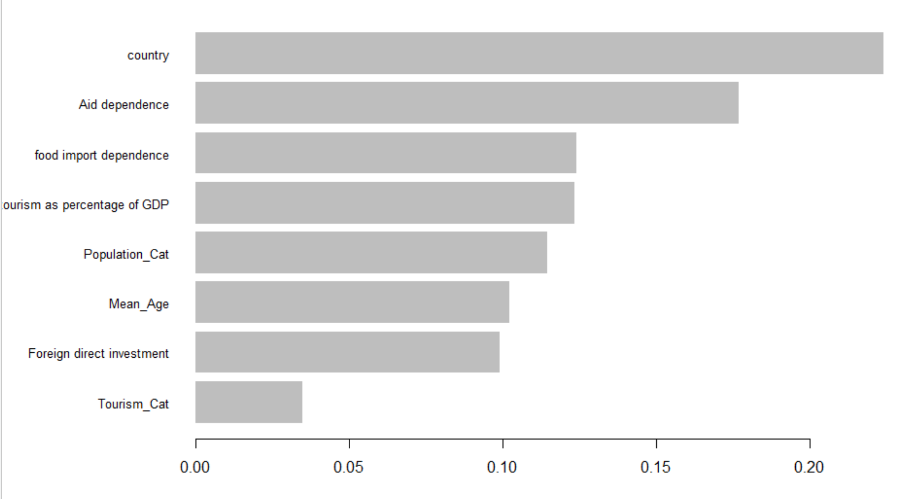
Strong Social Response – XG Boost
Error Rate:
.1379

Slide 21
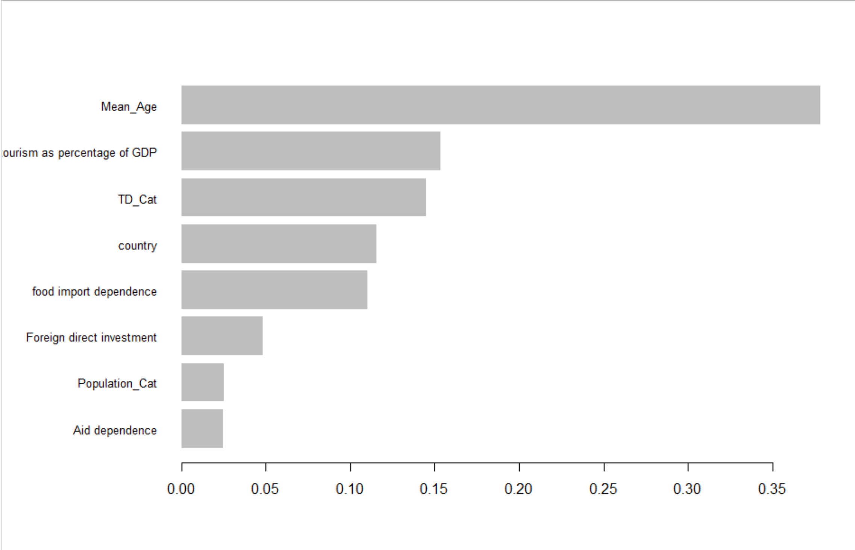
Weak Public Health – XG Boost
Differences after the top 4 when compared to Strong Public Health
Error Rate:
0.034

Slide 22
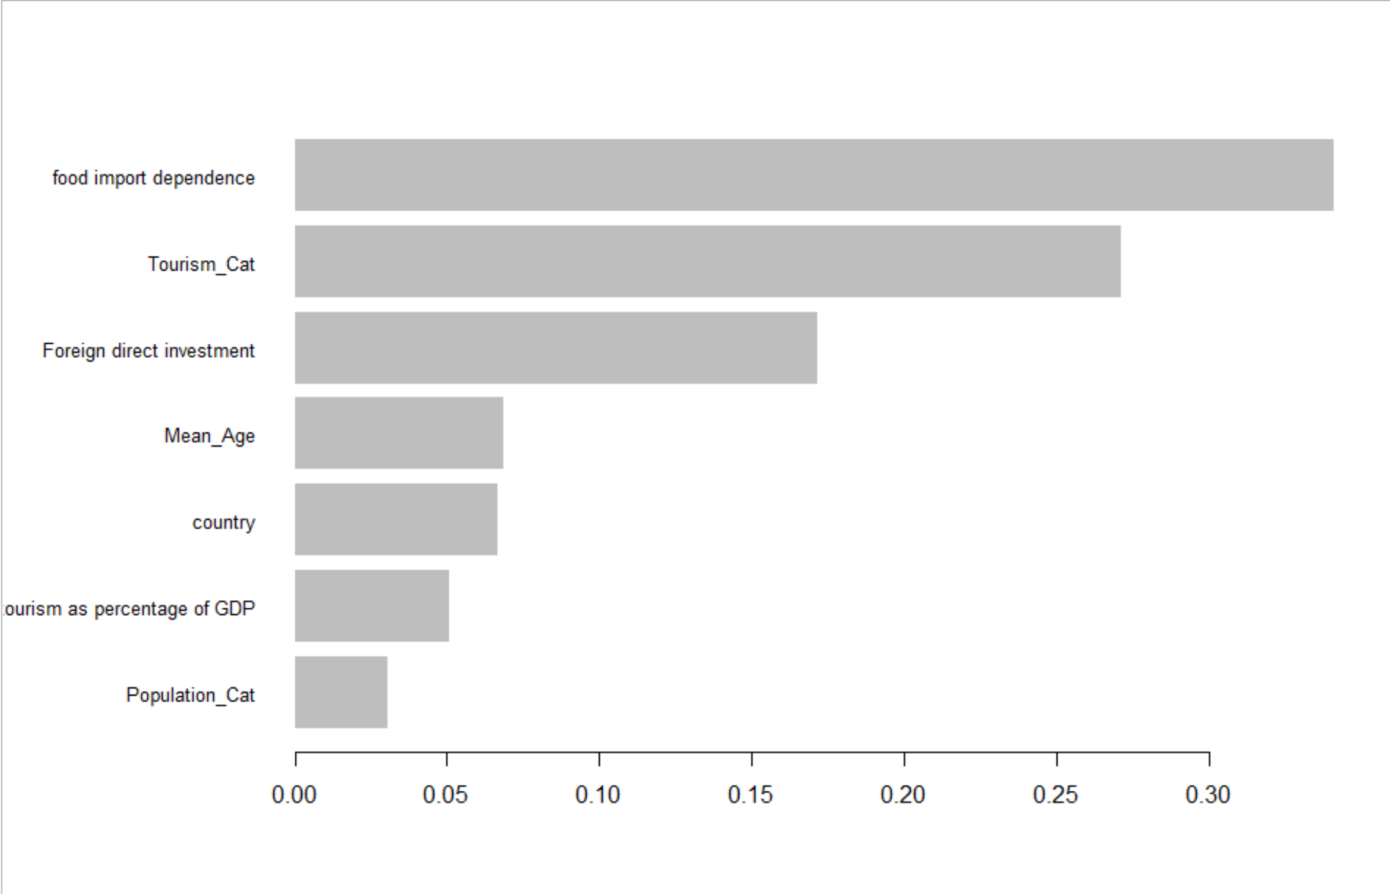
Strong Response
Error Rate:
0.2413

Slide 23
Weak Response
Same as Strong Response
Error Rate:
0.1378

Slide 24
Post XG Boost Evaluation

Slide 25
Limitations and further research
COVID-19 landscape and available data constantly changing.
data available was before vaccine rollouts
United States as one entry
New York and California can be included
EU as one entry as well
Choice of variables from PCA analysis
such as primary commodity export dependence.
Use of outliers for analysis

Slide 26
Discussions
Those with High tourism and/or High Tourism dependent had stronger responses to COVID-19
Previous exposure to outbreaks, SARS, MERS, SWINE
Food import Independence
“…there is much evidence that food production patterns are responsible for repeated outbreaks of the corona virus, including SARS, MERS and COVID-19 (Pongsiri et al., 2009; Labonte et al., 2011)…” (Gössling et al., 2020).

Slide 27
References
An, B. Y., & Tang, S.-Y. (2020). Lessons From COVID-19 Responses in East Asia: Institutional Infrastructure and Enduring Policy Instruments. The American Review of Public Administration, 50(6-7), 790–800. https://doi.org/10.1177/0275074020943707
Bojanic, D. C., & Lo, M. (2016). A comparison of the moderating effect of tourism reliance on the economic development for islands and other countries. Tourism Management, 53, 207–214. https://doi.org/10.1016/j.tourman.2015.10.006
Farzanegan, M. R., Gholipour, H. F., Feizi, M., Nunkoo, R., & Andargoli, A. E. (2020). International Tourism and Outbreak of Coronavirus (COVID-19): A Cross-Country Analysis. Journal of Travel Research, 004728752093159. https://doi.org/10.1177/0047287520931593
Gössling, S., Scott, D., & Hall, C. M. (2020). Pandemics, tourism and global change: a rapid assessment of COVID-19. Journal of Sustainable Tourism, 29(1), 1–20. https://doi.org/10.1080/09669582.2020.1758708
Greer, S. L., King, E. J., da Fonseca, E. M., & Peralta-Santos, A. (2020). The comparative politics of COVID-19: The need to understand government responses. Global Public Health, 15(9), 1–4. https://doi.org/10.1080/17441692.2020.1783340
Hale, T., Angrist, N., Cameron-Blake, E., Hallas, L., Kira, B., Majumdar, S., Petherick, A., Phillips, T., Tatlow, H., & Webster, S. (2020). Variation in government responses to COVID-19 BSG Working Paper Series Providing access to the latest policy-relevant research. https://www.bsg.ox.ac.uk/sites/default/files/2020-09/BSG-WP-2020-032-v7.0.pdf
Holzner, M. (2011). Tourism and economic development: The beach disease? Tourism Management, 32(4), 922–933. https://doi.org/10.1016/j.tourman.2010.08.007
Jenkins, C. L. (2015). Tourism policy and planning for developing countries: some critical issues. Tourism Recreation Research, 40(2), 144–156. h ttps://doi.org/10.1080/02508281.2015.1045363
Seyfi, S., Hall, C. M., & Shabani, B. (2020). COVID-19 and international travel restrictions: the geopolitics of health and tourism. Tourism Geographies, 1–17. https://doi.org/10.1080/14616688.2020.1833972
Tateno, Y., & Bolesta, A. (2020, May 1). Addressing the impact of the pandemic on tourism in Asia-Pacific small island developing States. Ideas.repec.org. https://ideas.repec.org/p/unt/pbmpdd/pb111.html
Watson, P., & Deller, S. (2021). Tourism and economic resilience. Tourism Economics, 135481662199094. https://doi.org/10.1177/1354816621990943

