Slide 1
Book3.2
File created on: 6/17/2021 4:31:25 PM

Slide 2
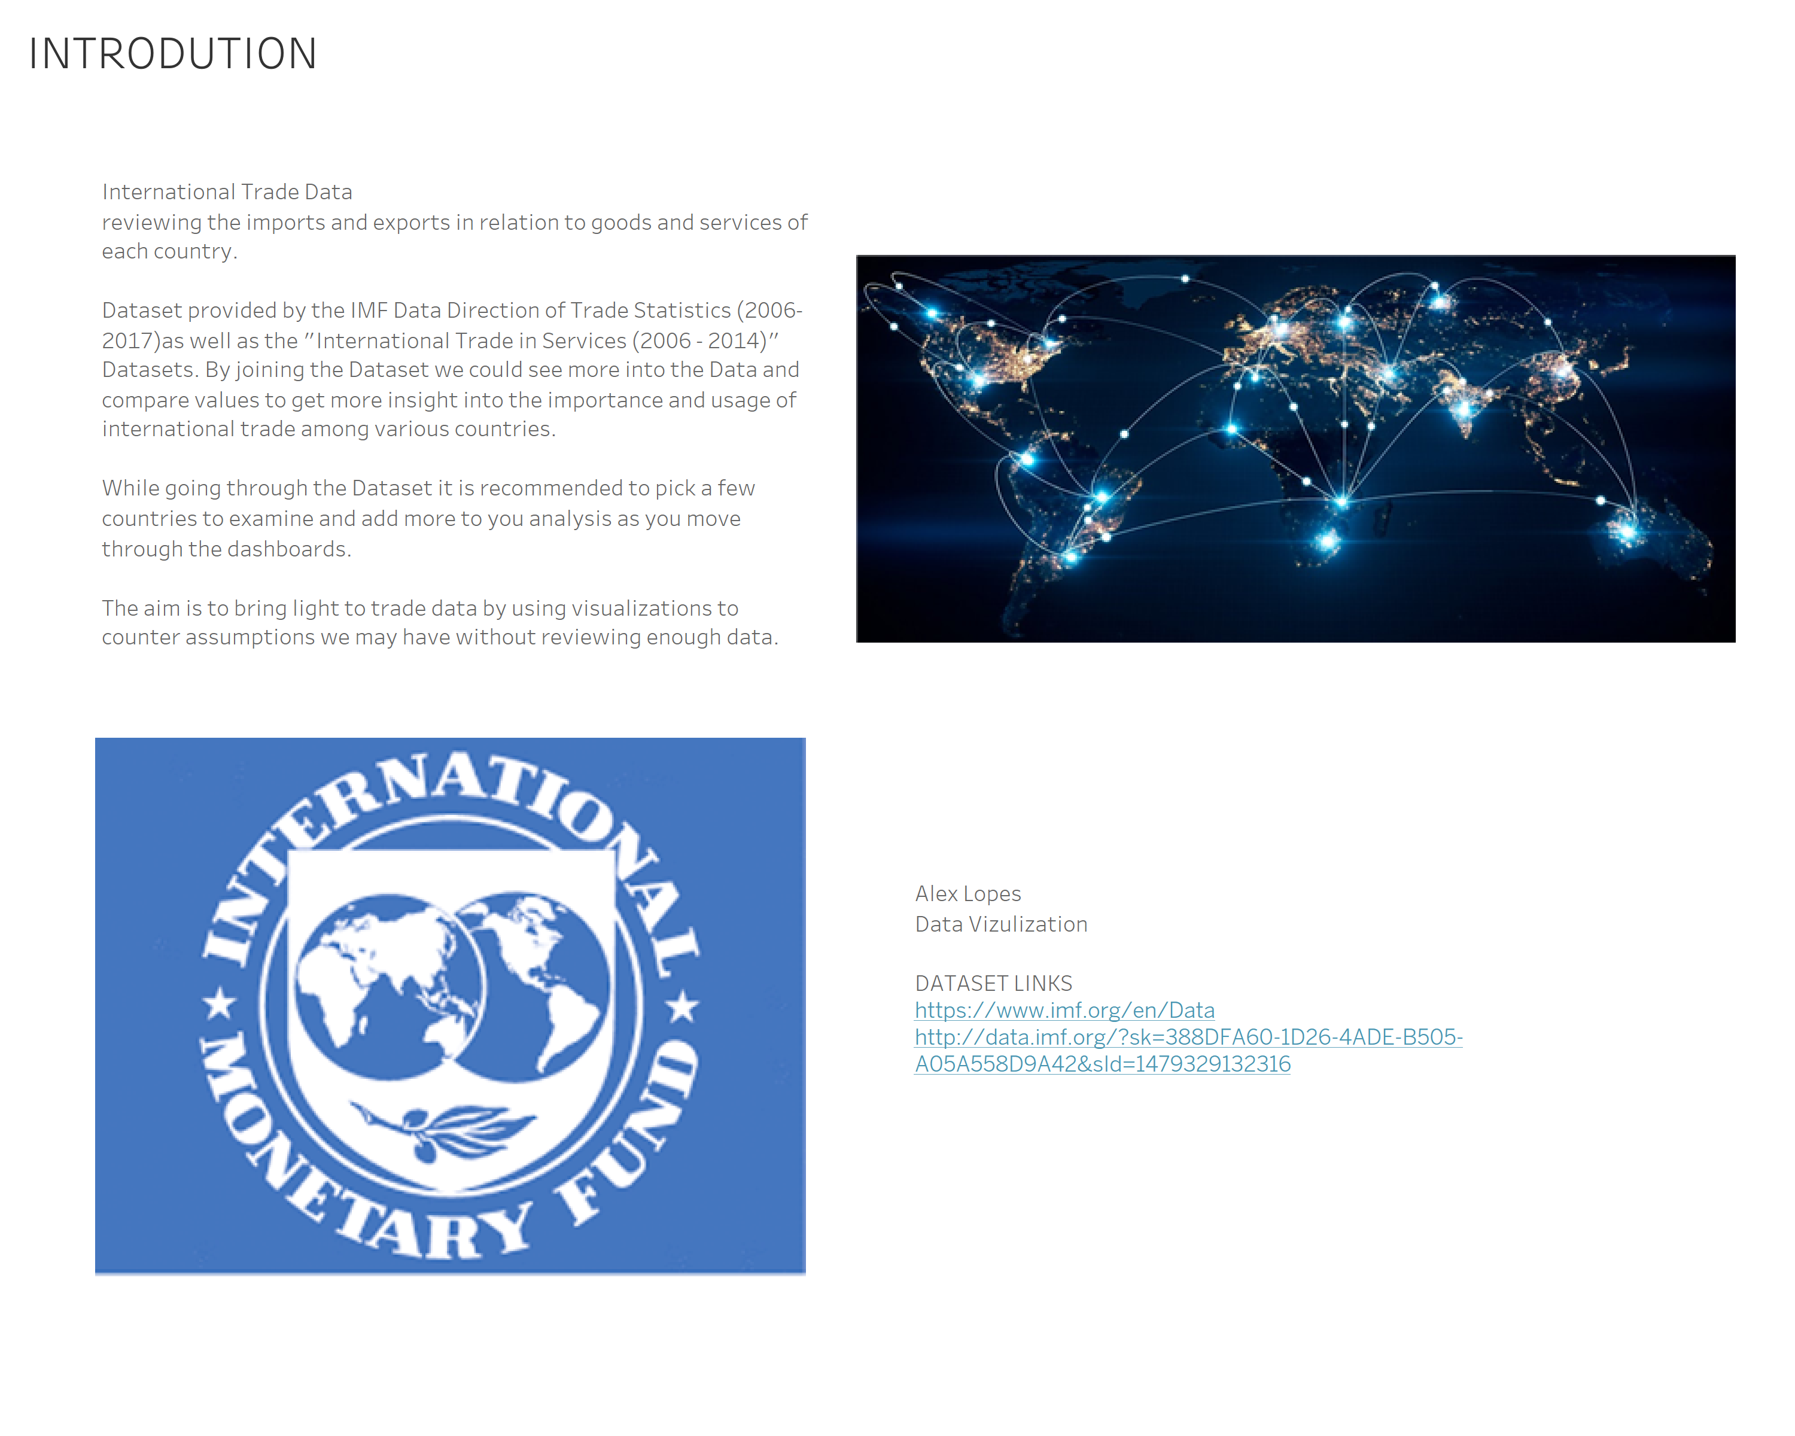

Slide 3
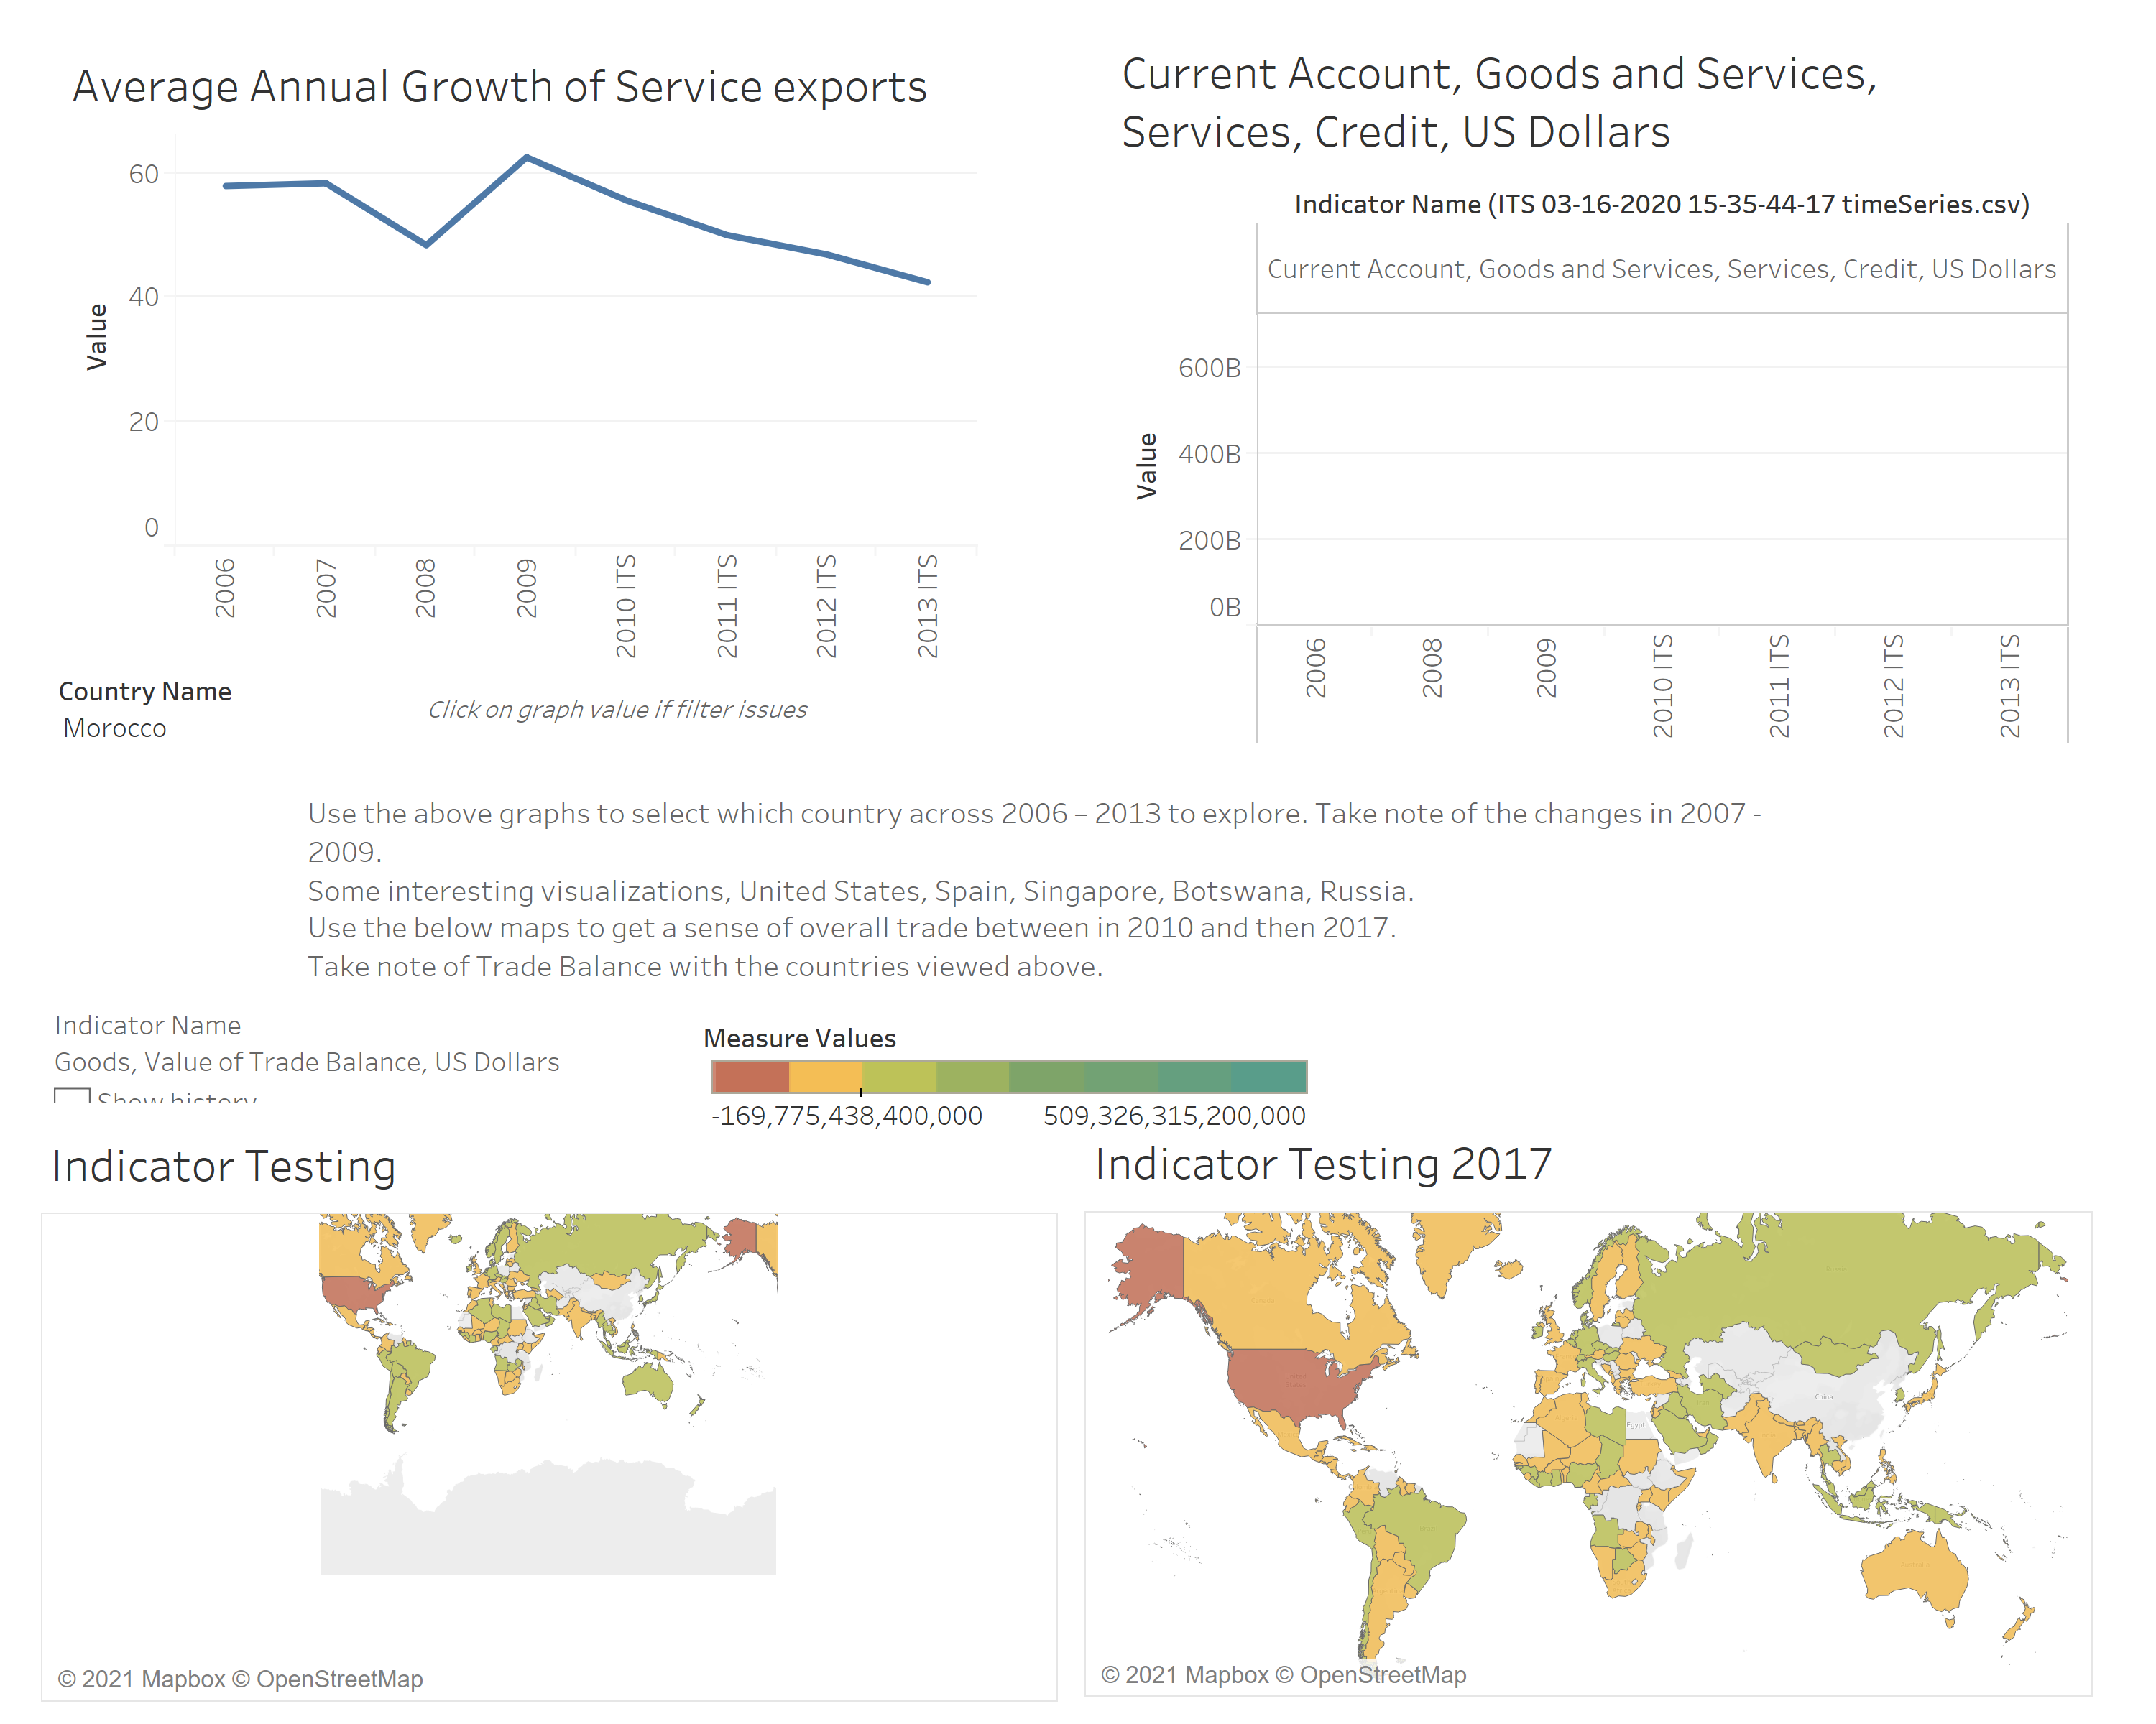

Slide 4
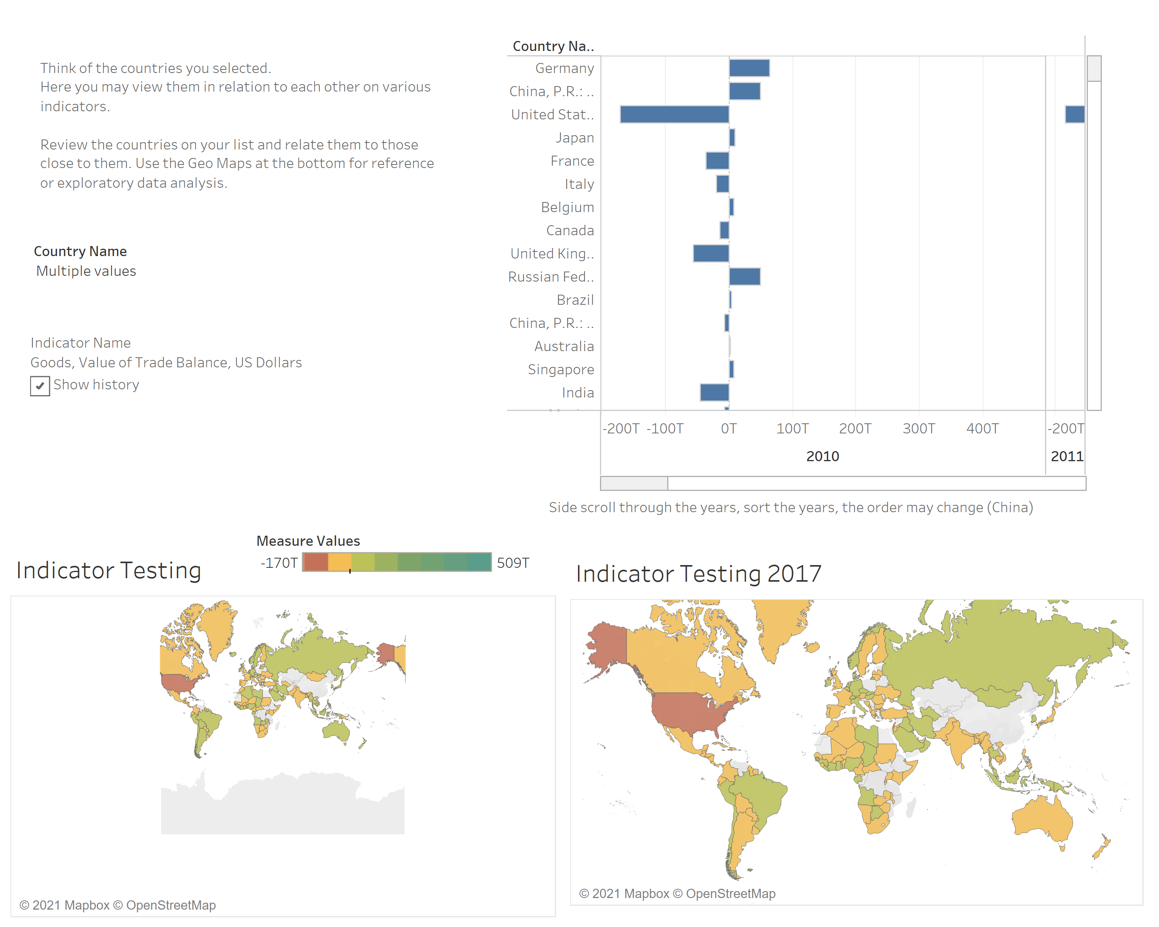

Slide 5
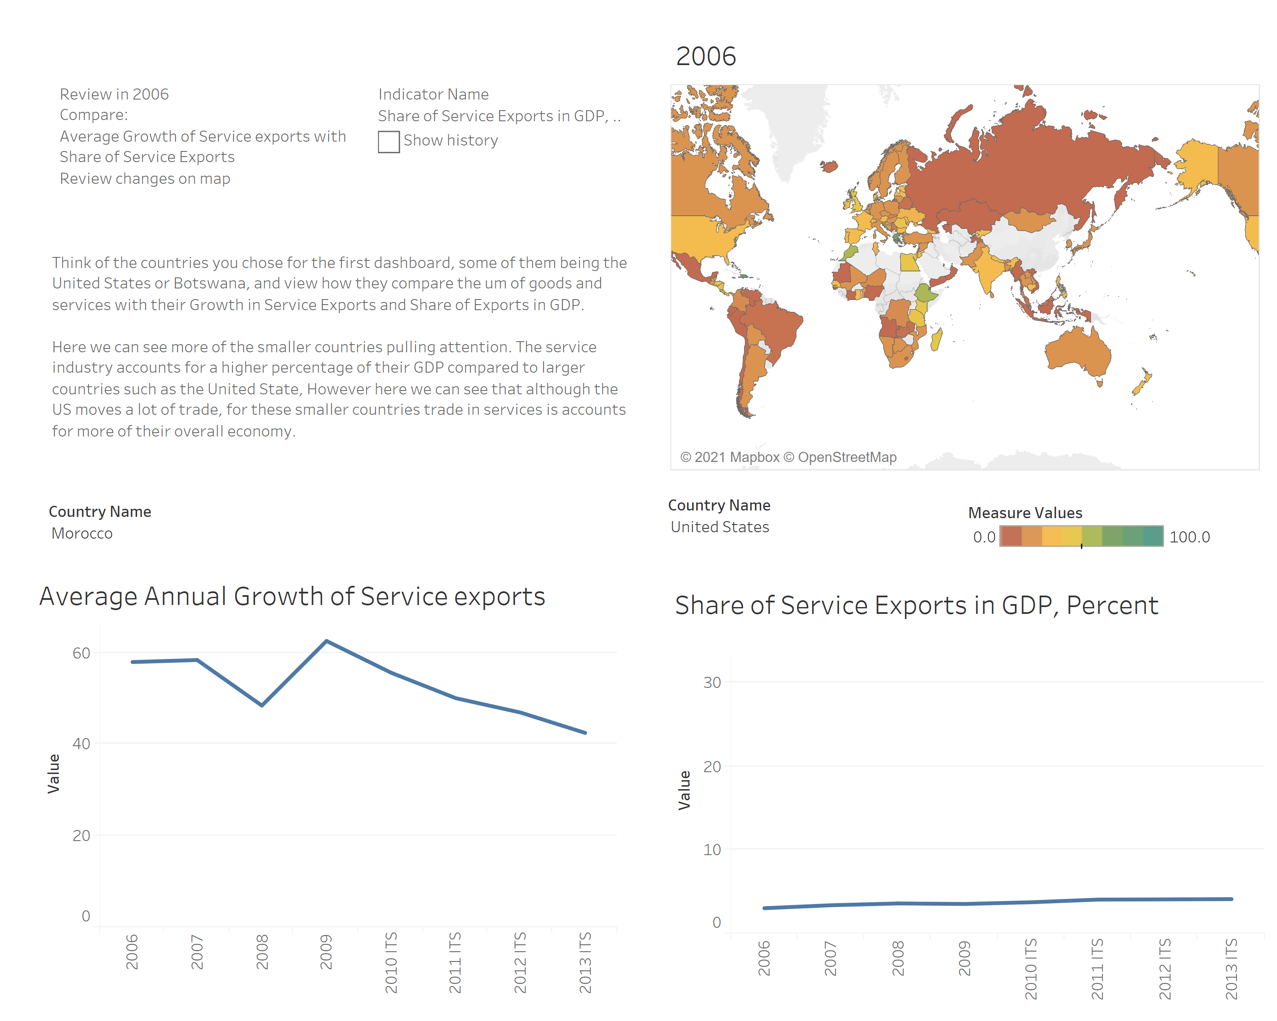

Slide 6
