Slide 1
Coffee Countries
Alex Lopes

Slide 2
Objective
Using the domestic consumption dataset to determine if a country was a coffee belt country or not.
Using other datasets to predict if a country belongs to the Coffee belt of not.

Slide 3
The Data
International Coffee Organization (ICO)
years 1998 – 2018 as variables
The four datasets
domestic consumption by all exporting countries,
imports by selected importing countries,
exports of all forms of coffee by all exporting countries,
total production by all exporting countries.

Slide 4
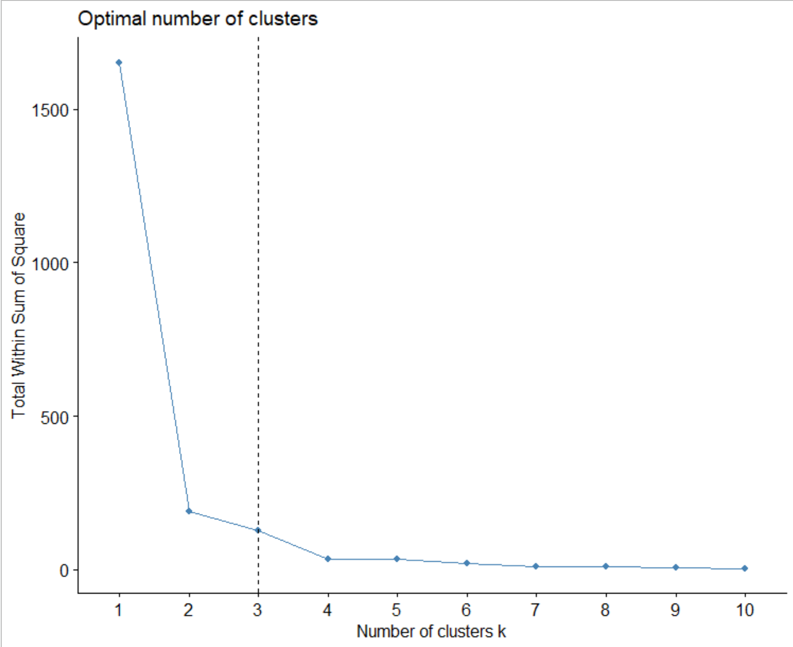
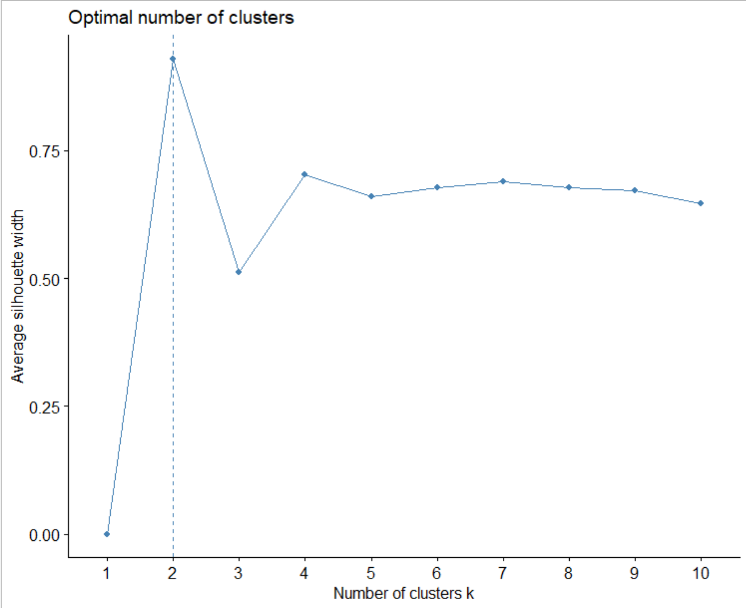
Elbow and Silhouette Plots

Slide 5
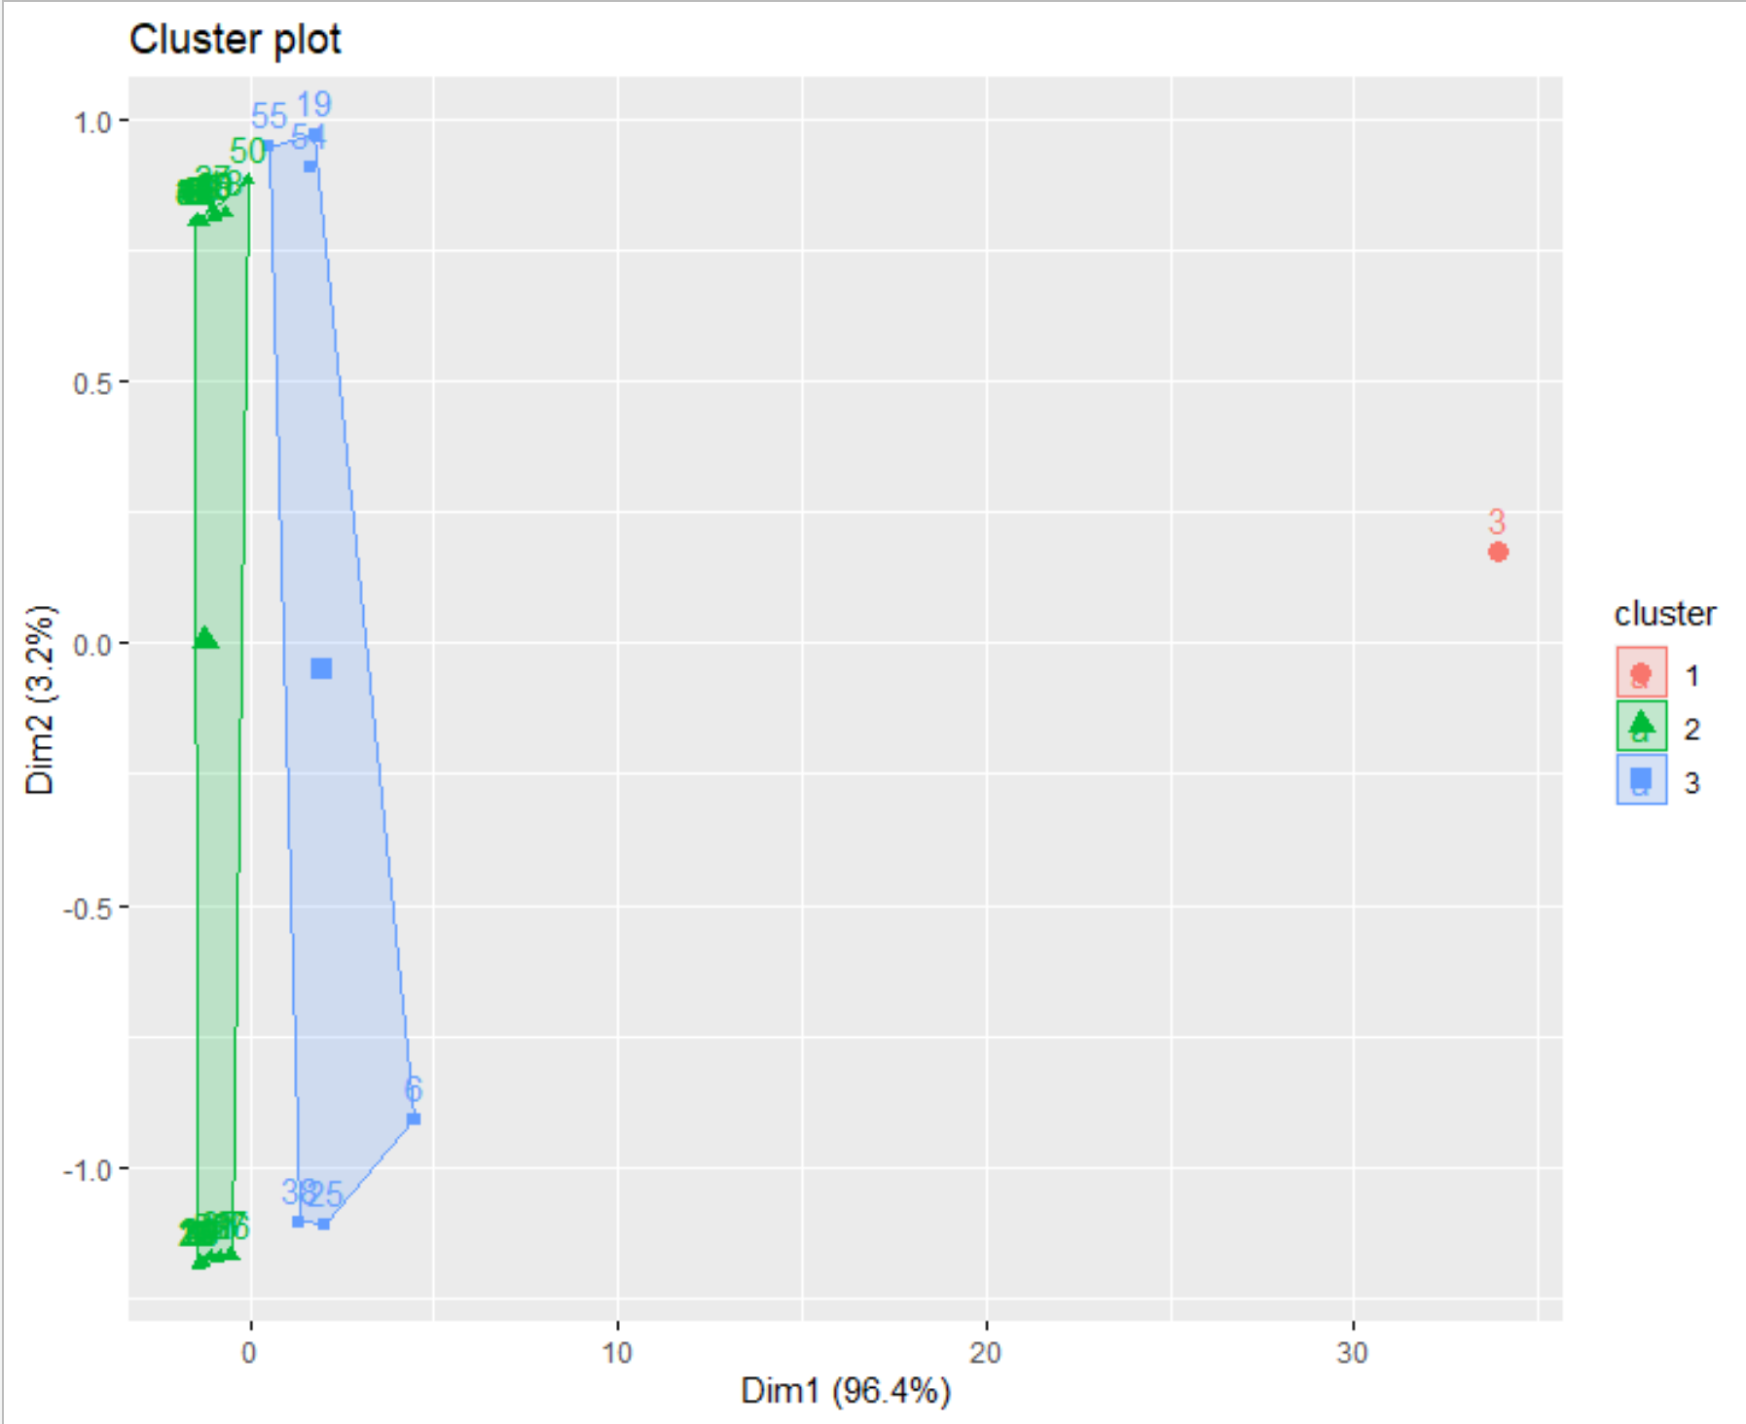
K-Means Clusters

Slide 6
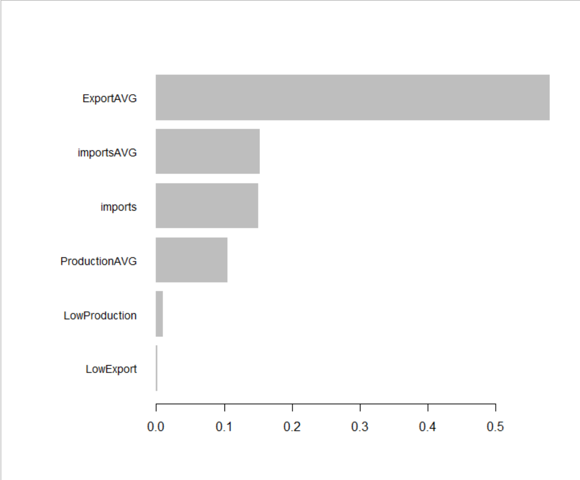
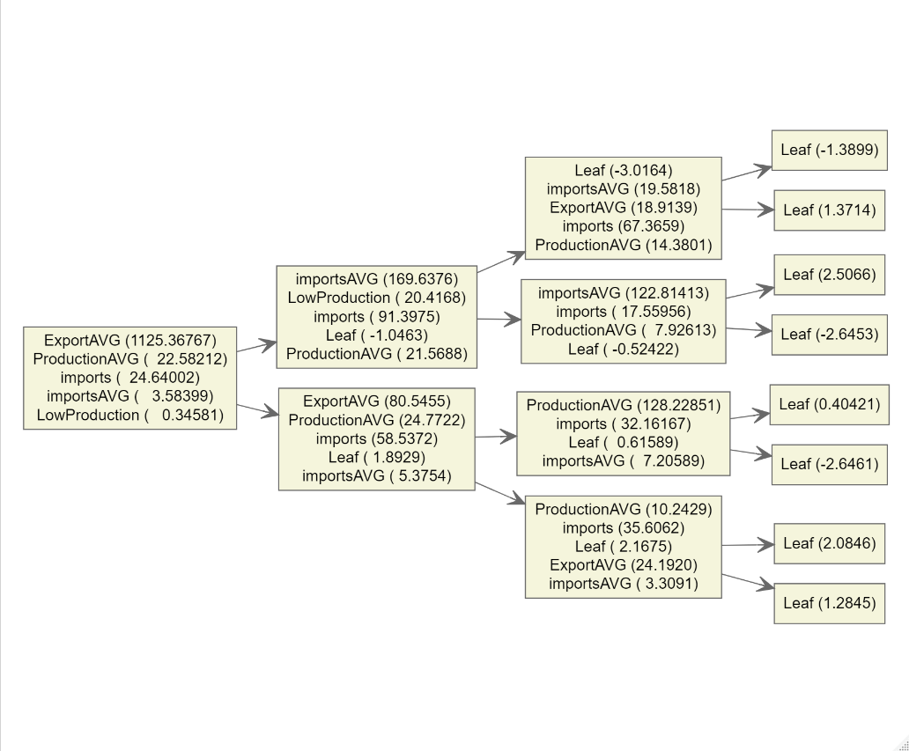
XG Boost Trees & Variable Importance

