Slide 1
Wildfires
By Alex Lopes

Slide 2
Ideas & Concepts
Economic Impacts
Economic losses attributed to wildfires in 2018 alone are almost equal to the collective losses from wildfires incurred over the past decade…” (Fawzy et al., 2020).
Environmental Degradation
“wildfire threatens surface drinking water sources with eroded contaminants” (Gannon et al., 2020).
“two [of the] largest contemporary wildfires, and two most destructive wildfires all occurred during 2017 and 2018” (Goss et al., 2020).

Slide 3
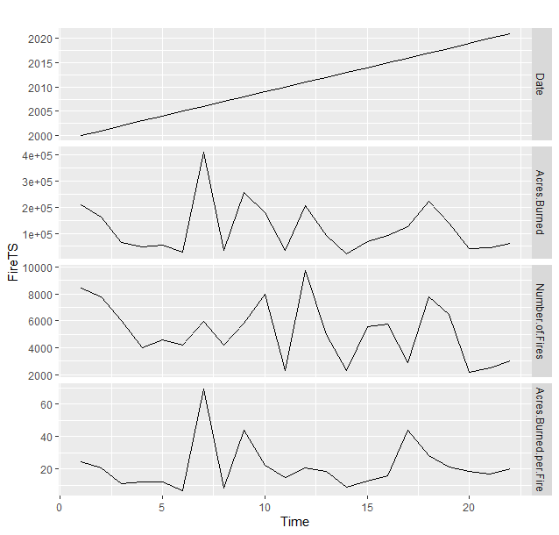
The Data
National Centers for Environmental Information (NCEI)
Number of Fires
Acres Burned
Acres Burned per fire
Years Observed
2000 - 2021

Slide 4
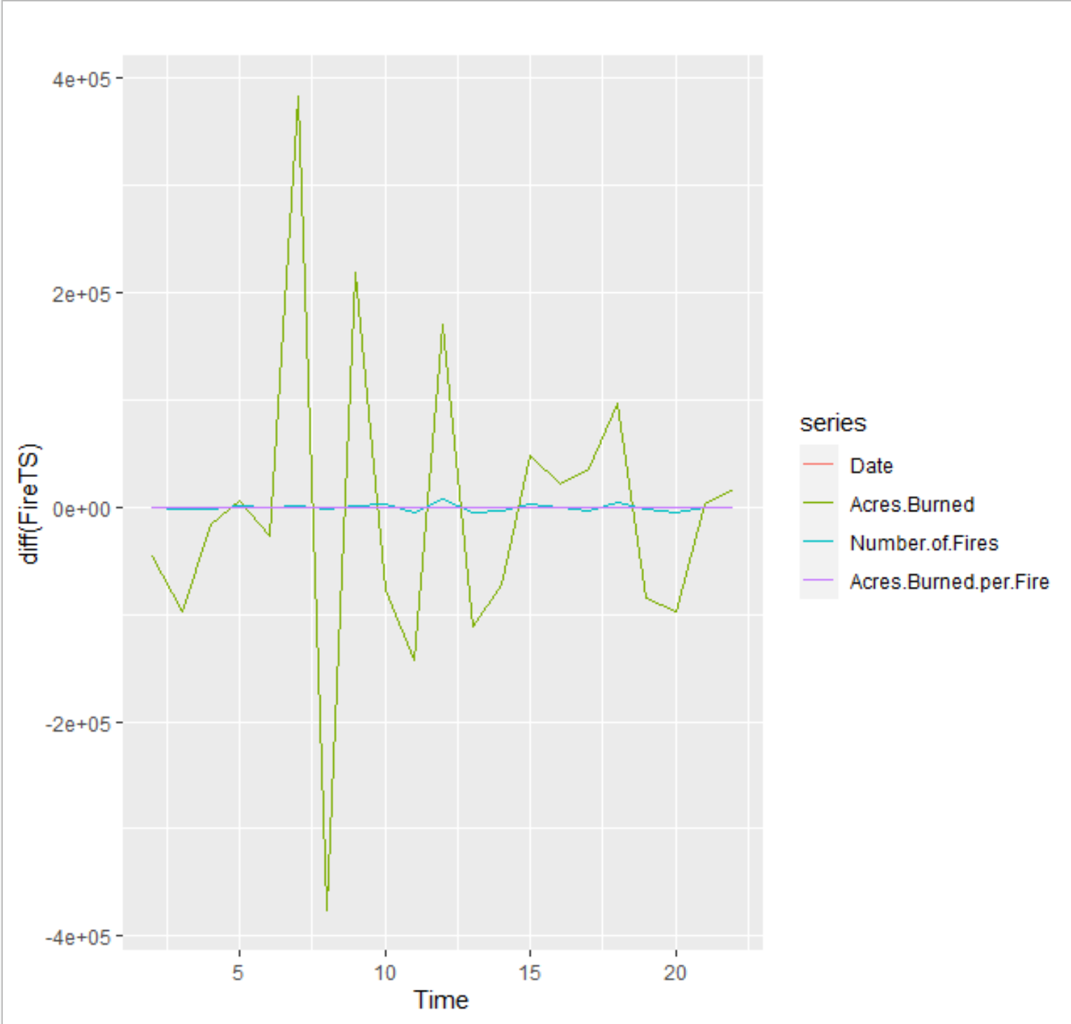
Results
Variance explained
Acres Burned
Correlation
Acres Burned: Number of fires
Auto Regressive Integrated Moving Average (ARIMA)

Slide 5
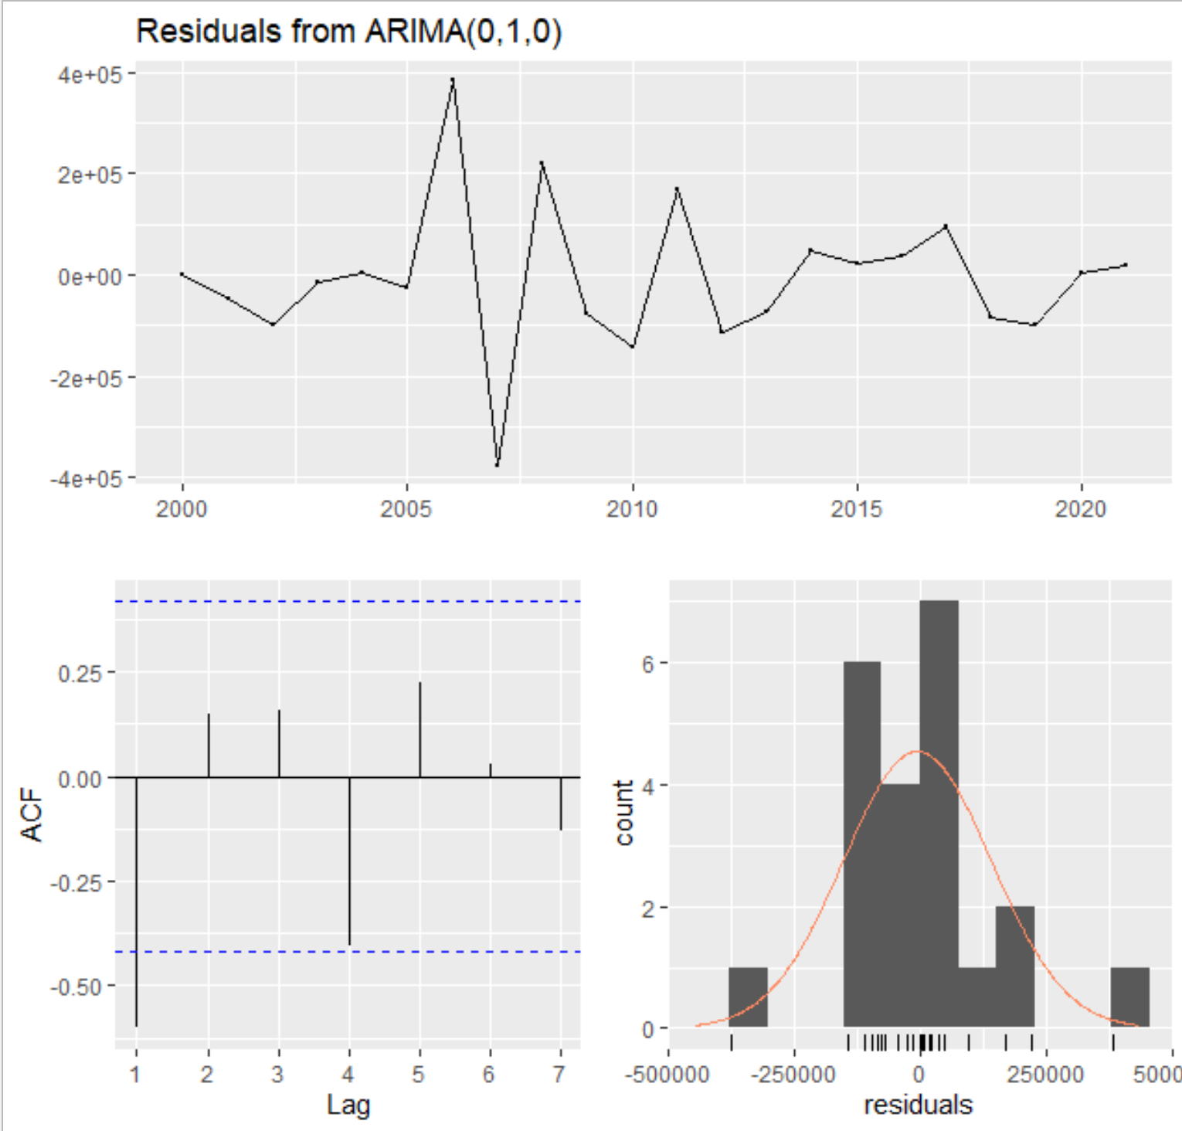
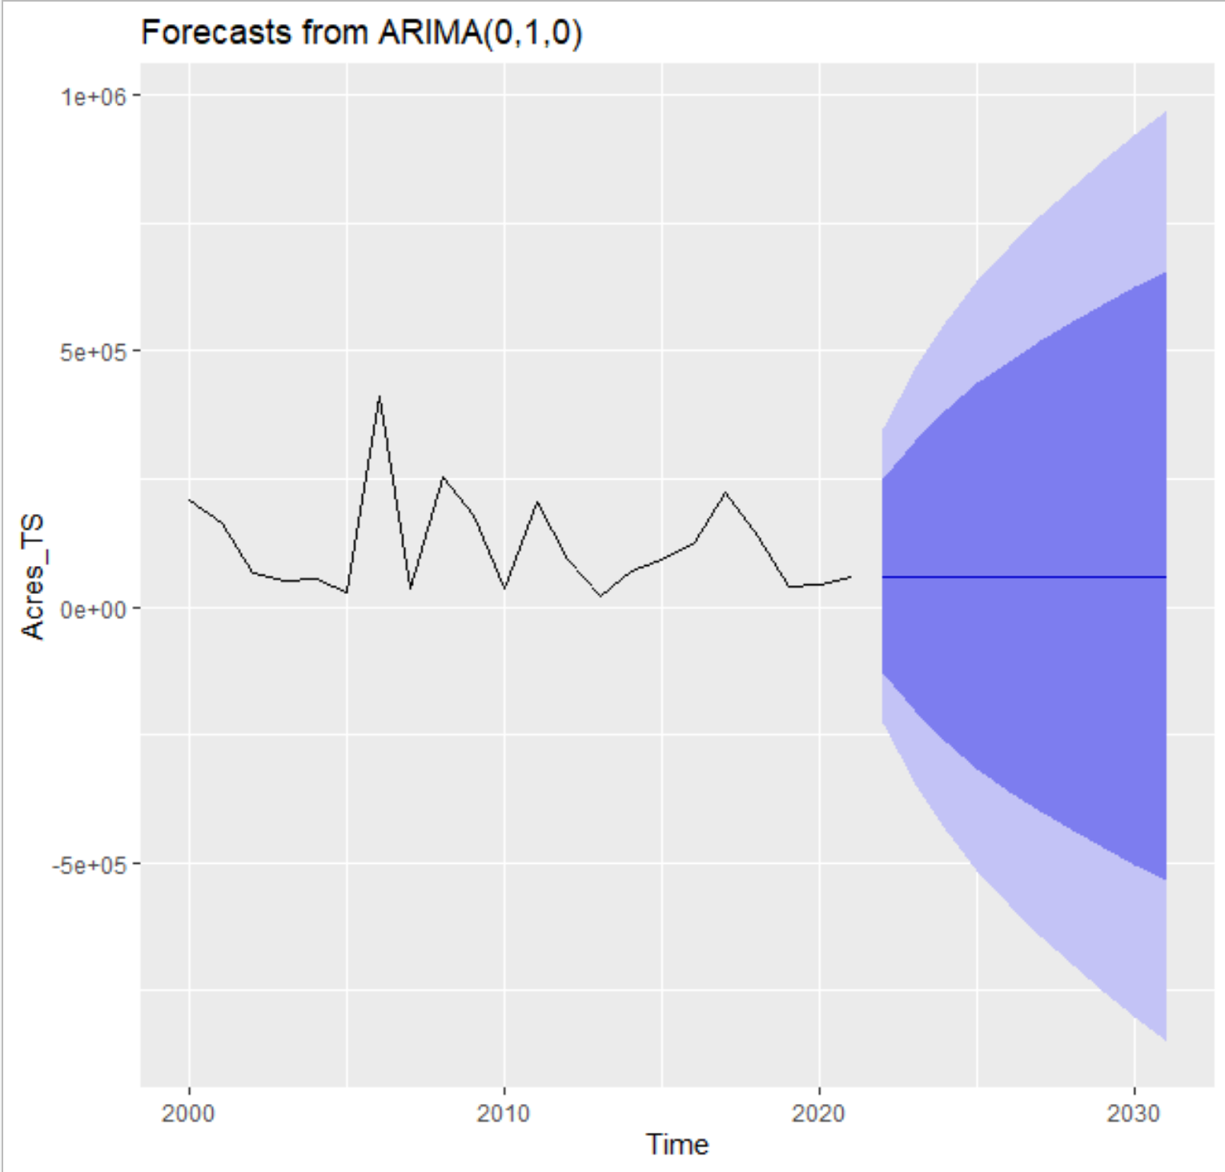
ARIMA (0,1,0)

Slide 6
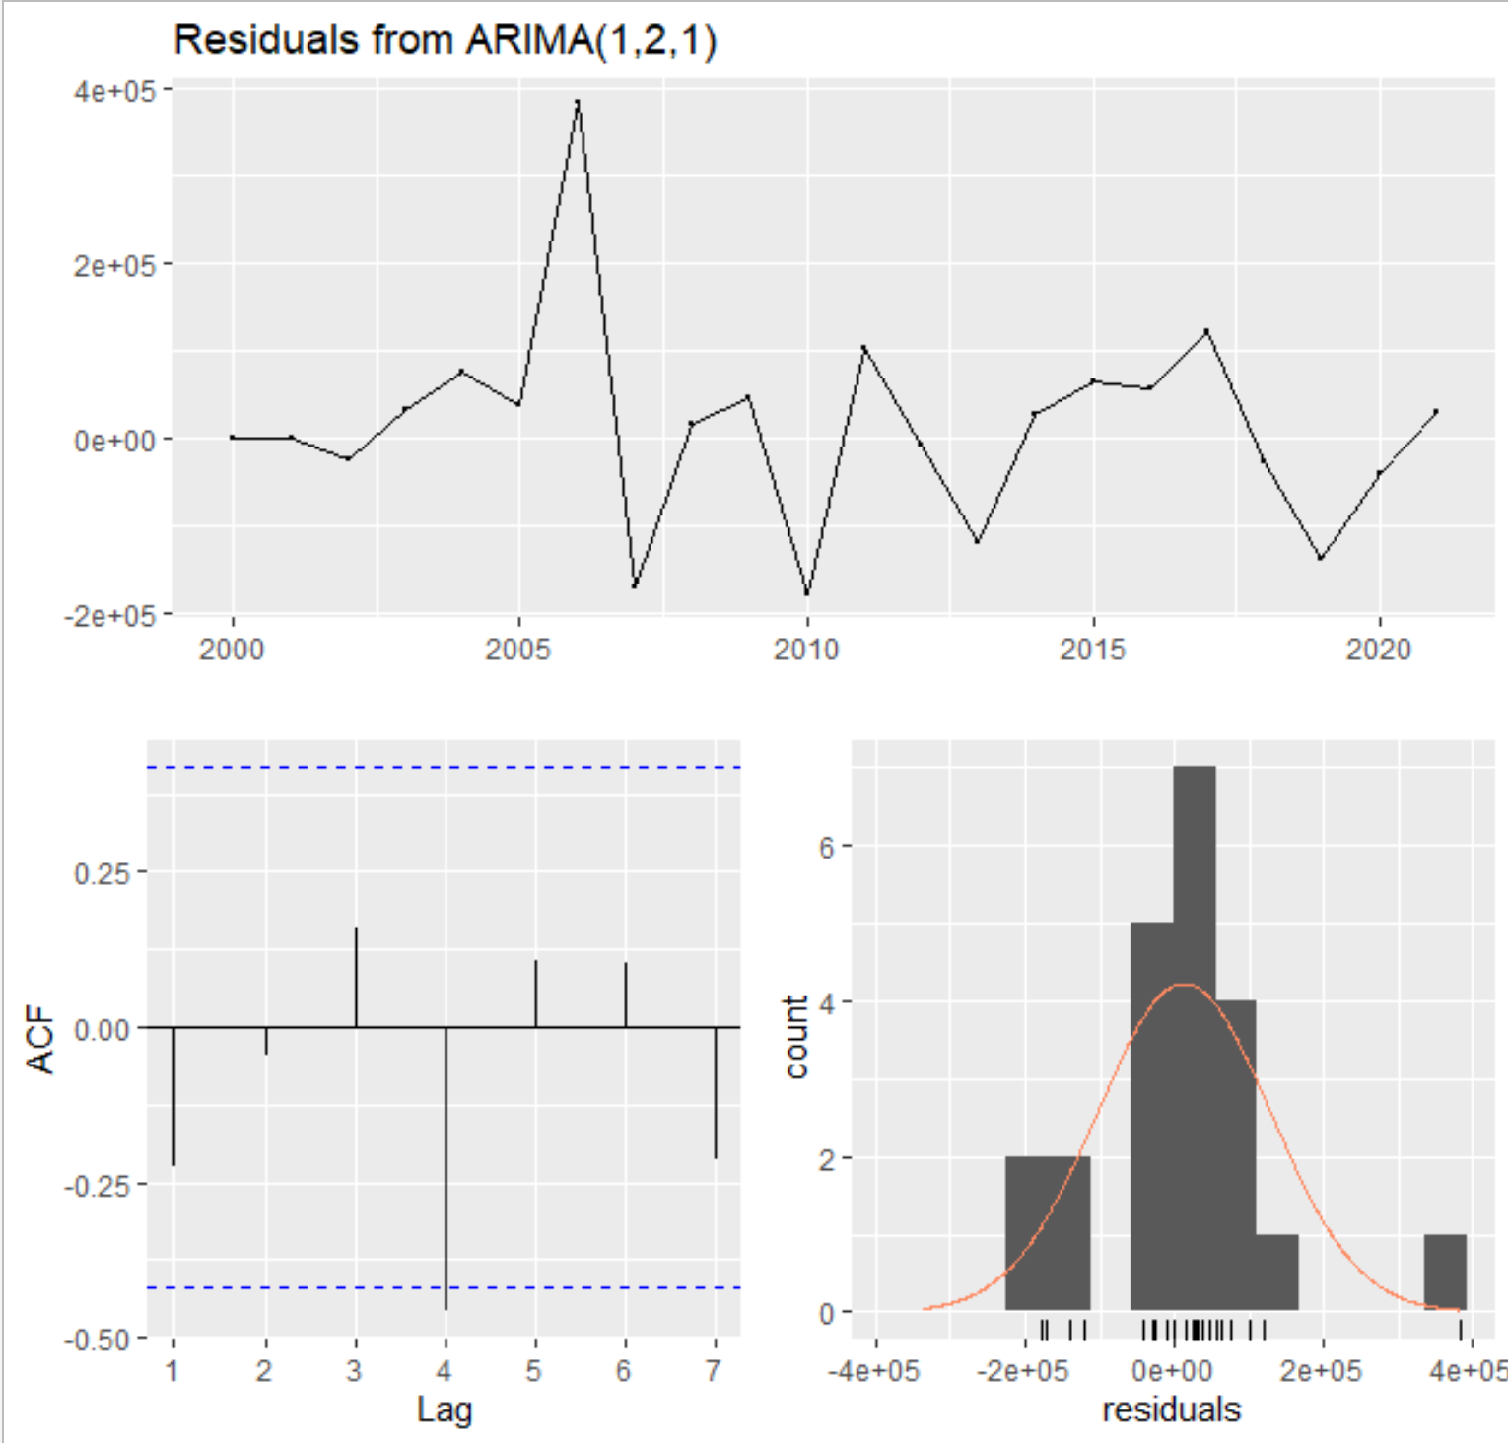
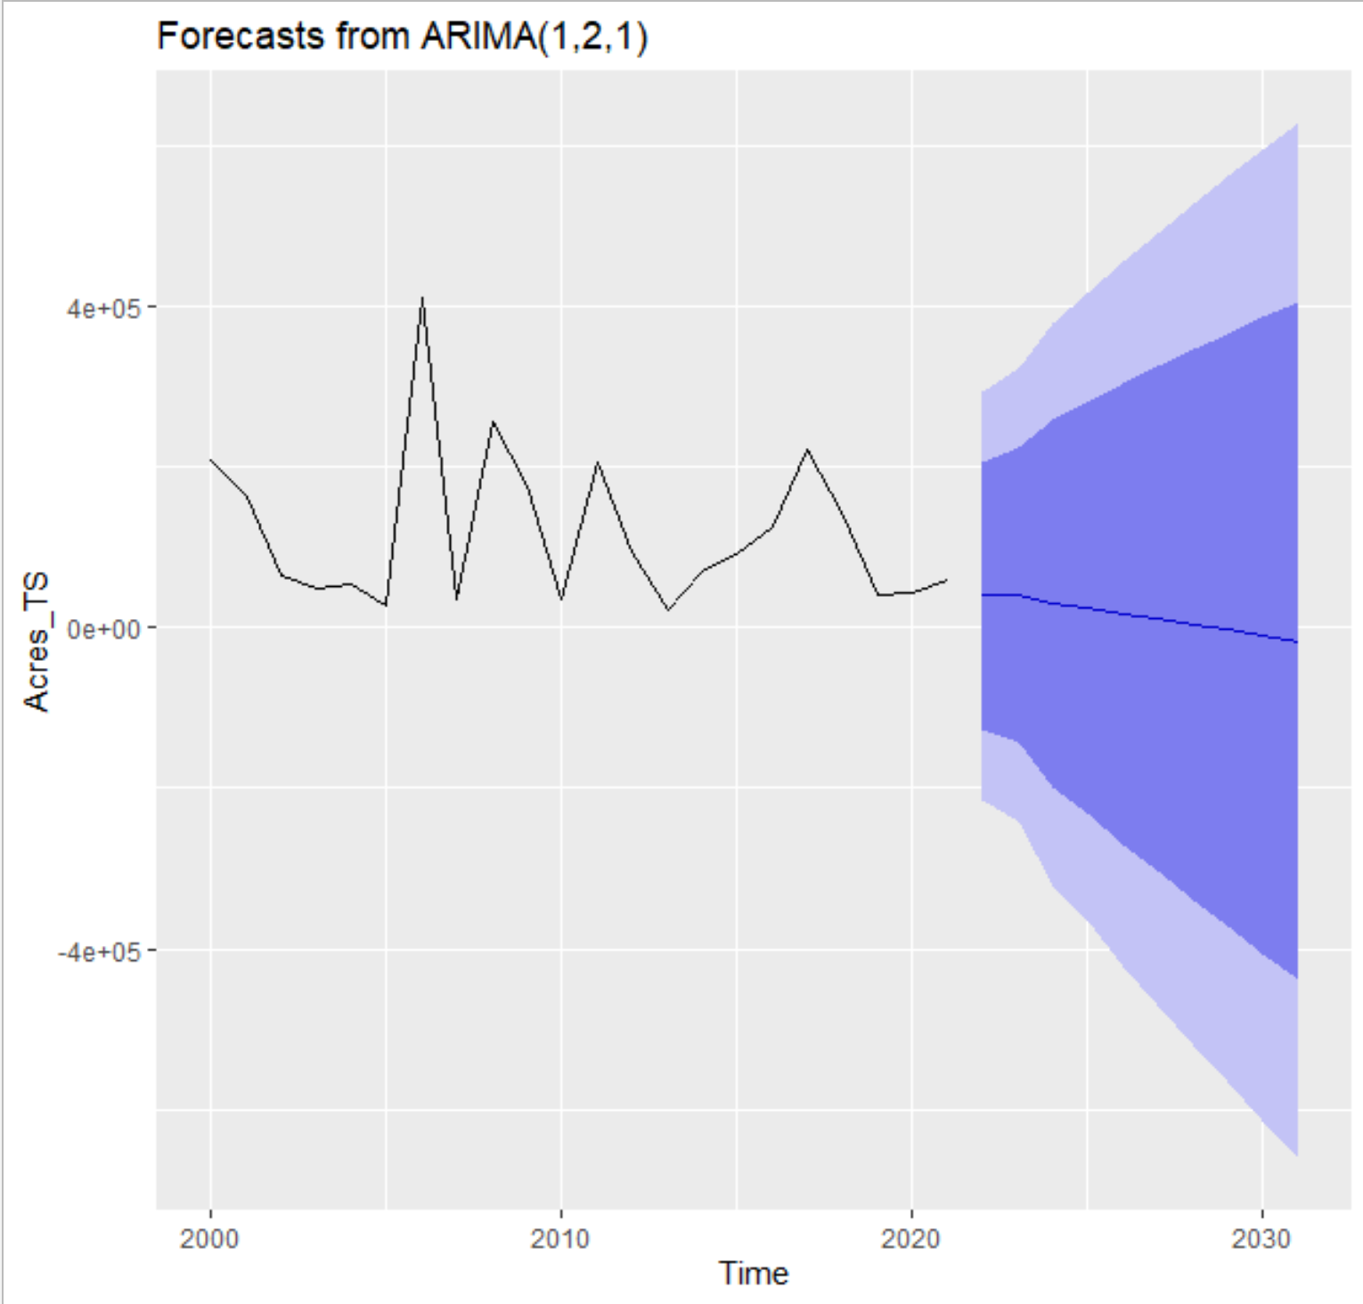
ARIMA(1,2,1)

Slide 7
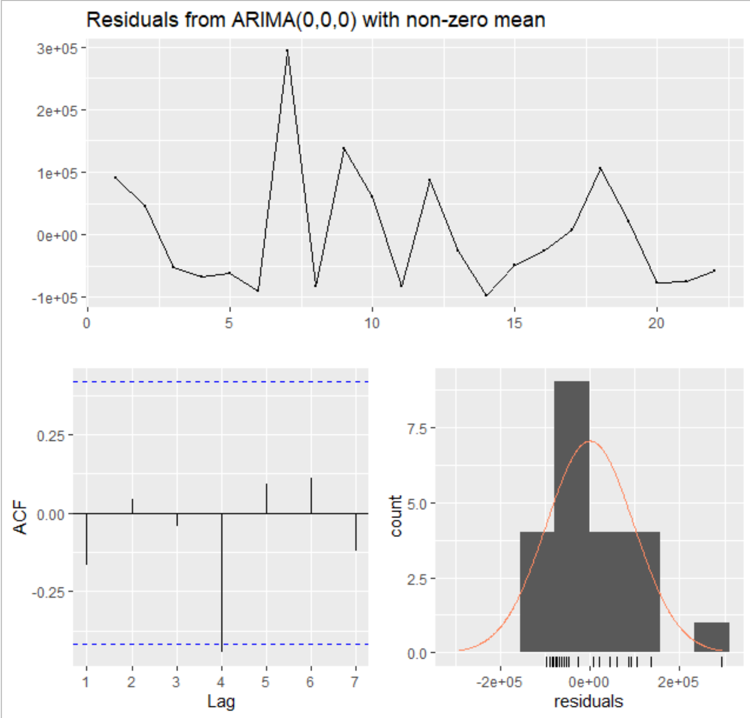
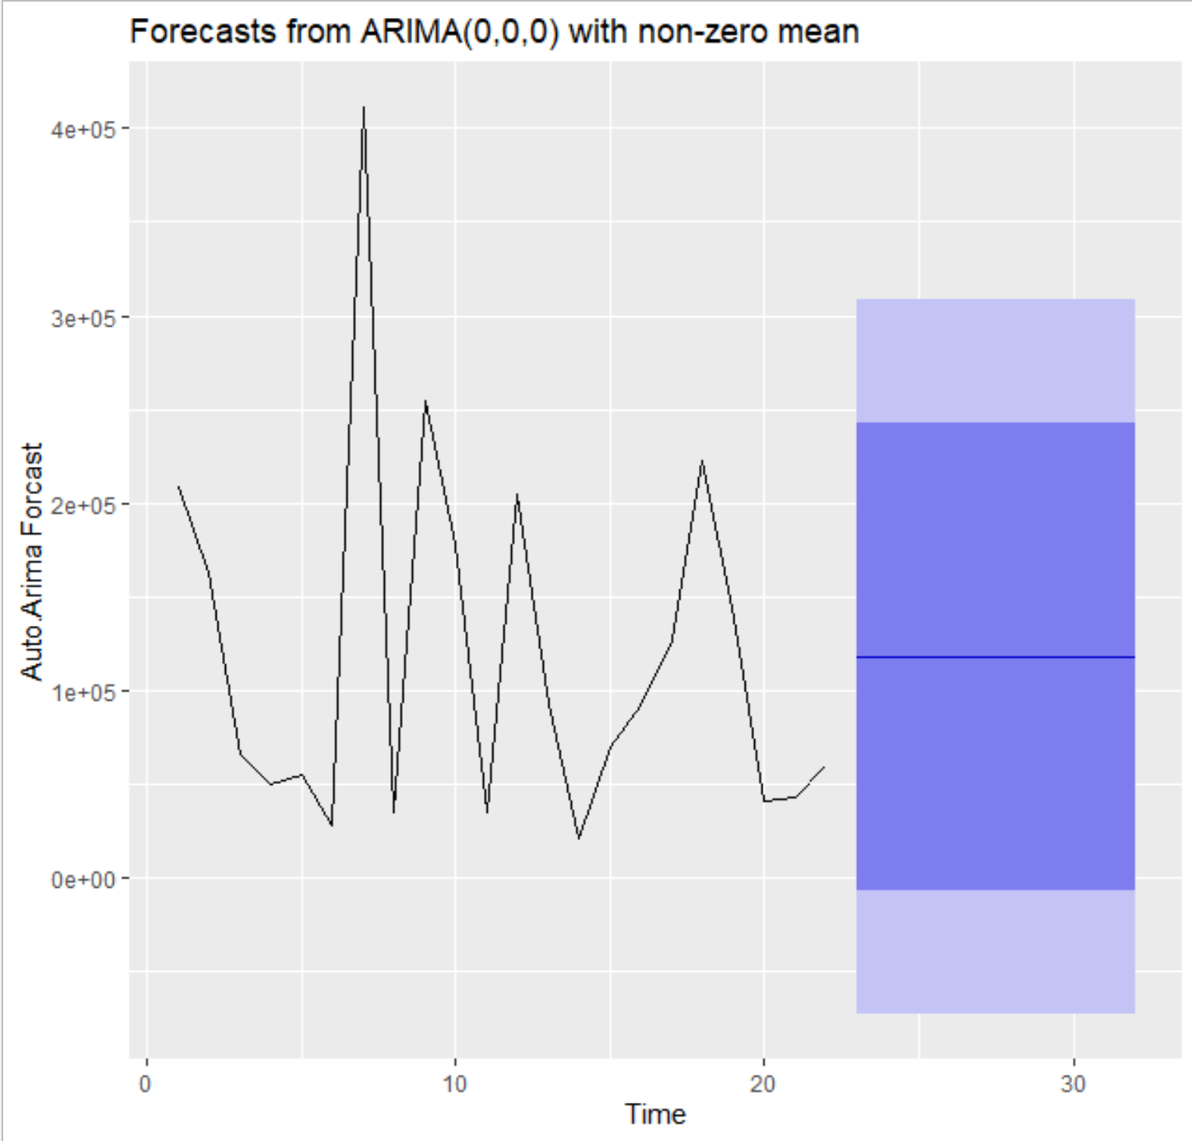
ARIMA(0,0,0)

Slide 8
ARIMA(1,2,1) : ARIMA(0,0,0)

Slide 9
Ending Thoughts
Environmental Impacts
“… wildfires are a direct source of CO2 emissions. Although wildfires are part of the natural system, it is clear that human-induced emissions are directly interfering and amplifying the impact of natural system emissions” (Fawzy et al., 2020)
“Climate change can thus be viewed as a wildfire ‘threat multiplier’ amplifying natural and human risk factors that are already prevalent throughout California” (Goss et al., 2020).
Overall Downward Trend
With Spikes to be accounted for
Limitations within the dataset

Slide 10
References
Fawzy, S., Osman, A. I., Doran, J., & Rooney, D. W. (2020). Strategies for mitigation of climate change: a review. Environmental Chemistry Letters. https://doi.org/10.1007/s10311-020-01059-w
Gannon, B. M., Wei, Y., & Thompson, M. P. (2020). Mitigating Source Water Risks with Improved Wildfire Containment. Fire, 3(3), 45. https://doi.org/10.3390/fire3030045
Goss, M., Swain, D. L., Abatzoglou, J. T., Sarhadi, A., Kolden, C., Williams, A. P., & Diffenbaugh, N. S. (2020). Climate change is increasing the risk of extreme autumn wildfire conditions across California. Environmental Research Letters, 15(9). https://doi.org/10.1088/1748-9326/ab83a7

